Slide 1
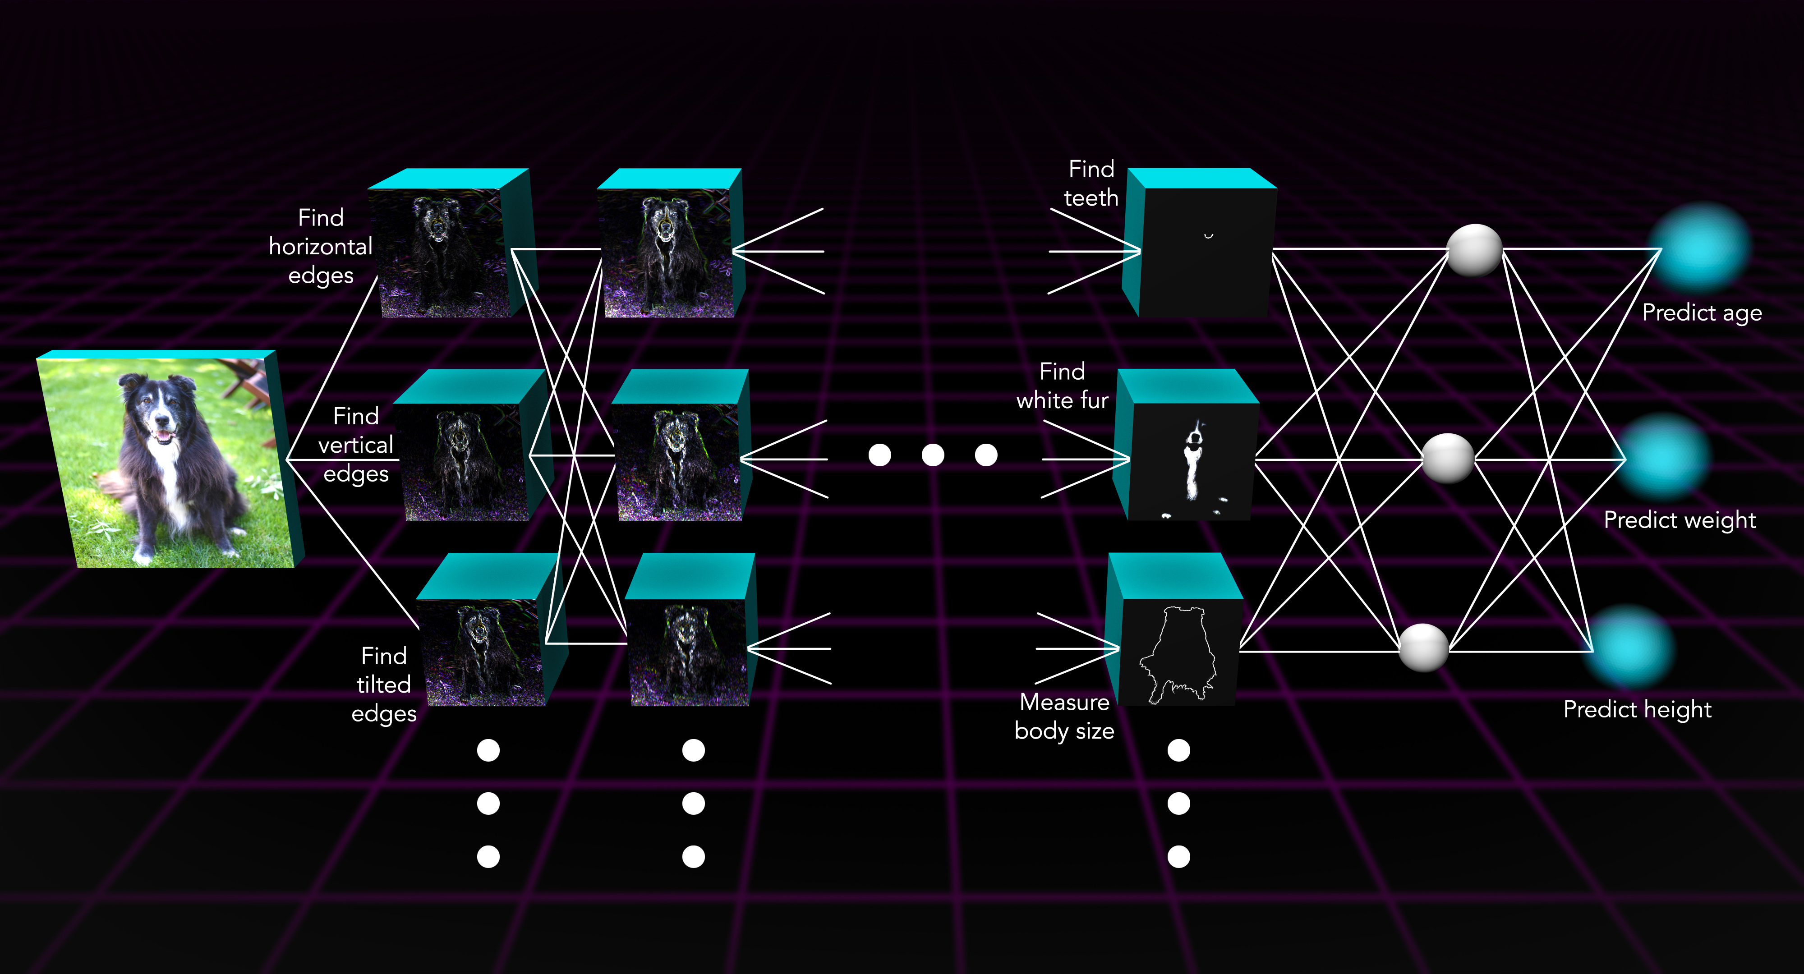
CNN

Slide 2


Learning CNN
-The main objective is to predict weather to use encoding queen11 or queen4 to solve the blocked n-queens problem. We do this by changing blocked instances of the n-queens problem a turning them into images.
queen4
queen11

Slide 3
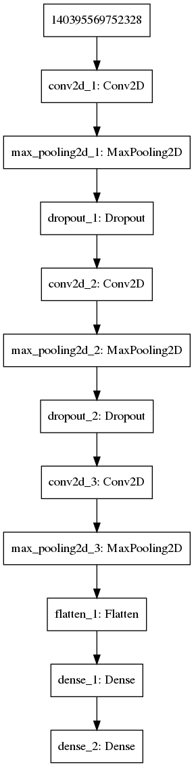
We train CNN with this model
-This model has three layors.
After each layor of the network there is a dropout where some of the edges of the network are removed.
This prevents over fitting as it stop the network from “overefizing” a particular node or edge.
Then at the end the netwok is flattened so it can be turned into the binary classifier we wish it to. This part is inconsequential

Slide 4
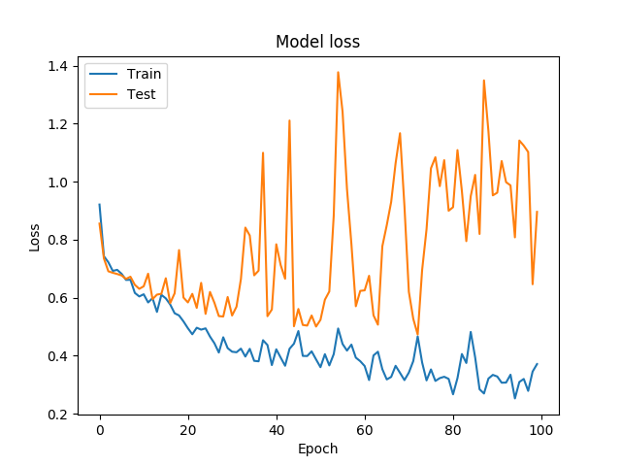
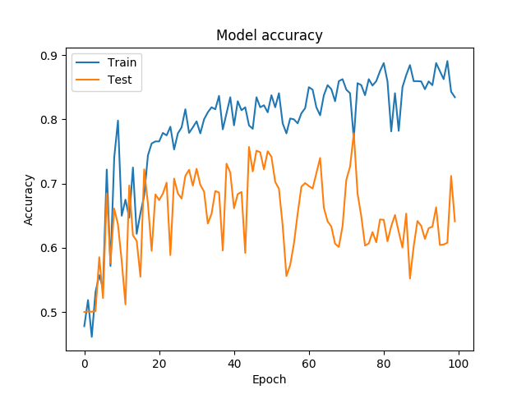
Results
Results tend to over fit when we did not drop out the the edges however dropping to many edges was not effective either.

Slide 5
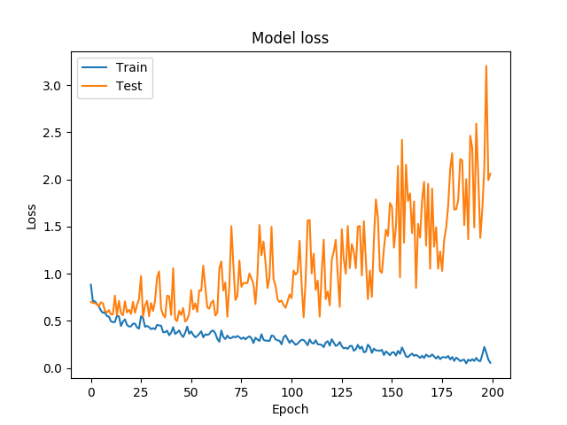
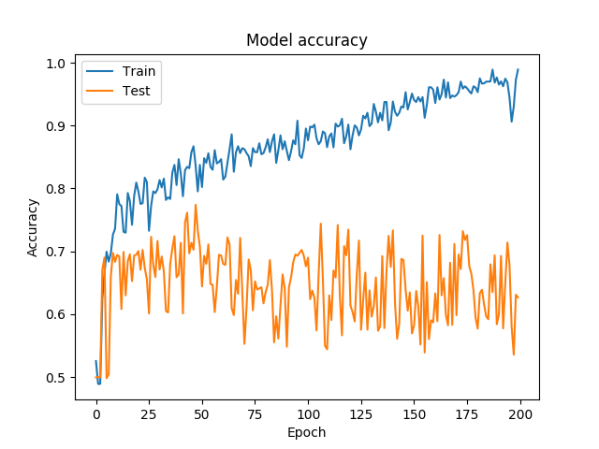
Results
Not that just guess or guessing only one of them. Results in only 50% accuracy.
Without messing with the model just changing epoch numbers and how many to send through the model. I can’t seem to get accuracy very much over 70% for a long period of time.

Slide 6
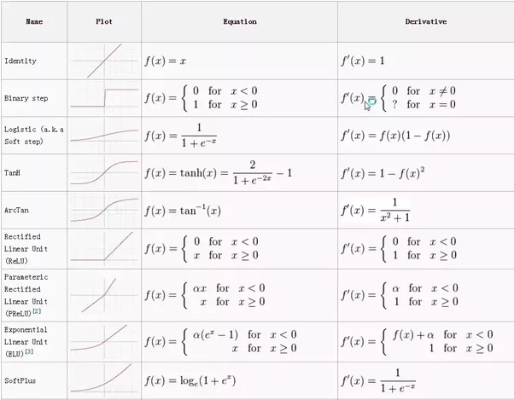
Using different activation functions
Not it is conman in machine learning networks to use more then one type of activation function for you CNN since this can
stop different types of
over fitting.

Slide 7
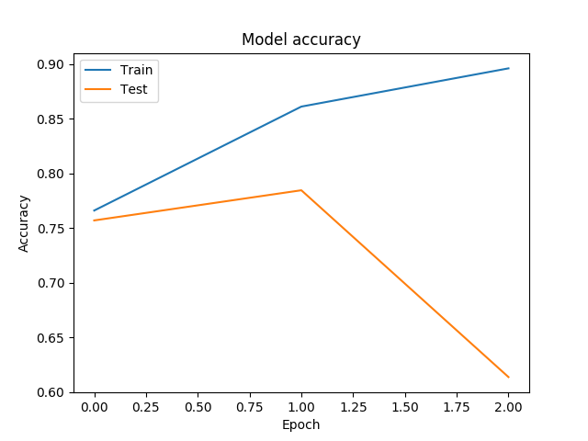
Results
The best results we got was training in the fewest epochs with a drop out rate of 50% (explained on next slide).
We can see that this works
well but if we train another
epoch it will over fit.

Slide 8
Overfitting
One other thing it is useful to do is drop a random amount of edges from the network. This prevents over fitting. Since the network cannot become to “attached” to certain edges in the network.

Slide 9
Recap
Using different methods for training on images we conclude that this works quite well getting close to 80% accuracy. As compared to the 50% of picking the best encoding.

Slide 10
Portfolio
We can improve our accuracy on the encoding by using a portfolio of models and using voting techniques.
Consider 4 solvers A1, A2, A3 and A4. For a instance B we compute the probability of B being solved the fastest by queen11. Then
If A1(B)+A2(B)+A3(B)+A4(B) < threshold queen4
else queen11.

Slide 11
Now we have control over the threshold value. So we can test that this gives us better results by choosing some different models. With accuracy on the testing set 62%,63%, 63% and 72% respectively. Then using voting on a held out set we get accuracy 80%. Thus portfolio solver can indeed help use with this problem.

