Slide 1


Slide 2
A logo often gets one second to earn attention and leave a memory.
1
01
Distinctive
A silhouette people can recognize again.
second
02
Simple
A form the eye can understand quickly.
03
Scalable
A mark that survives small sizes.
04
Adaptable
A system that works across backgrounds.
02 / 17

Slide 3

The design brief
A faith community needs energy, warmth and trust in the same visual voice.
Energy
The symbol should communicate ignition and forward movement.
Welcome
The identity should feel open to people encountering the group for the first time.
Trust
The visual language should remain calm, respectful and credible.
The name carries the invitation.
The symbol carries the spark.
Use
Every format should work from signage down to a favicon.
03 / 17

Slide 4

Three choices give the symbol meaning
The mark shows the moment ignition begins.
01
Recognized at a glance
The outer silhouette reads as flame before color or detail enters the picture.
02
Ignition stays visible
Keeping the full shaft shows ignition in progress, rather than a flame floating on its own.
03
A moment of transformation
The rounded join captures the instant a match becomes light, turning two shapes into one idea.
04 / 17

Slide 5

THE REVEAL
The mark
One continuous matchstick inside a two-colour flame.
Yellow
Momentum and light
Ignite cobalt
Calm and openness
Ink
Structure and clarity
“Stir up the gift of God which is in you.”
2 Timothy 1:6 (WEB)
05 / 17

Slide 6
The wordmark
Lowercase geometry gives the identity an open, contemporary voice.
Poppins Medium
Rounded geometry supports the symbol without competing with it.
06 / 17

Slide 7

Primary horizontal lockup
The default version whenever the layout offers enough width.
Use it for
Why it works
Website headers, exterior signage and printed communications.
The symbol leads, the name stays easy to read and the full matchstick remains visible.
07 / 17

Slide 8

Secondary stacked lockup
A centered option for narrow or compact compositions.
Best fit
Square social graphics, program covers and stage screens.
Keep in mind
Protect the space around the flame and never shorten the matchstick shaft.
The centered structure feels balanced while the angled shaft keeps the mark active.
08 / 17

Slide 9

One-color artwork
The silhouette must survive when color is unavailable.
Production uses
Why it matters
Embossing, engraving, vinyl, screen printing and photocopying.
Reliable one-color artwork lowers production risk and gives every vendor the same clear source.
09 / 17

Slide 10



Proof at every size
A durable mark keeps its silhouette when detail and space disappear.
48
32
16
Small size
The flame remains recognizable at favicon scale.
One colour
The core silhouette survives production constraints.
App icon
The silhouette remains clear inside a square field.
Contrast
Reversed artwork protects visibility on dark surfaces.
10 / 17

Slide 11
Design ID
A shared set of choices helps every application feel like Ignite in Him.
Ignite yellow
RGB 253, 201, 4
TYPOGRAPHY
#FDC904
Energy and emphasis
Poppins Medium
Lowercase wordmark
Ignite cobalt
RGB 49, 93, 242
#315DF2
Confidence and vitality
WHY CONSISTENCY MATTERS
Recognition compounds
Ink
RGB 17, 17, 17
Repeated color, spacing and lockups help people identify Ignite in Him before they read.
#111111
Wordmark and dark ground
Trust grows
Warm ivory
RGB 255, 248, 232
A controlled identity feels intentional and dependable.
#FFF8E8
Background and warmth
Production gets easier
Clear specifications reduce guesswork and prevent visual drift.
11 / 17

Slide 12

BUSINESS-CARD APPLICATION
The identity in print
The logo holds its character on dark stock and warm ivory.
Full matchstick
Visible in both applications
Colour
Consistent across stocks
Concept visualization
12 / 17

Slide 13
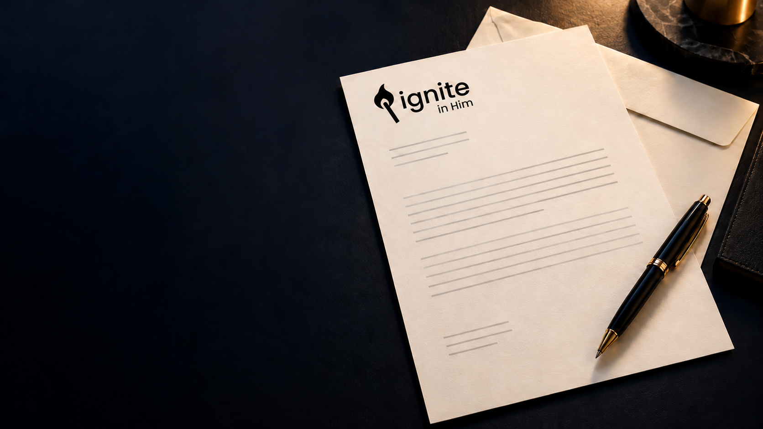
LETTERHEAD APPLICATION
A clear first impression
The horizontal lockup anchors formal communication without overpowering the message.
Placement
Upper-left with generous space
Benefit
Easy to recognize at a glance
Concept visualization
13 / 17

Slide 14
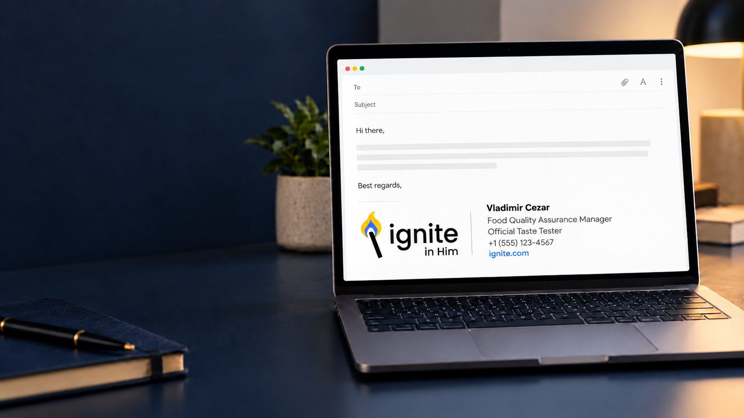
EMAIL SIGNATURE APPLICATION
Recognition in every reply
A compact signature repeats the identity in everyday communication.
Format
Logo with contact details
Benefit
A consistent presence with little effort
Concept visualization
14 / 17

Slide 15
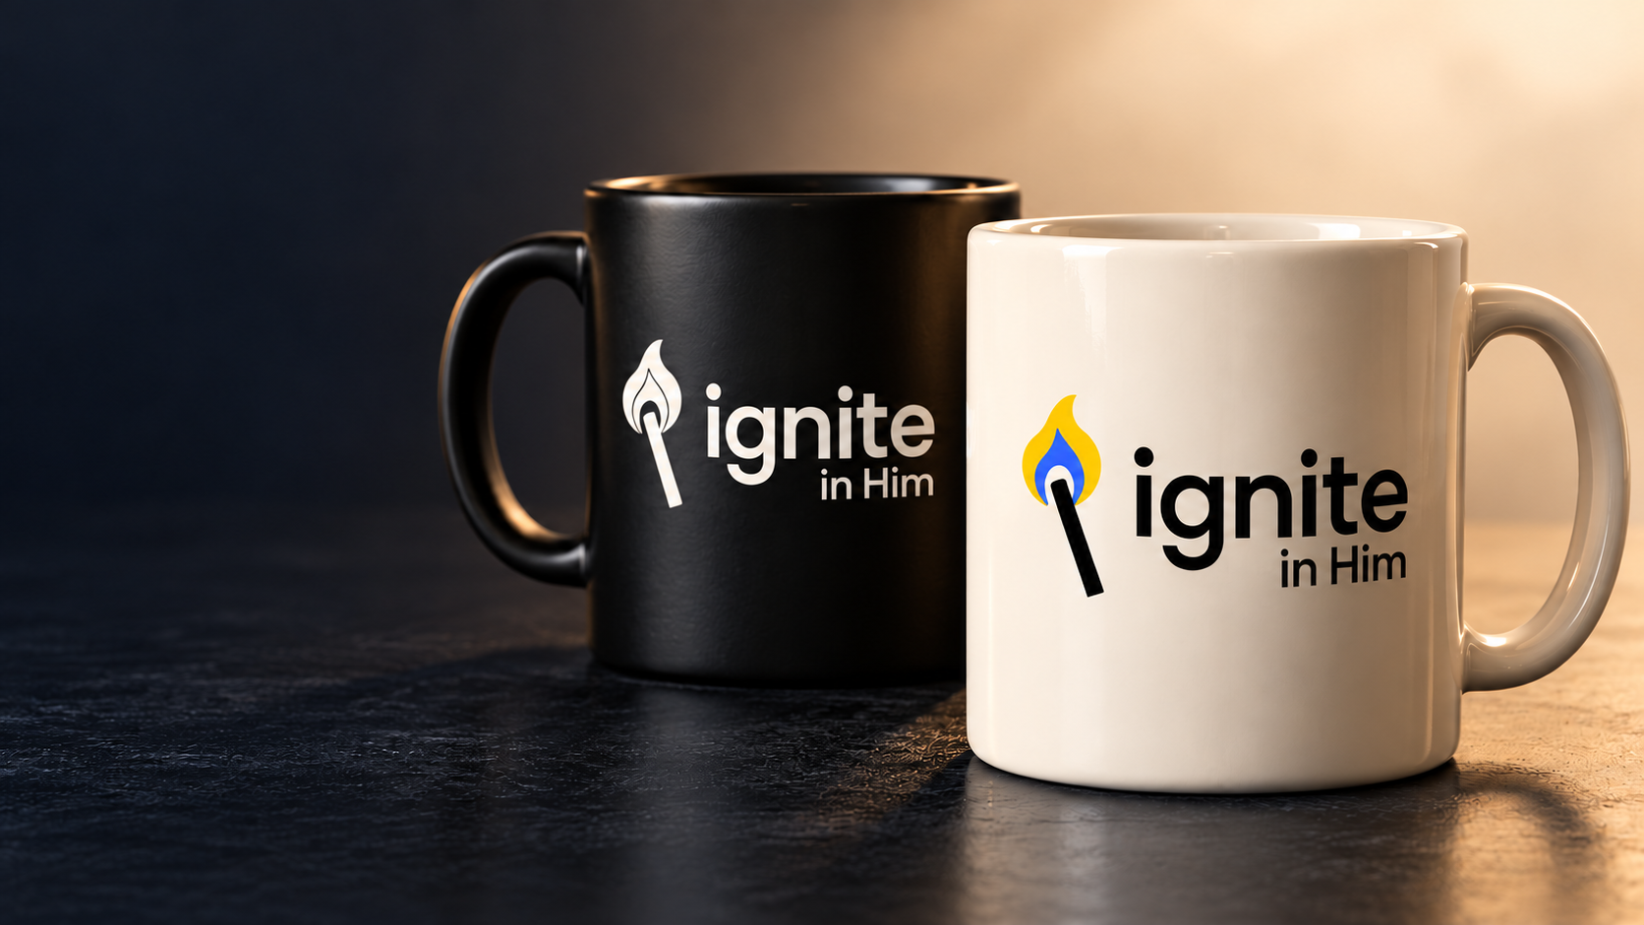
MERCHANDISE APPLICATION
The identity people keep
A simple application turns an everyday object into a familiar reminder.
Artwork
One-color or full-color logo
Benefit
Durable and easy to reproduce
Concept visualization
15 / 17

Slide 16

CLOTHING APPLICATION
Built to be worn
The symbol works on a sweatshirt and cap without needing the full wordmark.
Placement
Chest and front panel
Production
Embroidery or screen print
Concept visualization
16 / 17

Slide 17
APPROVAL RECOMMENDATION
Ready for approval
“Let your light shine before men.”
Matthew 5:16 (WEB)
Approve the core identity and release the production assets.
17 / 17

