Slide 1
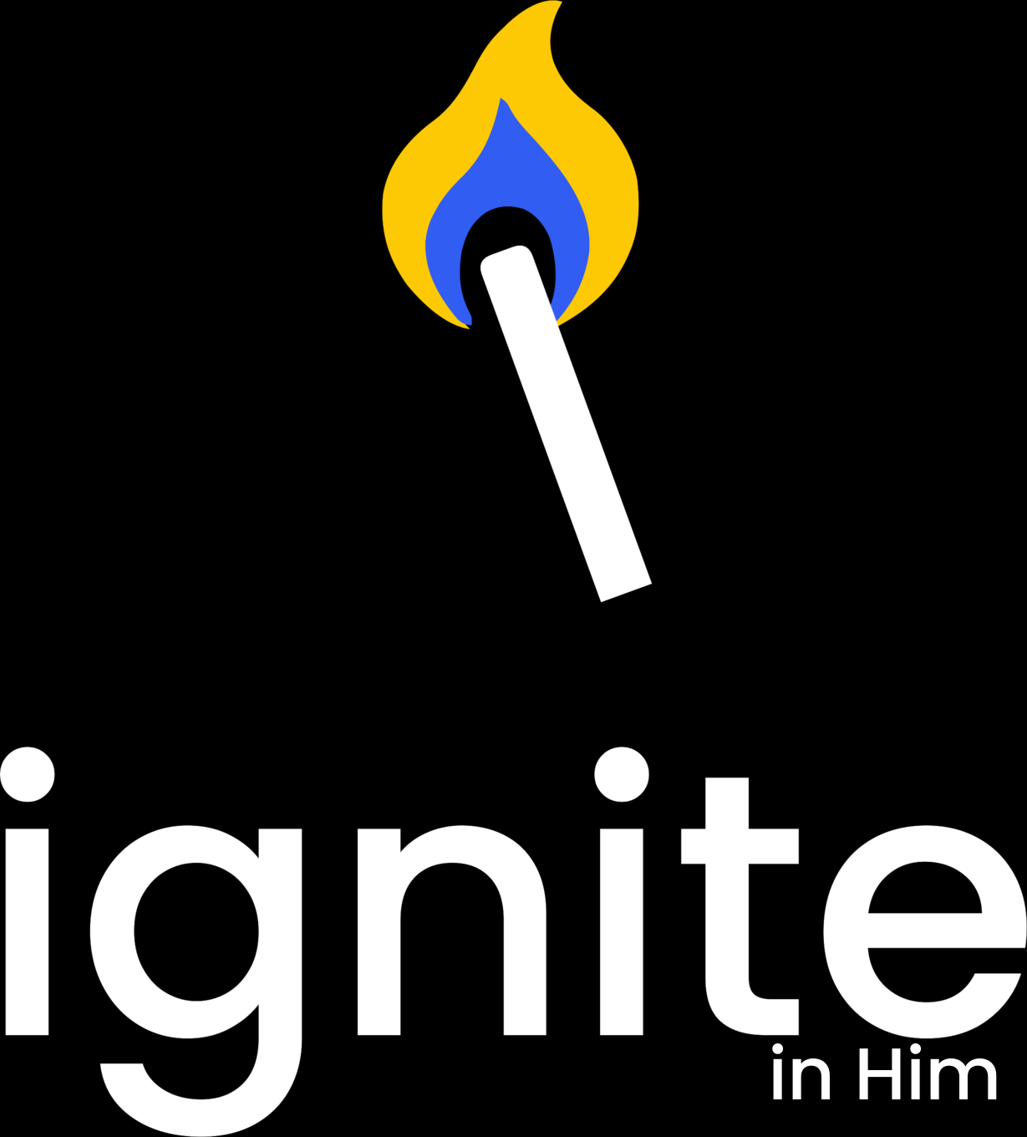
Ignite in Him logo approval
A clear identity built around one lit match
Core identity system
October 2026
01

Slide 2

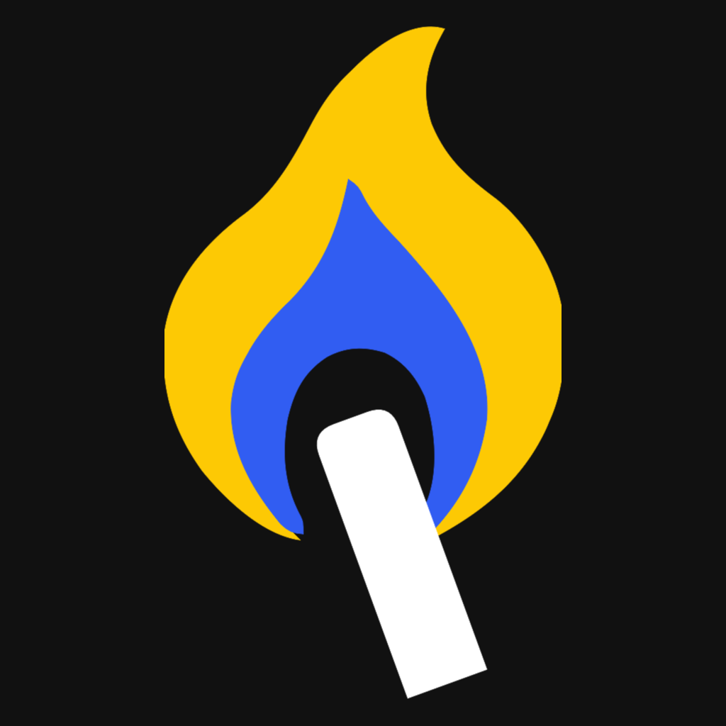
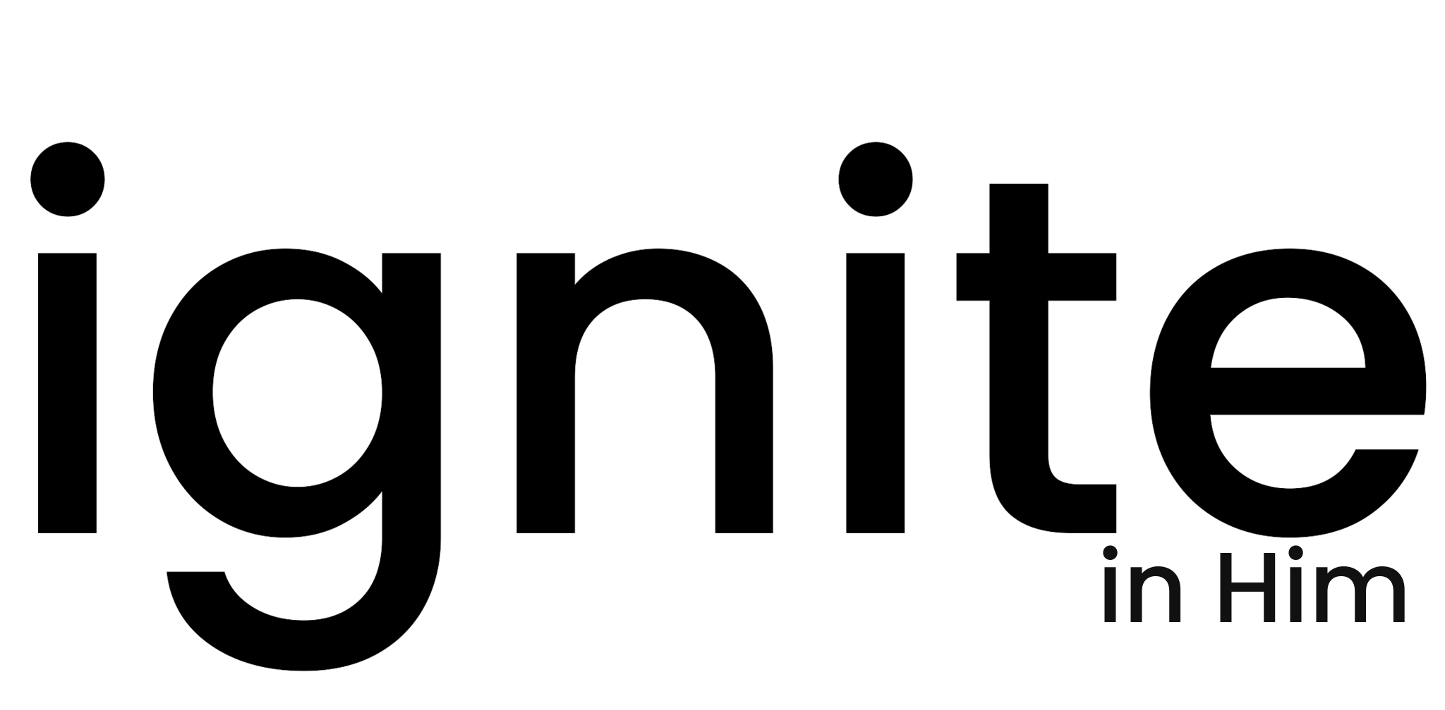
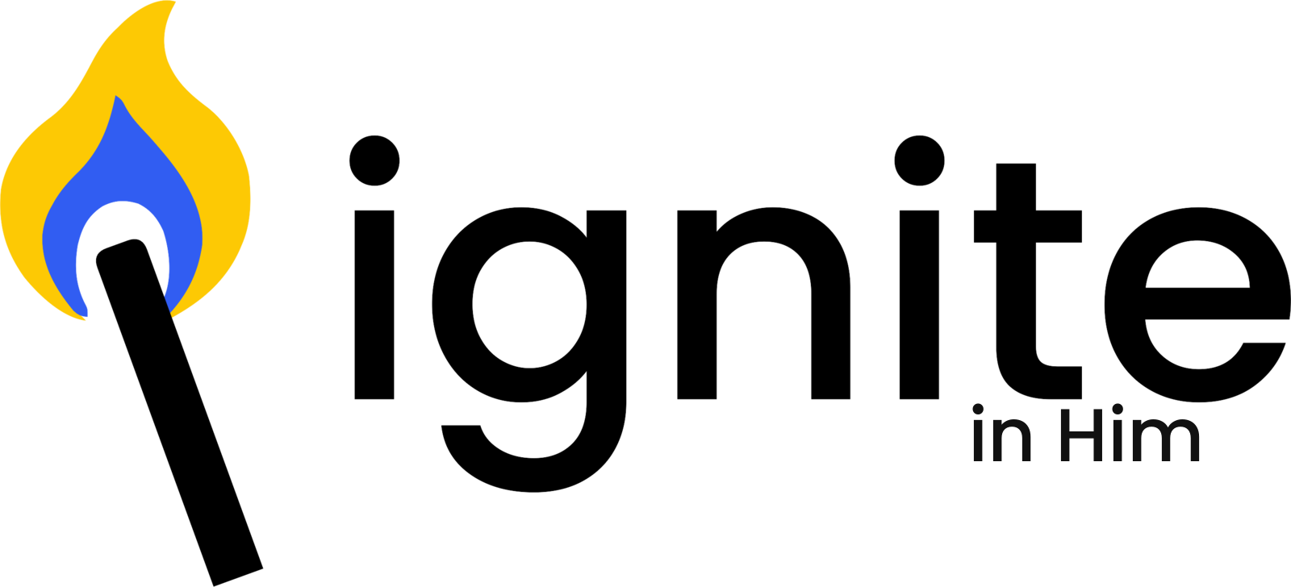
Design process
The identity turns the idea of ignition into a compact system that works from a favicon to signage.
01 Concept
02 Reduction
03 Typography
04 System
Ignition suggests momentum, energy and a clear starting point.
The original flame returns with one straight shaft and softly rounded top corners.
A lowercase geometric wordmark keeps the tone modern and approachable.
Horizontal, stacked and icon formats create a consistent family.
02

Slide 3


Four tests for a durable logo
A strong mark keeps its meaning when size, color and context change.
01
Distinctive
The original flame retains the recognizable Ignite silhouette.
02
Simple
Small corner radii soften the connection without creating a separate head.
03
Scalable
The symbol remains clear at app-icon and favicon sizes.
04
Adaptable
One-color and reversed versions protect legibility.
Display
48 px
32 px
16 px
03

Slide 4
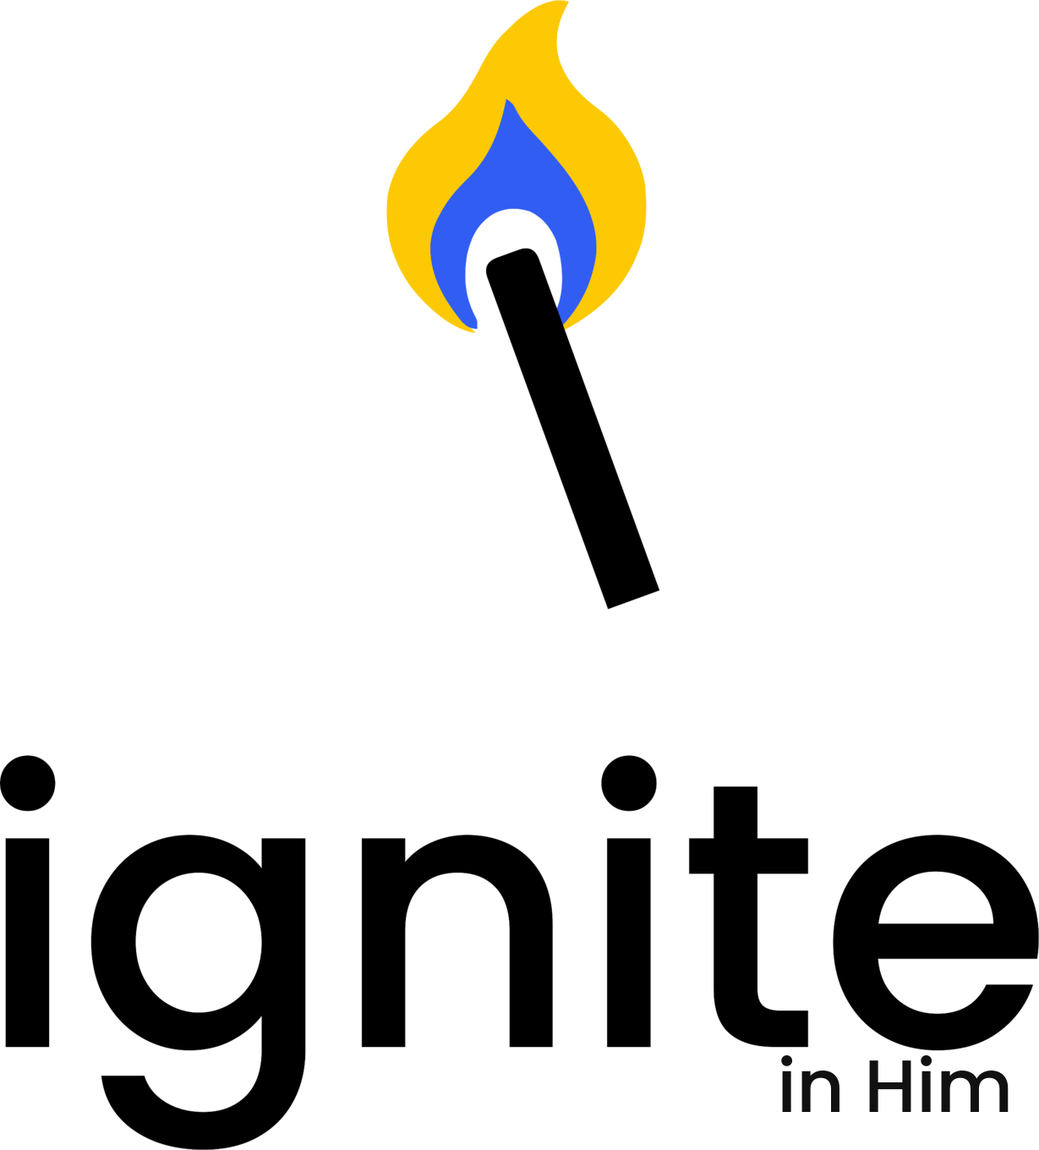
Final identity system
One symbol, one wordmark and three usage formats cover the core brand needs.
PRIMARY Horizontal lockup
SECONDARY Stacked
SMALL SPACE Symbol
Ignite yellow
#FDC904
Sky blue
#92C2DF
Ink
#111111
Warm ivory
#FFF8E8
04

Slide 5
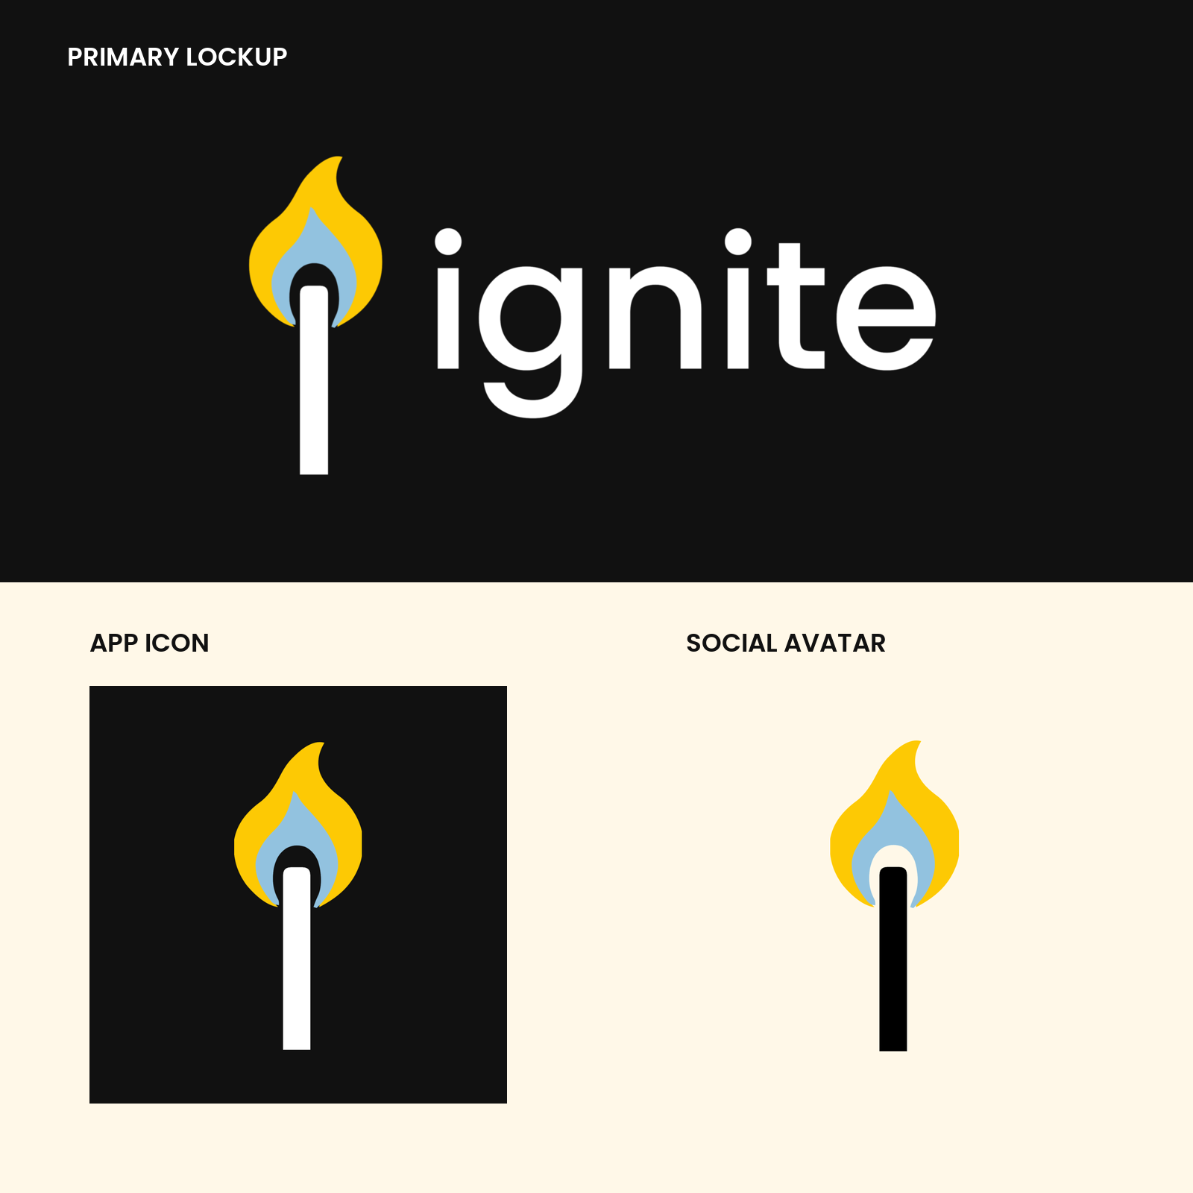
Approval recommendation
Approve the core identity for production use.
Original flame with a softly rounded shaft top
Poppins Medium lowercase wordmark
Yellow, sky blue, ink and ivory palette
Horizontal primary and stacked secondary lockups
Exact logo applications
05

