Slide 1
Manage your calories!
Project word
1. Vladimir Khvan U1910046
2. Bakhrom Usmanov U1910063
3. Farrukh Asatov U1910100

Slide 2
We help people live normal life

Slide 3
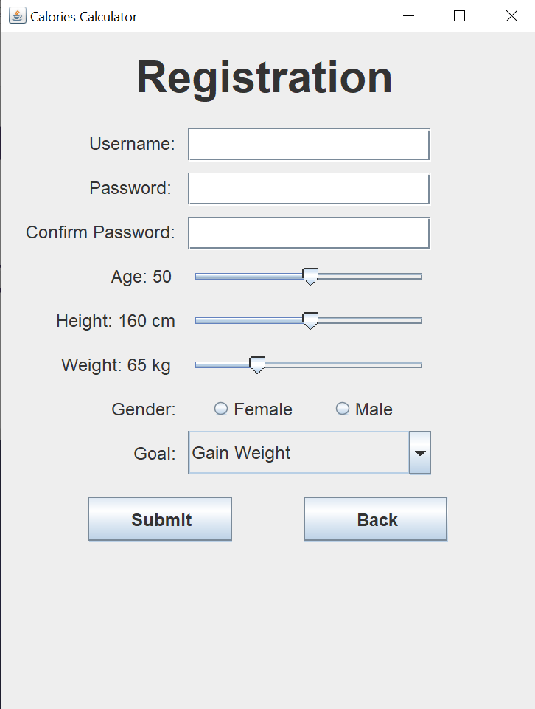
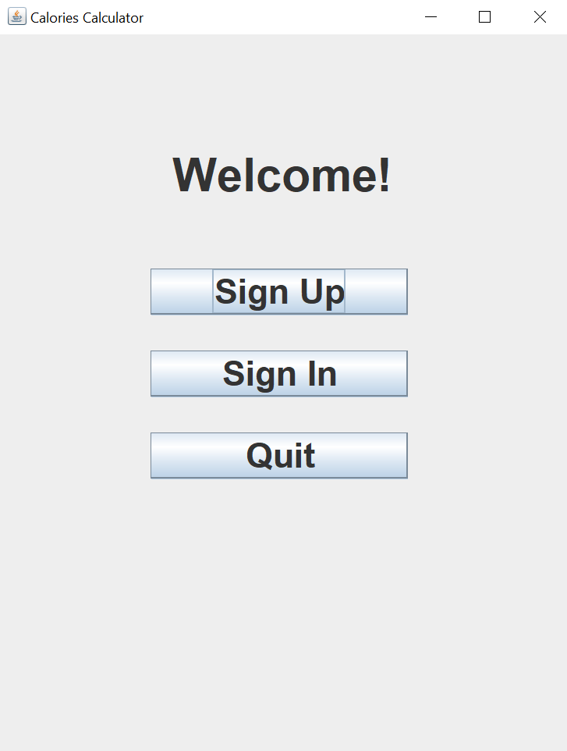
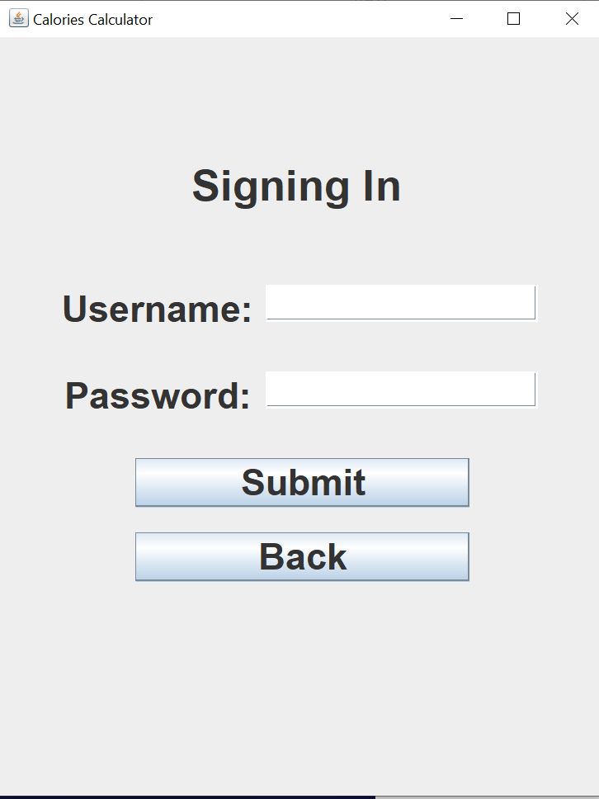

Slide 4
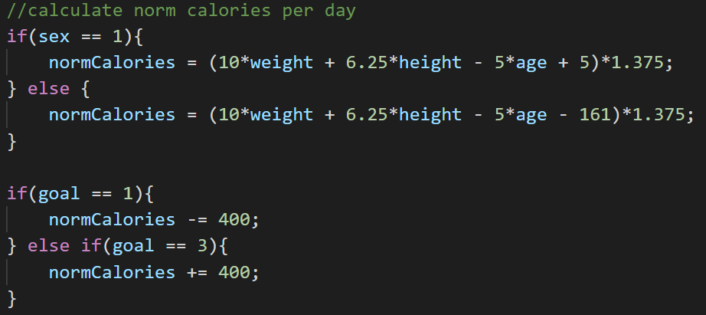
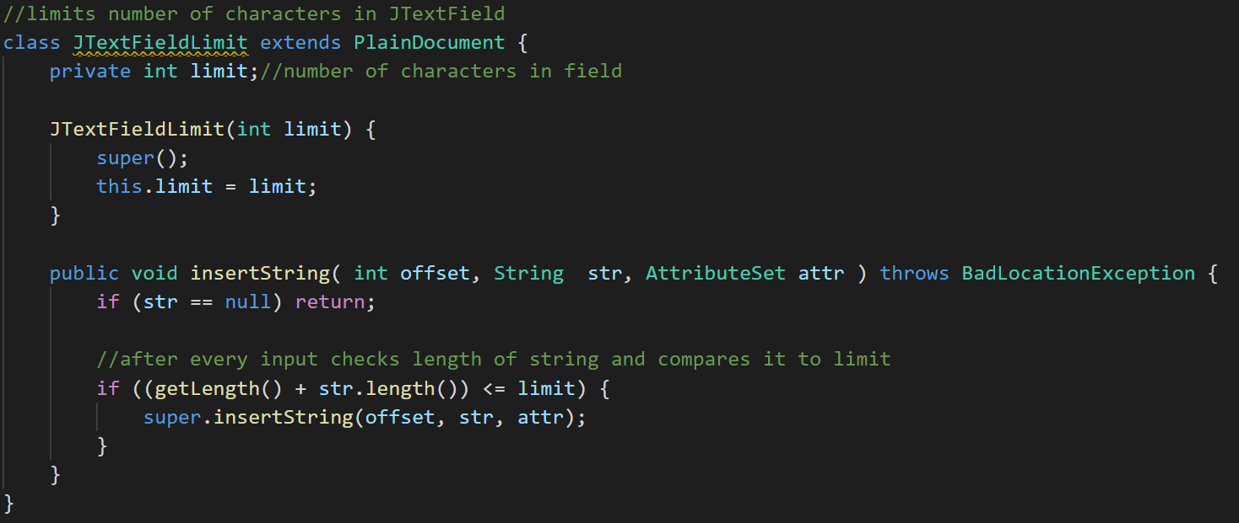
Registration
MySQL
Auto calories calculating
Input restrictions
MySQL
Input restrictions
Auto calories calculating
Anonymous functions
GUI

Slide 5
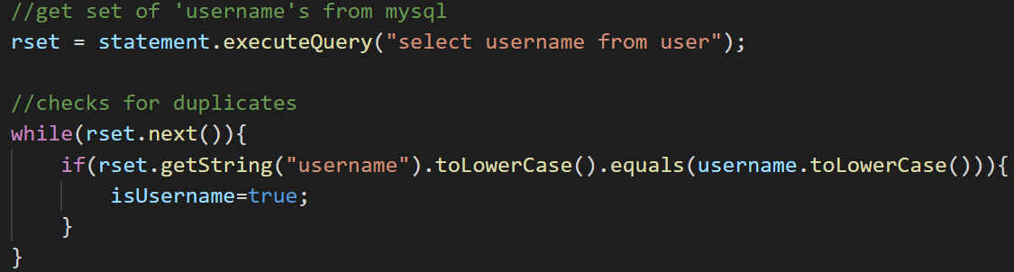
Login
MySQL
Input restrictions
MySQL
Input restrictions
Anonymous functions
GUI

Slide 6
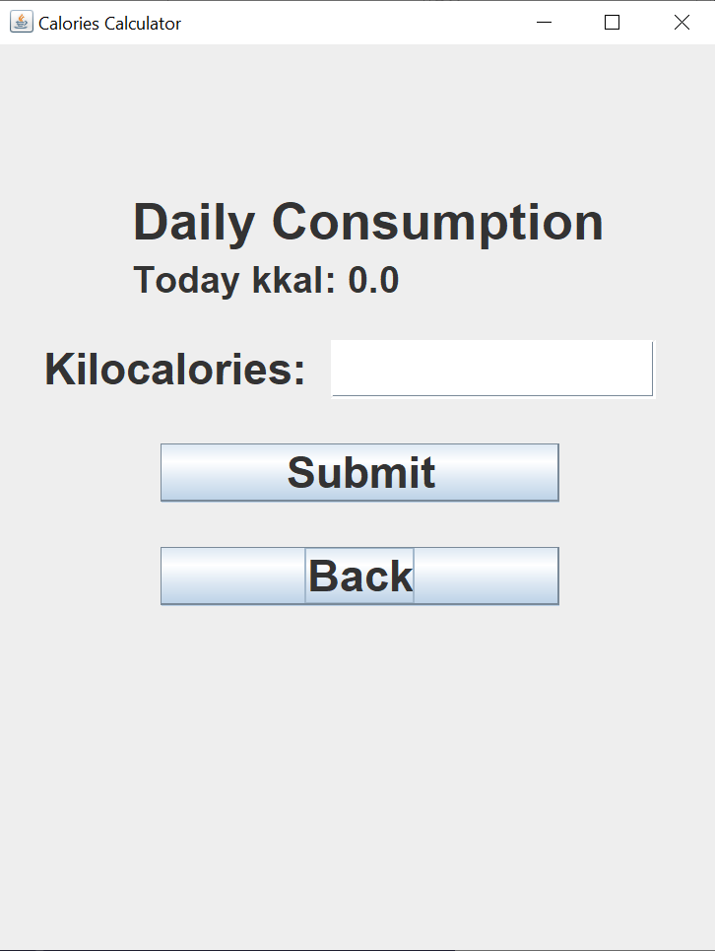
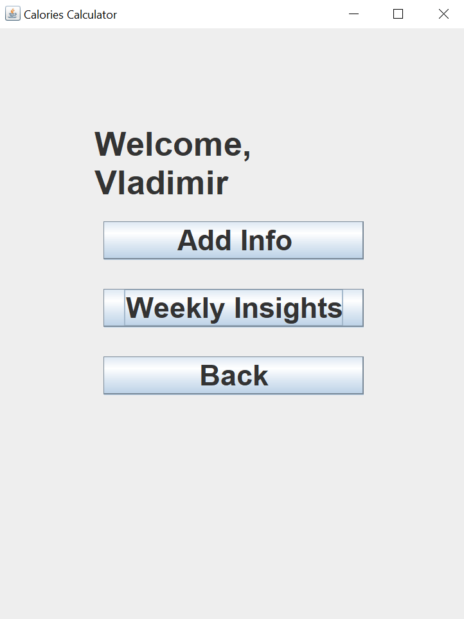
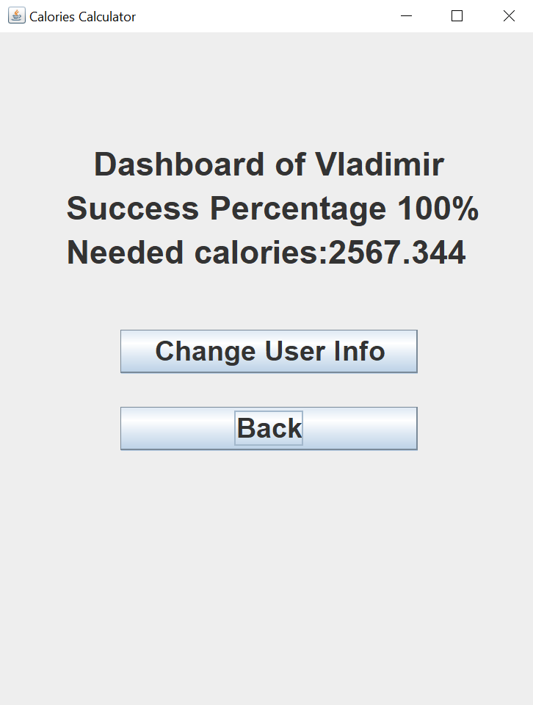

Slide 7
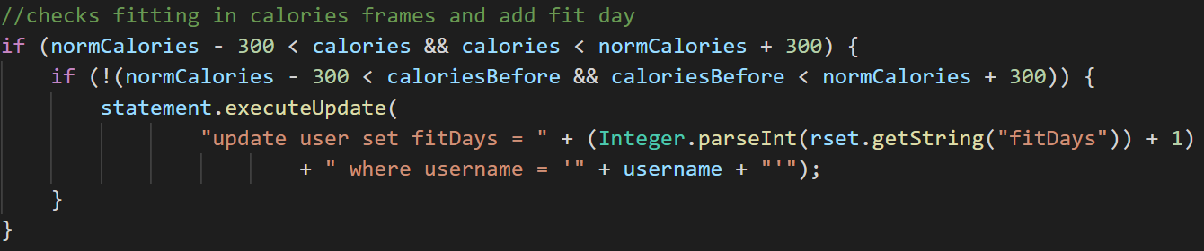
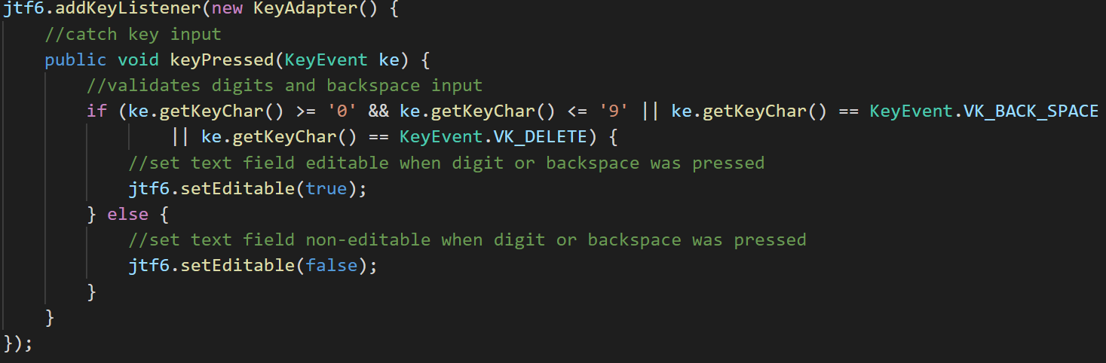
Daily consumption
MySQL
Input restrictions
MySQL
Input restrictions
Anonymous functions
GUI

Slide 8
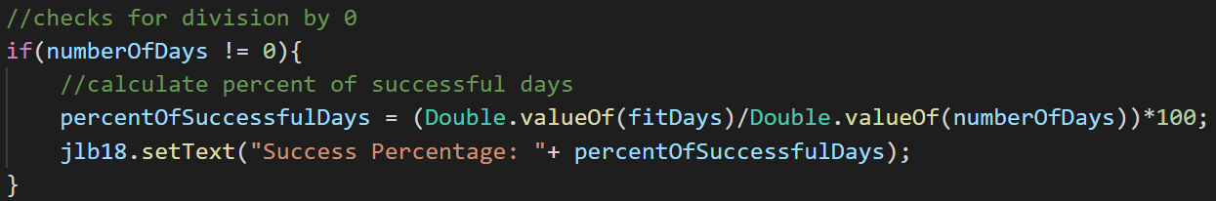
Dashboard
MySQL
MySQL
Anonymous functions
GUI
Highlights

Slide 9
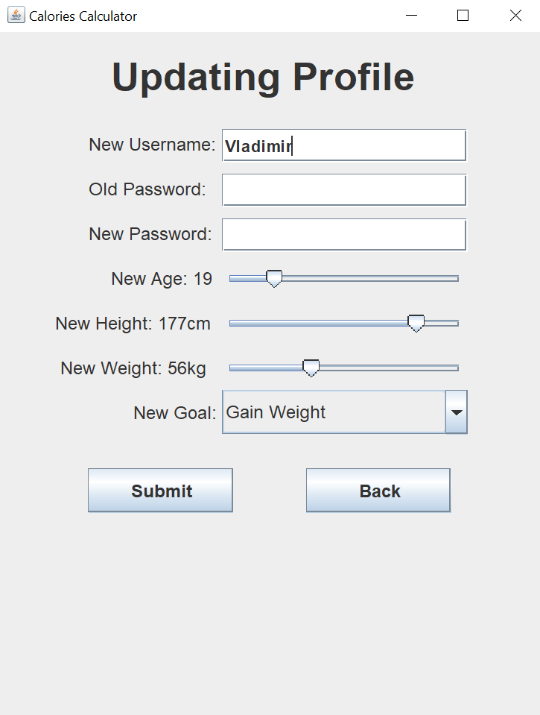

Slide 10
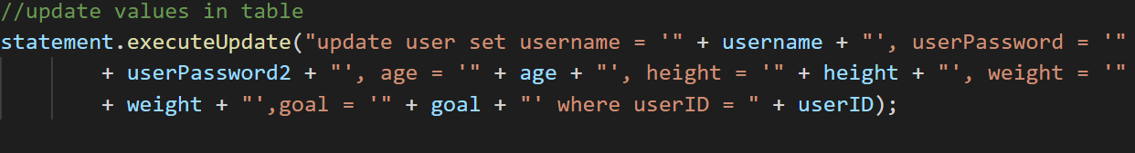
Update
MySQL
Input restrictions
MySQL
Inserting set data
Anonymous functions
GUI

Slide 11
Our team
Bakhrom Usmanov
Vladimir Khvan
Farrukh Asatov
U1910063
U1910046
U1910100

Slide 12

Thank you

