Slide 1

The impact of wine design on the purchase decision involvement
Vladimir Yankov
Matriculation number: 5925494 For the course Applied Marketing Research Methods (AMRM) WS 15/16
Submitted to Prof. Dr. Jochen Reiner

Slide 2

Purpose of the research
Studies arguing about the impact of visual wine design on the buyer’s behavior
Exogenous design factors and characteristics
“Before purchase” and “actual purchase” decision
Definition for the general perception of wine design
Effect on the purchase decision involvement
Effect on the importance of the stimulus
Regarding the consumer involvement profile
Purpose
Approach
Data
Models
Results

Slide 3

Conceptual framework
Visual wine design – CVPA (centrality of visual product aesthetics) construct (Bloch, Brunel, and Arnold, 2003)
Value, acumen and response of wine design
11 items scored on 5-point Likert-type scales
Purchase decision involvement – PDI (purchase decision involvement) construct (Mittal 1989)
4 items, scored on 5-point bipolar phrases
Importance of the wine purchase stimulus
modified PDI scale (Mittal, 1995)
3 items, scored on 5-point bipolar phrases
modified CIP (consumer involvement profile) scale (Mittal, 1995)
6 items, scored on 5-point Likert-type scales
Purpose
Approach
Data
Models
Results

Slide 4
Hypothesеs
H1: Wine design value has a significant effect on the purchase decision involvement.
H2: Wine design acumen has a significant effect on the purchase decision involvement.
H3: Wine design response has a significant effect on the purchase decision involvement.
?
Purpose
Approach
Data
Models
Results

Slide 5
Hypothesеs
H4: Wine design value has a significant effect on the importance of the stimulus for the purchase decision involvement.
H5: Wine design acumen has a significant effect on the importance of the stimulus for the purchase decision involvement.
H6: Wine design response has a significant effect on the importance of the stimulus for the purchase decision involvement.
?
Purpose
Approach
Data
Models
Results

Slide 6

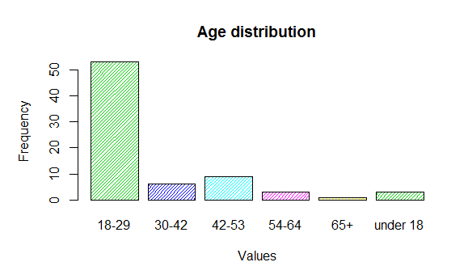
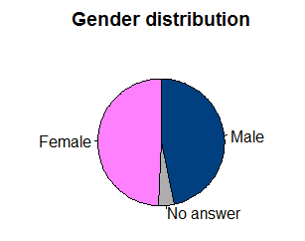
Data collection and manipulation
An online survey with Typeform
90 respondents, sample with 75 records
Deletion of missing values in the scales and duplicated records based on Network ID
All alpha coefficients were greater than 0.7
Purpose
Approach
Data
Models
Results
https://rimidalv1991.typeform.com/to/QqrCwN

Slide 7
First model
PDI = β₀ + β₁xValue + β₂xAcumen + β₂xResponse
Model results:
Model | R squared | Adjusted R squared | Sigma | F-Statistic | P-value
M1 | 0.3405 | 0.3127 | 0.6249 | 12.2220 | 0.00000155
Model coefficients:
 | Estimate | Std. Error | t value | P-value
(Intercept) | 2.25178 | 0.32825 | 6.86001 | 2.12E-09
Value | -0.11597 | 0.12332 | -0.94041 | 0.35019
Acumen | 0.30574 | 0.1086 | 2.81545 | 0.0063
Response | 0.29628 | 0.0958 | 3.09282 | 0.00283
H1 rejected, H2 and H3 accepted
Purpose
Approach
Data
Models
Results

Slide 8
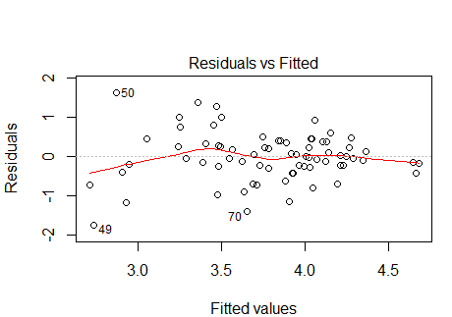
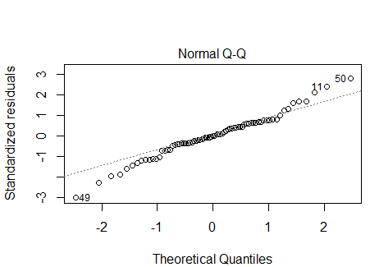
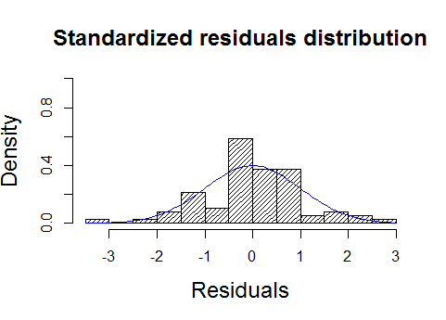
First model OLS assumptions
Problems with the normal distribution of error term
No multicollinearity, heteroscedasticity or autocorrelation
Potential outliers
Purpose
Approach
Data
Models
Results

Slide 9
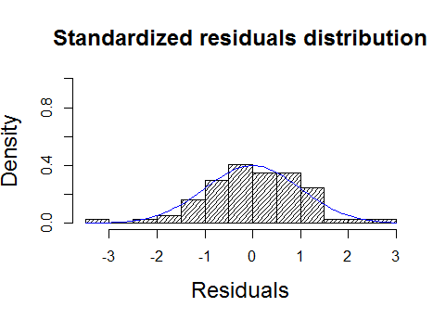
First model modification
After removing an outlier
Purpose
Approach
Data
Models
Results

Slide 10
First model modification (2)
After removing an outlier
Model coefficients:
 | Estimate | Std. Error | t value | P-value
(Intercept) | 1.70061 | 0.30371 | 5.59946 | 3.93E-07
Value | -0.16753 | 0.10781 | -1.55393 | 0.12471
Acumen | 0.42904 | 0.09325 | 4.60104 | 0.00001
Response | 0.32580 | 0.08232 | 3.95764 | 0.00017
Purpose
Approach
Data
Models
Results

Slide 11
Second model
PDI_Stimulus = β₀ + β₁xValue + β₂xAcumen + β₂xResponse
Model results:
Model | R squared | Adjusted R squared | Sigma | F-Statistic | P-value
M2 | 0.53474 | 0.51508 | 0.55050 | 27.20129 | 8.024e-12
Model coefficients:
 | Estimate | Std. Error | t value | P-value
(Intercept) | 1.44653 | 0.28917 | 5.00228 | 3.95E-06
Value | -0.12069 | 0.10864 | -1.11086 | 0.27037
Acumen | 0.44039 | 0.09567 | 4.60328 | 0.00001
Response | 0.33807 | 0.08439 | 4.00583 | 0.00015
H4 rejected, H5 and H6 accepted
Purpose
Approach
Data
Models
Results

Slide 12
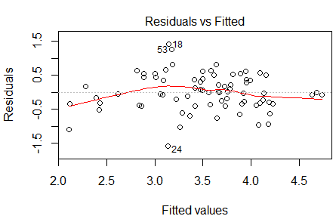
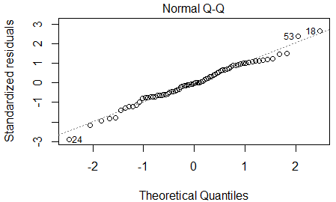
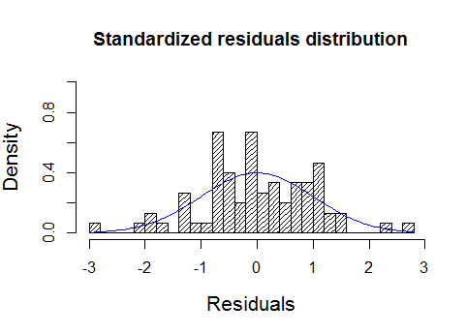
Second model OLS assumptions
Evidence for linearity, rather normal distribution of error term
No multicollinearity or autocorrelation
Possible heteroscedasticity – p-value = 0.06 (Breusch-Pagan test)
global validation of linear model assumptions – homoscedasticity accepted
Potential outliers
Purpose
Approach
Data
Models
Results

Slide 13
Second model modification
Performing a robust linear regression
Similar coefficient estimates
No particularly great influence of outliers
Cook’s distance less than 0.5
Model coefficients:
 | Value | Std. Error | t value
(Intercept) | 1.4449 | 0.2737 | 5.2790
Value | -0.1072 | 0.1028 | -1.0428
Acumen | 0.4022 | 0.0906 | 4.4417
Response | 0.3618 | 0.0799 | 4.5289
Purpose
Approach
Data
Models
Results
Notes:
Robust standard Errors <-> Robust linear regression

Slide 14
Findings
Not each dimension of visual wine design affects the purchase behavior
The competence to recognize and evaluate wine package aesthetics has a positive effect on
The purchase decision involvement
The importance of the stimulus for purchase
The acknowledgement, desire and satisfaction of wine design features is favorable for
The purchase decision involvement
The importance of the stimulus for purchase
Visual wine design has a greater impact on the perception of the stimulus for a purchase rather than the involvement
Purpose
Approach
Data
Models
Results

Slide 15
Limitations
Homogeneity of the sample
Broader definition of design
Precise effects when considering
The targeted customer group
The perceived strategy
Market circumstances
Purpose
Approach
Data
Models
Results

Slide 16
References
Bloch, Peter A., Frédéric F. Brunel, and Todd J. Arnold (2003), “Individual Differences
in the Centrality of Visual Product Aesthetics: Concept and Measurement,” Journal of
Consumer Research, 29 (March), 551–65.
Mittal, Banwari (1989), “Measuring Purchase-Decision Involvement,” Psychology &
Marketing, 6, 147–62.
Mittal, Banwari (1995), “A Comparative Analysis of Four Scales of Involvement,”
Psychology & Marketing, 12, 663–82.
Typeform, https://www.typeform.com/ accessed on 10.02.2016

Slide 17


Thank you for your attention!

