Slide 1
Data Analysis in Big Data
Stream Processing

Slide 2
Data Analysis in Big Data
Stream Processing
Presentation
History
Traditional Infrastructure
Lambda Architecture
Hadoop
Apache Spark
Kappa Architecture
Apache Kafka
Apache Flink
Twitter: Lambda
Twitter: Kappa
Lambda vs Kappa

Slide 3
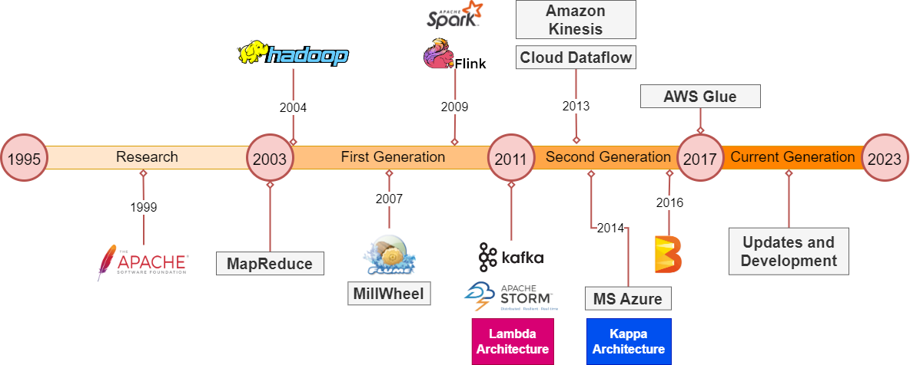
History
Different Architectures and Frameworks

Slide 4
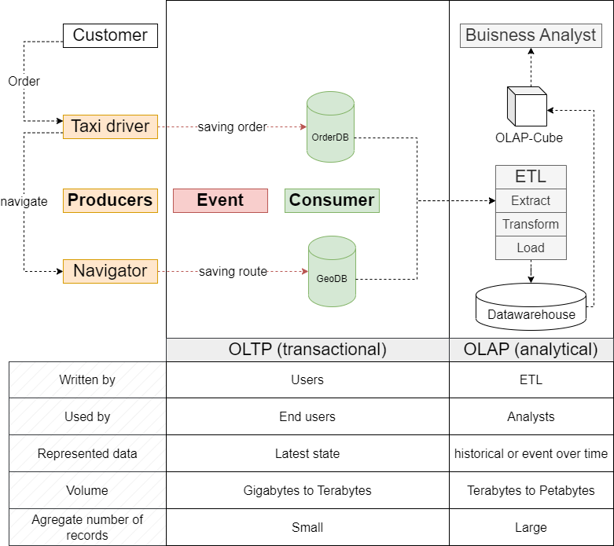
Traditional Infrastructure
Introduction to OLTP and OLAP

Slide 5
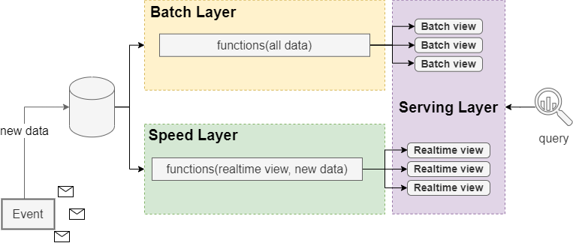
Lambda Architecture
Layout

Slide 6
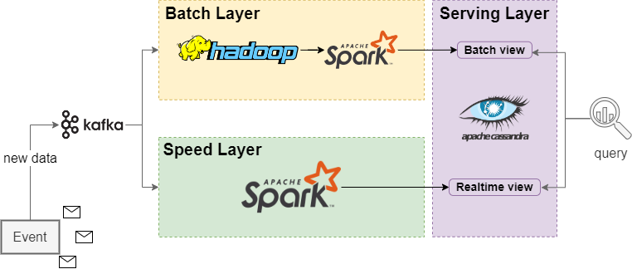
Lambda Architecture
Example

Slide 7
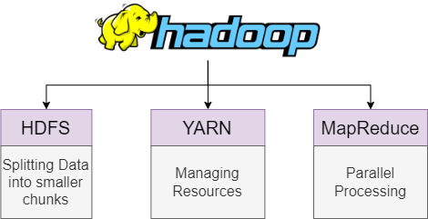
Hadoop
Overview

Slide 8
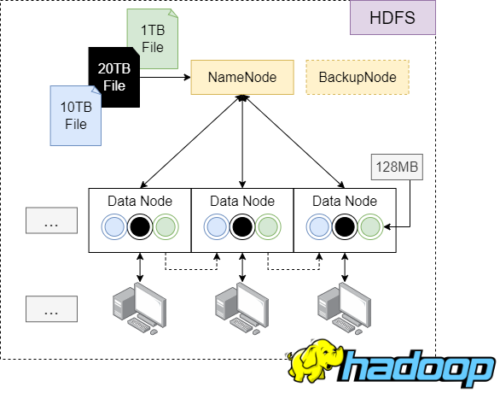
Hadoop
HDFS

Slide 9
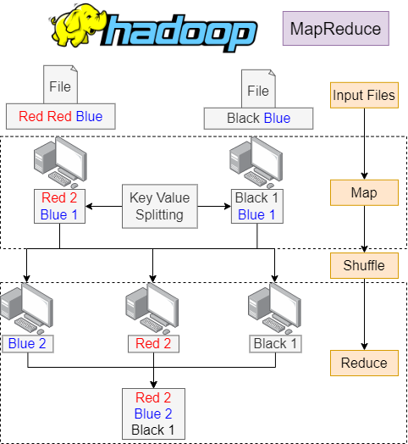
Hadoop
MapReduce

Slide 10
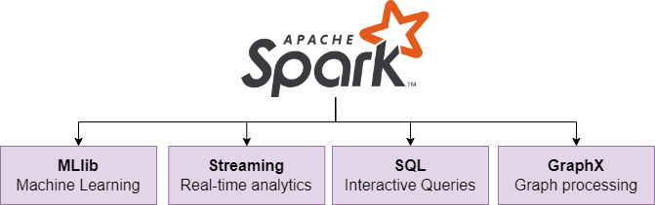
Apache Spark
Overview

Slide 11
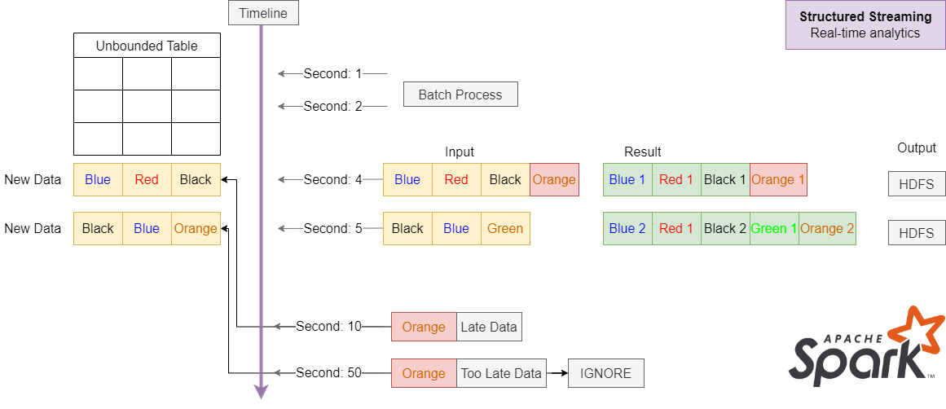
Apache Spark
Structured Streaming

Slide 12


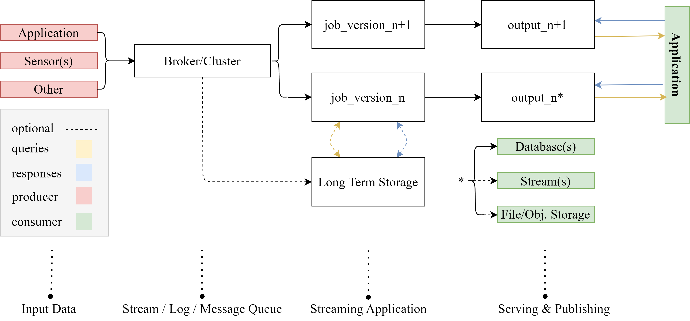
Kappa Architecture
Everything is a stream!

Slide 13
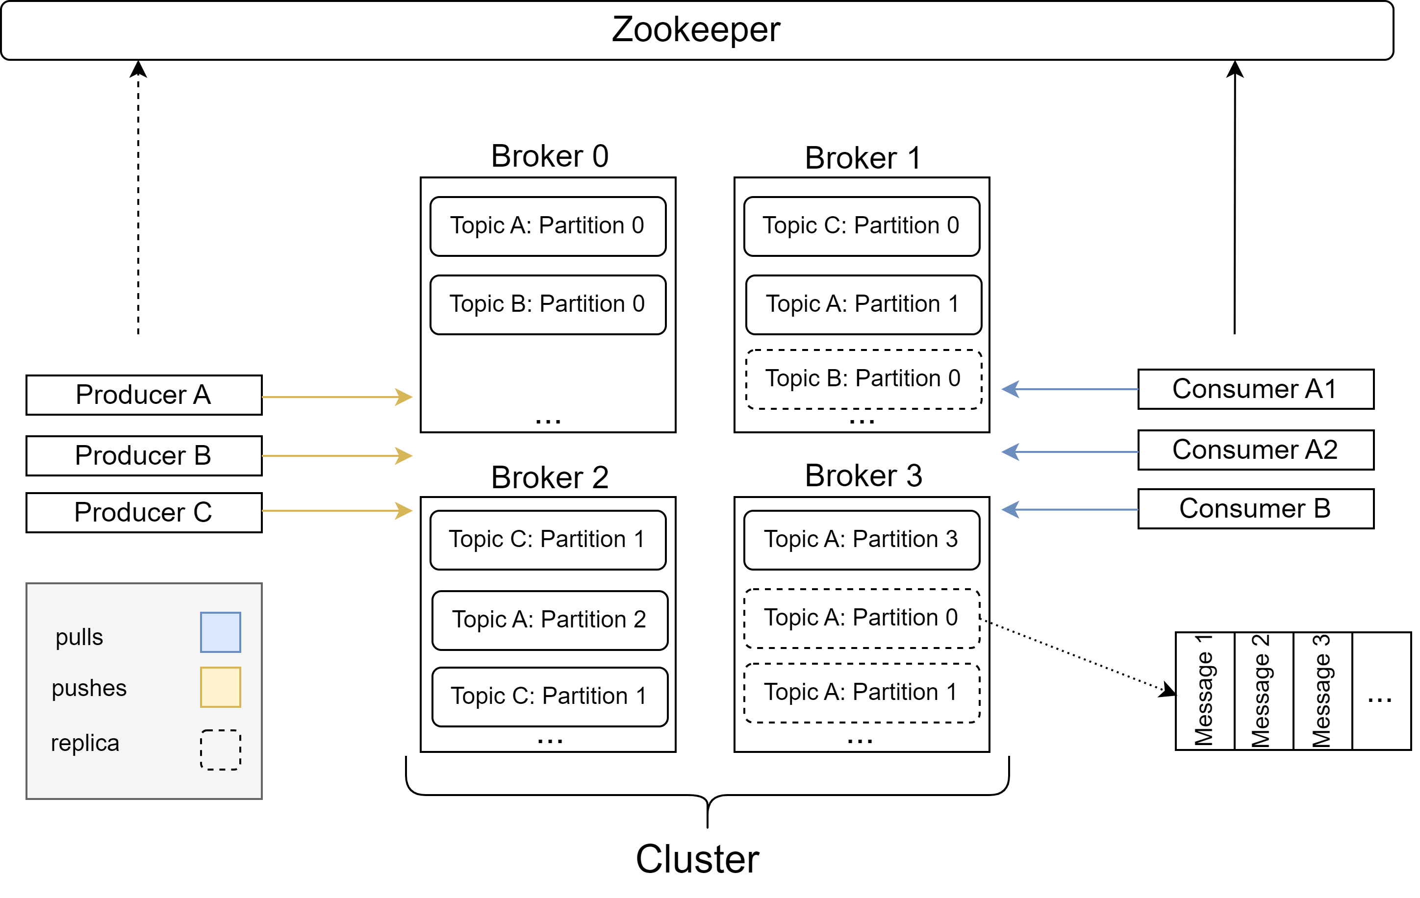
Introduction to Apache Kafka
De Facto Standard API for Event Streaming

Slide 14
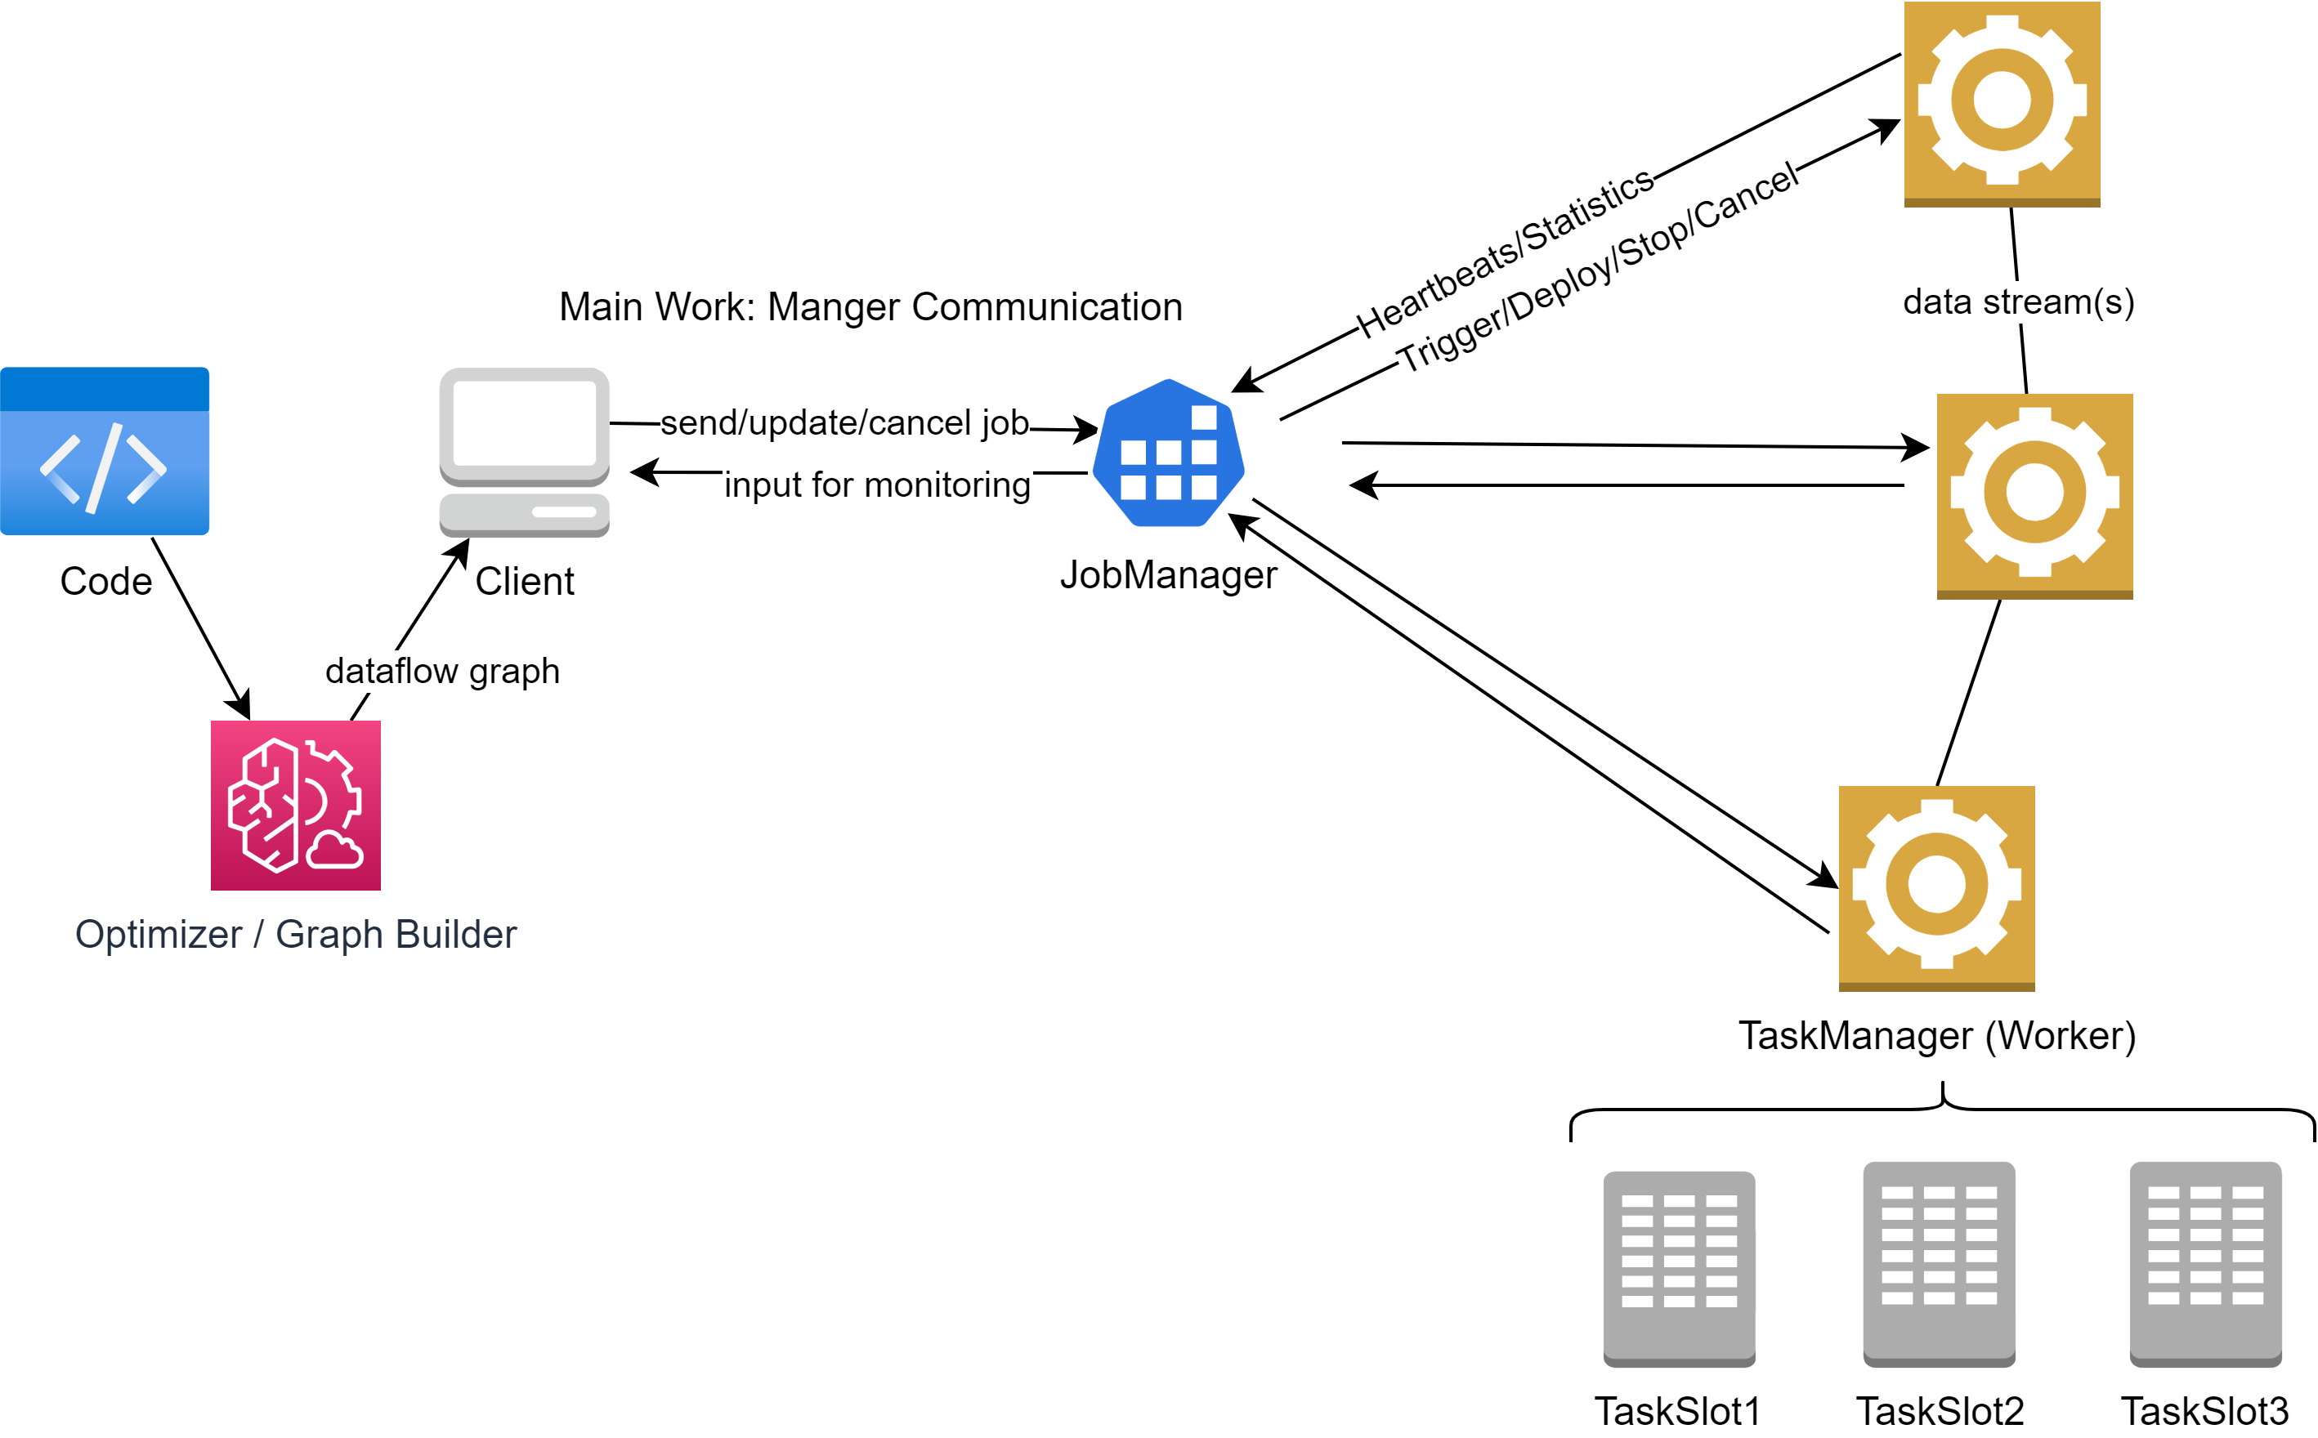
Apache Flink
Stateful Computations over Data Streams

Slide 15
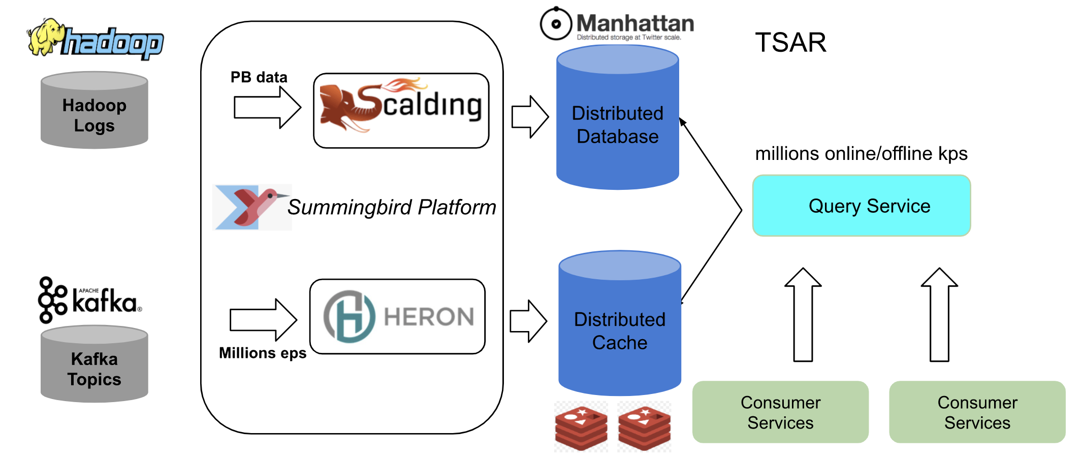
Real Case Study: Twitter
Before: Lambda
Batch layer
Speed layer

Slide 16
Real Case Study: Twitter
Lambda Insights
Summingbird provides high-level language, eliminating the problem of parallel maintainance Lambda layers.
Twitter Service Auto-Scaling Rules (TSAR) manages services’ auto-scaling. It adjusts the number of instances running for a particular service based on real-time demand. Also, merges produced data by both layers.
Batch processing costs are reduced by centralizing the computing on one data center and replicas distribution to others.
Arising streaming volumes led to the data losses in the Speed Layer, which resulted into less accurate aggregated data shown to Twitter users.

Slide 17
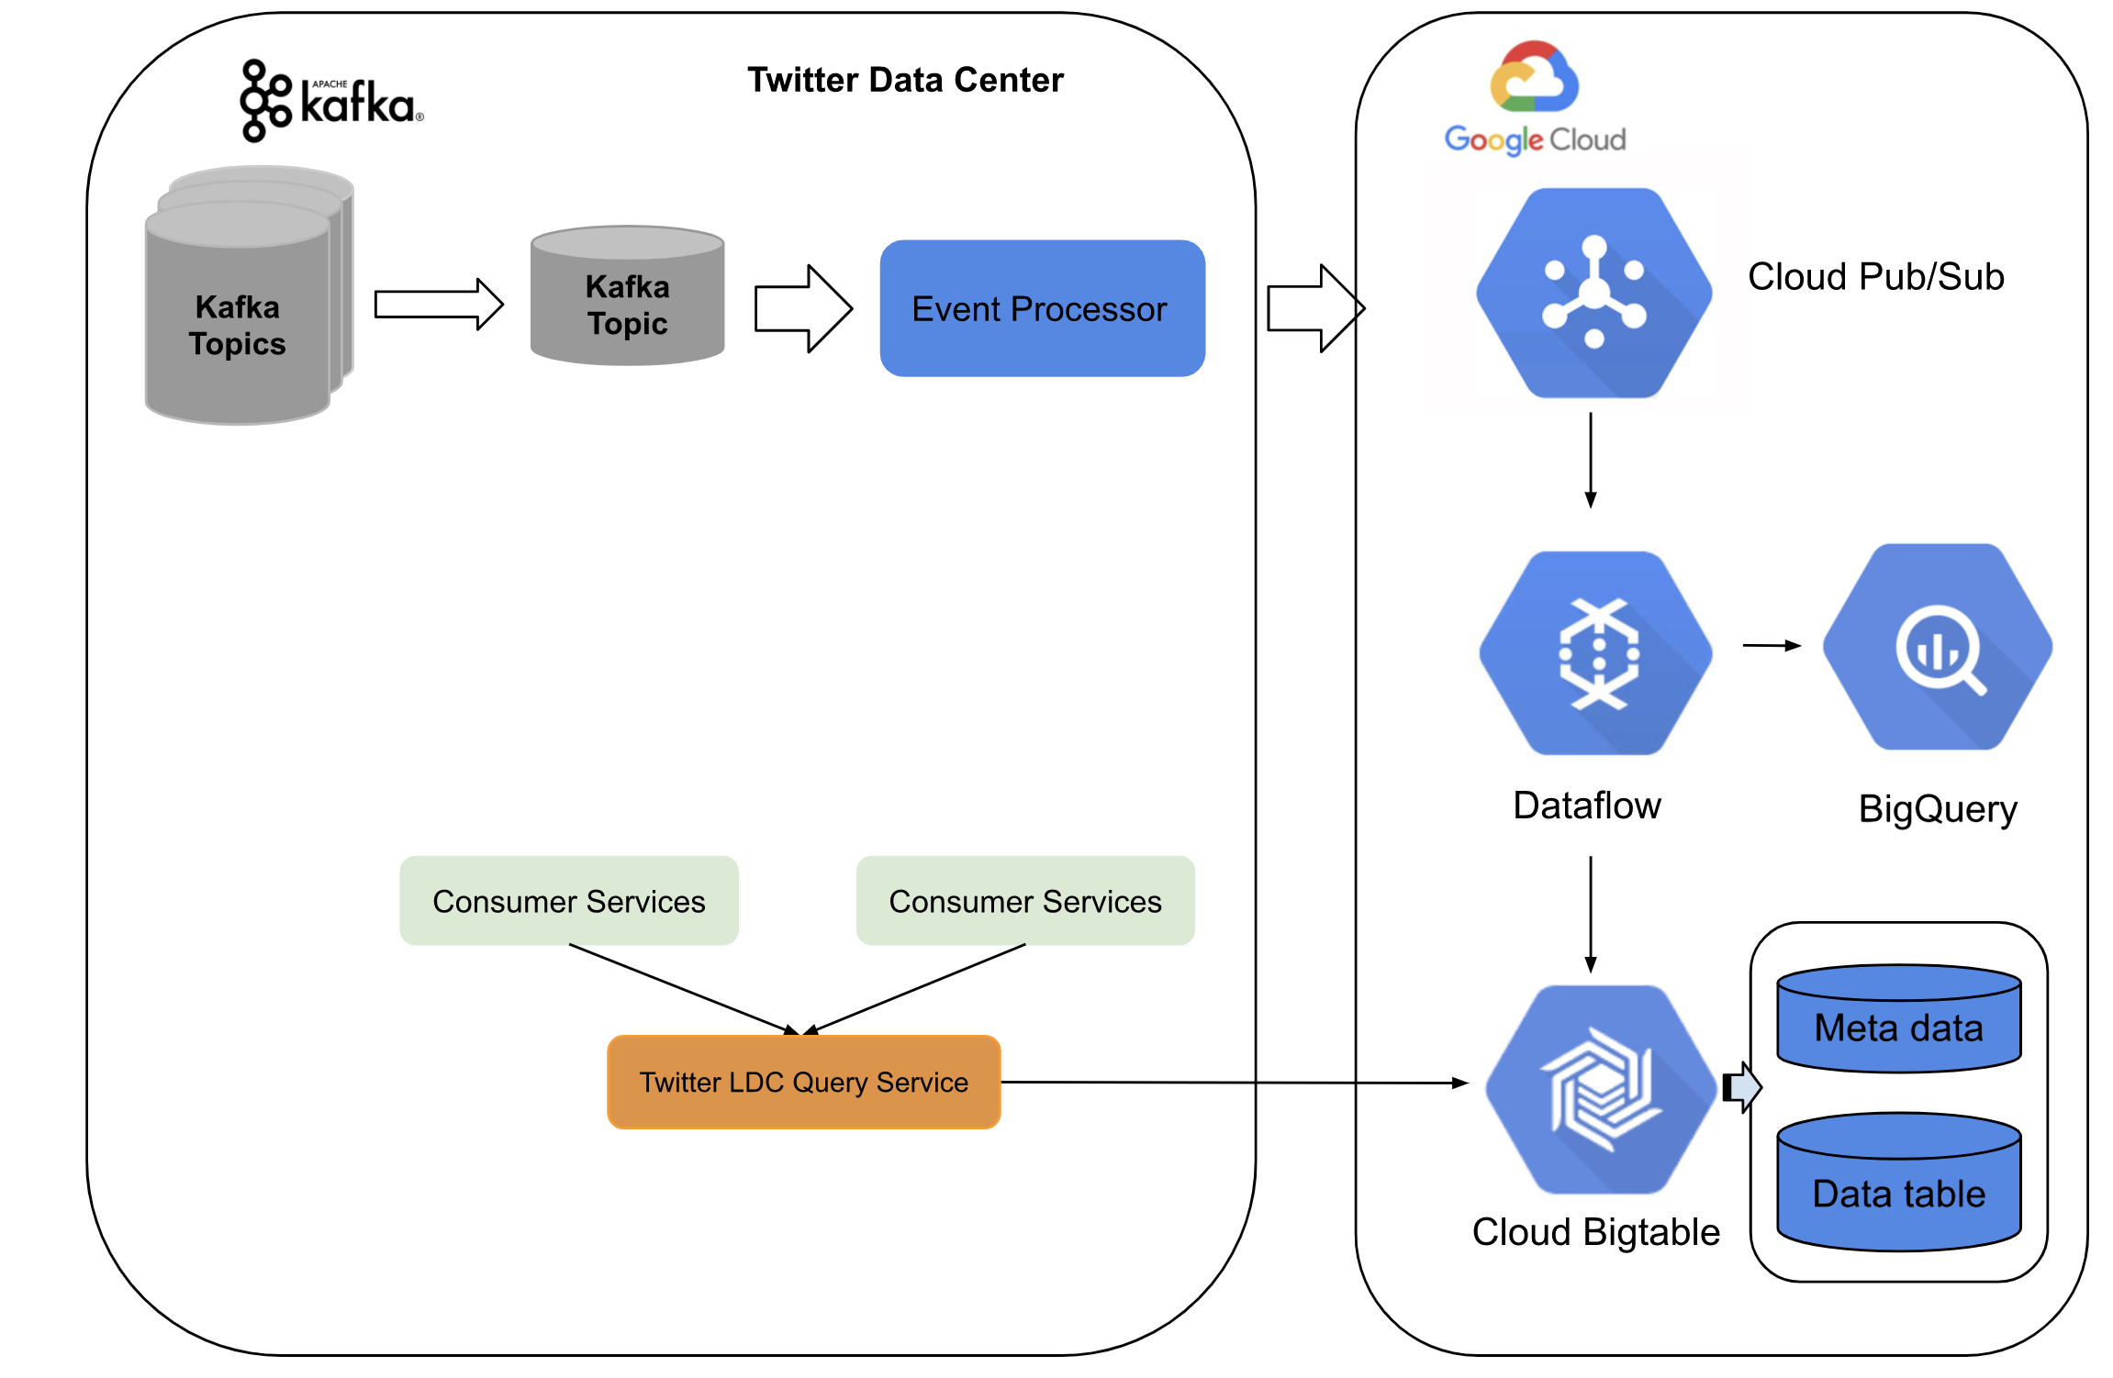
Real Case Study: Twitter
After: Kappa

Slide 18
Real Case Study: Twitter
Kappa Insights
During the whole data pipeline, Twitter ensures that all message are delivered, by using at-least-once semantics.
Before transferring to the cloud, the pipeline makes data preprocessing and optimizes Kafka logs for a Pubsub topic for reducing data storage.
To achieve near exactly-once processing, Twitter applies internal deduping strategies within a timed window. The deduplication is made by Dataflow workers via UUID assigned by the Event Processor.
Distributed aggregation of real-time data over Dataflow and BigQuery provides low-latency and high streaming throughput.
On-premise Twitter query services tap the data from the high-scalable and distributed storage system for structured data.

Slide 19

Lambda vs Kappa
Compare
 | Lambda | Kappa
Cost
Implementation
Robustness (fault tolerance)
Troubleshooting
Resources
Size of Dataflow
Scalability (difficulty)
Complexity of calculation
Consumer Requirements | Precise Results | Live Data
Necessity of historical data | Yes | No
Type of Machine Learning | Supervised (historical needed) | Unsupervised and semi-supervised

Slide 20
Literature
Seite 1/1
1. Hueske, F., & Kalavri, V. (2019). Stream Processing with Apache Flink Fundamentals, Implementation, and Operation of Streaming Applications. O’Reilly Media.
2. Feick, Martin, Niko Kleer, and Marek Kohn. "Fundamentals of real-time data processing architectures lambda and kappa.“
3. Owczarek. “Lambda vs. Kappa Architecture.” URL: https://nexocode.com/blog/posts/lambda-vs-kappa-architecture/
4. Garg, Nishant. Apache kafka. Birmingham, UK: Packt Publishing, 2013.
5. Twitter Blog: https://blog.twitter.com/engineering/en_us/topics/infrastructure/2021/processing-billions-of-events-in-real-time-at-twitter-
6. Apache Flink Documentation: https://nightlies.apache.org/flink/flink-docs-release-1.16/docs/concepts/flink-architecture/
7. Kleppmann, M. (2017). Designing Data-Intensive Applications: The Big Ideas Behind Reliable, Scalable, and Maintainable Systems. O’Reilly Media
8. Hueske, F., & Kalavri, V. (2019). Stream Processing with Apache Flink Fundamentals, Implementation, and Operation of Streaming Applications. O’Reilly Media.
9. Akidau, T., Chernyak, S., & Lax, R. (2018). Streaming Systems. O’Reilly Media.
10. Online: Apache Software Foundation Projects https://projects.apache.org/
11. Marz, N. (2015). Big Data. Manning.
12. Achari, S. (2015). Hadoop Essentials. Packt Publishing, Limited.
13. Online: Apache Spark Documentation https://spark.apache.org/docs/latest/structured-streaming-programming-guide.html
14. Chang, Dean (2006). Bigtable: A Distributed Storage System for Structured Data. 7th USENIX Symposium on Operating Systems Design and Implementation (OSDI)

