Slide 1
Data Analysis in Big Data
Stream Processing

Slide 2
Stream Processing
Introduction: Example
In this Presentation, we will …

Slide 3
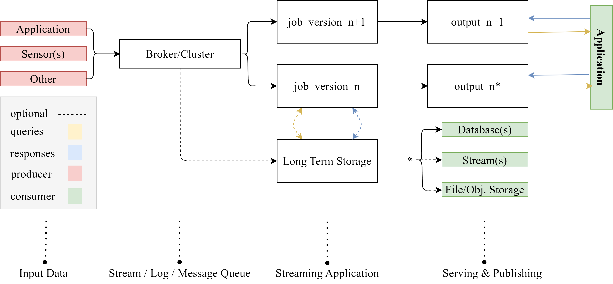
Kappa Architecture
Everything is a stream!
Feick, Martin, Niko Kleer, and Marek Kohn. "Fundamentals of real-time data processing architectures lambda and kappa.“ Owczarek. “Lambda vs. Kappa Architecture.” URL: https://nexocode.com/blog/posts/lambda-vs-kappa-architecture/

Slide 4
Literatur
Seite 1/1
1. Hueske, F., & Kalavri, V. (2019). Stream Processing with Apache Flink Fundamentals, Implementation, and Operation of Streaming Applications. O’Reilly Media.

