Slide 1
Data Analysis in Big Data
Stream Processing

Slide 2
Data Analysis in Big Data
Stream Processing
Presentation
History
Traditional Infrastructure
Lambda Architecture
Hadoop
Apache Spark
Kappa Architecture
Apache Kafka
Apache Flink
Twitter: Lambda
Twitter: Kappa
Lambda vs Kappa

Slide 3
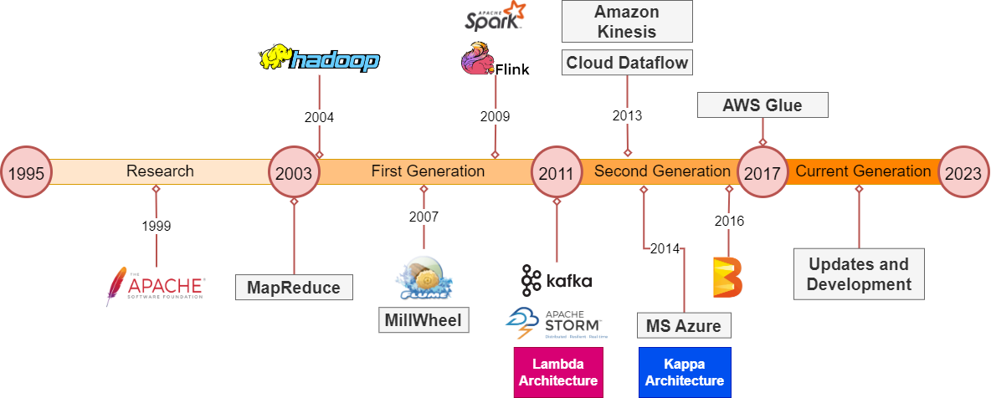
History
Different Architectures and Frameworks
9. Akidau, T., Chernyak, S., & Lax, R. (2018)
10. Online: Apache Software Foundation Projects https://projects.apache.org/

Slide 4
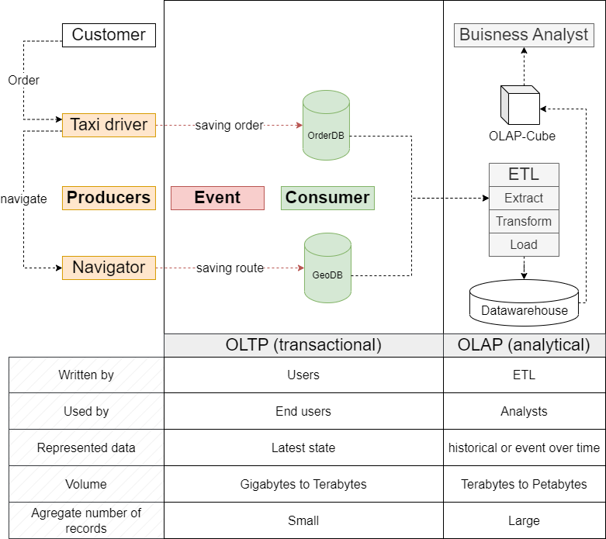
Traditional Infrastructure
Introduction to OLTP and OLAP
6. Kleppmann, M. (2017)
7. Hueske, F., & Kalavri, V. (2019)

Slide 5
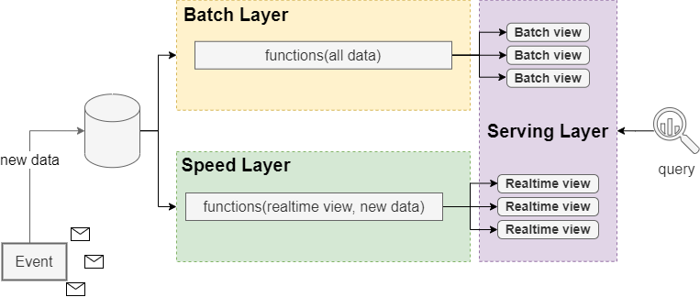
Lambda Architecture
Layout
8. Hueske, F., & Kalavri, V. (2019)
11. Marz, N. (2015).

Slide 6
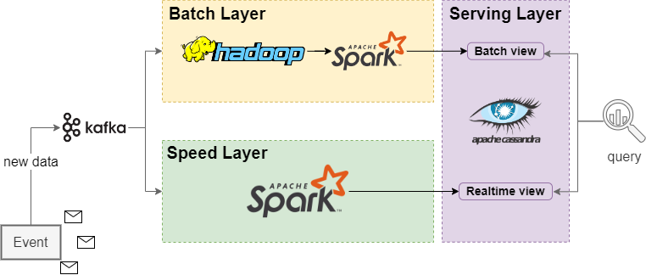
Lambda Architecture
Example

Slide 7
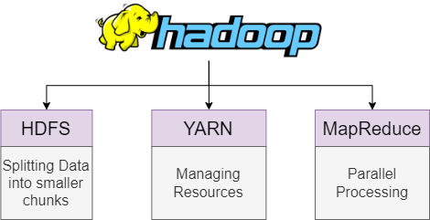
Hadoop
Overview
12. Achari, S. (2015)

Slide 8
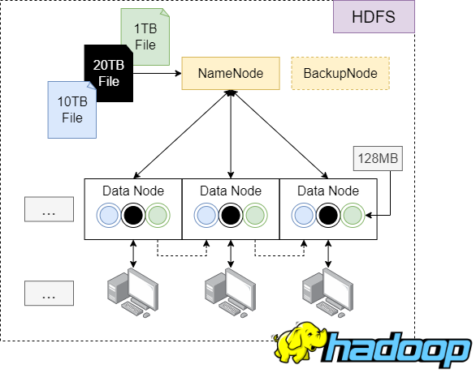
Hadoop
HDFS
12. Achari, S. (2015)

Slide 9
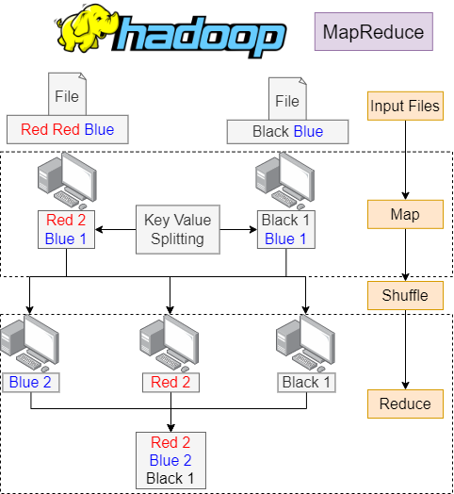
Hadoop
MapReduce
12. Achari, S. (2015)

Slide 10
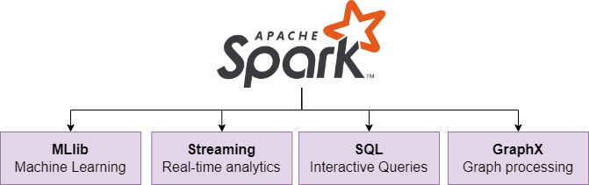
Apache Spark
Overview
12. Achari, S. (2015)

Slide 11
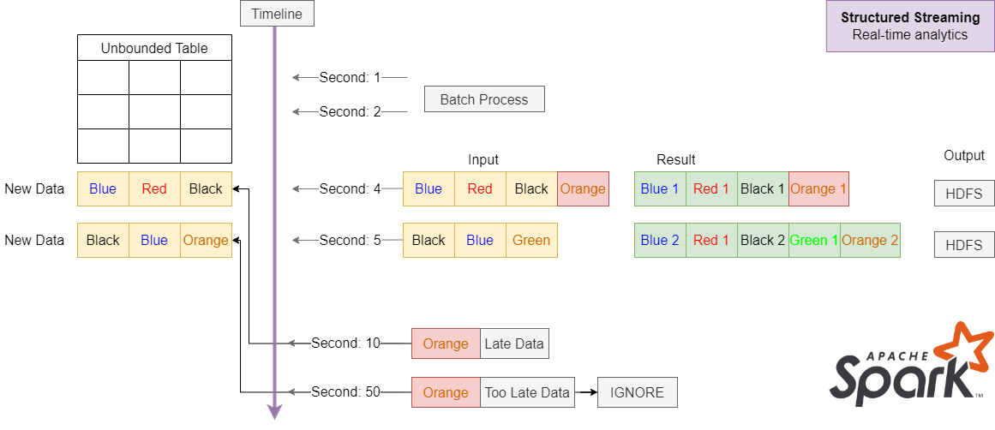
Apache Spark
Structured Streaming
13. Online: Apache Spark Documentation https://spark.apache.org/docs/latest/structured-streaming-programming-guide.html

Slide 12


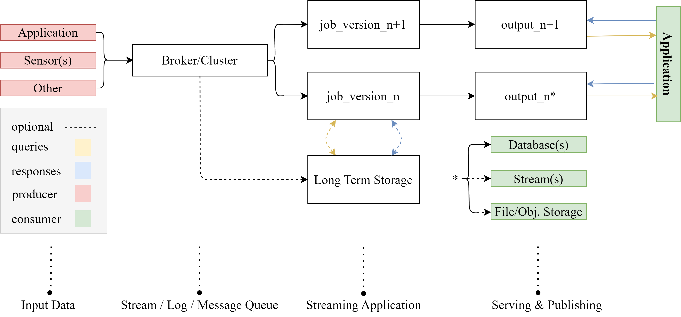
Kappa Architecture
Everything is a stream!
2. Feick, Martin, Niko Kleer, and Marek Kohn. "Fundamentals of real-time data processing architectures lambda and kappa.“ 3. Owczarek. “Lambda vs. Kappa Architecture.” URL: https://nexocode.com/blog/posts/lambda-vs-kappa-architecture/

Slide 13
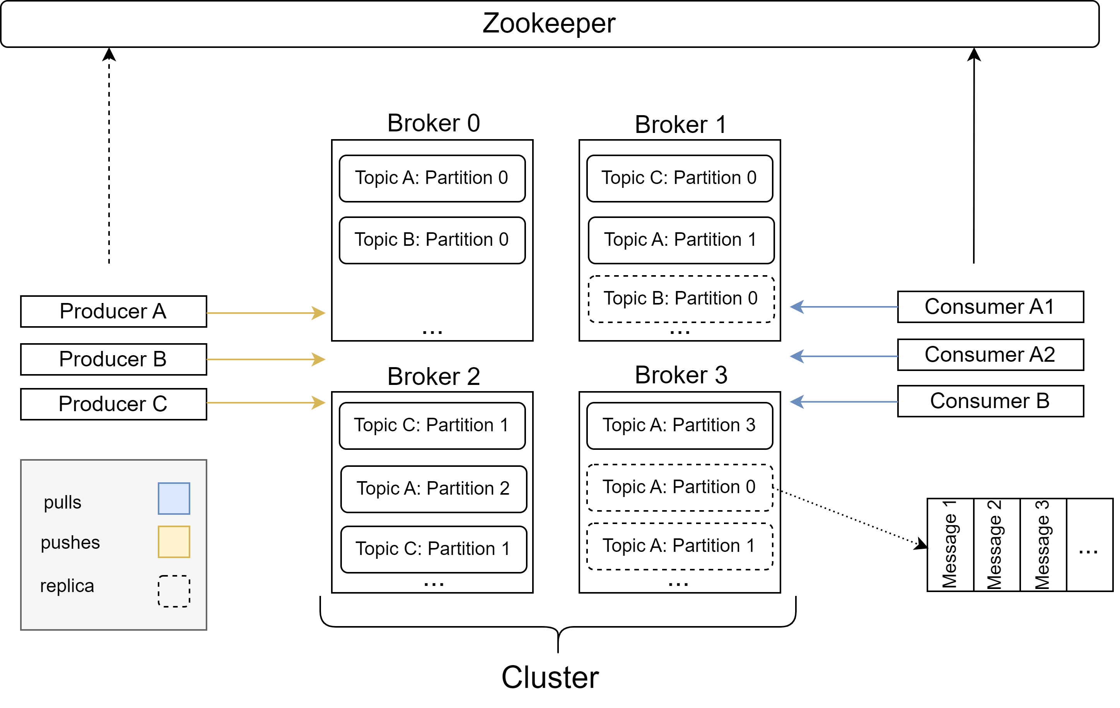
Introduction to Apache Kafka
De Facto Standard API for Event Streaming
4. Garg, Nishant. Apache kafka. Birmingham, UK: Packt Publishing, 2013.

Slide 14
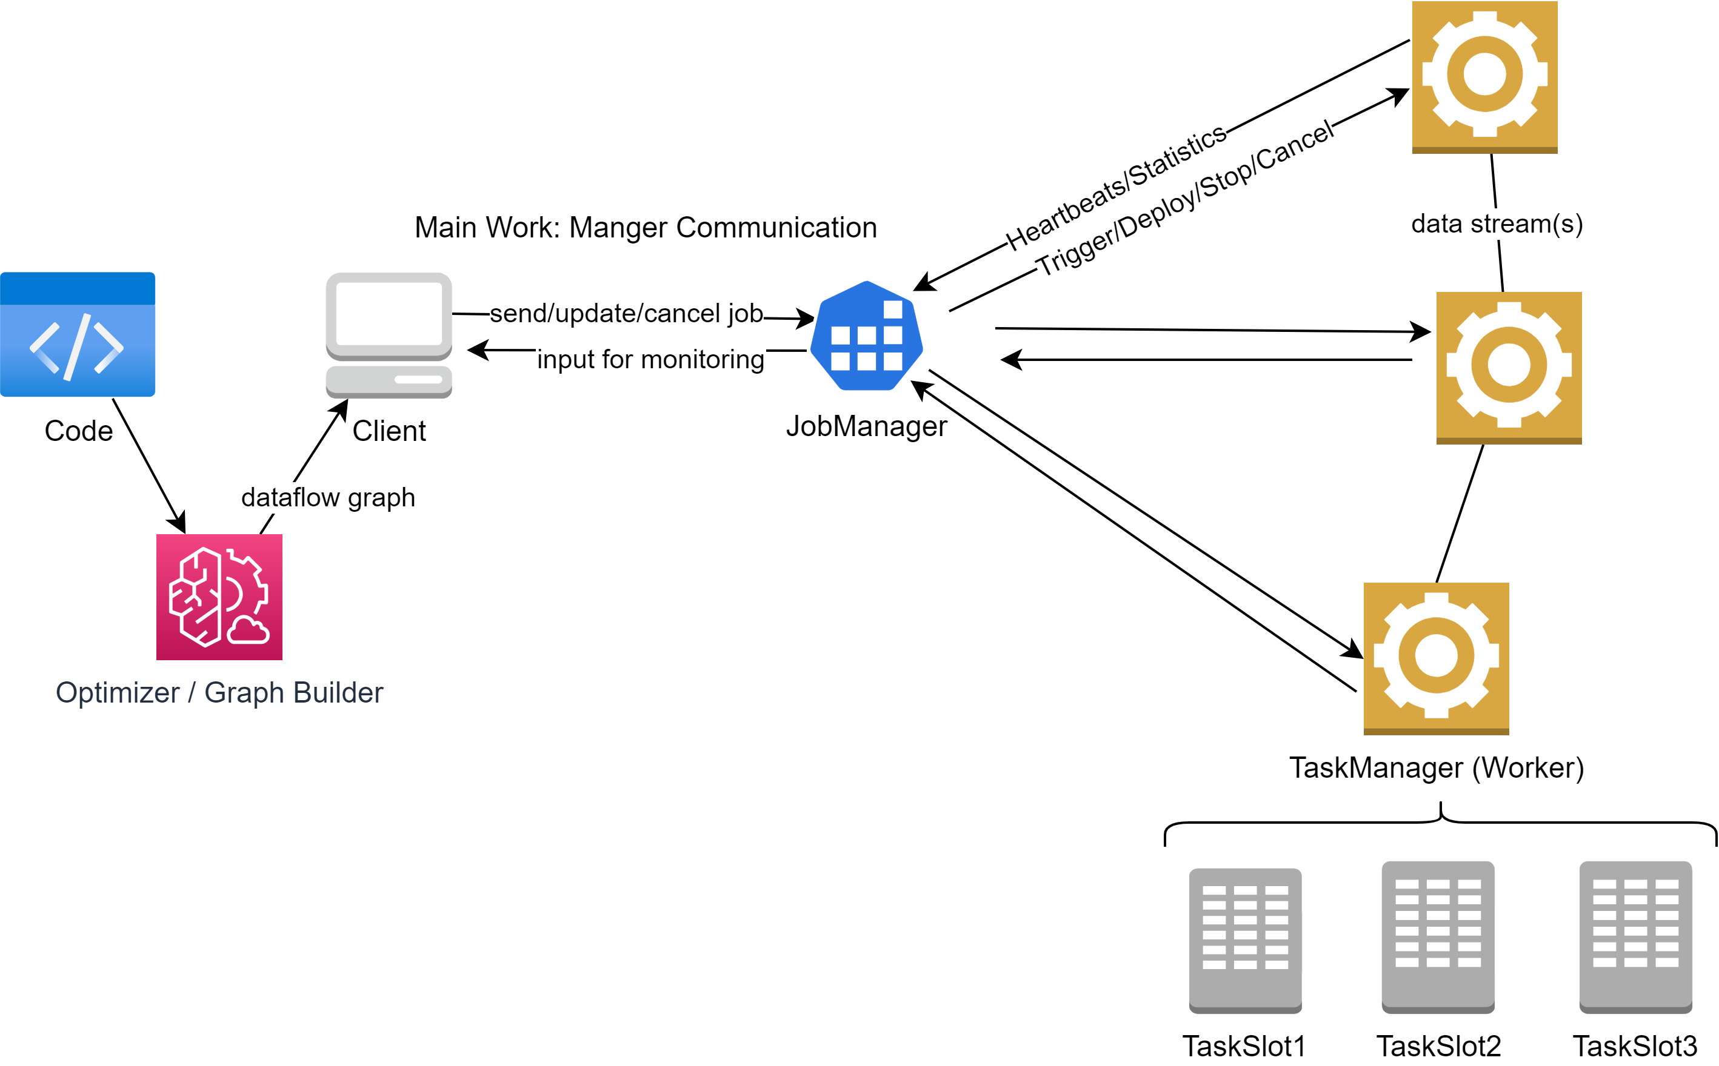
Apache Flink
Stateful Computations over Data Streams
6. Apache Flink Documentation: https://nightlies.apache.org/flink/flink-docs-release-1.16/docs/concepts/flink-architecture/

Slide 15
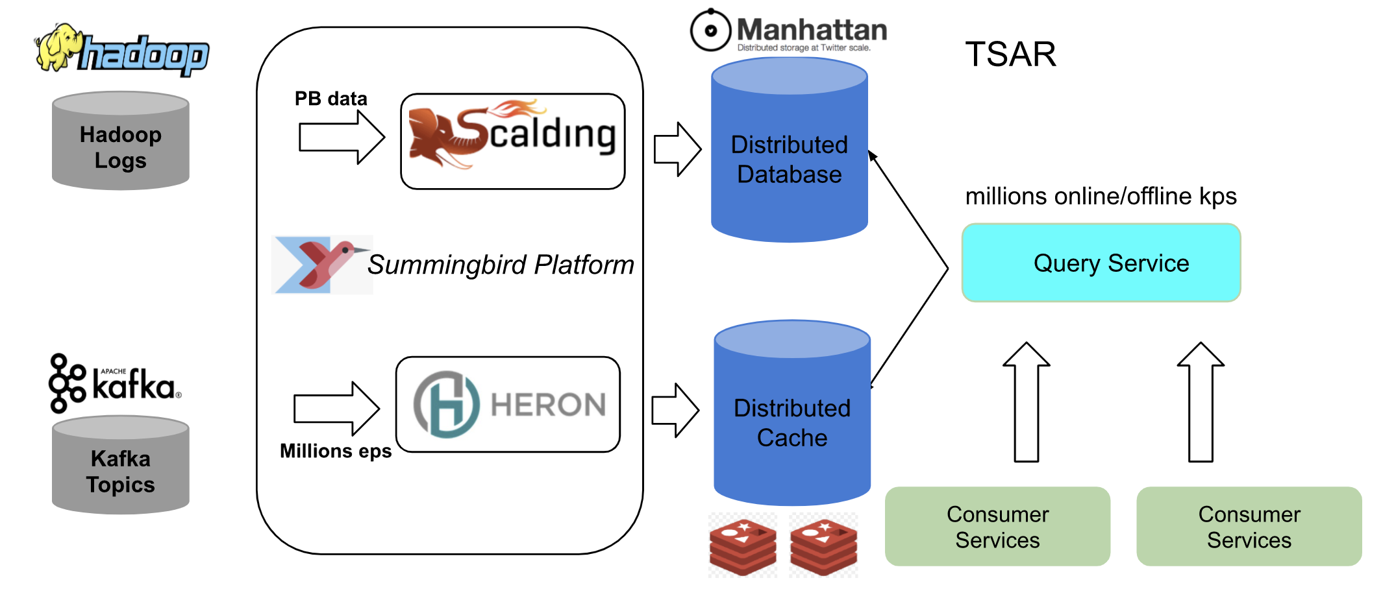
Real Case Study: Twitter
After: Lambda
5. Twitter Blog: https://blog.twitter.com/engineering/en_us/topics/infrastructure/2021/processing-billions-of-events-in-real-time-at-twitter-

Slide 16
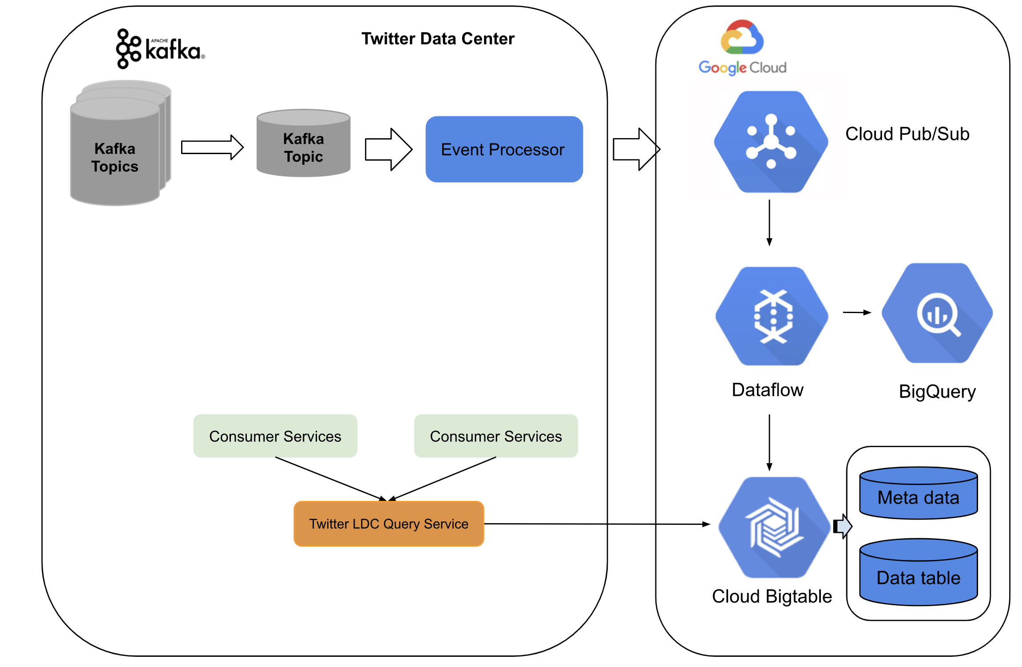
Real Case Study: Twitter
After: Kappa
5. Twitter Blog: https://blog.twitter.com/engineering/en_us/topics/infrastructure/2021/processing-billions-of-events-in-real-time-at-twitter-

Slide 17

Lambda vs Kappa
Compare
 | Lambda | Kappa
Cost
Implementation
Robustness (fault tolerance)
Troubleshooting
Resources
Size of Dataflow
Scalability (difficulty)
Complexity of calculation
Consumer Requirements | Precise Results | Live Data
Necessity of historical data | Yes | No
Type of Machine Learning | Supervised (historical needed) | Unsupervised and semi-supervised

Slide 18
Literature
Seite 1/1
1. Hueske, F., & Kalavri, V. (2019). Stream Processing with Apache Flink Fundamentals, Implementation, and Operation of Streaming Applications. O’Reilly Media.
2. Feick, Martin, Niko Kleer, and Marek Kohn. "Fundamentals of real-time data processing architectures lambda and kappa.“
3. Owczarek. “Lambda vs. Kappa Architecture.” URL: https://nexocode.com/blog/posts/lambda-vs-kappa-architecture/
4. Garg, Nishant. Apache kafka. Birmingham, UK: Packt Publishing, 2013.
5. Twitter Blog: https://blog.twitter.com/engineering/en_us/topics/infrastructure/2021/processing-billions-of-events-in-real-time-at-twitter-
6. Apache Flink Documentation: https://nightlies.apache.org/flink/flink-docs-release-1.16/docs/concepts/flink-architecture/
7. Kleppmann, M. (2017). Designing Data-Intensive Applications: The Big Ideas Behind Reliable, Scalable, and Maintainable Systems. O’Reilly Media
8. Hueske, F., & Kalavri, V. (2019). Stream Processing with Apache Flink Fundamentals, Implementation, and Operation of Streaming Applications. O’Reilly Media.
9. Akidau, T., Chernyak, S., & Lax, R. (2018). Streaming Systems. O’Reilly Media.
10. Online: Apache Software Foundation Projects https://projects.apache.org/
11. Marz, N. (2015). Big Data. Manning.
12. Achari, S. (2015). Hadoop Essentials. Packt Publishing, Limited.
13. Online: Apache Spark Documentation https://spark.apache.org/docs/latest/structured-streaming-programming-guide.html

