Slide 1
Data Analysis in Big Data
Stream Processing

Slide 2
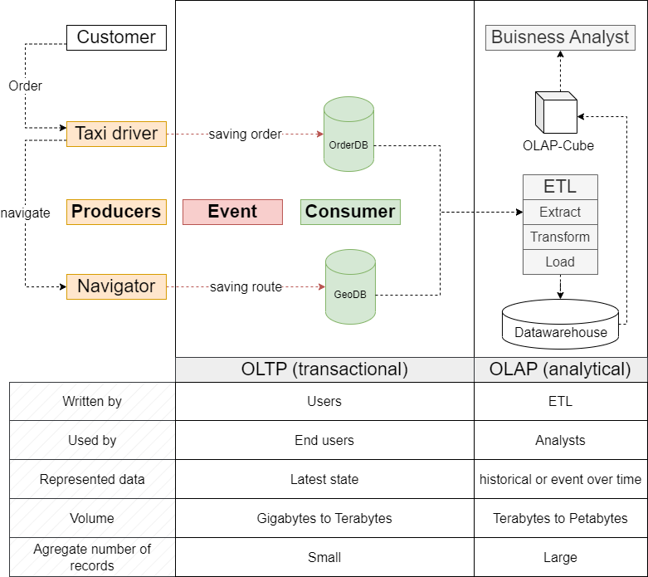
Stream Processing
Introduction: Traditional Infrastructure
1. Hueske, F., & Kalavri, V. (2019), Kleppmann, M. (2017)

Slide 3
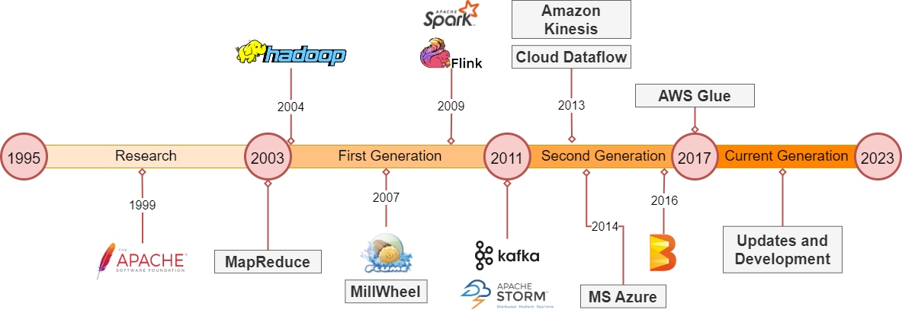
Stream Processing
Introduction: History
1. Hueske, F., & Kalavri, V. (2019), Kleppmann, M. (2017)

Slide 4
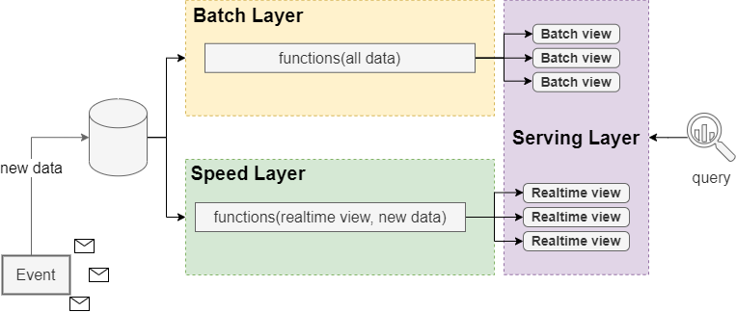
Stream Processing
Lambda Architecture
1. Hueske, F., & Kalavri, V. (2019) | 2. Marz, N. (2015)

Slide 5
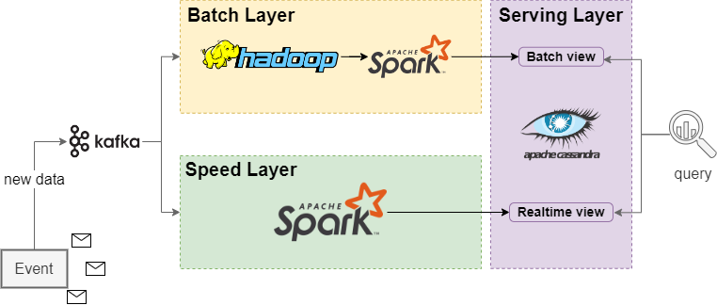
Stream Processing
Lambda Architecture
1. Hueske, F., & Kalavri, V. (2019) | 2. Marz, N. (2015)

Slide 6
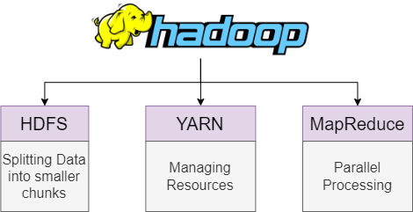
Stream Processing
Lambda Architecture
1. Hueske, F., & Kalavri, V. (2019) | 2. Marz, N. (2015)

Slide 7
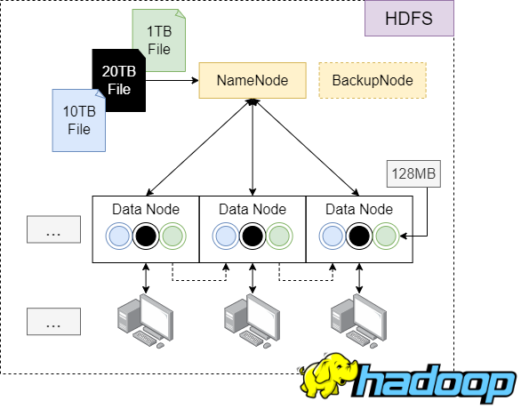
Stream Processing
Lambda Architecture
1. Hueske, F., & Kalavri, V. (2019) | 2. Marz, N. (2015)

Slide 8
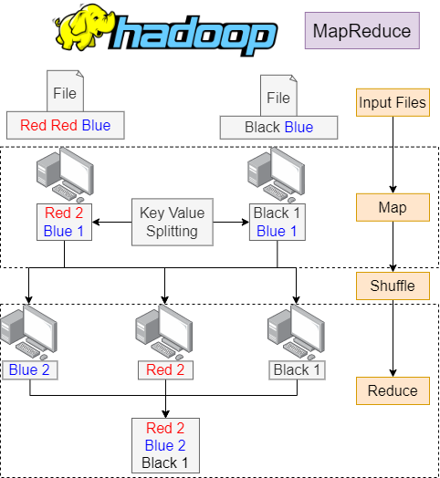
Stream Processing
Lambda Architecture
1. Hueske, F., & Kalavri, V. (2019) | 2. Marz, N. (2015)

Slide 9
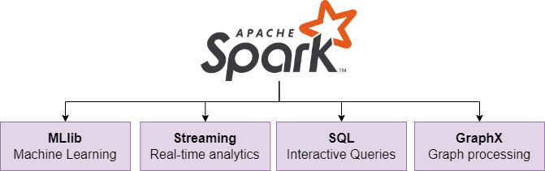
Stream Processing
Lambda Architecture
1. Hueske, F., & Kalavri, V. (2019) | 2. Marz, N. (2015)

Slide 10
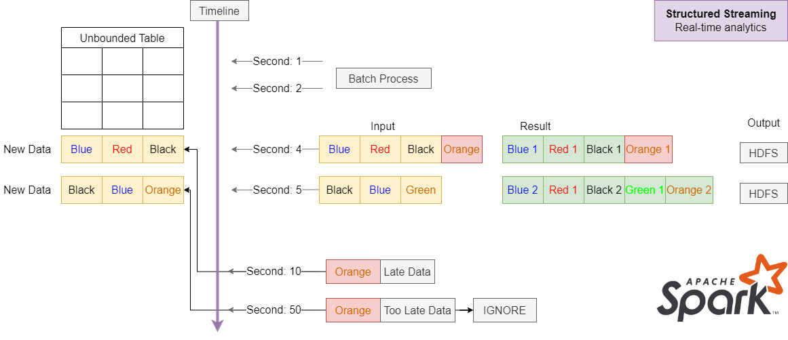
Stream Processing
Lambda Architecture
1. Hueske, F., & Kalavri, V. (2019) | 2. Marz, N. (2015)

Slide 11





Stream Processing
Introduction: History
from 1995
from 2000
2011
2013
Community
Community
First
Generation
Second Generation
First research prototypes
First commercial products
Growing availability of mature open-source stream processors and communities
Improving with new features and capabilities
First open-source processors
Focused on event processing
Guarantees against loss of events in the case of failures
Low-Level-APIs
Growing availability of mature open-source stream processors and communities
Improving with new features and capabilities
1. Hueske, F., & Kalavri, V. (2019)

Slide 12




Stream Processing
Introduction: History
2015
2023
More and more popular technology with companies in big and small
Superior solutions for many use cases
Facilitates novel applications, software architectures and business opportunities
Third
Generation
Current
State
First open-source processors
Focused on event processing
Guarantees against loss of events in the case of failures
Today stream processors power business-critical-applications in many enterprises across different industries (gaming, bacnking, social media …)
1. Hueske, F., & Kalavri, V. (2019)

Slide 13
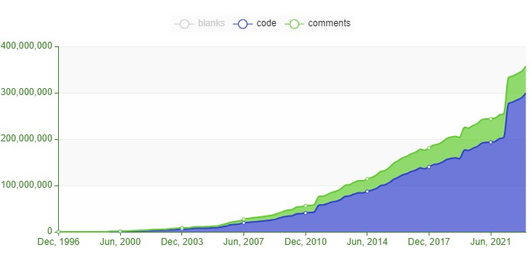

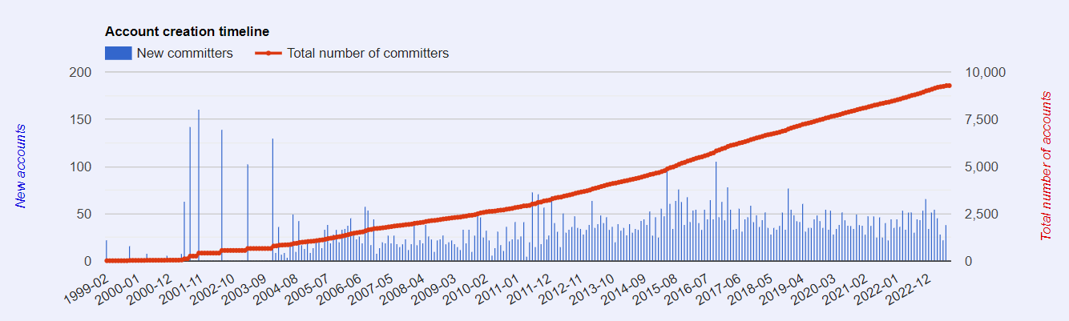
Stream Processing
Apache

Slide 14






Stream Processing
Apache
336 projects

Slide 15
Stream Processing
Apache
Description
Hadoop = HDFS + MapReduce (Store + Process)
Open source implementation of big data
Used for large-scale, massively parallel and distributed data processing
Advantages:
Highly fault tolerant
Large-scale
Lowcost
Open source
Complex data analytics
Storage flexibility (unstructured, semi-structured)
Widely accepted in the industry
Impressive benchmarks
Usecases:
Searching / text mining
Log processing
Archiving
Video and image analysis
Graph creation and analyses
https://hadoop.apache.org/

Slide 16
Stream Processing
Apache
https://projects.apache.org/project.html?spark
Description:
Highly scalable in-memory data analytics system
Advantages:
Fast processing (in-memory)
Flexibility
Complex analytics
Same API for batch and stream, easy to switch between both
Micro-batching (many little tasks splited)
Usecases:
Machine learning with MLlib (ML)
Visualization with Spark GraphX
Database queries with Spark SQL
Stream processing (with data sources like for example : Kafka, HDFS, Flume …)

Slide 17
Stream Processing
Apache
Description:
Distributed, real-time and data processing platforms
Made for processing large amount of data in real time in a highly scalable maner
Storm is for real-time processing what Hadoop is for batch processing
Advatages:
Fast
Horizontally scalable
Fault tolerant
Guaranteed data processing
Easy to operate
Usecases:
Stream processing
Continuous computation
Distributed RPC
Real-time analytics

Slide 18
Stream Processing
Apache
Kosten: Lambda billiger bei geringem Datenfluss
Implementierung: Lambda ist einfacher aufzusetzen
Robustheit: Lambda ist robuster, weil Speed Layer kann Fehler in einem Durchlauf machen (Batch korrigiert Speed)
Fehlerbehebung: Kappa schwieriger, da du dein System nicht „stoppen“ kannst
Art von ML: Lambda für ML-Ansätze mit historischen Daten (supervised) und Kappa für eingehende Daten (semi-supervised)
Anforderungen von Consumern: Kappa, wenn Consumer eher Livedaten benötigen und die alten Daten interessieren die nicht z.B. Börse
Größe der Datenströme: Kappa verarbeitet eher die größeren Datenströme
Komplexität der Daten: Lambda besser bei komplexeren Berechnungen
Skalierbarkeit: Kappa einfacher zu skalieren (da nicht viele Layers)
Notwendigkeit der Historischen Daten im Berechnungsprozess: Lambda
Ressourcen: Lambda ist Ressourcenschonender (Hardwaretechnisch), wegen dem Batch Layer

Slide 19
Literatur
Seite 1/1
Zuweisung Service zu Architekturen
Inhalt / Inhaltsverzeichnis, was kommt alles vor… ? (Vitali)
Grundlegende Architekturen (OLTP / OLAP) (Vitali)
Geschichte von stream-processing (Vitali)
Lambda (Allgemein) (Vitali)
Toolsüberblick / Services für Lambda (Vitali)
Anwendungsfall für Lambda (Vitali)
Kappa (Allgemein) (Vladislav)
Toolsüberblick / Services für Kappa (Vladislav)
Anwendungsfall für Kappa (Vladislav)
Lambda vs Kappa und sonstige Architekturen (Blick in die Gegenwart) (Vladislav)
Zusammenfassung / Outro (Vladislav)
Kafka(Vlad), Spark(Vitali), Flink(Vlad), Hadoop(Vitali), Apache und andere (Vitali)
Welche sind erwähnenswert?
Tool darstellen und Begriffe wie z.B. Broker nutzen usw.
Draw.io
ZUSATZ:
Unser Anwendungsfall (Vladislav) / (Vitali) git

Slide 20
Literatur
Seite 1/1
1. Hueske, F., & Kalavri, V. (2019). Stream Processing with Apache Flink Fundamentals, Implementation, and Operation of Streaming Applications. O’Reilly Media.
2. Marz, N. (2015). Big Data (p. 308). Manning.
3. Kleppmann, M. (2017). Designing Data-Intensive Applications: The Big Ideas Behind Reliable, Scalable, and Maintainable Systems (p. 624). O’Reilly Media.

