Slide 1


SYMBIOSIS INSTITUTE OF TECHNOLOGY, NAGPUR
Predictive Analytics · CA3 — End-to-End Predictive Model Development
Predicting EV Charging Station Demand
Applying the KDD process to estimate average daily users per station
Vladlen Rebello
PRN: 23070521170
Faculty: Deepak Suresh Asudani, Ph.D, Assistant Professor
Computer Science and Engineering · Batch 2023-27 · Semester 7
Notes:
Introduce yourself and the project: predicting how many users per day an EV charging station will get, using the KDD process taught in the course.

Slide 2



Problem Statement
Can we predict how busy an EV charging station will be from its location, configuration and pricing?
Target variable
Usage Stats (avg users/day)
Why it matters
EV adoption is growing quickly and stations are expensive to build
A badly placed station sits idle; an under-sized one creates queues
A demand estimate helps operators choose sites, charger types and prices
Problem type
Supervised regression (predicting a number)
Success criterion
Beat a baseline that always predicts the average
Notes:
State the business question. The target is average users per day, so this is a regression problem. Success means beating a simple baseline that always predicts the average, otherwise the model adds no value.

Slide 3




Dataset: Detailed EV Charging Stations
5,000
17
0
0
charging stations
attributes
missing values
duplicate rows
Location
Hardware
Service
Usage & feedback
Latitude, longitude, address, distance to city
Charger type, capacity (kW), connector types, parking spots
Cost per kWh, opening hours, operator, renewable energy, maintenance
Avg users/day (target), review rating, installation year
Source: Kaggle, 2025 · file: detailed_ev_charging_stations.csv
Notes:
The dataset has 5,000 stations worldwide and 17 columns. Group them: location, hardware, service and usage. The target is average users per day. It is complete: no missing values or duplicates.

Slide 4
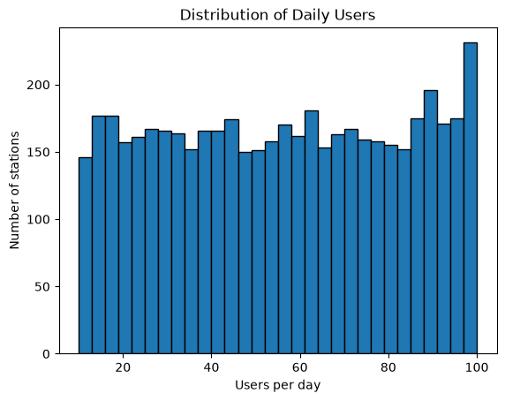
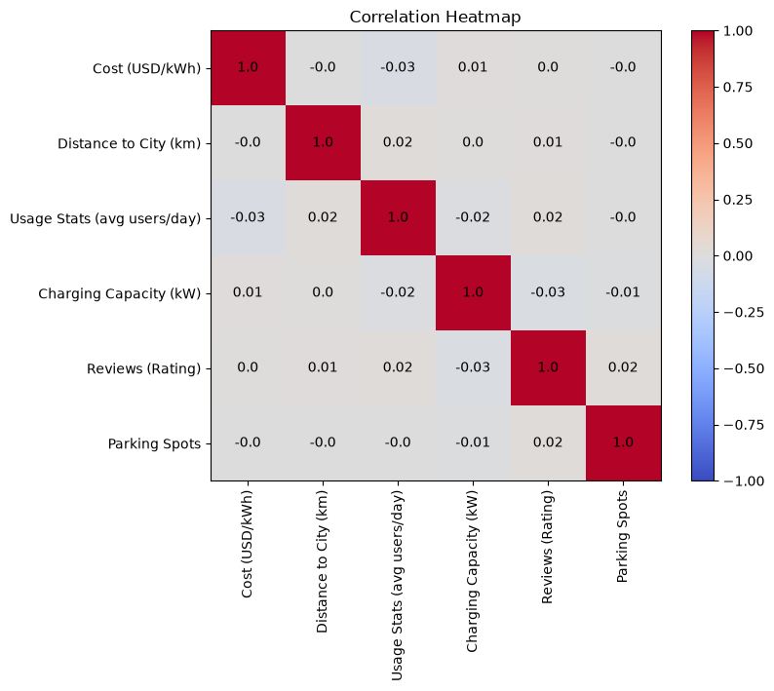
Data Understanding: Exploratory Analysis
Key findings
No outliers in any numeric column
No feature is correlated with usage
Usage is almost the same for every charger type, operator and opening hours
Daily users spread evenly from 10 to 100 (mean ≈ 55)
Every correlation with usage is close to 0 (|r| < 0.035)
Notes:
The target is spread evenly between 10 and 100 users per day. The heatmap shows all correlations with usage are near zero. This is the first sign that the features may not predict usage.

Slide 5

Preprocessing: Data Quality Check
Charger type vs charging capacity (number of stations)
Charger type | 22 kW | 50 kW | 150 kW | 350 kW
AC Level 1 | 401 | 384 | 418 | 435
AC Level 2 | 406 | 479 | 431 | 448
DC Fast | 398 | 393 | 434 | 373
The data looks synthetic
Impossible charger / capacity combinations
Same average cost (≈ $0.30/kWh) for every charger type
500 placeholder addresses ("Random Rd, City 98, Country")
Every category almost perfectly balanced
Real AC Level 1 chargers deliver only ≈ 2 kW, yet 435 are listed at 350 kW.
Standard cleaning: nothing to fix
0 missing values · 0 duplicates · 0 outliers (box plots)
Notes:
Beyond missing values, I checked the data against domain knowledge. AC Level 1 chargers cannot deliver 350 kW, and fast charging normally costs more. Together with placeholder addresses, this suggests the data was randomly generated. I recorded this as a key risk.

Slide 6
Data Transformation Pipeline
1
2
3
4
5
Drop columns
Feature engineering
One-hot encoding
Train / test split
Scaling
Station ID, address, latitude and longitude
New Station Age = 2025 − installation year
6 text columns → 32 numeric input features
80% train (4,000)
20% test (1,000)
StandardScaler fitted on training data only
Why scale after splitting? Fitting the scaler on training data only stops test-set information leaking into the model.
Notes:
Five transformation steps: remove columns with no predictive meaning, create Station Age, one-hot encode the categorical columns to get 32 features, split 80/20, and scale. The scaler is fitted on training data only to avoid leakage.

Slide 7




Predictive Modelling Approach
Four regression algorithms of increasing flexibility, all compared against a simple baseline
Baseline
Linear Regression
K-Nearest Neighbours
Decision Tree
Random Forest
Always predicts the training average
Fits a straight-line relationship
Averages the 15 most similar stations
Learns if / else rules (depth 5)
100 trees averaged (depth 8)
The minimum bar a model must beat
Simple and interpretable
Captures similarity patterns
Captures non-linear rules
Robust, lower variance
Notes:
I chose four algorithms from simple to flexible: linear, distance-based, rule-based, and an ensemble. If even Random Forest cannot beat the baseline, the problem is the data, not the model choice.

Slide 8
Model Development
Data split
Model settings
Train 80% · 4,000
Test 20%
Model | Key settings
Baseline | Predict training mean
Linear Regression | Default
KNN | k = 15 neighbours
Decision Tree | max_depth = 5
Random Forest | 100 trees, max_depth = 8
random_state = 42 for reproducible results
Training loop (Python, scikit-learn)
for name, model in models.items():
model.fit(X_train_scaled, y_train)
pred = model.predict(X_test_scaled)
r2 = r2_score(y_test, pred)
mae = mean_absolute_error(y_test, pred)
Depth limits keep the trees from memorising noise.
Notes:
Every model is trained on the same 4,000 scaled training rows and tested on the same 1,000 unseen rows. The tree models have depth limits to reduce overfitting.

Slide 9
Evaluation of the Model
Test-set results (1,000 unseen stations)
R²
Share of variation explained
1 = perfect, 0 = no better than the average
Model | R² | MAE | RMSE
Baseline (mean) | -0.001 | 22.81 | 26.43
Linear Regression | -0.002 | 22.81 | 26.44
KNN | -0.040 | 23.03 | 26.94
Decision Tree | -0.034 | 22.95 | 26.85
Random Forest | -0.000 | 22.75 | 26.42
MAE
Mean absolute error
Average miss in users/day (lower is better)
RMSE
Root mean squared error
Like MAE, but penalises big misses more
Best model: Random Forest, but only 0.01 users/day better than the baseline.
Notes:
Explain the three metrics briefly. Then the table: Random Forest has the lowest error, but the baseline is almost identical. KNN and the Decision Tree are slightly worse than the baseline because they fit noise.

Slide 10
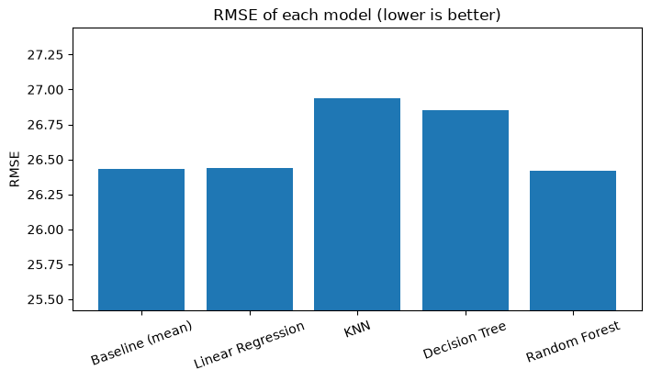
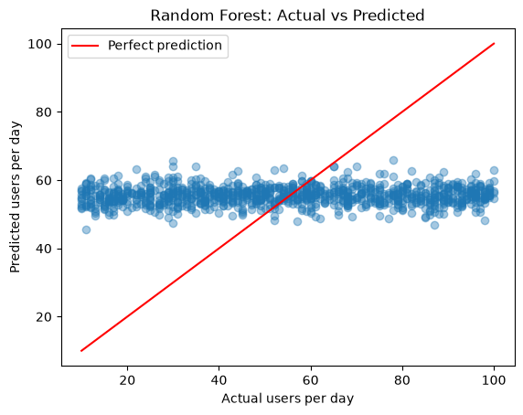
Results: No Model Beats the Average
R² ≈ 0
for every model
Random Forest predictions sit in a flat band around 55 users/day, whatever the actual value. The model has learned to predict the average.
Axis zoomed in to show the tiny differences between models
Notes:
All bars are almost the same height: every model is within about half a user per day of the baseline. In the scatter plot, predictions form a flat band at about 55. The model is effectively predicting the average.

Slide 11
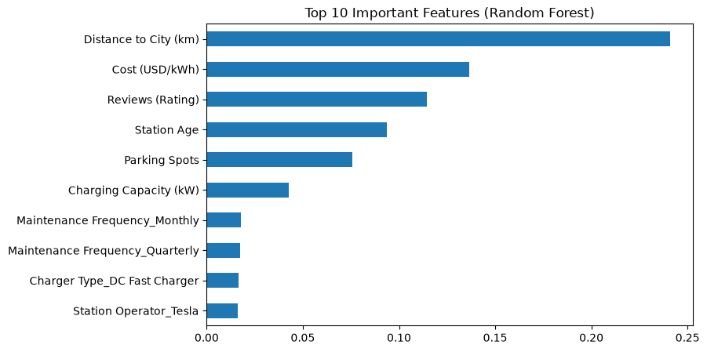



Interpretation: Why the Models Fail
Consistent evidence
EDA, four different models and the data quality check all point the same way
Root cause: the data
Features are random and independent of usage, so there is no pattern to learn
Distance, cost and rating rank highest, but only because numeric columns offer more split points. They are not real demand drivers.
Value of KDD
The process caught the problem early and the baseline stopped a misleading claim
Notes:
Feature importance should not be over-read: when the model is no better than the baseline, importances only show which columns the trees split on. Everything points to the data: the attributes are random, so no algorithm could find a pattern. KDD worked as intended by exposing this.

Slide 12
Conclusion
A model is only as good as its data
What was done
What was found
What it means
Applied every KDD stage: selection, preprocessing, transformation, modelling and evaluation
Best model (Random Forest) RMSE 26.42 vs 26.43 baseline; R² ≈ 0 for all models
The dataset appears synthetic, so station demand cannot be predicted from it
Future work
Use real charging-session data (e.g. open city EV charging datasets)
Add context: population density, EV registrations, traffic, nearby shops
Forecast demand over time once time-stamped data is available
Notes:
Summarise: every KDD stage was applied. No model beat the baseline, because the data appears to be randomly generated. The key lesson is that better data, not a more complex algorithm, is needed. The same pipeline can be reused on real data. Thank the audience and invite questions.

