Slide 1
OVS – Receive Packet function trace
geneve_rcv || gre_rcv || internal_dev_xmit || lisp_rcv || netdev_port_receive || stt_rcv || vxlan_rcv
void ovs_vport_receive (struct vport *vport, struct sk_buff *skb, const struct ovs_tunnel_info *tun_info)
void ovs_dp_process_packet (struct sk_buff *skb, struct sw_flow_key *key)
struct sw_flow *ovs_flow_tbl_lookup_stats (struct flow_table *tbl, const struct sw_flow_key *key, u32 skb_hash, u32 *n_mask_hit)
static struct sw_flow *flow_lookup (struct flow_table *tbl, struct table_instance *ti,
const struct mask_array *ma, const struct sw_flow_key *key, u32 *n_mask_hit, u32 *index)
static struct sw_flow *masked_flow_lookup (struct table_instance *ti, const struct sw_flow_key *unmasked,
const struct sw_flow_mask *mask, u32 *n_mask_hit)
LOOKUP HIT
LOOKUP MISS
int ovs_execute_actions (
struct datapath *dp,
struct sk_buff *skb,
const struct sw_flow_actions *acts,
struct sw_flow_key *key)
int ovs_dp_upcall (struct datapath *dp, struct sk_buff *skb,
const struct sw_flow_key *key,
const struct dp_upcall_info *upcall_info)
1

Slide 2
OVS – Transmit packet function trace
1
static void process_deferred_actions (struct datapath *dp)
static int do_execute_actions (struct datapath *dp, struct sk_buff *skb, struct sw_flow_key *key,
const struct nlattr *attr, int len)
static void do_output (struct datapath *dp, struct sk_buff *skb, int out_port)
int ovs_vport_send (struct vport *vport, struct sk_buff *skb)
geneve_tnl_send || gre_send || internal_dev_recv || lisp_send || netdev_send || stt_tnl_send || vxlan_tnl_send
int rpl_vxlan_xmit_skb (struct vxlan_sock *vs, struct rtable *rt, struct sk_buff *skb, __be32 src, __be32 dst, __u8 tos, __u8 ttl, __be16 df, __be16 src_port, __be16 dst_port, struct vxlan_metadata *md, bool xnet, u32 vxflags)
static inline struct rtable *find_route (struct net *net, __be32 *saddr, __be32 daddr, u8 ipproto, u8 tos, u32 skb_mark)
int rpl_ip_local_out (struct sk_buff *skb) → static int output_ip(struct sk_buff *skb)
int rpl_iptunnel_xmit (struct sock *sk, struct rtable *rt, struct sk_buff *skb, __be32 src, __be32 dst, __u8 proto, __u8 tos, __u8 ttl, __be16 df, bool xnet)
int rpl_udp_tunnel_xmit_skb (struct rtable *rt, struct sk_buff *skb, __be32 src, __be32 dst, __u8 tos, __u8 ttl, __be16 df, __be16 src_port, __be16 dst_port, bool xnet, bool nocheck)

Slide 3
OVS Packet receive – ovs_vport_receive()
void ovs_vport_receive(struct vport *vport, struct sk_buff *skb, const struct ovs_tunnel_info *tun_info)
struct vport {
struct rcu_head rcu;
struct datapath *dp;
struct vport_portids __rcu *upcall_portids;
u16 port_no;
struct hlist_node hash_node;
struct hlist_node dp_hash_node;
const struct vport_ops *ops;
struct pcpu_sw_netstats __percpu *percpu_stats;
struct vport_err_stats err_stats;
struct list_head detach_list;
};
/**
* struct vport - one port within a datapath
* @rcu: RCU callback head for deferred destruction.
* @dp: Datapath to which this port belongs.
* @upcall_portids: RCU protected 'struct vport_portids'.
* @port_no: Index into @dp's @ports array.
* @hash_node: Element in @dev_table hash table in vport.c.
* @dp_hash_node: Element in @datapath->ports hash table in datapath.c.
* @ops: Class structure.
* @percpu_stats: Points to per-CPU statistics used and maintained by vport
* @err_stats: Points to error statistics used and maintained by vport
* @detach_list: list used for detaching vport in net-exit call.
*/
struct sk_buff;
struct ovs_tunnel_info {
struct ovs_key_ipv4_tunnel tunnel;
const void *options;
u8 options_len;
};

Slide 4
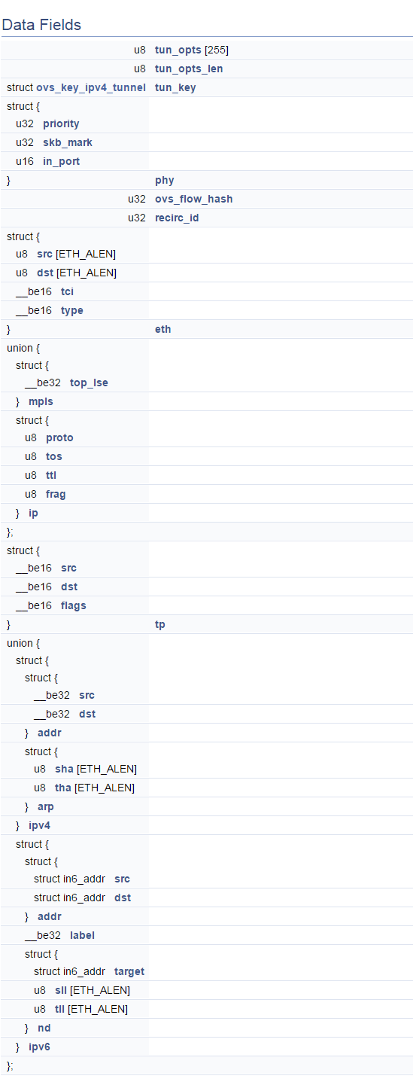
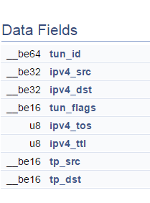
OVS Packet receive – ovs_dp_process_packet
void ovs_dp_process_packet(struct sk_buff *skb,
struct sw_flow_key *key)
struct sk_buff;
struct sw_flow_key

Slide 5
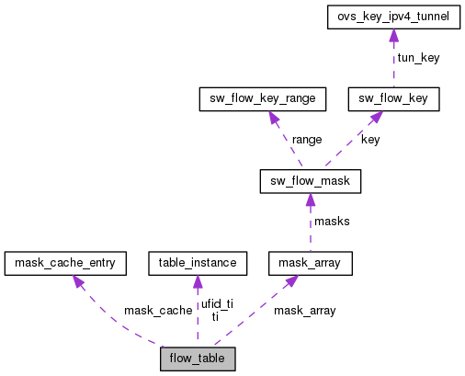
OVS Packet receive – ovs_dp_process_packet
struct sw_flow *ovs_flow_tbl_lookup_stats(struct flow_table *tbl, const struct sw_flow_key *key,
u32 skb_hash, u32 *n_mask_hit)
struct flow_table {
struct table_instance __rcu *ti;
struct table_instance __rcu *ufid_ti;
struct mask_cache_entry __percpu *mask_cache;
struct mask_array __rcu *mask_array;
unsigned long last_rehash;
unsigned int count;
unsigned int ufid_count;
};

Slide 6
OVS Packet receive – flow_lookup
static struct sw_flow *flow_lookup(struct flow_table *tbl, struct table_instance *ti, const struct mask_array *ma, const struct sw_flow_key *key,
u32 *n_mask_hit,
u32 *index)
struct table_instance {
struct flex_array *buckets;
unsigned int n_buckets;
struct rcu_head rcu;
int node_ver;
u32 hash_seed;
bool keep_flows;
};
struct mask_array {
struct rcu_head rcu;
int count, max;
struct sw_flow_mask __rcu *masks[];
};

Slide 7
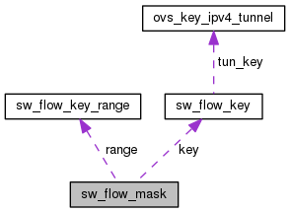
OVS Packet receive – masked_flow_lookup
static struct sw_flow *masked_flow_lookup(struct table_instance *ti, const struct sw_flow_key *unmasked, const struct sw_flow_mask *mask, u32 *n_mask_hit)
struct sw_flow_mask {
int ref_count;
struct rcu_head rcu;
struct sw_flow_key_range range;
struct sw_flow_key key;
};

Slide 8
OVS Packet receive – ovs_execute_actions
int ovs_execute_actions(struct datapath *dp, struct sk_buff *skb, const struct sw_flow_actions *acts, struct sw_flow_key *key)
struct datapath {
struct rcu_head rcu;
struct list_head list_node;
/* Flow table. */
struct flow_table table;
/* Switch ports. */
struct hlist_head *ports;
/* Stats. */
struct dp_stats_percpu __percpu *stats_percpu;
#ifdef CONFIG_NET_NS
/* Network namespace ref. */
struct net *net;
#endif
u32 user_features;
};
struct sw_flow_actions {
struct rcu_head rcu;
u32 actions_len;
struct nlattr actions[];
};

Slide 9
OVS Packet transmit – deferred actions to process packet
static void process_deferred_actions(struct datapath *dp)
static int do_execute_actions(struct datapath *dp, struct sk_buff *skb,
struct sw_flow_key *key,
const struct nlattr *attr, int len)
static void do_output(struct datapath *dp, struct sk_buff *skb, int out_port)

Slide 10
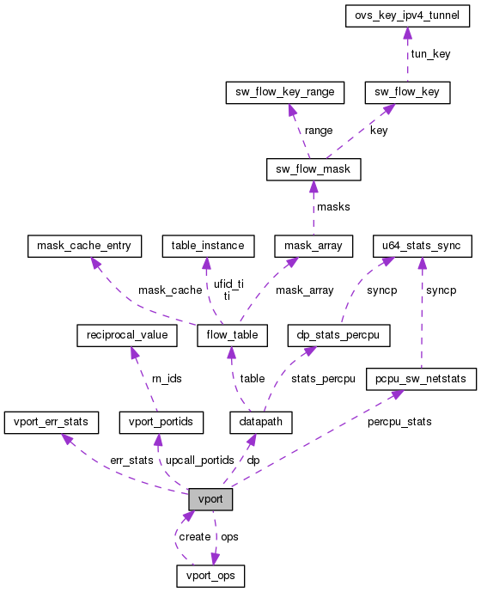
OVS Packet transmit –ovs_vport_send
int ovs_vport_send(struct vport *vport, struct sk_buff *skb)
struct vport {
struct rcu_head rcu;
struct datapath *dp;
struct vport_portids __rcu *upcall_portids;
u16 port_no;
struct hlist_node hash_node;
struct hlist_node dp_hash_node;
const struct vport_ops *ops;
struct pcpu_sw_netstats __percpu *percpu_stats;
struct vport_err_stats err_stats;
struct list_head detach_list;
};
/**
* struct vport - one port within a datapath
* @rcu: RCU callback head for deferred destruction.
* @dp: Datapath to which this port belongs.
* @upcall_portids: RCU protected 'struct vport_portids'.
* @port_no: Index into @dp's @ports array.
* @hash_node: Element in @dev_table hash table in vport.c.
* @dp_hash_node: Element in @datapath->ports hash table in datapath.c.
* @ops: Class structure.
* @percpu_stats: Points to per-CPU statistics used and maintained by vport
* @err_stats: Points to error statistics used and maintained by vport
* @detach_list: list used for detaching vport in net-exit call.
*/

Slide 11
OVS Packet transmit – vxlan send
static int vxlan_tnl_send(struct vport *vport, struct sk_buff *skb)
static inline struct rtable *find_route(struct net *net, __be32 *saddr, __be32 daddr, u8 ipproto, u8 tos, u32 skb_mark)
int rpl_vxlan_xmit_skb(struct vxlan_sock *vs,
struct rtable *rt, struct sk_buff *skb,
__be32 src, __be32 dst, __u8 tos, __u8 ttl, __be16 df,
__be16 src_port, __be16 dst_port,
struct vxlan_metadata *md, bool xnet, u32 vxflags)
struct rtable
{
struct rtable *rt_next;
__u32 rt_dst;
__u32 rt_src;
__u32 rt_gateway;
atomic_t rt_refcnt;
atomic_t rt_use;
unsigned long rt_window;
atomic_t rt_lastuse;
struct hh_cache *rt_hh;
struct device *rt_dev;
unsigned short rt_flags;
unsigned short rt_mtu;
unsigned short rt_irtt;
unsigned char rt_tos;
};

