Slide 1
Final Project Presentation
03/11/2018
Group 1

Slide 2
Summary
Organization and plan
Results and experiences
Design overview
Component diagram
Static structure
Dynamic structure
Implementation and testing
Software demonstration
Questions and discussion

Slide 3
Organization and plan
Organization:
Meetings almost every week to coordinate and plan work.
Microsoft Teams was used for communication, sharing of files and communication progress of the work.
GitHub was used to host the project repository.
Trello was never used during the project.

Slide 4
Organization and plan
Planning:
Divided into four phases: planning, design, implementation and project analysis.
Planning: agree on a project plan and write it down.
Design: design UML diagrams, agreeing on the UI, sketching the UI and write down an initial design document.
Implementation: implement the system, test the system and update the design document.
Project analysis: analyze the result of the project and write a project analysis report.

Slide 5
Results and experiences
Project plan
Design document
Initial implementation
Complete implementation
Project analysis

Slide 6
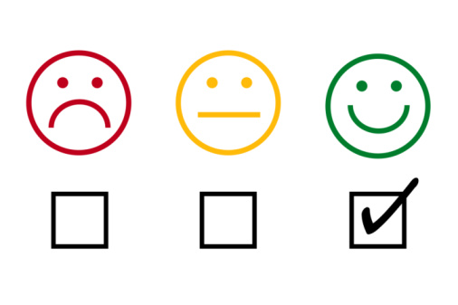
Results and experiences
Positive experiences
Improved possibilities

Slide 7
Design overview
Component diagram
Static structure – main functionality
Dynamic structure

Slide 8
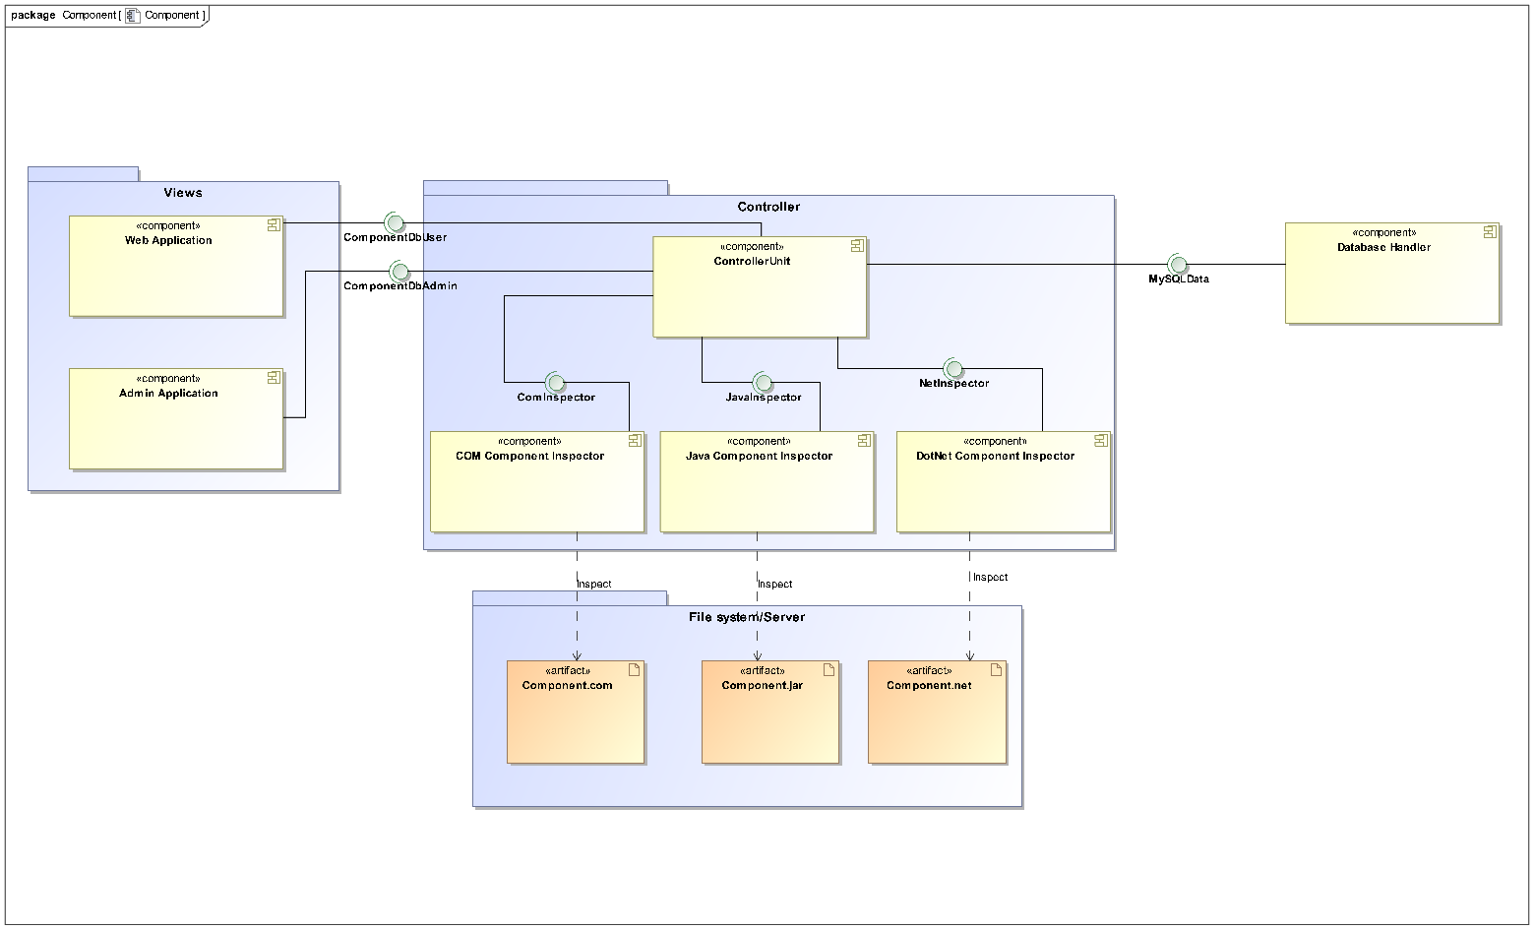
Component diagram

Slide 9
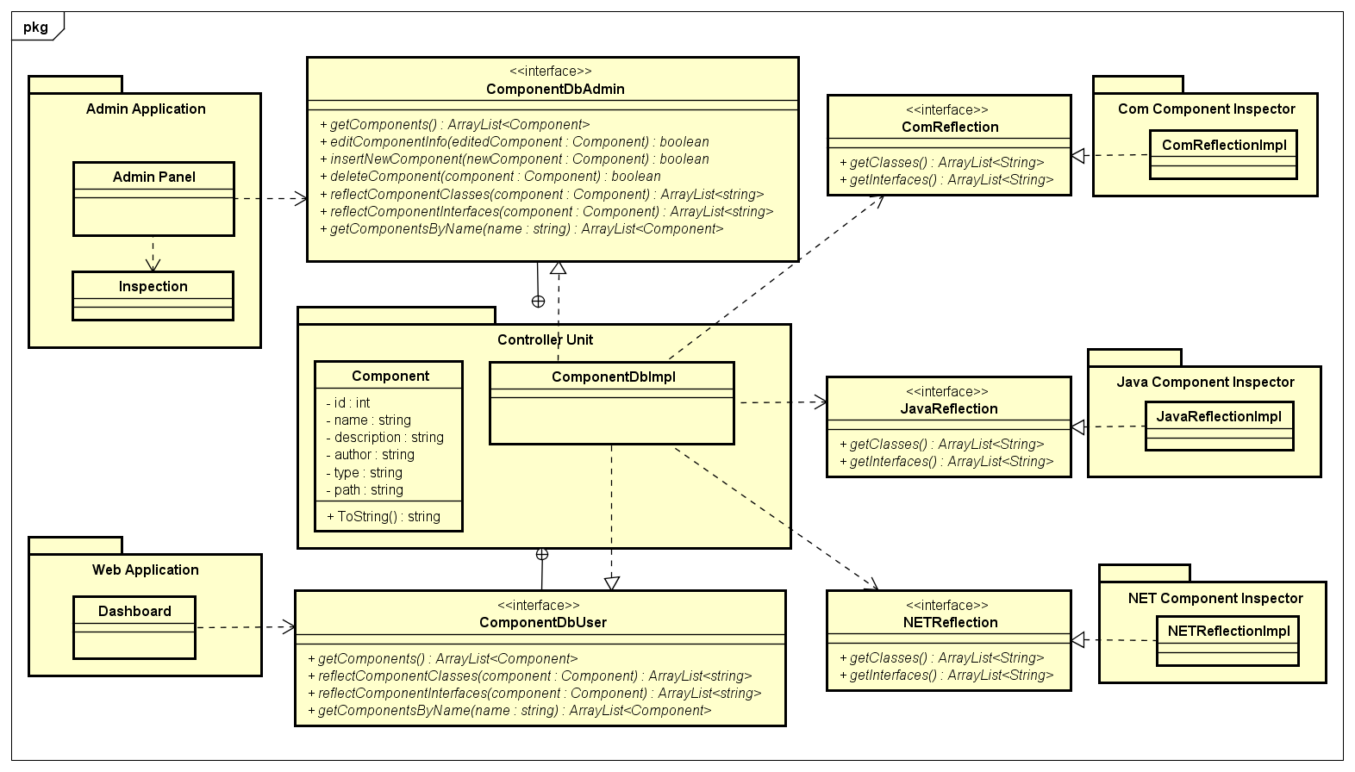
Static structure – main functionality

Slide 10
Dynamic Structure – search

Slide 11
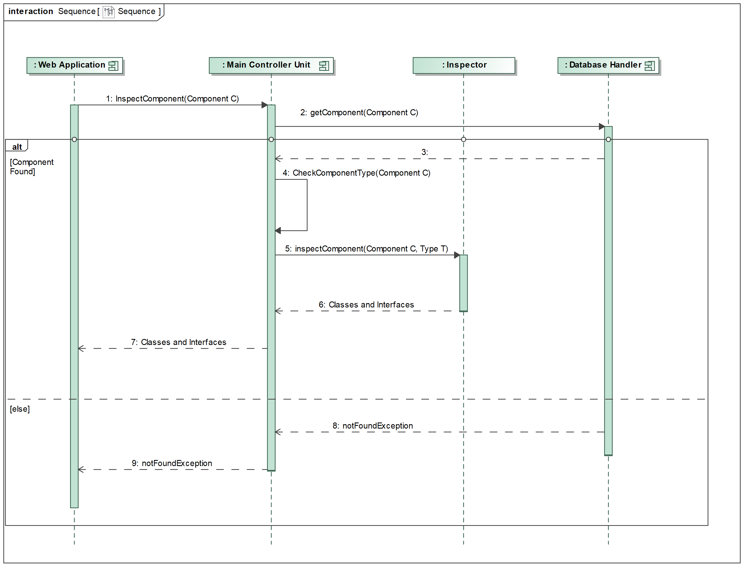
Dynamic Structure – inspect and admin

Slide 12
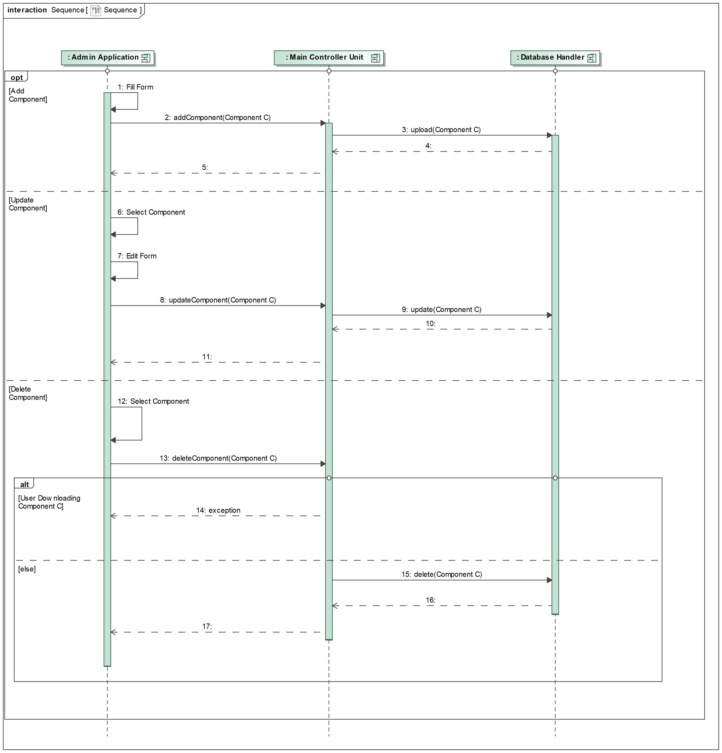
Dynamic structure - admin

Slide 13
Implementation
Applications :
Desktop application, in C#, used by the admin.
ASP .NET application, for the client, using a CSS/JS framework called Materialize for the UI.
Both use a different interface to communicate with the controller unit.
Reflection :
For Java, IKVM.NET allows the use of Java code direcly on .NET.
For COM, the LoadTypeLibEx function is used and its result is send direclty to the .NET part.

Slide 14
Testing
Component Testing :
For both COM and Java inspection component, the tests were done in program where only one is used to inspect a component with some classes and interfaces.
Application Testing :
A complete test of each functionality of each application, was done.
A functionality was choose, it's expected outcome was known, if the actual outcome match the test PASS.
The complete list of the tests is available on the project repository.

Slide 15

Software demonstration

Slide 16

Questions

