Slide 1
Final Project Presentation
03/11/2018
Group 1

Slide 2
Summary
Organization and plan
Results and experiences
Design overview [Vladimir]
Component diagram
Static structure – main functionality
Implementation and testing
Dynamic structure - interaction between applications and components
Software demonstration [Vladimir]
Questions and discussion

Slide 3
Design overview
Component diagram
Static structure – main functionality

Slide 4
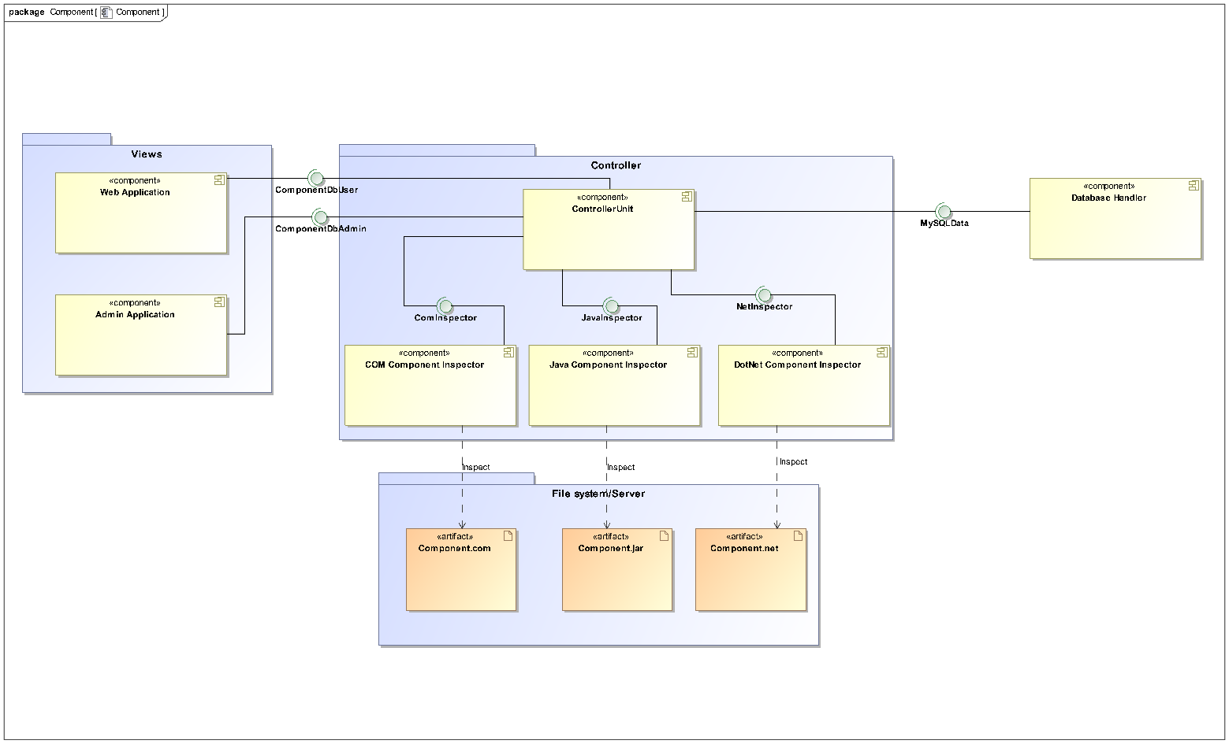
Component diagram

Slide 5
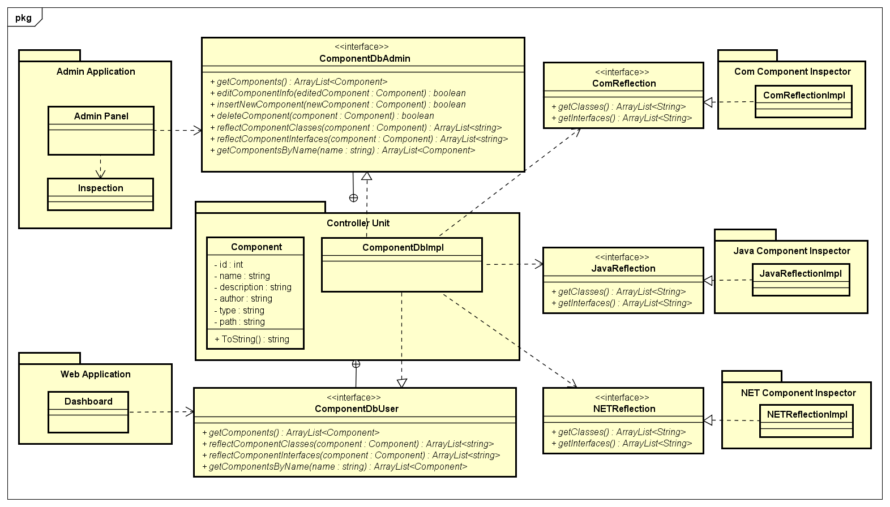
Static structure – main functionality

Slide 6


Software demonstration [Vladimir]

Slide 7

Questions

