Slide 1
Vladimir Filipović
Mladen Zagarčanin
Dušan Tošić
Sanja Stanišić
Faculty of Mathematics, University of Belgrade
NCD 2011
Digitalization in the Bar County Museum – Pilot project

Slide 2
Outline
Faculty of Mathematics, Universty of Belgrade
NCD 2011
Bar County Museum
Digital asset management
Open source software
FocusOPEN Digital Asset Manager
Pilot project and gained results
Conclusion and future work

Slide 3
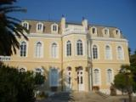
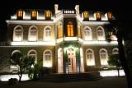
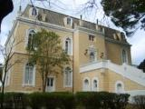
Bar County Museum
Faculty of Mathematics, Universty of Belgrade
NCD 2011
Established 1959
Located in King Nikola’s Palace
Complex type of a museum with archaeological, historic history of art and ethnological collections
In archaeological department are prehistoric, antique, medieval and numismatic collections
In historical department there are collection of medals, collection of old weapons, old books and archive materials and old photos
Museum includes laboratory for conservation and library

Slide 4
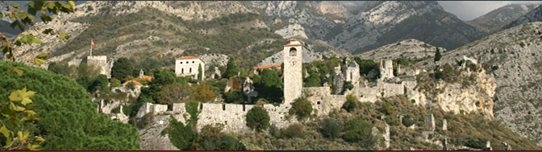
Bar County Museum
Faculty of Mathematics, Universty of Belgrade
NCD 2011
Old town Bar is first-class historical monument
Remains of old town are since 1957. protected by state law
Majority of the town, with more than 600 objects is still unexplored

Slide 5
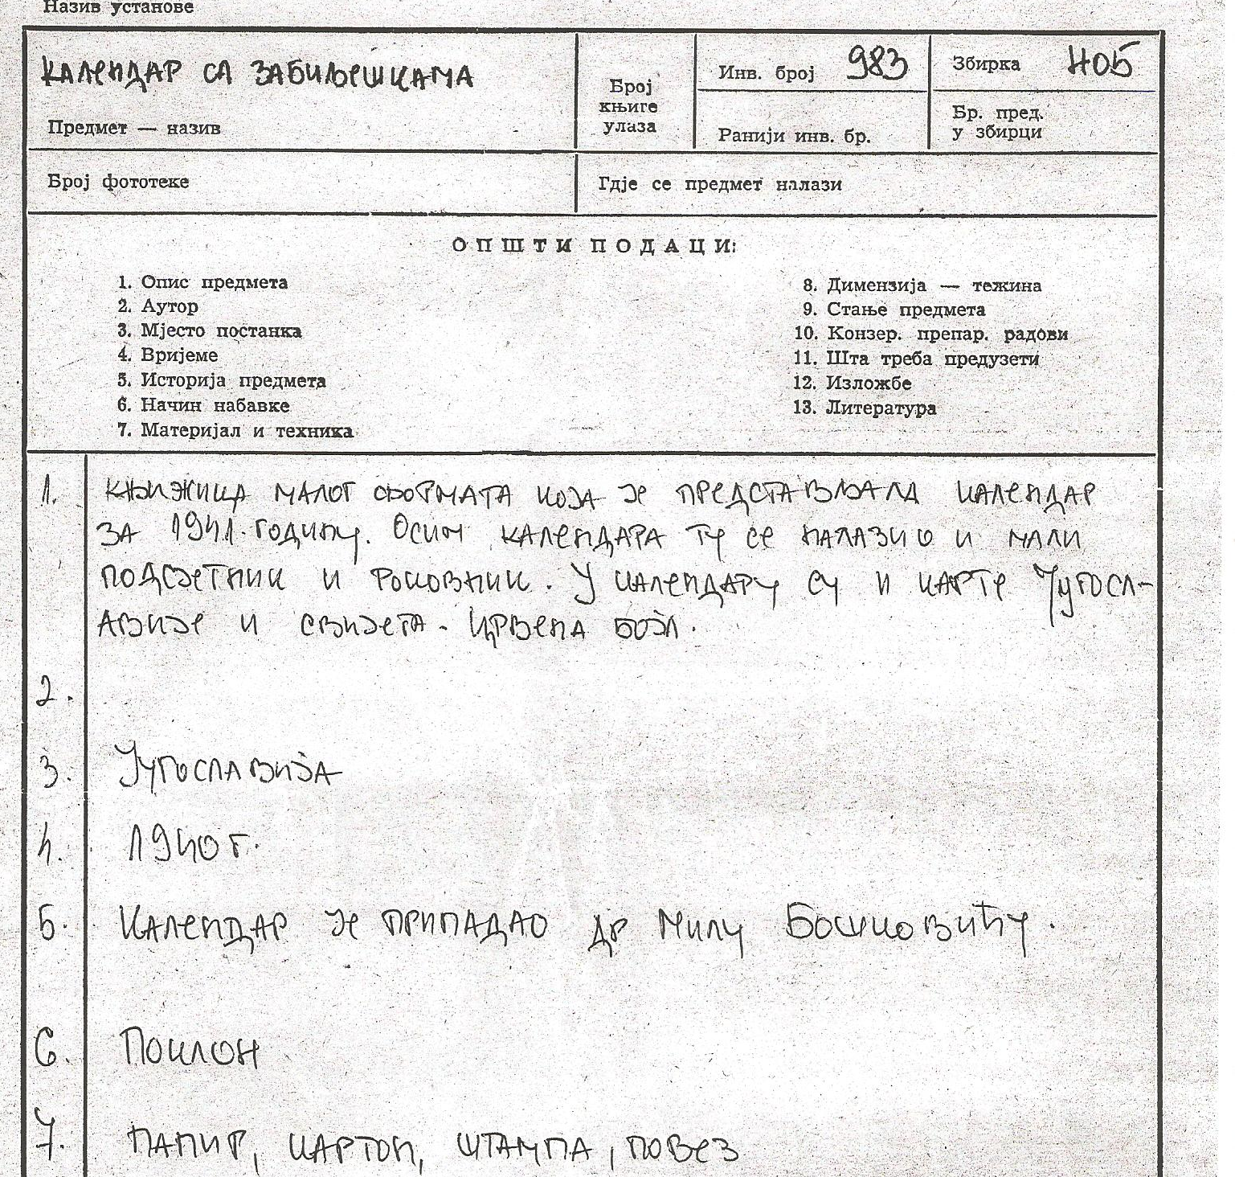
Bar County Museum
Faculty of Mathematics, Universty of Belgrade
NCD 2011
Example of museum catalog document

Slide 6
Digital asset management
Faculty of Mathematics, Universty of Belgrade
NCD 2011
Digital asset management (DAM) consists of management tasks and decisions surrounding the ingestion, annotation, cataloguing, storage, retrieval and distribution of digital assets.
Digital asset management systems (DAMS) include computer software and hardware systems that aid in the process of digital asset management.
Generally the "asset" being managed is collected and stored in a digital format. There is usually a target version - referred to as "essence" - generally the highest-resolution and highest-fidelity representation.

Slide 7
Digital asset management
Faculty of Mathematics, Universty of Belgrade
NCD 2011
The asset is detailed by its metadata. Metadata is the description of the asset and the description depth can vary depending on the needs of the system, designer, or user.
Metadata can describe, but is not limited to, the description of: asset content (what is in the package?); the means of encoding/decoding (e.g. JPEG, tar, MPEG2); provenance (history to point of capture); ownership; rights of access; as well as many others. There exist some pre-defined standards and template for metadata such as Dublin Core and PBCore.
DAM software may be open source or proprietary.

Slide 8
Digital asset management
Faculty of Mathematics, Universty of Belgrade
NCD 2011
DAM software should have following characteristics:
Ability to upload and store digital resources
2. Ability to add various properties to uploaded digital resource
3. Ability to work on the web
4. Advanced Search
5. Powerful Media Processing Features
6. Easy To Use
7. Flexible and Configurable
8. Scalable

Slide 9
Digital asset management
Faculty of Mathematics, Universty of Belgrade
NCD 2011
DAM software should have following characteristics:
9. Possibility of automatic interchange
10. Ability for further changes and improvements
11. Multiple brands under multiple domains in the same core system
12. Single sign-on
13. Streamlined Cataloguing
14. Copyright and Brand Control
15. Comprehensive Statistics and Reporting

Slide 10
Open source software
Faculty of Mathematics, Universty of Belgrade
NCD 2011
There are three main types of software product firms:
1. Closed source firms owns all competitively differentiating software components their products is based on.
2. Single-vendor open source firms also own all competitively differentiating components, but they make some of these components available as open.
3. Open source distributors integrate a large set of open source components and distribute assembly for free. Distributors typically don’t own their components.
Open-source software is computer software that is available in source code form: the source code and certain other rights normally reserved for copyright holders are provided under a software license that permits users to study, change, improve and at times also to distribute the software.

Slide 11
Open source software
Faculty of Mathematics, Universty of Belgrade
NCD 2011
In order to be Open Source, all of the terms below must be applied together, and in all cases:
Free Redistribution
Source Code
Derived Works
Integrity of the Author's Source Code
No Discrimination Against Persons or Groups
No Discrimination Against Fields of Endeavor
Distribution of License
License Must Not Be Specific to a Product
License Must Not Contaminate Other Software

Slide 12
FocusOPEN Digital Asset Manager
Faculty of Mathematics, Universty of Belgrade
NCD 2011
FocusOPEN Digital Asset Manager is a digital asset management solution designed to help businesses make more of their media, from managing brands to distributing marketing collateral or other media assets.
We are working with open source version of FocusOPEN Digital Asset Manager.
FocusOPEN is based on Windows server technology. The main requirements are:
• Windows Server 2003 or 2008
• IIS 6,7 or 7.5
• SQL Server 2005 or 2008
• ASP.NET 3.5

Slide 13
FocusOPEN Digital Asset Manager
Faculty of Mathematics, Universty of Belgrade
NCD 2011
FocusOPEN is delivered using a multi-tier architecture that can be distributed across one or more hosts:
• Web Application: The core ASP.NET DAMS where most of the business logic is contained
• Database: SQL Server RDBMS
• Filesystem: Assets are stored in the file system so any accessible file storage device can be used
• Media Processing: A dedicated Asset Processing Server (APS) is provided as a Windows service
FocusOPEN supports server farms, clustering, redundancy, and other High Availability technology. For storing digital assets, FocusOPEN supports multiple storage points and it is possible to store assets in multiple locations simultaneously without consolidating them.

Slide 14
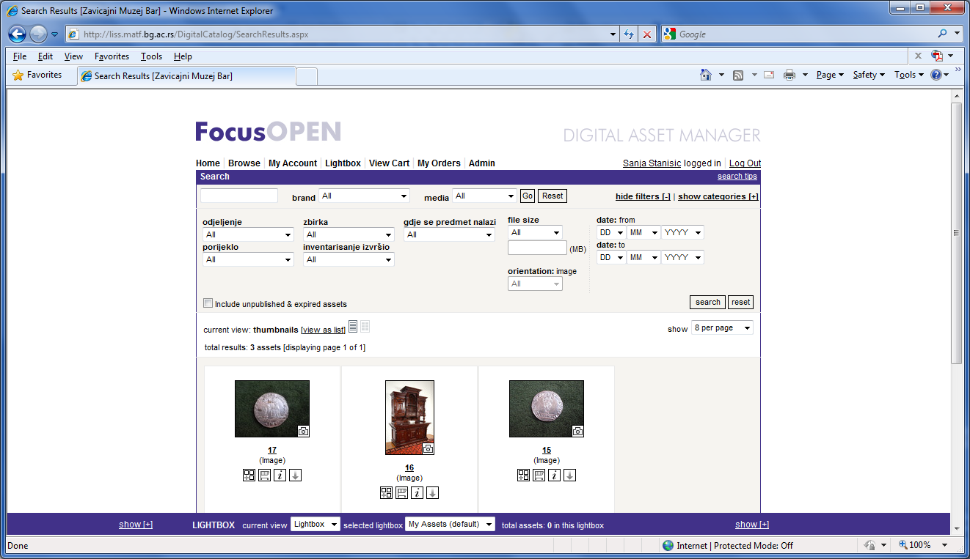
Pilot project
Faculty of Mathematics, Universty of Belgrade
NCD 2011
We configure DAMS based on the FocusOPEN open source software, set it on web server at Faculty of Mathematics and upload and catalogue Bar County Museum digital resources.

Slide 15
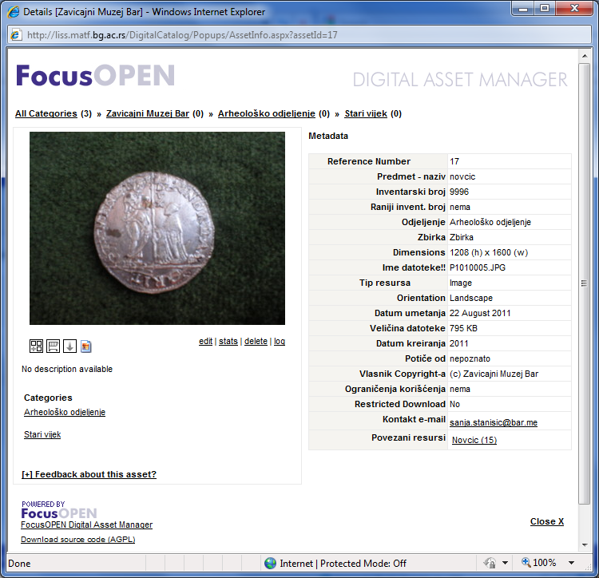
Pilot project
Faculty of Mathematics, Universty of Belgrade
NCD 2011

Slide 16
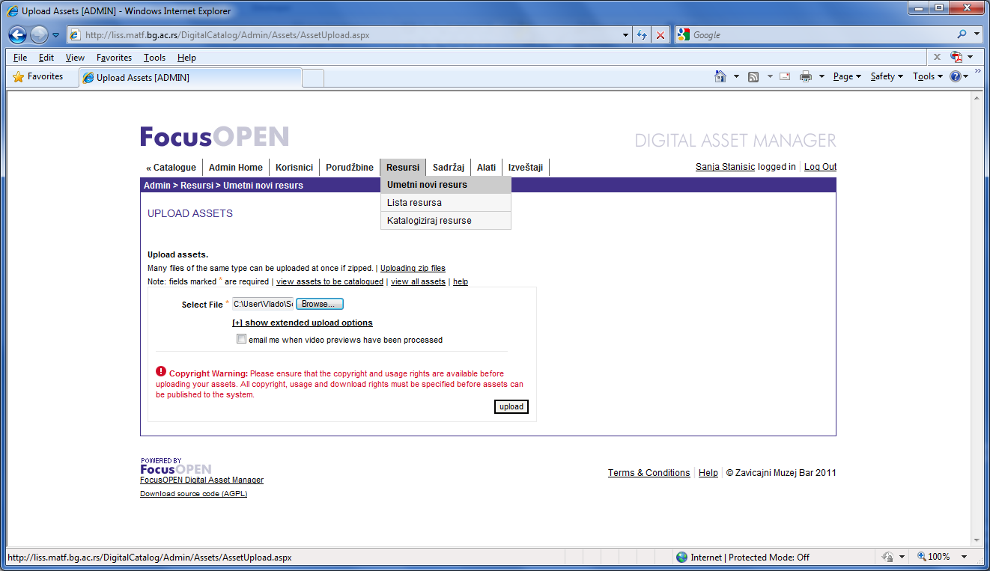
Pilot project
Faculty of Mathematics, Universty of Belgrade
NCD 2011

Slide 17
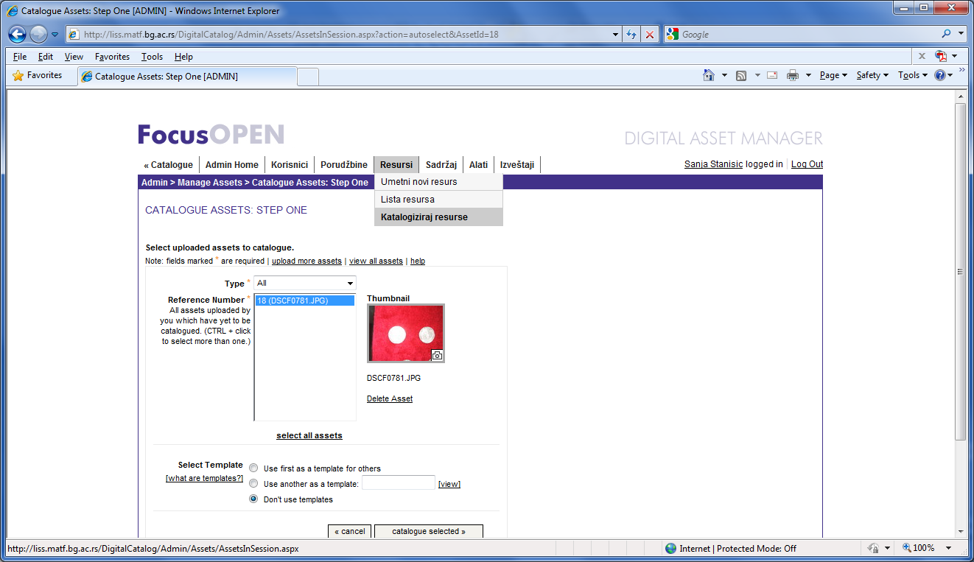
Pilot project
Faculty of Mathematics, Universty of Belgrade
NCD 2011

Slide 18
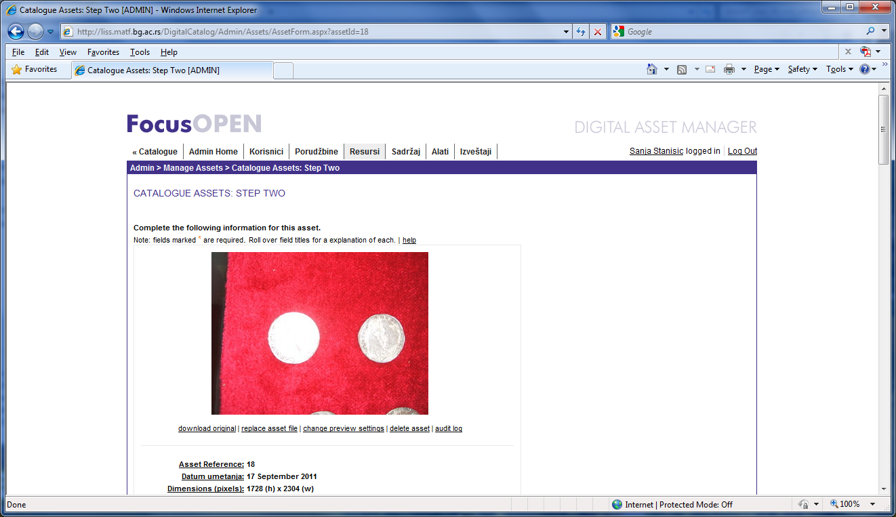
Pilot project
Faculty of Mathematics, Universty of Belgrade
NCD 2011

Slide 19
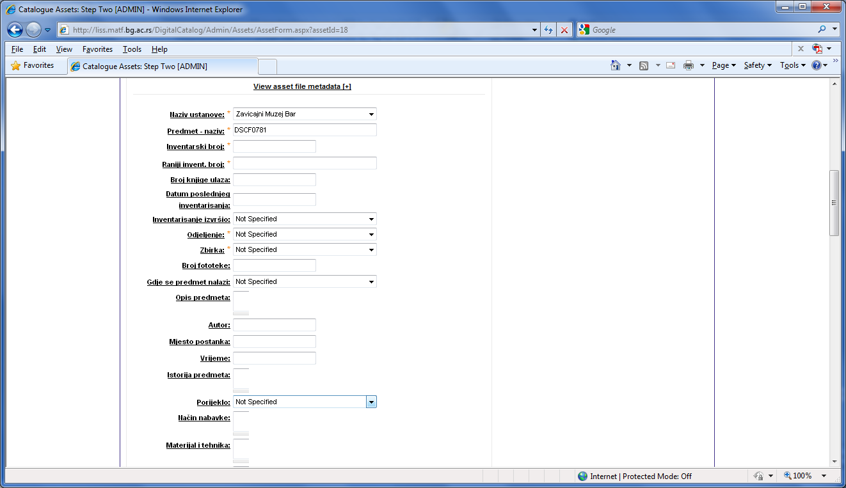
Pilot project
Faculty of Mathematics, Universty of Belgrade
NCD 2011

Slide 20
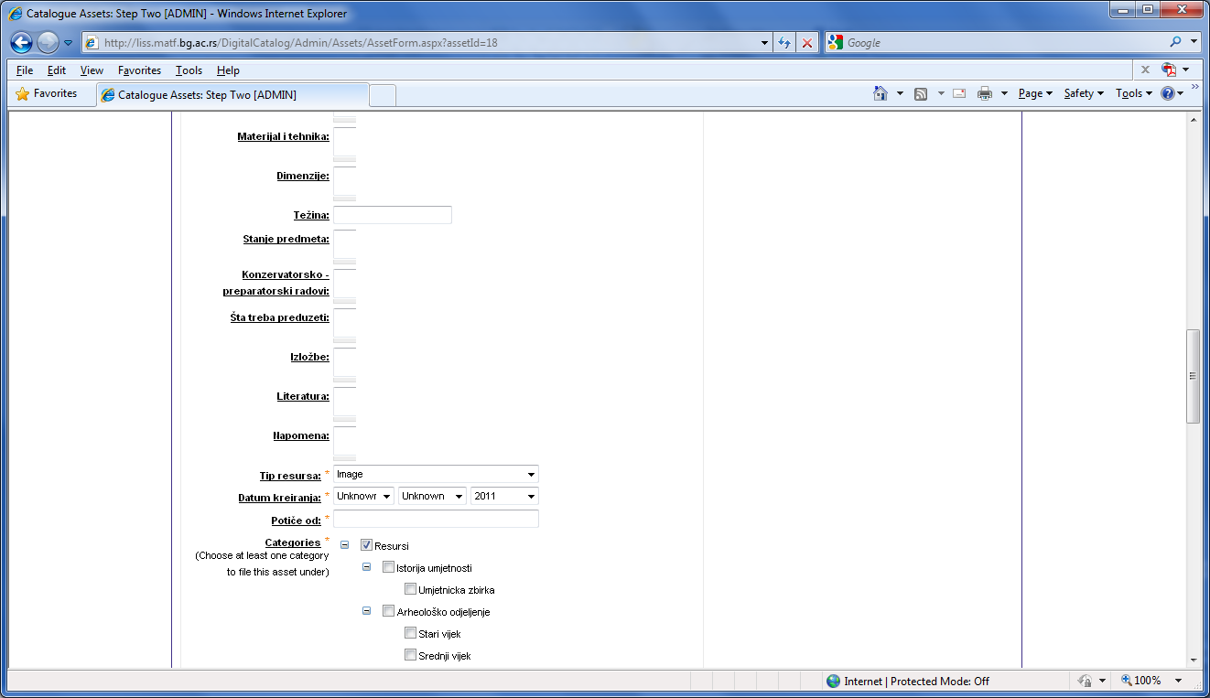
Pilot project
Faculty of Mathematics, Universty of Belgrade
NCD 2011

Slide 21
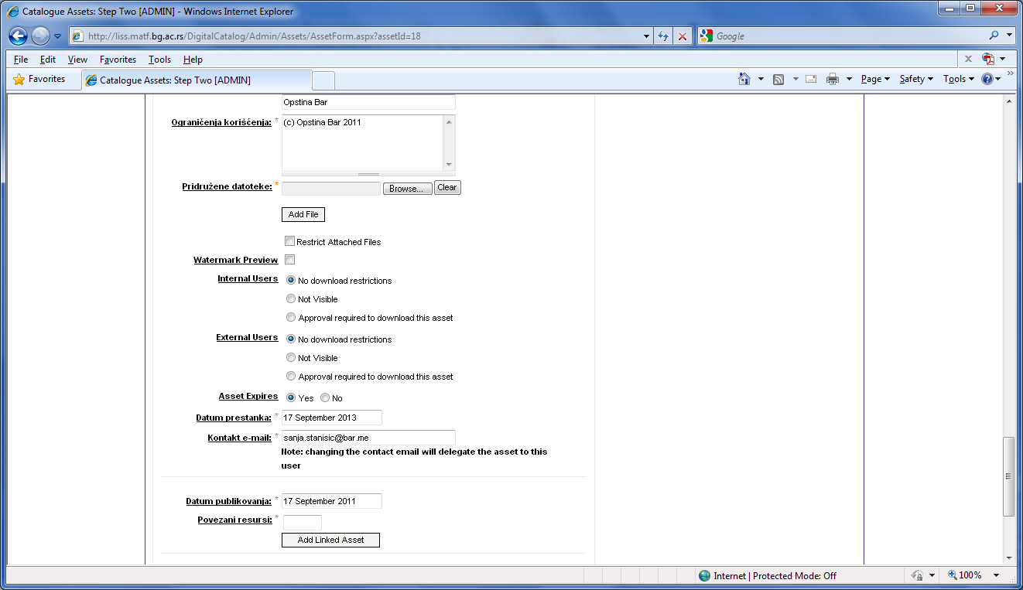
Pilot project
Faculty of Mathematics, Universty of Belgrade
NCD 2011

Slide 22
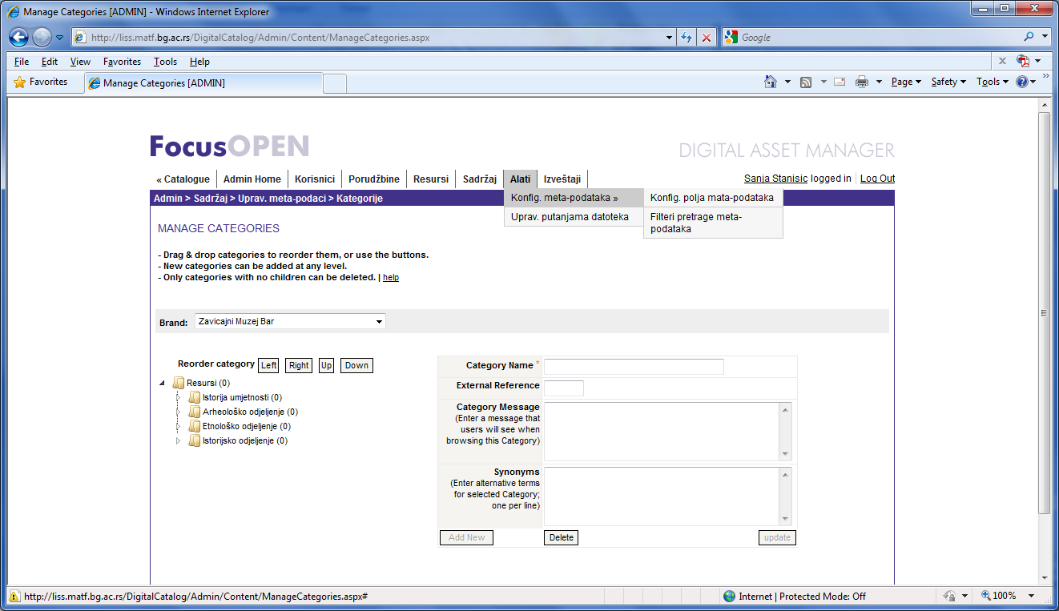
Pilot project
Faculty of Mathematics, Universty of Belgrade
NCD 2011

Slide 23
Conclusions and future work
Faculty of Mathematics, Universty of Belgrade
NCD 2011
Pilot project shows that open source software for DAM FocusOPEN can be successfully in Bar County Museum digital resource management.
Now, when pilot project is successfully finished, we are going to upgrade and localize FocusOPEN open source system and translate all user interfaces to Serbian.
In order to do so and not breach license agreement, we are going to set a repository for modified source code and make that repository accessible from every web page of modified solution.
Assets that are already uploaded into DAMS will be preserved – changes of the software will not destroy previously uploaded assets and current metadata

Slide 24
Thank you!
Faculty of Mathematics, Universty of Belgrade
NCD 2011
My e-mail address is
vladaf@matf.bg.ac.rs

