Slide 1
Online-Store
Vladimir Iliev №82167

Slide 2
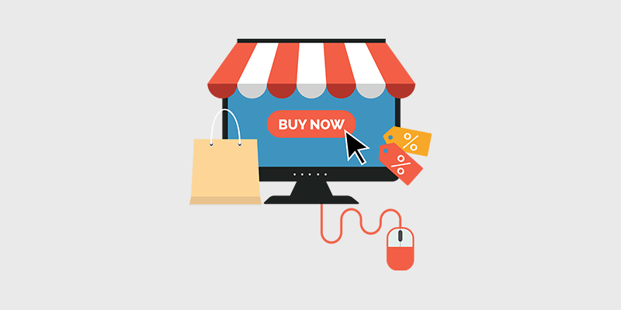
Idea
Online store, where users can buy and sell products

Slide 3
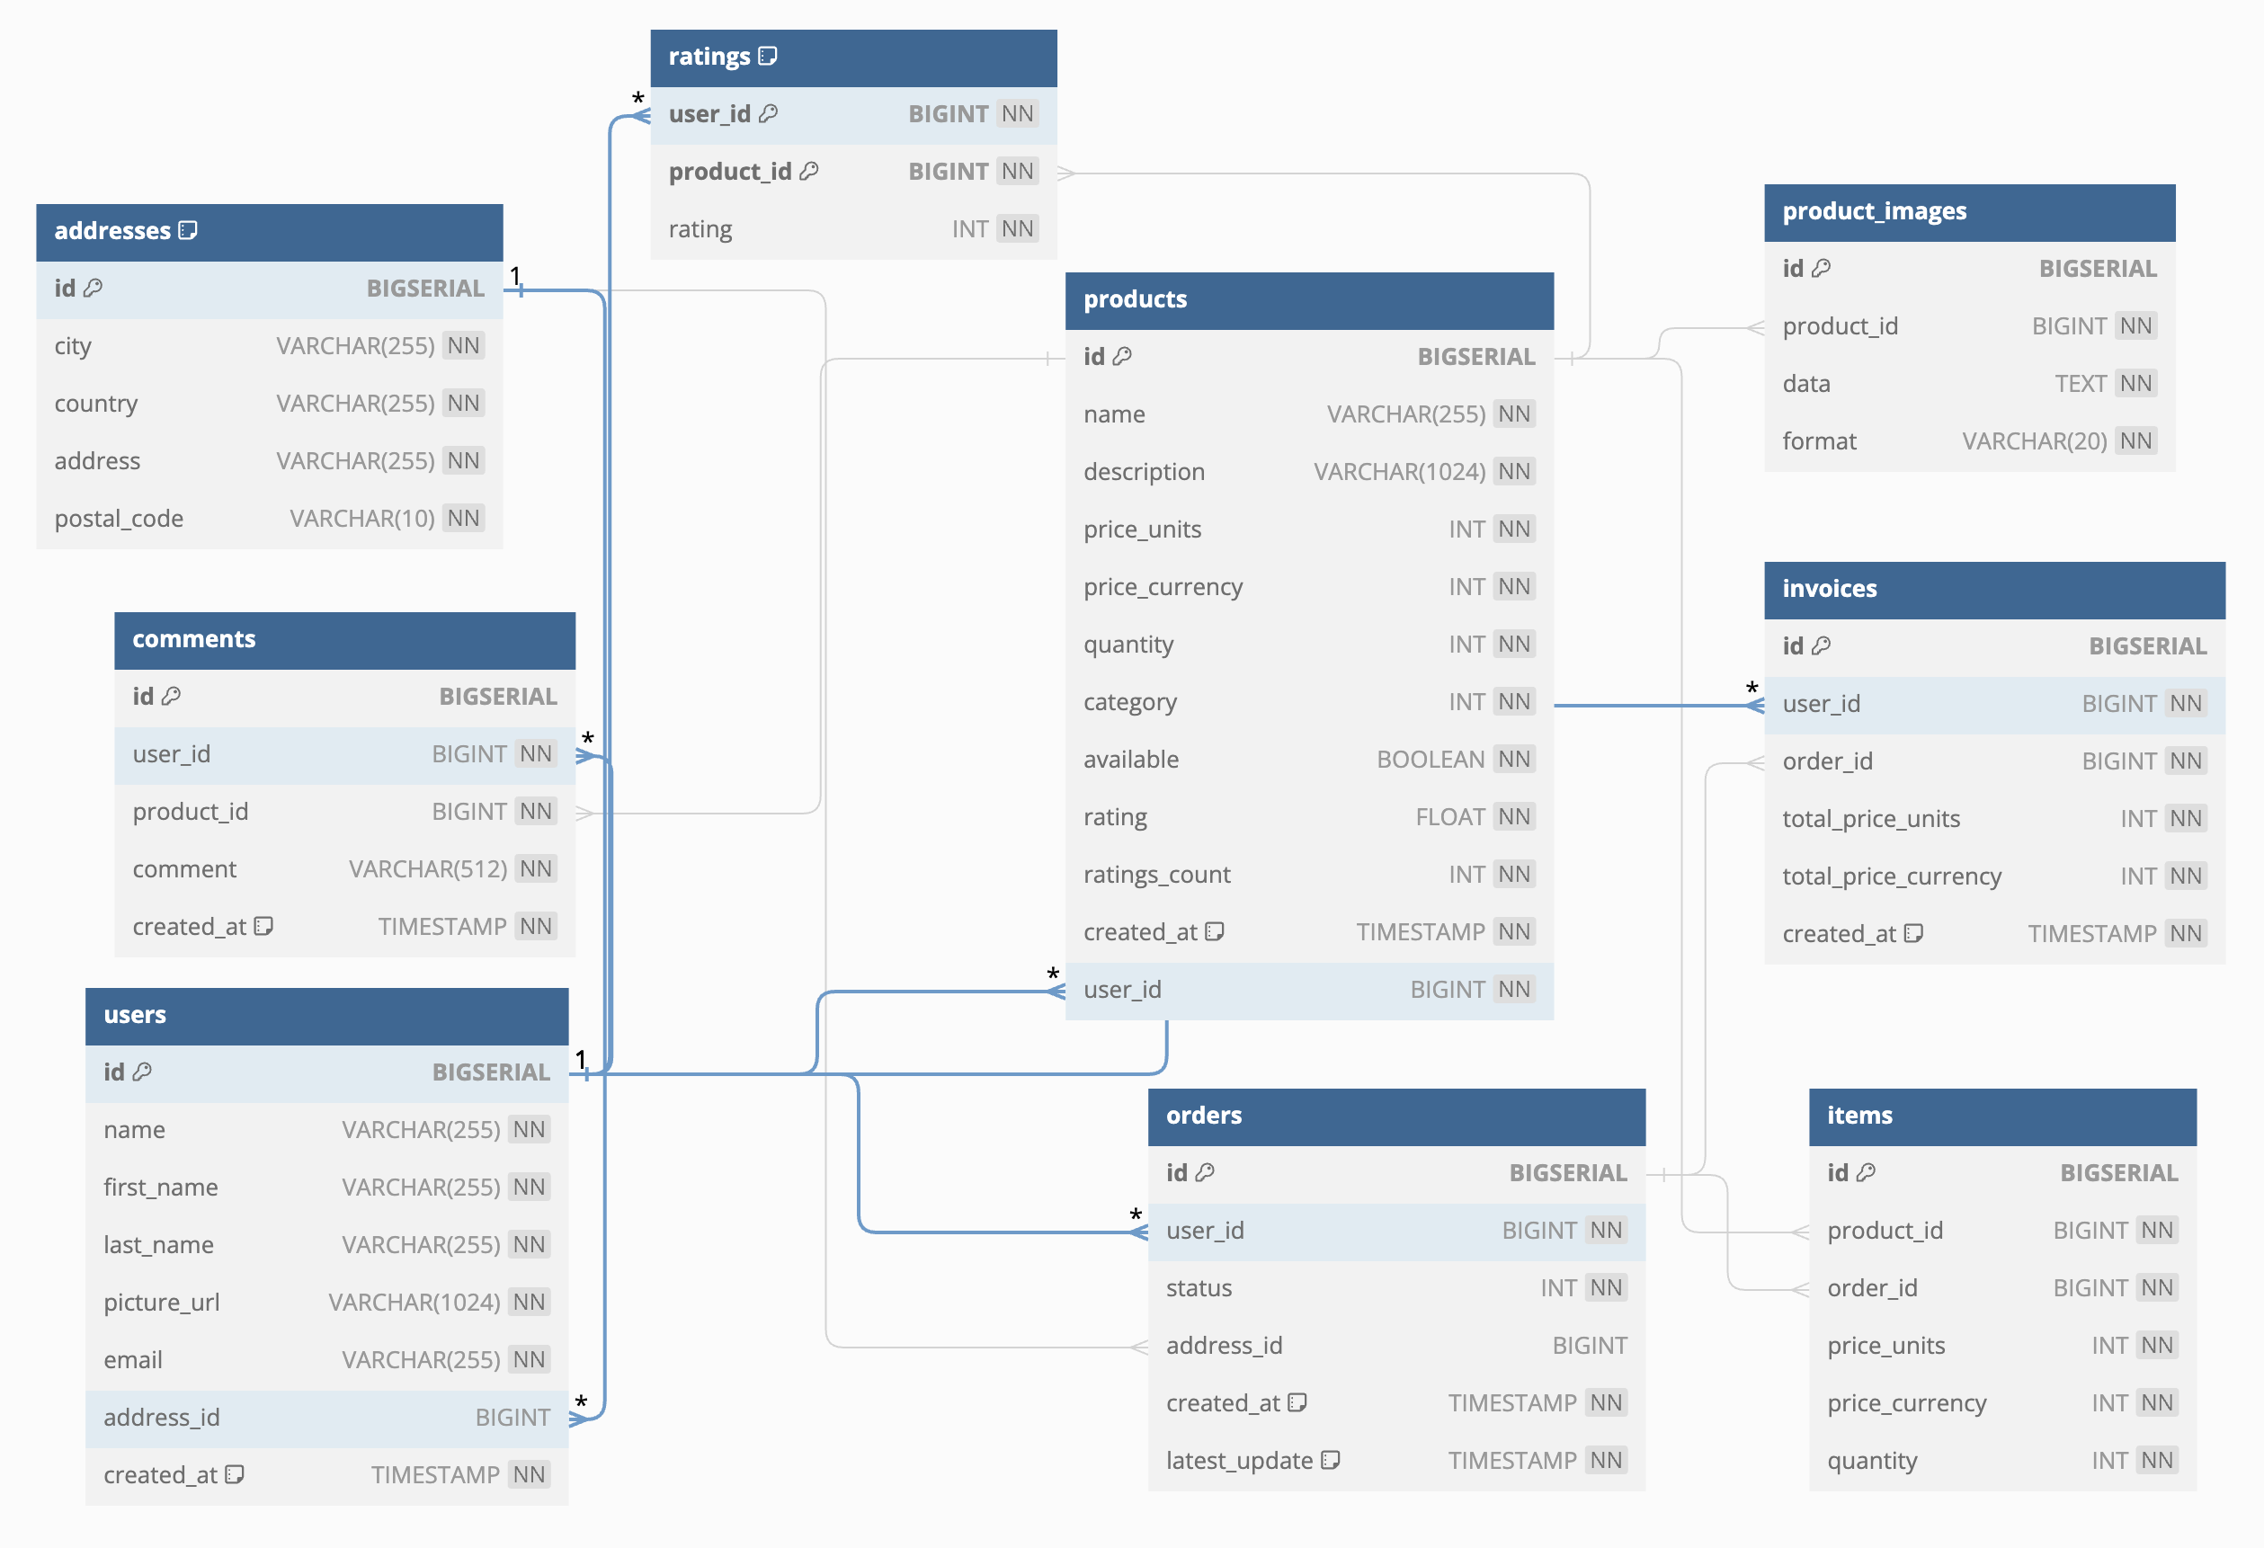
DB Schema

Slide 4
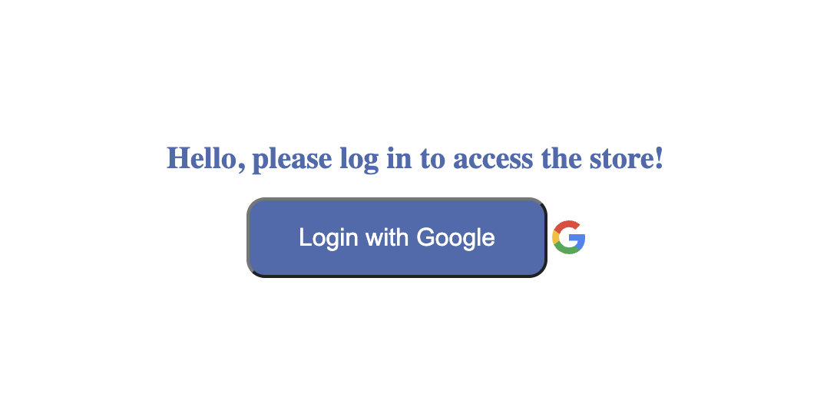
Authentication
Login page – for unauthenticated users
For every other page the user has to be logged in
Currently only OAuth2 with Google supported for login

Slide 5
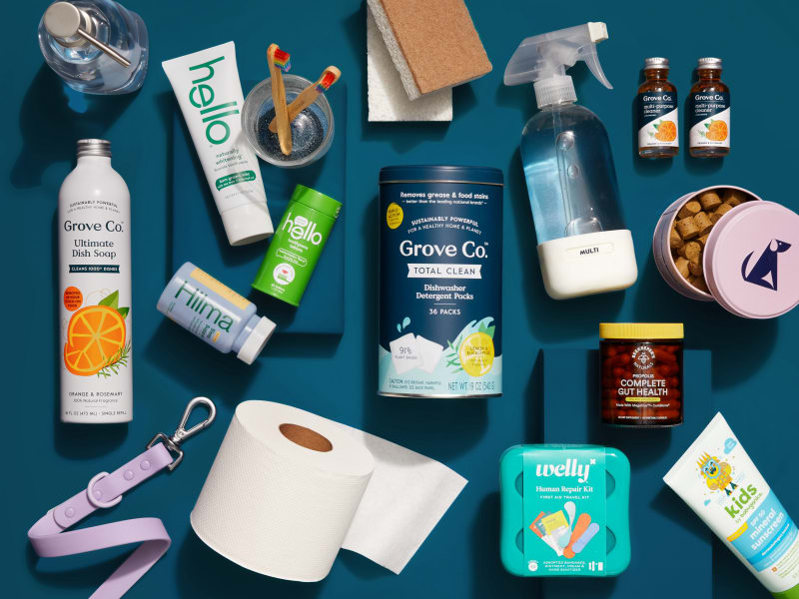
What can you do?
List products on the store
Search for products
Add a product for sale
Comment on products
Rate products
Update your products
Purchase products

Slide 6



Technologies
REST API backend implemented in Golang
PostgreSQL
HTML, CSS, Javascript for frontend

Slide 7

Demo

Slide 8
Thank you <3

