Slide 1



Slide 2


Slide 3
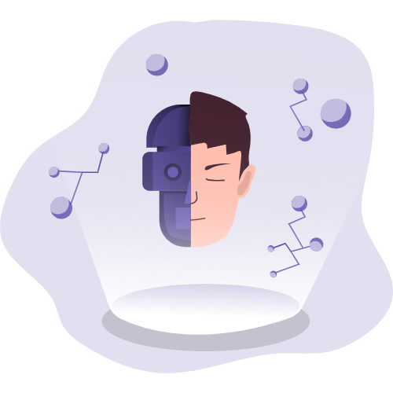
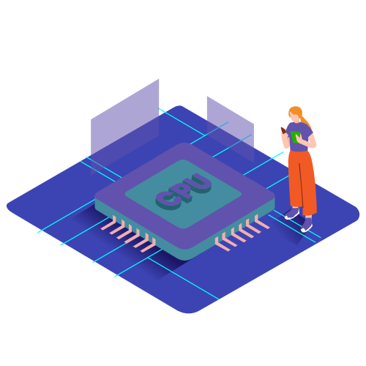


Enabling tracking modules…
Implanting microchip…
Modifying DNA…
Fine-tuning mind processes…

