Slide 1
Detecting Cars in Images Using Histogram of Oriented Gradients
Reasarch Area Fall 2013 - 2014
Vlad Păunescu
vlad.paunescu@cti.pub.ro
Prof. Dr. Ing. Marius Leordeanu

Slide 2
Agenda
Introduction
Motivation
Theory
Results
Conclusion and Future Work
Questions
Research – fall 2013-2014

Slide 3
Computer Vision
Field of Artificial Intelligence
Acquiring, processing;
Analyzing and understanding of images
Extracting information from images
Reconstructing the model that generated the image – inverse of Computer Graphics
Research – fall 2013-2014

Slide 4
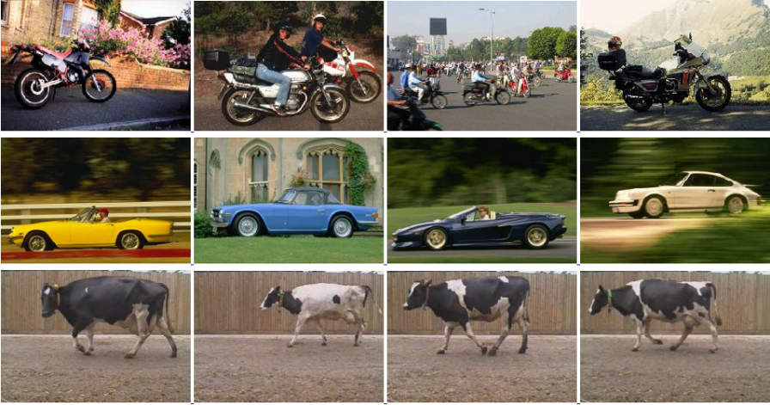
Object Category Recognition
Detecting objects in images
Classifying detected objects
Objects at different sizes(scale)
Different view angles
Different classes of objects
Research – fall 2013-2014

Slide 5
Motivation
Humans detect a multitude of objects
No effort
Computer Vision aims to ahieeve and exceed human vision
Still a challange in computer vision
Many categories (classes) of objects
Research – fall 2013-2014

Slide 6
A Machine Learning Approach
Idea – capture somehow the features of one category of objects from many labeled images;
Construct a model;
Being able to identify new instances in unseen images
Research – fall 2013-2014

Slide 7
HOG
Histogram of Oriented Gradients
The HOG person detector was introduced by Dalal and Triggs at the CVPR conference in 2005.
Research – fall 2013-2014

Slide 8
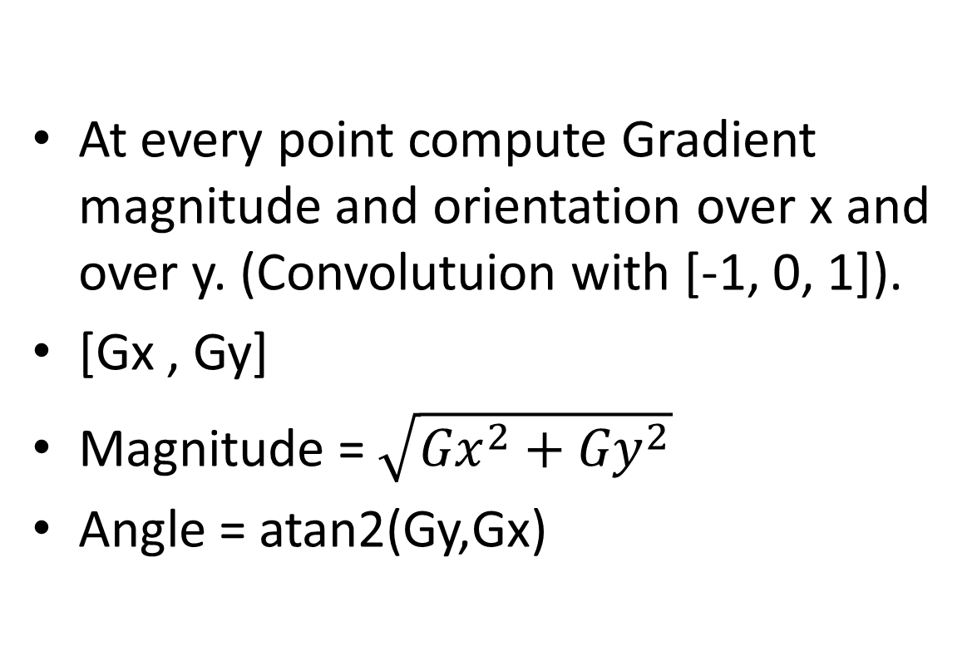
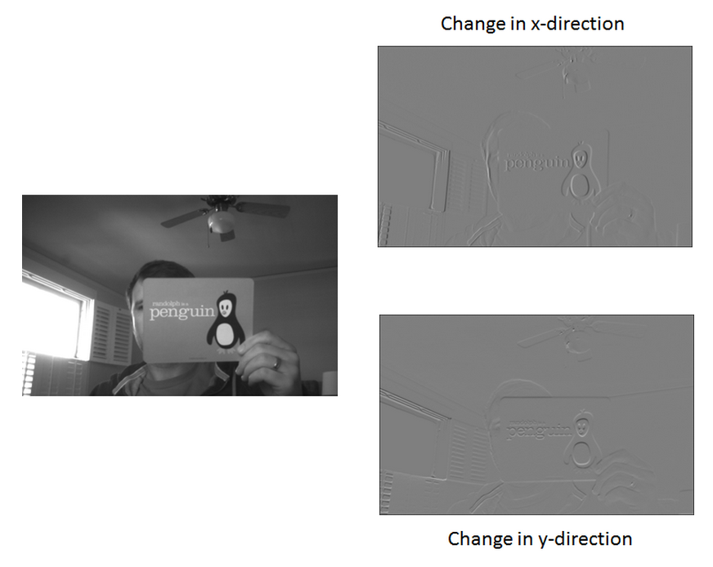
Oriented Gradients
Research – fall 2013-2014

Slide 9
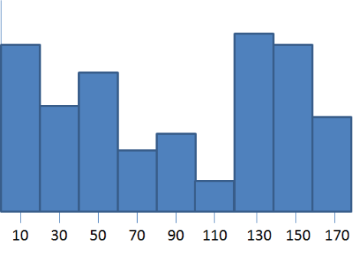
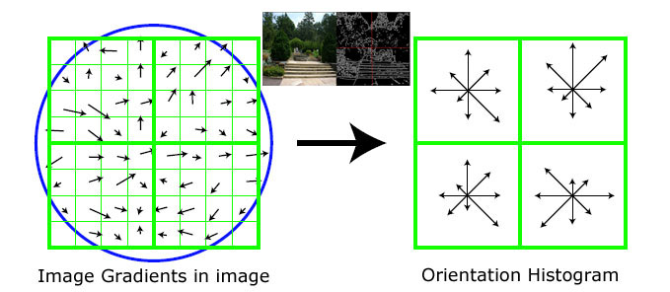
Binning (Histogram)
Split image in cells. Compute gradients.
For each cell build a histogram – binning.
Split interval 0 – 180 into bins.
Research – fall 2013-2014

Slide 10
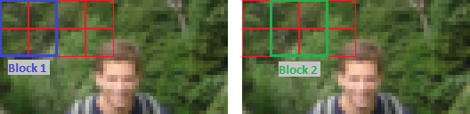
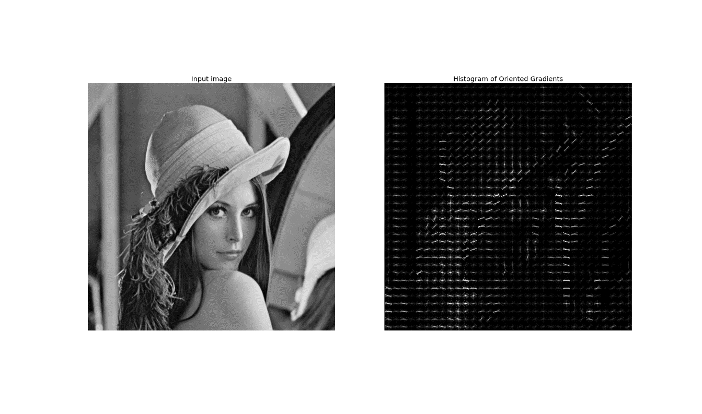
HOG
Research – fall 2013-2014

Slide 11
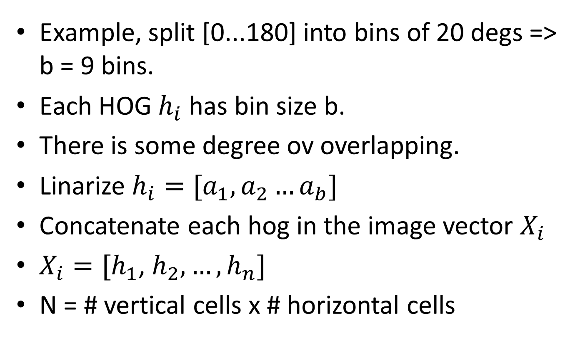
HOG Training set
Research – fall 2013-2014

Slide 12
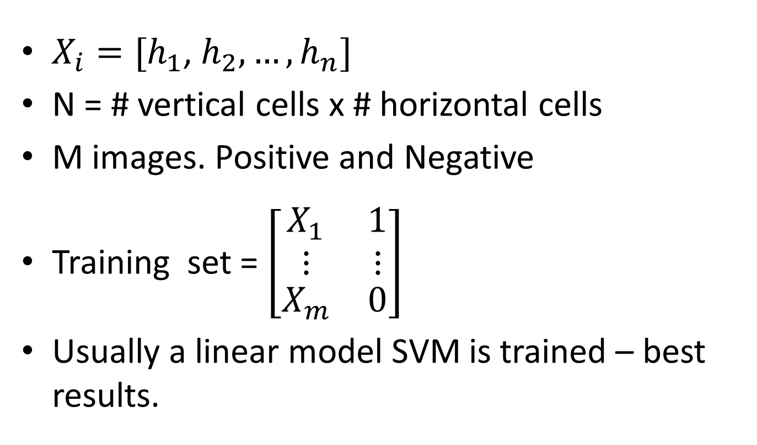
HOG Training set
Research – fall 2013-2014

Slide 13
Results and Experiments
Used Caltech Cars (Rear) Dataset
126 images of cars from the rear
Background dataset for negative examples
2 Tasks:
  Classification
  Detection
Research – fall 2013-2014

Slide 14
Classification
Classification
Worked only on cropped images, and on background
Image taken as a whole.
Is it a car or not?
K – fold cross validation (K = 10)
60 % Train set. 40 % Test set
Research – fall 2013-2014

Slide 15
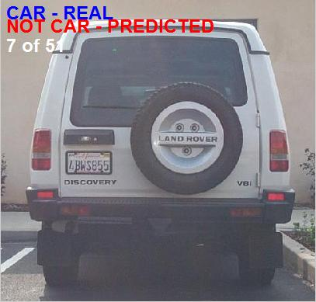
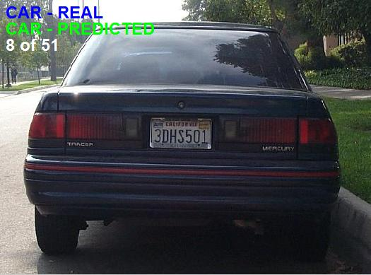
Classification
Research – fall 2013-2014

Slide 16
Classification
K – fold cross validation for 4 height cells and 8 horizontal cells: 97 %.
Varied
  Height Cells count [2… 10]
  Horiztontal Cells count [ 4-14]
On 60% / 40 % Train / Test obtained high > 97%) on all height/horiz. Cell counts.
Research – fall 2013-2014

Slide 17
Classification
Best accuracy is achieved at 4 height cells (vertical cells), and 10 horizontal cells (width cells). Accuracy = 0.9969
Note: Very high accuracy
Research – fall 2013-2014

Slide 18
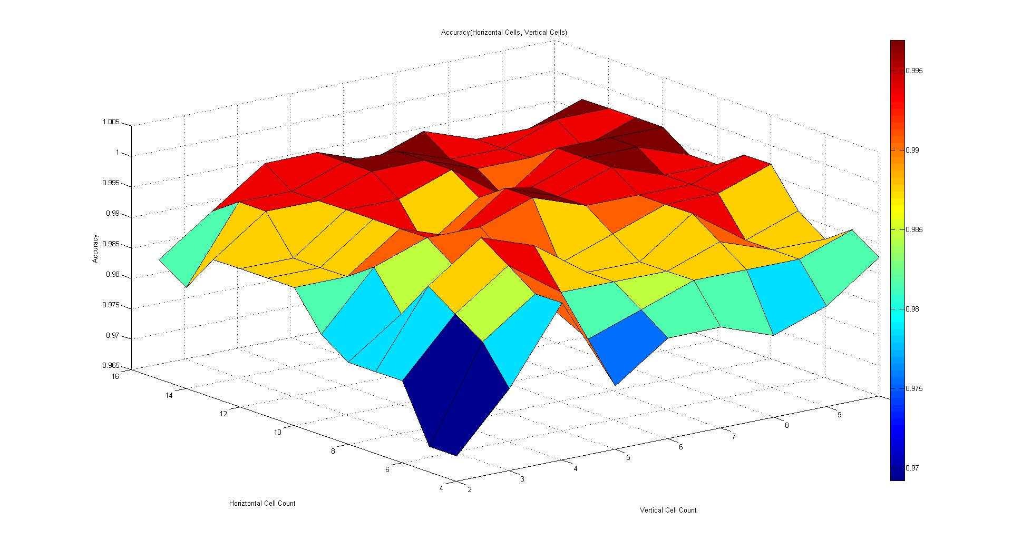
Classification
Research – fall 2013-2014

Slide 19
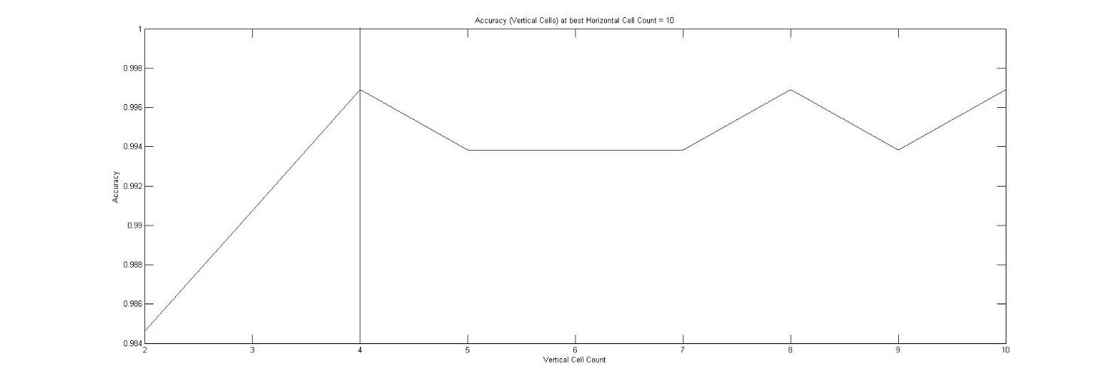
Classification
Research – fall 2013-2014

Slide 20
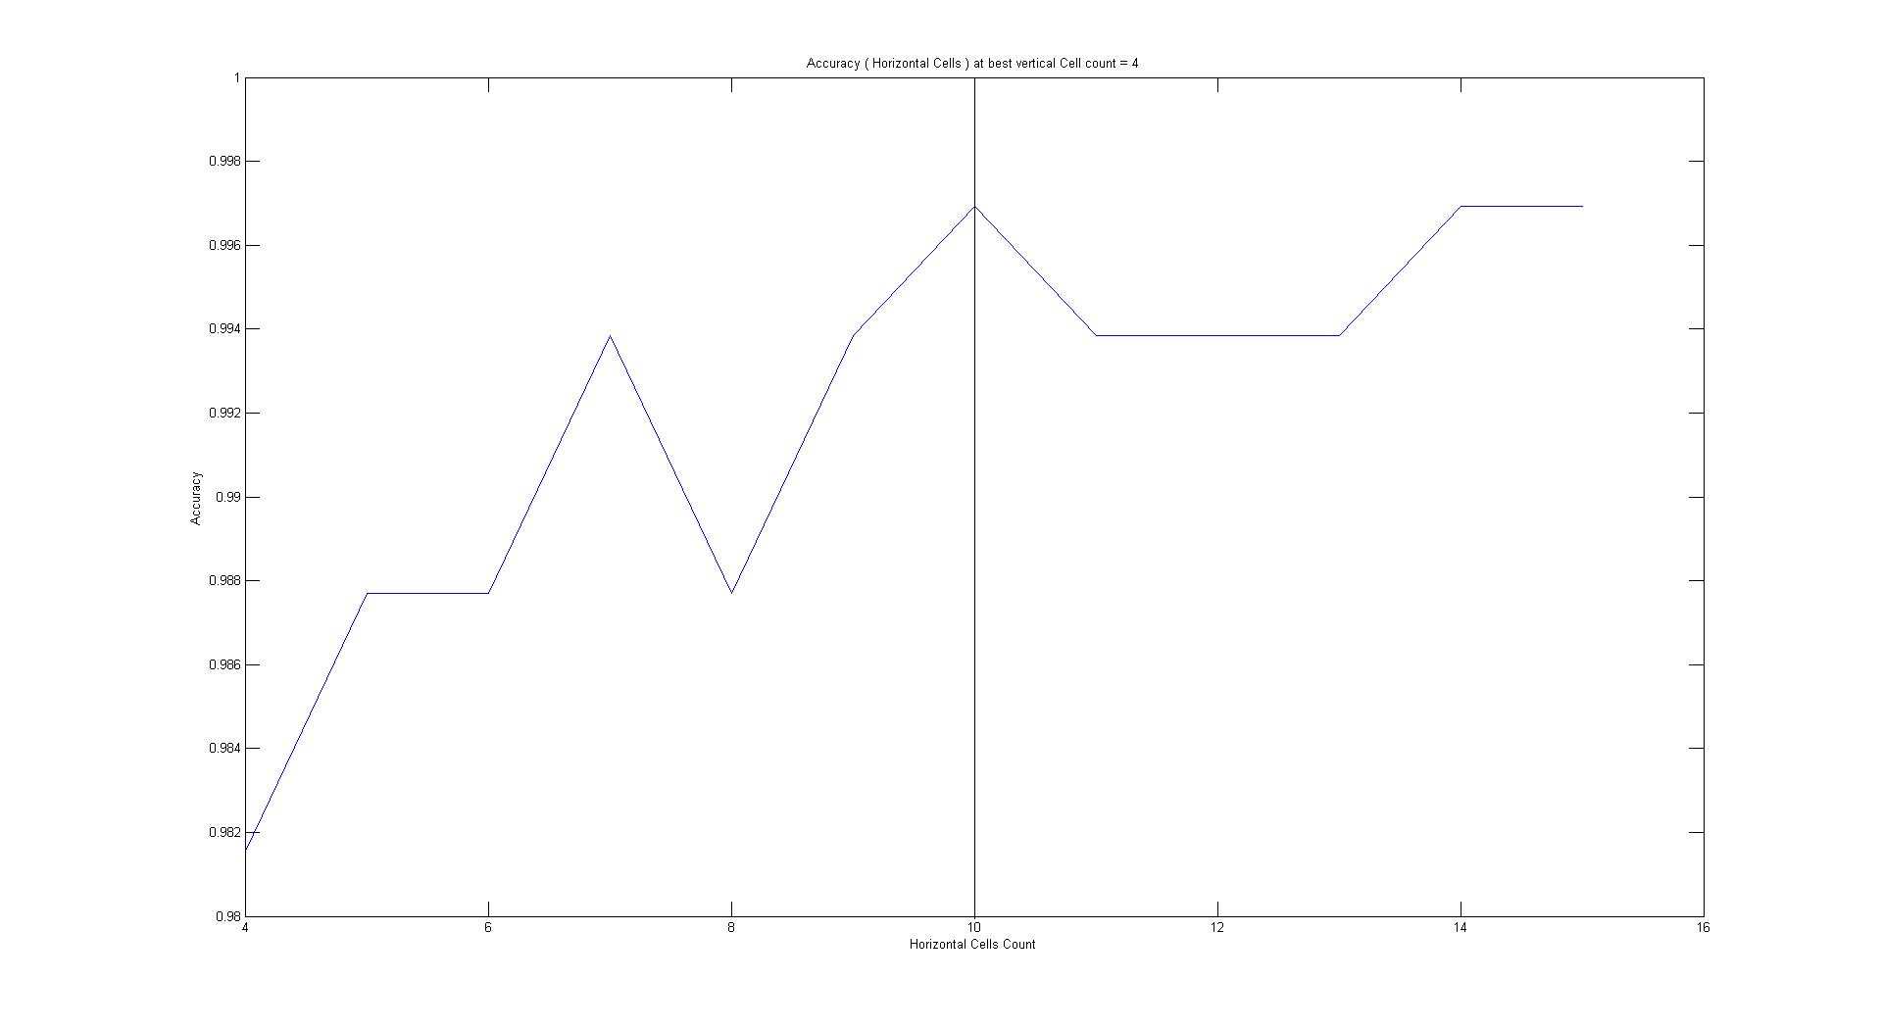
Classification
Research – fall 2013-2014

Slide 21
Detection
Scan the image with a moving window, and detect the bounding box of the car.
Method: Scanned at multiple scales
  3: 1, ½ 1/3.
  Used 10 px increments for the moving window.
Whenever the SVM says there is a car in given window, the window “votes” for all pixels.
The pixel with highest number of votes is chosen. (max number of votes)
Research – fall 2013-2014

Slide 22
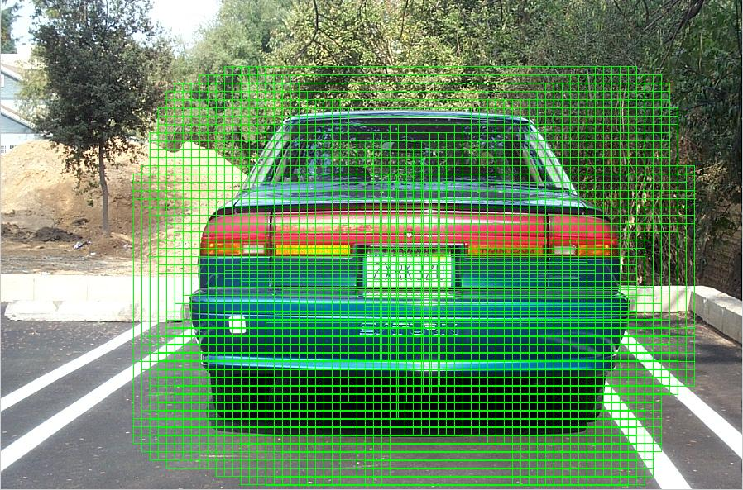
Detection
Research – fall 2013-2014

Slide 23
Detection
Expand the bounding box until we reach pixels with votes < 0.3 max number of votes.
The rectangle is said to be the detected car in the image.
A detection is correct if the overlap percent with the ground truth > some threshold – typically 50 %.
Research – fall 2013-2014

Slide 24
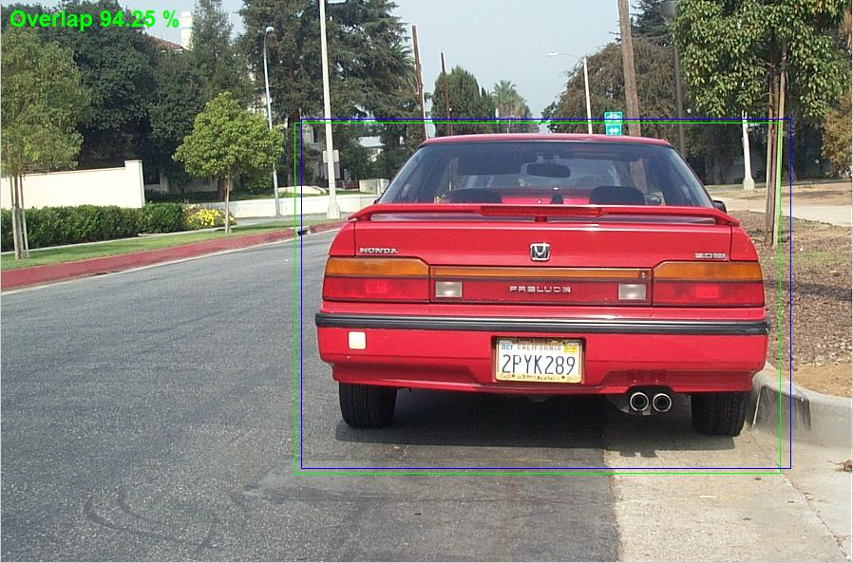
Detection
Overlap = intersection / union of detection rectangle and real rectangle
Research – fall 2013-2014

Slide 25
Conclusion
We achieve both good recognition rate, and detection rate.
However, we have only one class – cars.
Also, cars appear only from back position.
Initially used for pedestrian detection, HOG proves a very robust method for car detection.
Research – fall 2013-2014

Slide 26
Future Work
Expand detection for cars – side view.
Add multiple object categories.
Investigate other classifiers, other than SVMs.
Research – fall 2013-2014

Slide 27

Final
Thank you!
Questions?
Sesiunea de Licenţe - Iulie 2013

