Slide 1
Beyond the GPU
Driving factors, architectures, and economics of AI hardware acceleration — a systems lecture
In-depth lecture · ~2 hours
Notes:
Full lecture version. Same thesis as the short talk but with the mechanisms shown. Tell the audience: we build a repeatable test, then read the whole landscape through it. Pace: ~7 movements, keep each family to a few minutes.

Slide 2
ROADMAP
Seven movements
1
Why offload
2
Workload pressures
3
The framework
4
The families
The physical driving factors.
The measured bounds.
Contracts + necessity test.
Eight contract changes.
5
Landscape
6
Substrate
7
Futures
★
Conclusions
Grouped, not cataloged.
Software, packaging, cost.
Graded by evidence.
What holds everywhere.
Beyond the GPU — 2-hour lecture
2
Notes:
Roadmap. The spine is movements 3 (framework) and 4 (families); everything before builds the pressures, everything after applies them. Reassure a software audience: hardware concepts are introduced as needed.

Slide 3
CONCEPTS PRIMER
The hardware vocabulary, in software terms
GPU
Matrix / tensor engine
Systolic array
Thousands of parallel lanes; fast on regular, batched, streamed work.
A whole matrix tile per instruction; control cost amortized over many multiply-adds.
A grid where operands flow to neighbors — a value fetched once is reused many times.
HBM & scratchpad
NPU / dataflow / PIM
TOPS vs contract
Stacked DRAM for bandwidth; software-managed SRAM for reuse under compiler control.
Blocks that change a contract: wake-scope energy, static schedule, or compute in memory.
TOPS is a peak rating (marketing). A contract is what hardware promises software.
Beyond the GPU — 2-hour lecture
3
Notes:
Vocabulary. Plant three ideas: bandwidth (HBM) is usually the scarce resource; a "contract" is a promise to software that specialization renegotiates; TOPS is marketing, not a benchmark. Systolic array preview: reuse from geometry — comes back as the mechanism under tensor processors.

Slide 4
01
Why work leaves the GPU
The physical pressures behind offload
Beyond the GPU — 2-hour lecture
4
Notes:
Section 1 goal: establish that the pressures are PHYSICAL (energy, bandwidth, timing) — not software immaturity. Everything here is a "driving factor" the later families answer.

Slide 5
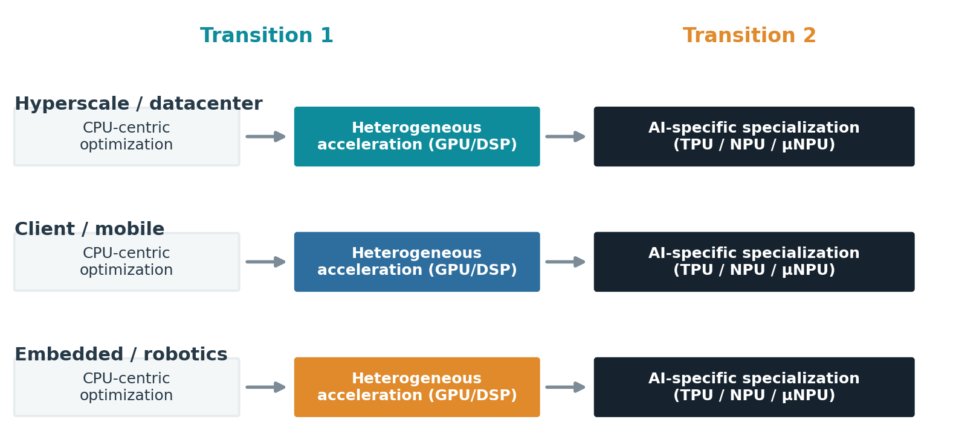
THE THESIS
Two transitions, across the whole continuum
⇒ Software succeeds until it hits a limit; each transition adds specialization rather than replacing what came before.
Beyond the GPU — 2-hour lecture
5
Notes:
Thesis. Both transitions = software succeeding until it exposed a physical/economic limit. Each ADDS an execution domain; nothing is retired. Same pattern, three lanes (datacenter/mobile/embedded) under different dominant constraints — we follow all three.

Slide 6
HISTORY AS CONSTRAINTS
Why general-purpose scaling stalled
The memory wall
The power wall
Compute outran memory; the question became which data is resident and reused, not raw latency.
Frequency scaling ended; more transistors help only when software exposes parallelism.
Dark silicon
Data movement
Not all transistors can switch at once in a fixed power budget — specialization does more per joule.
Energy is dominated by moving operands, not computing on them — the recurring lever.
Beyond the GPU — 2-hour lecture
6
Notes:
Four decades of constraint in one slide. Memory wall (Wulf & McKee 1995): compute outran DRAM, so locality/reuse became the question. Power wall + Dennard scaling ending → multicore, but only if software exposes parallelism. Dark silicon → can't power all transistors at once, so specialize. Data movement is the thread that ties them together and sets up the next slide.

Slide 7
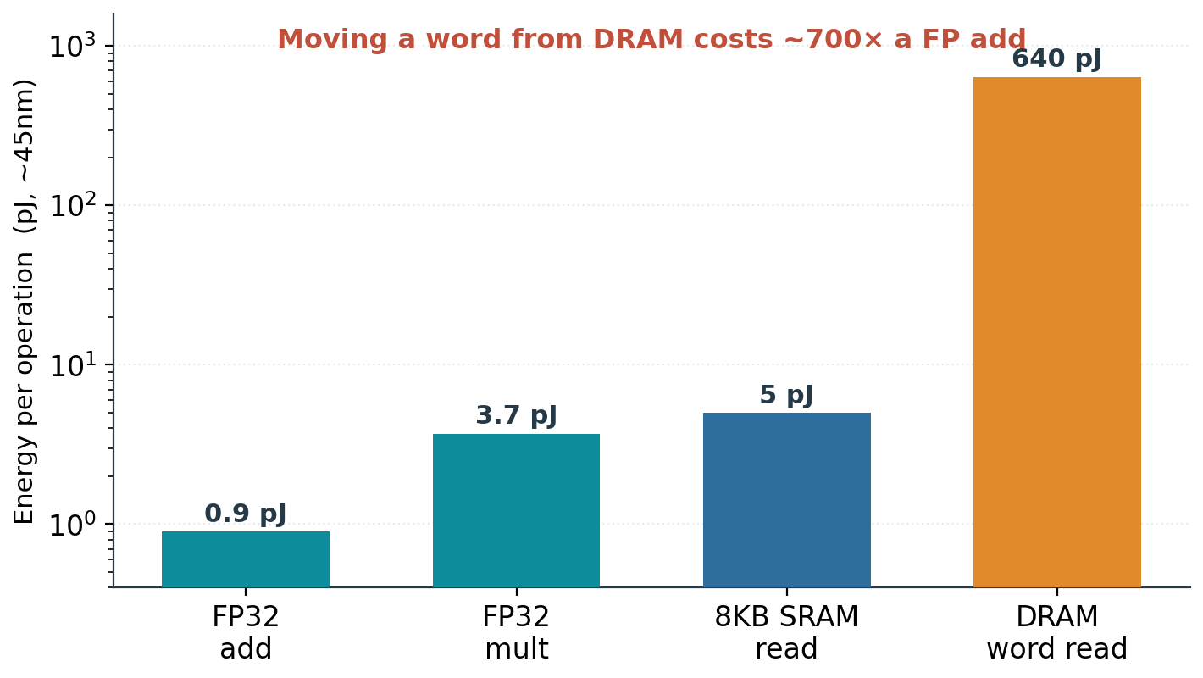
DRIVING FACTOR
Data movement dominates energy
Compute is nearly free.
Moving operands is not.
Locality sets efficiency, not FLOPS.
⇒ Every family that follows is a different way to move less data, or move it a shorter distance.
Beyond the GPU — 2-hour lecture
7
Notes:
Horowitz 45nm: FP add ~0.9 pJ vs DRAM word read ~640 pJ — ~700×. So energy and bottleneck are set by data movement. This one fact justifies nearly every family later. Ratio holds even as absolute numbers shift with node.

Slide 8
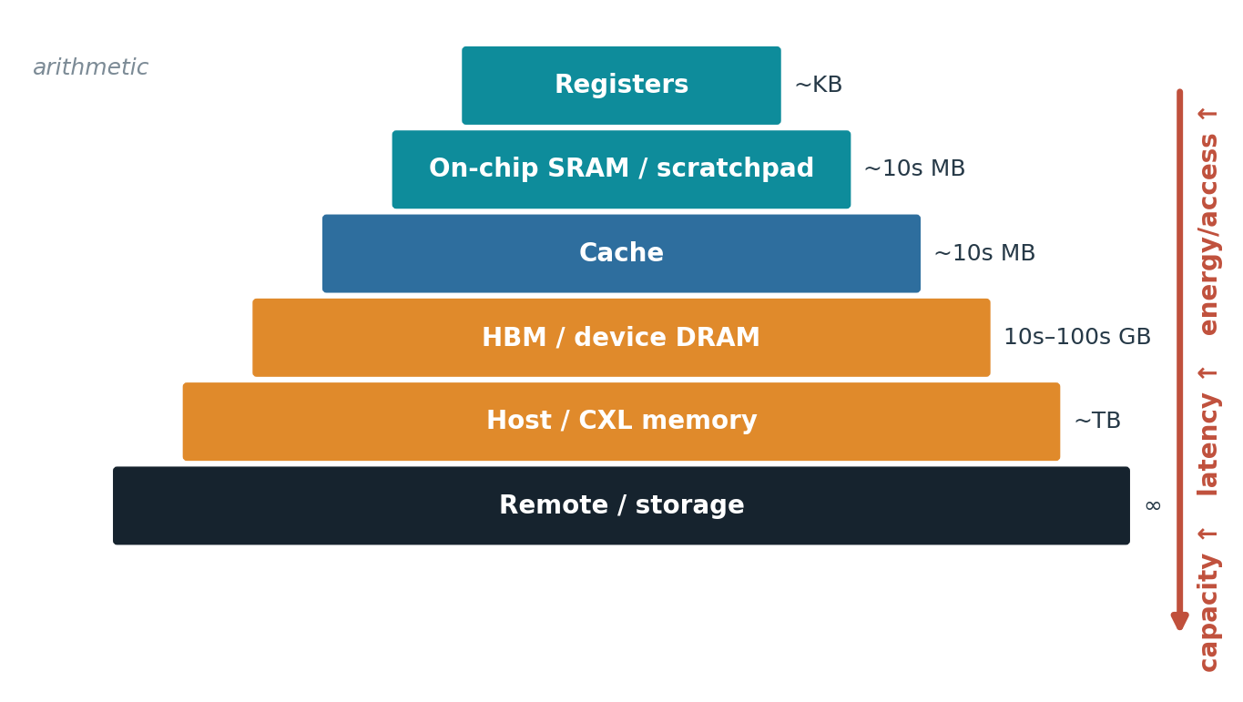
DRIVING FACTOR
Memory is a distance hierarchy
Farther = more capacity.
Also more latency and energy.
Caches help only with reuse.
⇒ 'Memory-bound' is many distinct problems — each a lever a specialized design can pull.
Beyond the GPU — 2-hour lecture
8
Notes:
Memory = ladder trading capacity for latency/energy. "Memory-bound" hides bandwidth, capacity, overfetch, irregular access, insufficient reuse. Caches pay only with reuse before eviction. Each rung is a different lever — remember at the families.

Slide 9
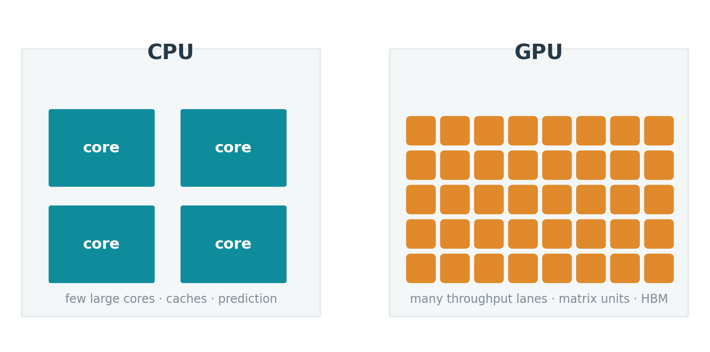
CONCEPT
CPU and GPU spend silicon differently
CPU: latency across diverse code.
GPU: throughput across regular work.
Neither wins every phase.
⇒ Specialization narrows the job in exchange for more useful work per area and per joule.
Beyond the GPU — 2-hour lecture
9
Notes:
Where transistors go. CPU: latency on branchy diverse code (caches, prediction, OoO). GPU: throughput lanes. Specialization is the next step on the same axis — narrower job, more useful work per mm² and per joule, for work that fits.

Slide 10
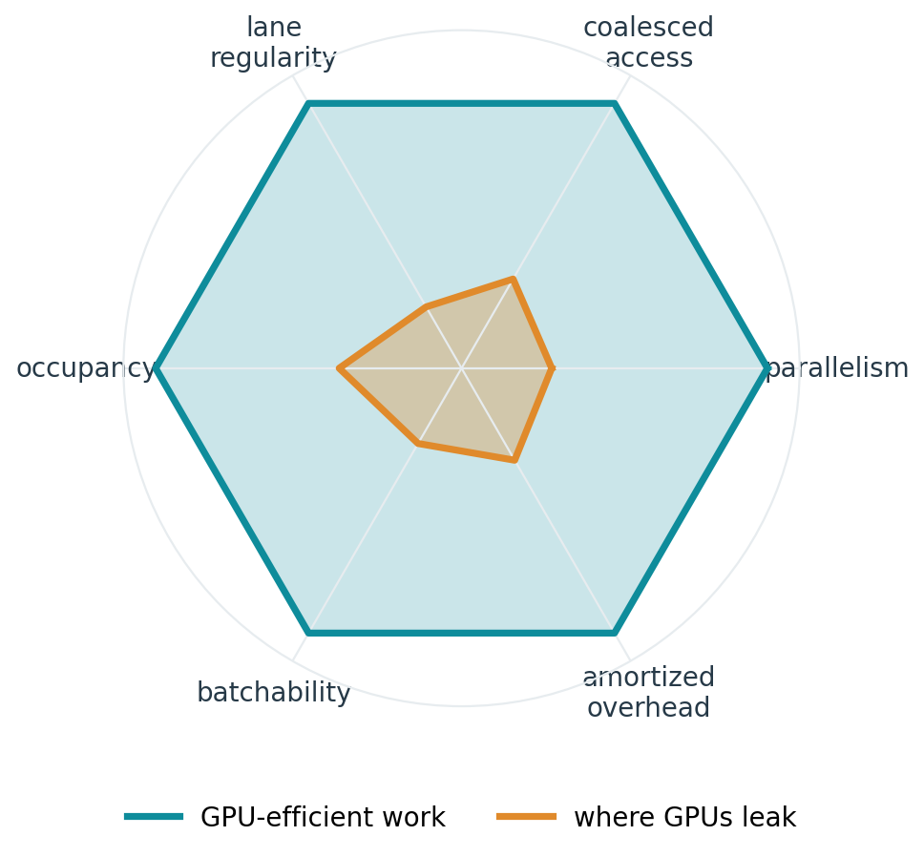
CONCEPT
The GPU efficiency envelope is real and bounded
⇒ GPUs are unbeatable inside the envelope and leak outside it — that boundary is where specialists live.
Beyond the GPU — 2-hour lecture
10
Notes:
The GPU is efficient when work has: parallelism, coalesced access, lane regularity, occupancy, batchability, amortized overhead. As each becomes narrow/irregular/latency-bound, useful utilization falls. NOT "GPUs can't do X" — it's a continuum. The leak region is exactly where specialists compete. This frames the whole families section.

Slide 11
02
The workload pressures
The measured bounds that reshape silicon
Beyond the GPU — 2-hour lecture
11
Notes:
Section 2 goal: turn "AI workloads" into MEASURED signatures and bounds. These are the numbers the necessity test consumes later.

Slide 12
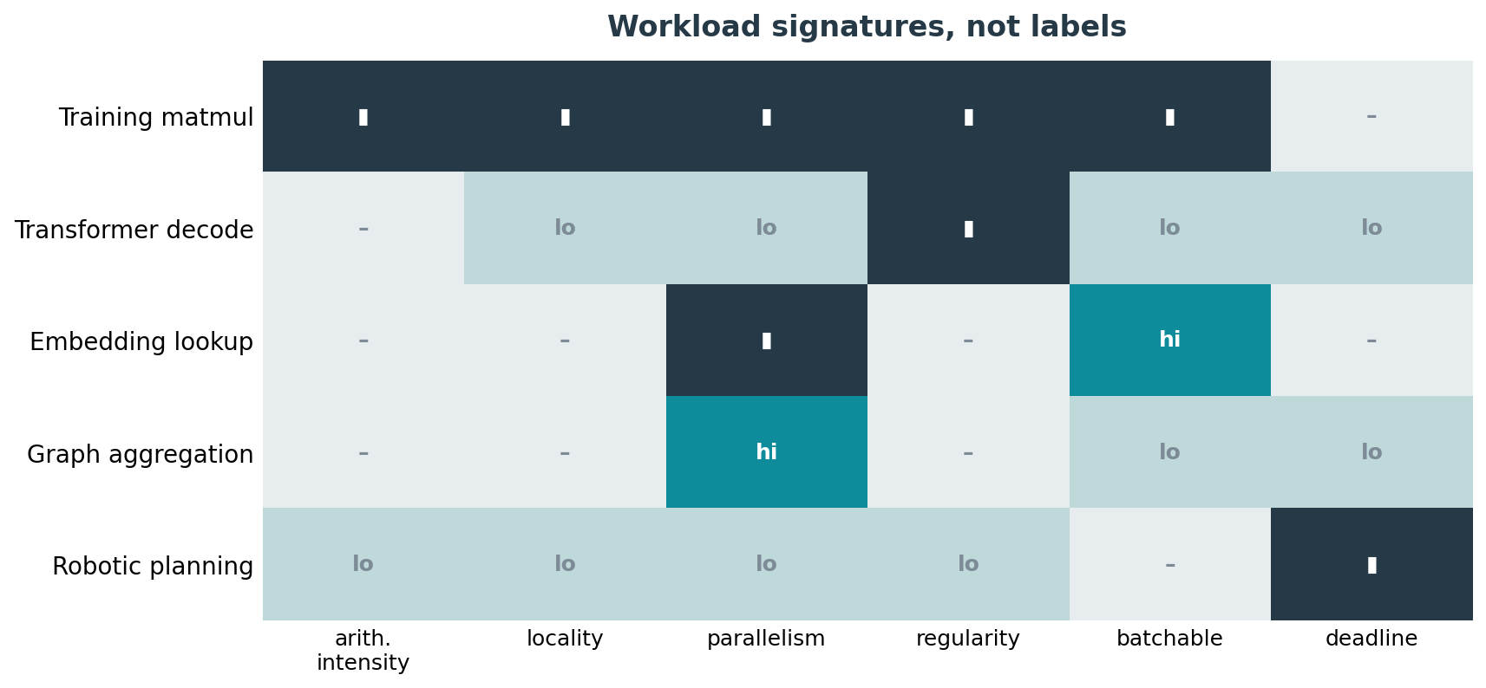
METHOD
Signatures, not labels
⇒ Characterize each phase by its behavior — the same model is compute-, bandwidth-, and capacity-bound in one request.
Beyond the GPU — 2-hour lecture
12
Notes:
Method note: don't reason from model NAMES; reason from signatures — arithmetic intensity, locality, parallelism, regularity, batchability, deadline. The same request is compute-bound in prefill and bandwidth-bound in decode. Signatures are what map onto contracts.

Slide 13
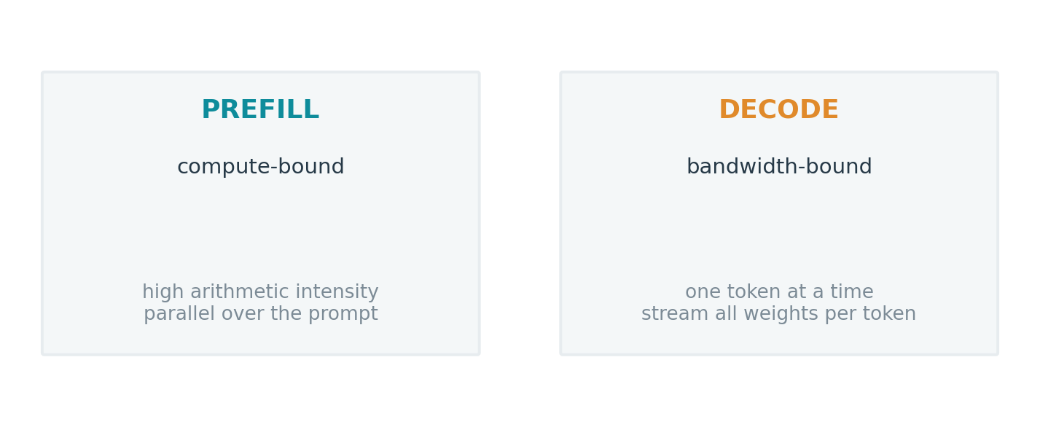
TWO PHASES
Prefill and decode want different machines
⇒ One pooled device compromises; phase-specialized silicon is now reaching hyperscale roadmaps.
Beyond the GPU — 2-hour lecture
13
Notes:
Transformer inference has two phases. Prefill = process the prompt, compute-bound, high arithmetic intensity, parallel. Decode = one token at a time, bandwidth-bound (must stream weights). A single device compromises; that's why "disaggregated" serving and even phase-split silicon (reported TPU-8) are appearing.

Slide 14
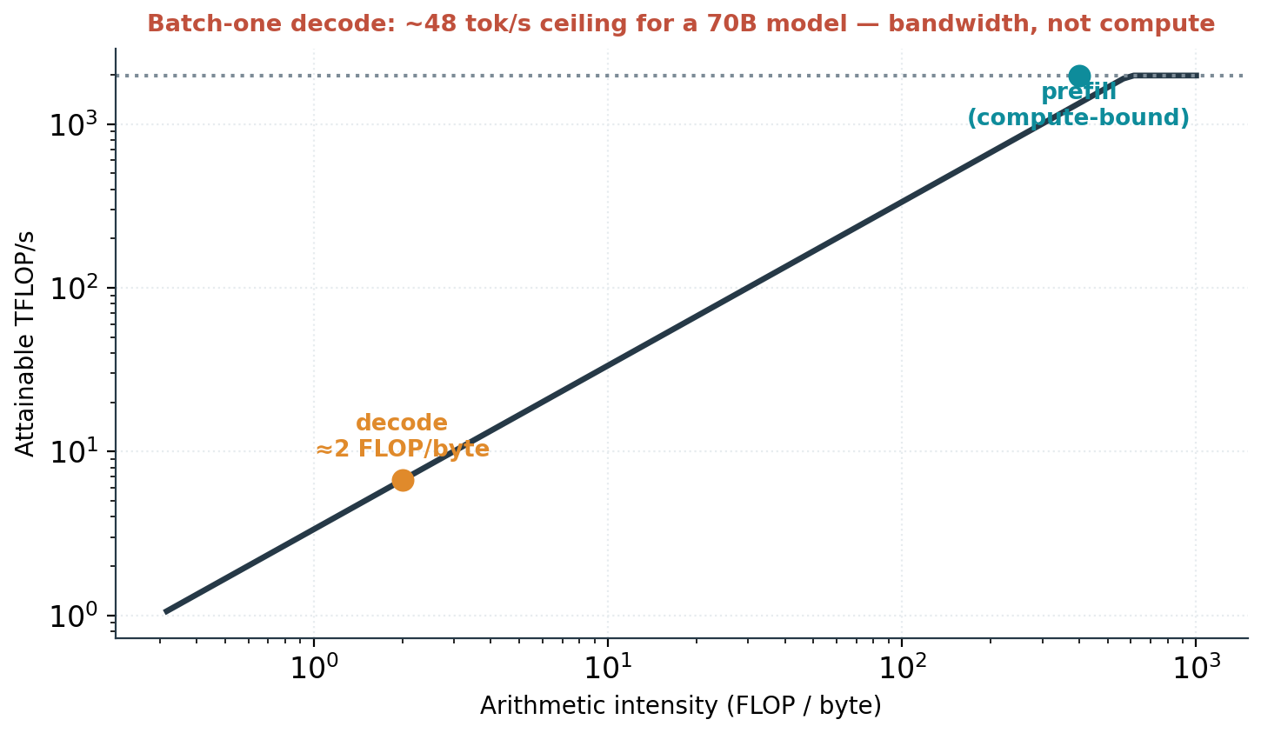
WORKED BOUND
Batch-one decode is a bandwidth wall
70B model, 8-bit, one sequence.
≈48 tokens/s ceiling on an H100.
~0.3% of matrix throughput used.
⇒ Only batching or a changed memory contract moves this — the pressure behind inference-first silicon.
Beyond the GPU — 2-hour lecture
14
Notes:
Keystone number. One sequence → stream ~70 GB weights/token; at ~3.35 TB/s → ~48 tok/s, ~0.3% of matrix throughput. Author-computed from datasheets; idealized. Only batching (amortize weight reads) or a changed memory contract helps — adding FLOPS does nothing. This is WHY silicon is going memory-first and inference-first.

Slide 15
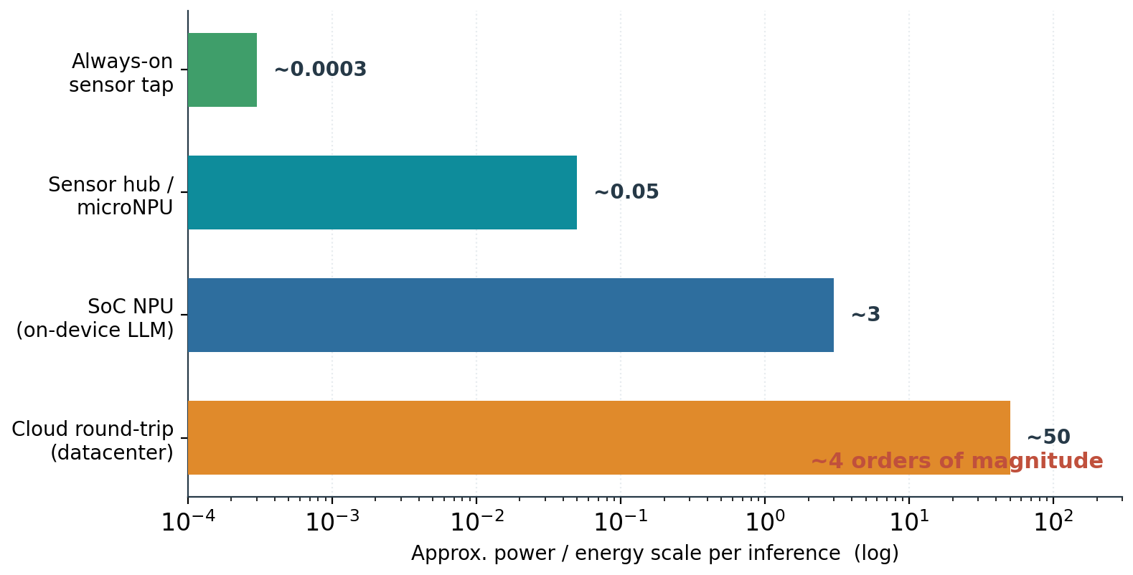
DRIVING FACTOR
Energy spans four orders of magnitude
Always-on: microwatts.
Cloud round-trip: watts.
Wake scope sets the cost.
⇒ Always-on features are impossible on a GPU contract — a structural bound, not an efficiency gap.
Beyond the GPU — 2-hour lecture
15
Notes:
Wake scope = which power domains must wake to answer. ~4 orders: µW always-on to W cloud round-trip. An always-on feature is IMPOSSIBLE within a battery budget on a GPU's submission/memory model — structural, not a tuning gap. Strongest beyond-GPU territory; returns at the NPU slide.

Slide 16
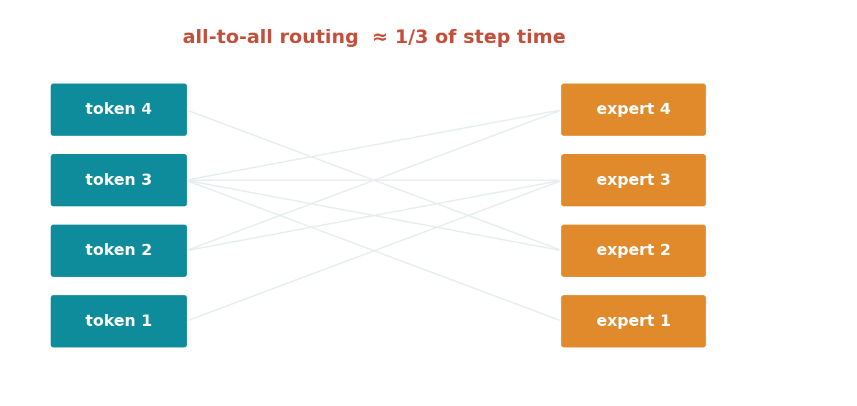
DRIVING FACTOR
MoE turns compute into communication
⇒ All-to-all routing can be ~1/3 of a training step — a bound in the fabric, not the arithmetic.
Beyond the GPU — 2-hour lecture
16
Notes:
Mixture-of-experts routes tokens to experts on different devices; all-to-all can be ~1/3 of a step. As models get sparser, the bottleneck moves to the NETWORK — which is why interconnect (NVLink/UALink/Ethernet) becomes a competitive axis in the landscape and packaging sections.

Slide 17
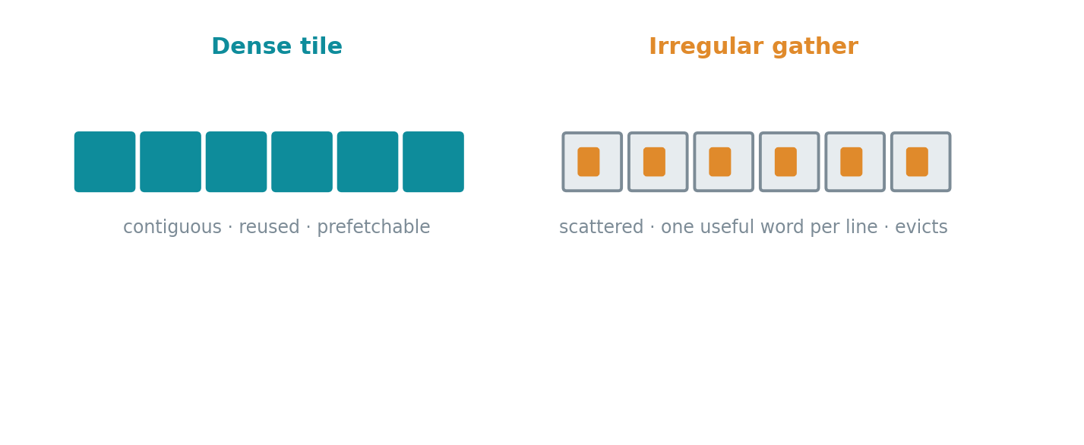
DRIVING FACTOR
Irregular access defeats the cache
⇒ Embeddings, gather, and graph traversal are the bound no family yet owns cleanly.
Beyond the GPU — 2-hour lecture
17
Notes:
Dense tiles are contiguous, reused, prefetchable. Irregular gather (embeddings, graphs, dynamic sparsity) fetches one useful word per cache line from scattered addresses and evicts before reuse. This is the survey's open problem — no family owns irregular memory access cleanly at scale. Sets up PIM later.

Slide 18
THE HONEST BASELINE
Software succeeds — until it meets physics
3×
2–4×
~34%
<300 µW
IO-aware attention throughput (FlashAttention)
KV paging / continuous batching (vLLM)
of a training step in MoE all-to-all
always-on keyword spotting budget
⇒ Each gain is real and each exposes a residual bound software cannot move — that residue is the case for hardware.
Beyond the GPU — 2-hour lecture
18
Notes:
Credit software first. FlashAttention ~3×, vLLM 2-4× — huge and real. But each success reveals a residual bound (MoE still ~34%, always-on still <300µW). The hardware case is that residue — never "software failed." This is the bridge into the framework.

Slide 19
03
The decision framework
Contracts, and a test for when to specialize
Beyond the GPU — 2-hour lecture
19
Notes:
Section 3 is the intellectual core. Two tools: six contracts (what can change) and the four-condition test (whether it should). Everything after is application.

Slide 20
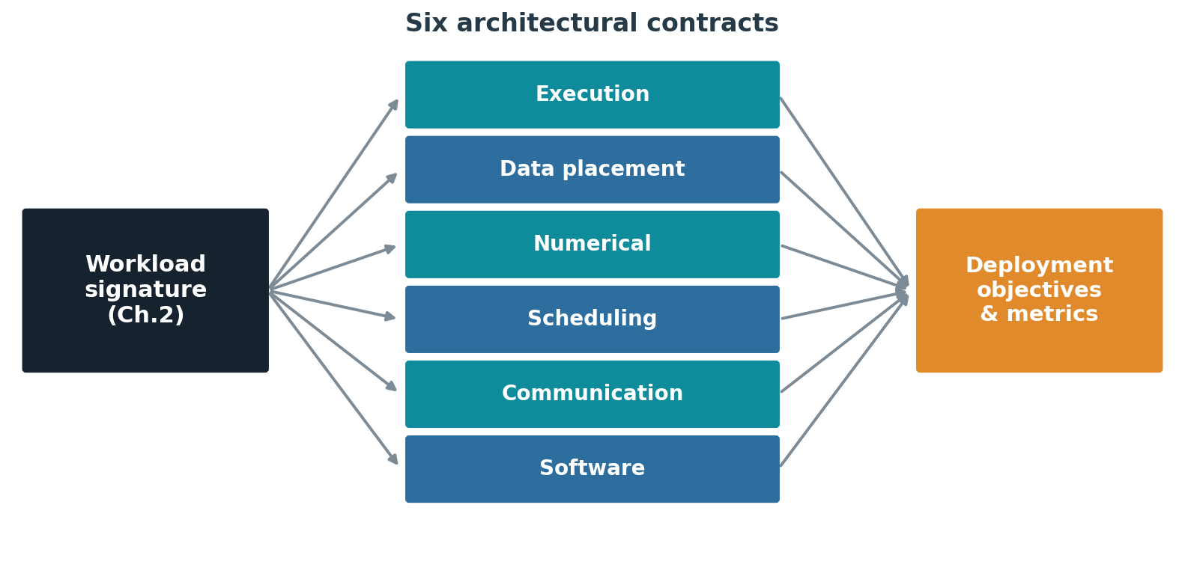
THE FRAMEWORK
Hardware defines six contracts
⇒ A signature stresses some contracts, not others — that mismatch is where a new architecture earns its place.
Beyond the GPU — 2-hour lecture
20
Notes:
Six promises hardware makes to software: execution, data placement, numerical, scheduling, communication, software/tooling. A workload stresses only some. A new architecture is justified only where it changes a contract the workload actually stresses — else it's a faster answer to a non-problem.

Slide 21
THE NECESSITY TEST
Four conditions — all must hold
1
Residual bound
2
Material consequence
3
Effective lever
4
Lifetime economics
A limit remains after software has done its best.
The bound actually hurts under the deployment's objective.
Hardware changes the bound rather than relocating it.
Recurring benefit repays fixed cost, software, and lost flexibility.
⇒ Conditions 1–3 are the architect's analysis; condition 4 is the business case — and it decides most outcomes.
Beyond the GPU — 2-hour lecture
21
Notes:
The test that makes the talk decidable. All four must hold. 1-3 are engineering (is there a bound, does it hurt, does hardware truly move it). 4 is economics (volume, software enablement, flexibility). Most real proposals clear 1-3 and die on 4. Condition 3 subtlety: a "lever" must change the bound, not relocate the bottleneck.

Slide 22
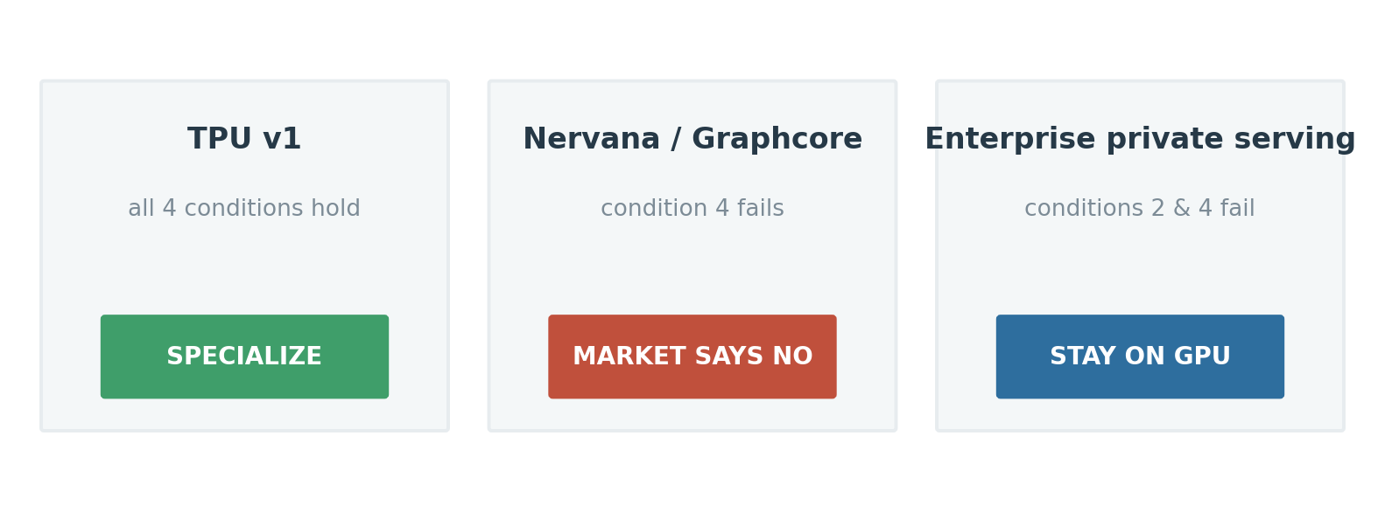
THE TEST, EXECUTED
Same architecture, opposite verdicts
⇒ TPU v1 specialized; Nervana/Graphcore were right on architecture but failed condition 4; enterprise stays on GPU.
Beyond the GPU — 2-hour lecture
22
Notes:
Three real outcomes from the same reasoning. TPU v1: all four held (published 15-30× throughput, 30-80× perf/W under production latency SLOs) → specialize. Nervana/Graphcore: good silicon, condition 4 failed (no internal volume, CUDA switching cost) → market says no. Enterprise private serving: conditions 2 & 4 fail → stay on GPU. Lesson: architecture selects the candidate; condition 4 decides.

Slide 23
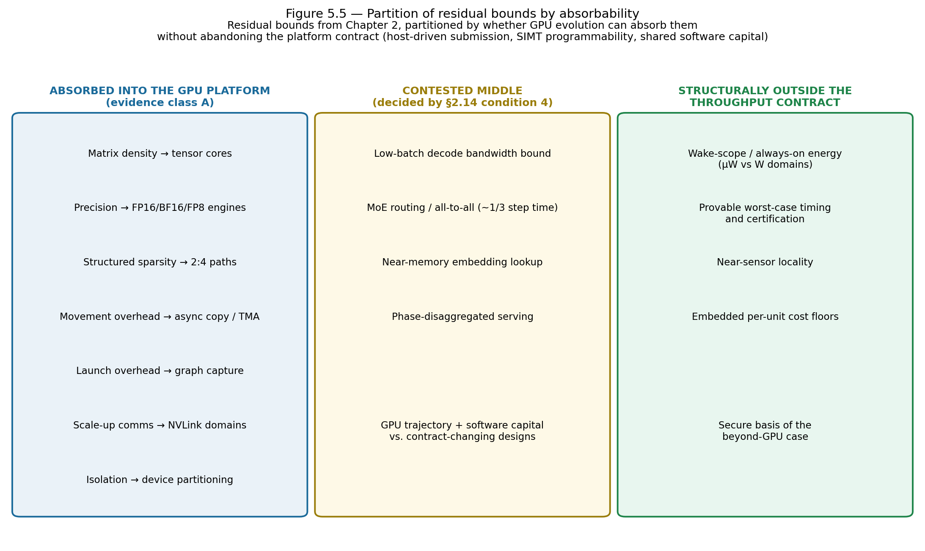
GPU VS SPECIALIZATION
What the GPU absorbs — and what it cannot
⇒ Absorbable bounds join the platform; structural bounds (wake scope, determinism, near-sensor, cost floors) do not.
Beyond the GPU — 2-hour lecture
23
Notes:
Absorbed into the GPU platform: matrix density, narrow precision, movement overhead, scale-up comms — become GPU features. Structurally NOT absorbable: wake-scope energy, provable worst-case timing, near-sensor locality, embedded cost floors — absorbing them means abandoning what makes a GPU a GPU. Contested middle: low-batch decode, routing, near-memory — where the commercial fights are.

Slide 24
04
The accelerator families
Eight contract changes, two organizing axes
Beyond the GPU — 2-hour lecture
24
Notes:
Section 4: the tour. Keep each family to "which contract did it change, and what does that buy?" Don't get lost in specs. Use the two-axis map (next slide) as the running frame.

Slide 25
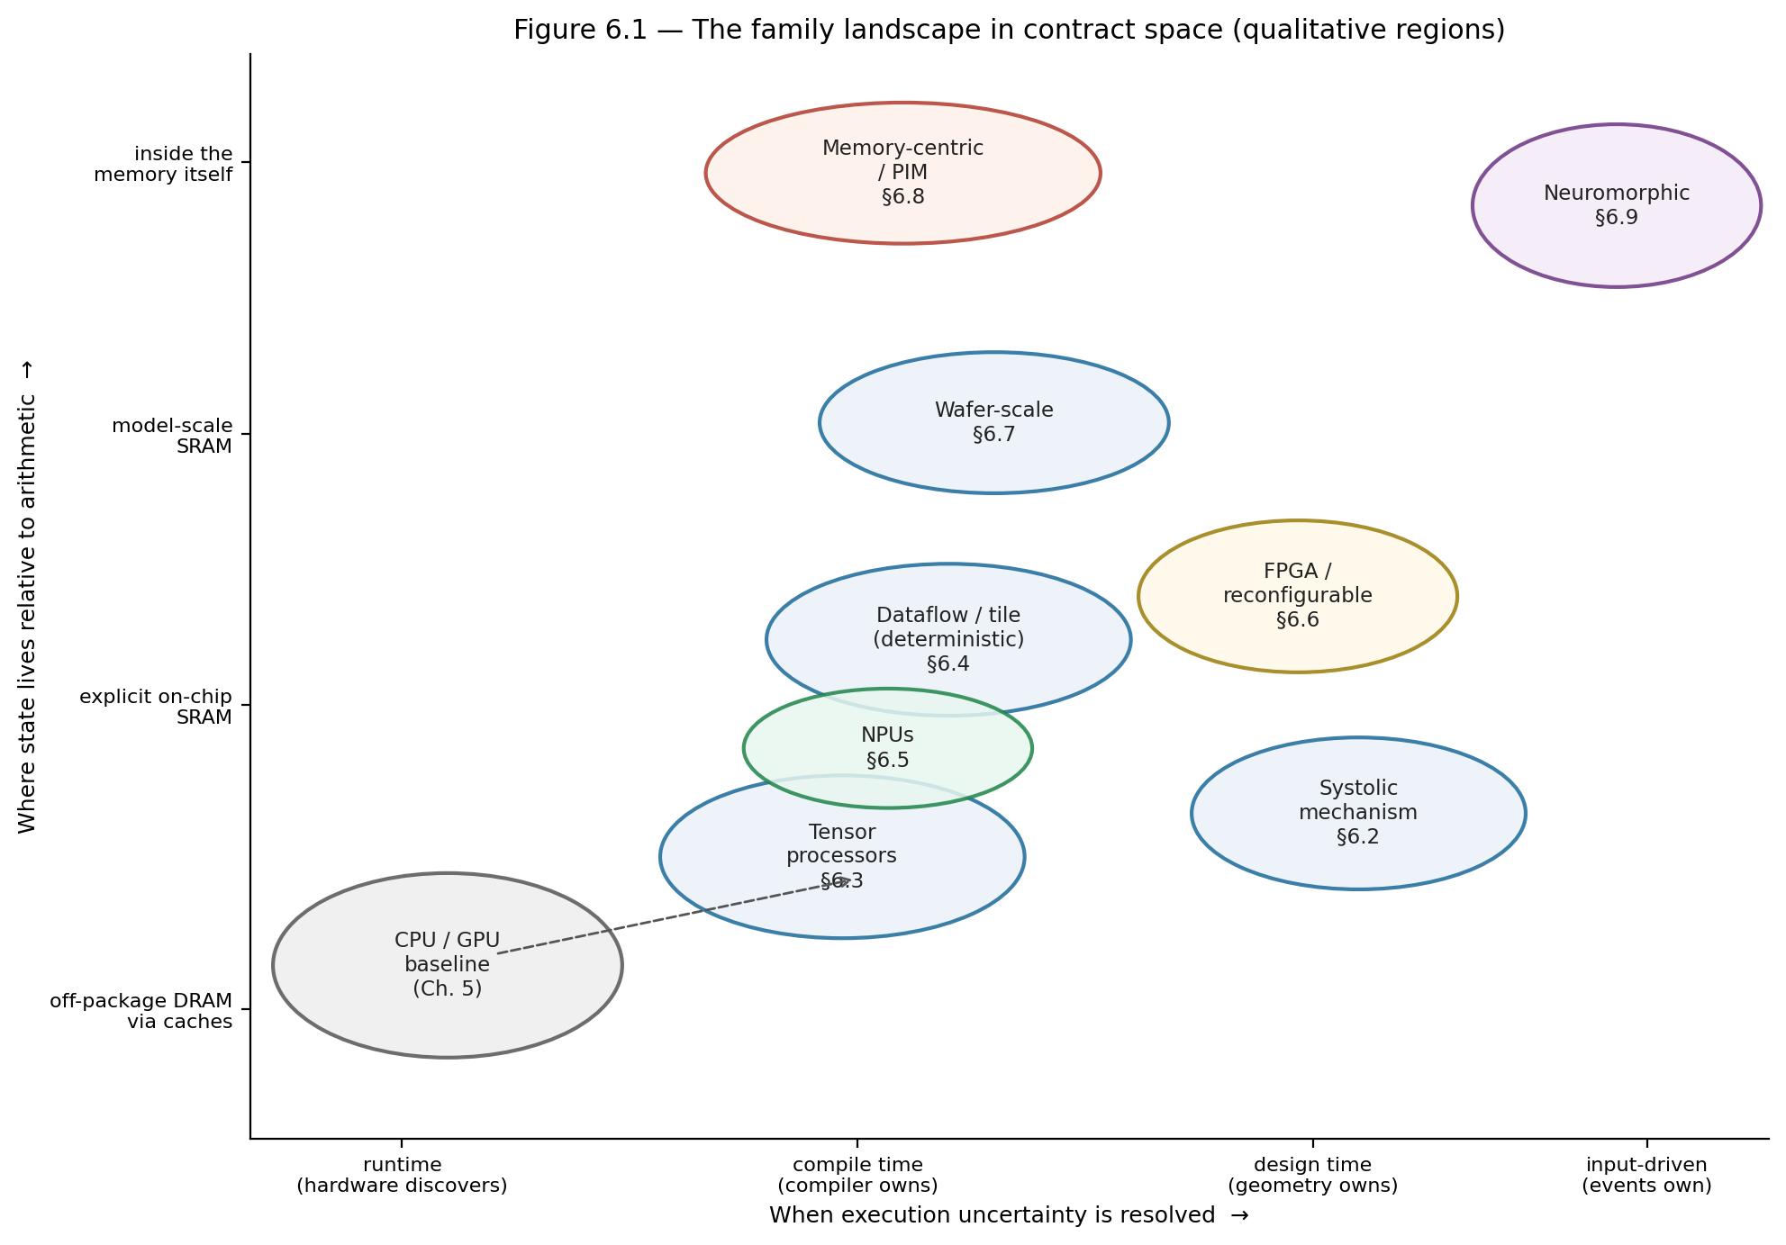
THE MAP
When uncertainty resolves × where state lives
⇒ Every family is a displacement from the CPU/GPU baseline on these two axes — no point dominates.
Beyond the GPU — 2-hour lecture
25
Notes:
Two axes. Horizontal: when execution uncertainty resolves — runtime (GPU) → compile time (tensor/dataflow) → design time (fixed) → input-driven (neuromorphic). Vertical: where state lives — DRAM → SRAM → in-memory. Every family is a displacement from CPU/GPU. No dominating point — each efficiency gain narrows an envelope. That's why plurality is permanent.

Slide 26
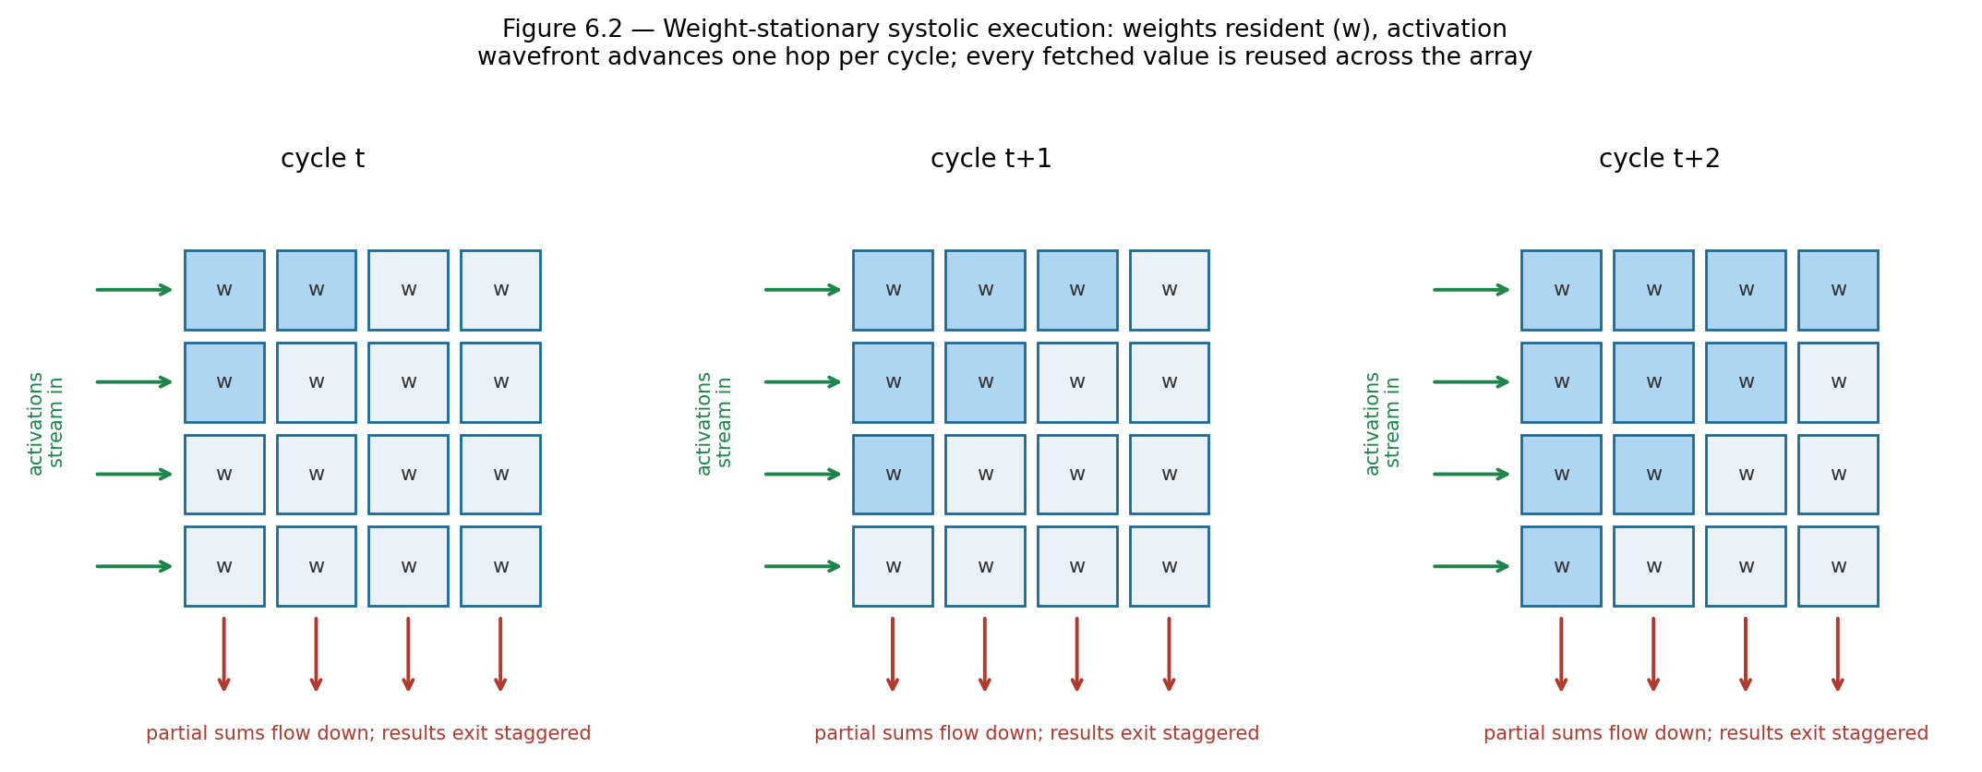
FAMILY · MECHANISM
Systolic arrays: reuse from geometry
⇒ A value fetched once is reused across the array — memory traffic only at the edges. Absorbed by everyone, including the GPU.
Beyond the GPU — 2-hour lecture
26
Notes:
The mechanism under most matrix hardware. Weights sit in a grid; activations flow through; a value fetched once is reused by every cell it passes — memory traffic only at the edges. TPU v1's 256×256 array = 65,536 MACs. Weakness: a matrix-vector op uses one column, rest idle. Now absorbed by everyone (GPU tensor cores) — committing a whole die to one big array is a bet on shape stability.

Slide 27
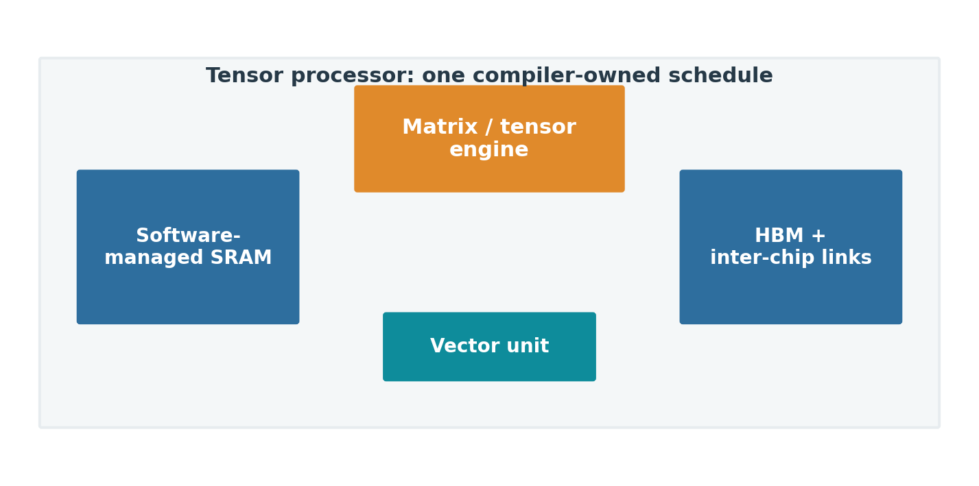
FAMILY · DEVICE
Tensor processors: one compiler-owned schedule
⇒ Matrix engine + software-managed SRAM. Wins dense portfolios at owner scale (TPU, Trainium, MTIA).
Beyond the GPU — 2-hour lecture
27
Notes:
Tensor processor = matrix engine + software-managed SRAM + DMA, all under ONE compiler-owned static schedule (vs the GPU's hardware scheduling). Contract changes: execution + scheduling + software. Wins stable dense portfolios at owner scale — hence every hyperscaler builds one. Risk: the compiler is load-bearing; coverage gaps become deployment blockers.

Slide 28
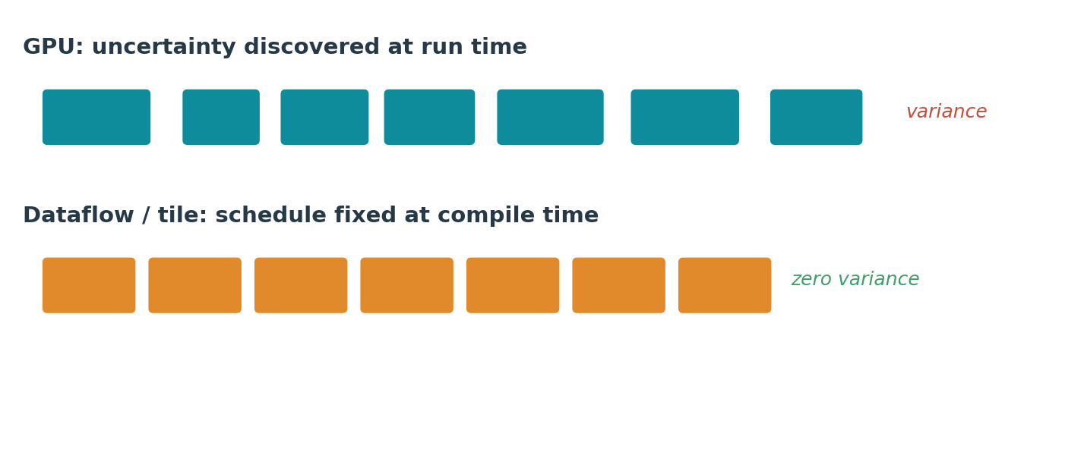
FAMILY
Deterministic dataflow / tile processors
⇒ Schedule fixed at compile time → zero variance. Bids for latency-bounded decode and reproducible execution (Groq).
Beyond the GPU — 2-hour lecture
28
Notes:
Push compile-time ownership to the limit: every operation and transfer placed at a fixed cycle → zero run-time variance, only device-boundary queueing. Buys deterministic low latency and reproducibility (Groq TSP, SambaNova, Tenstorrent). Cost: worst-case padding for dynamic shapes, and heavy compiler solve. Bids for latency-bounded decode.

Slide 29
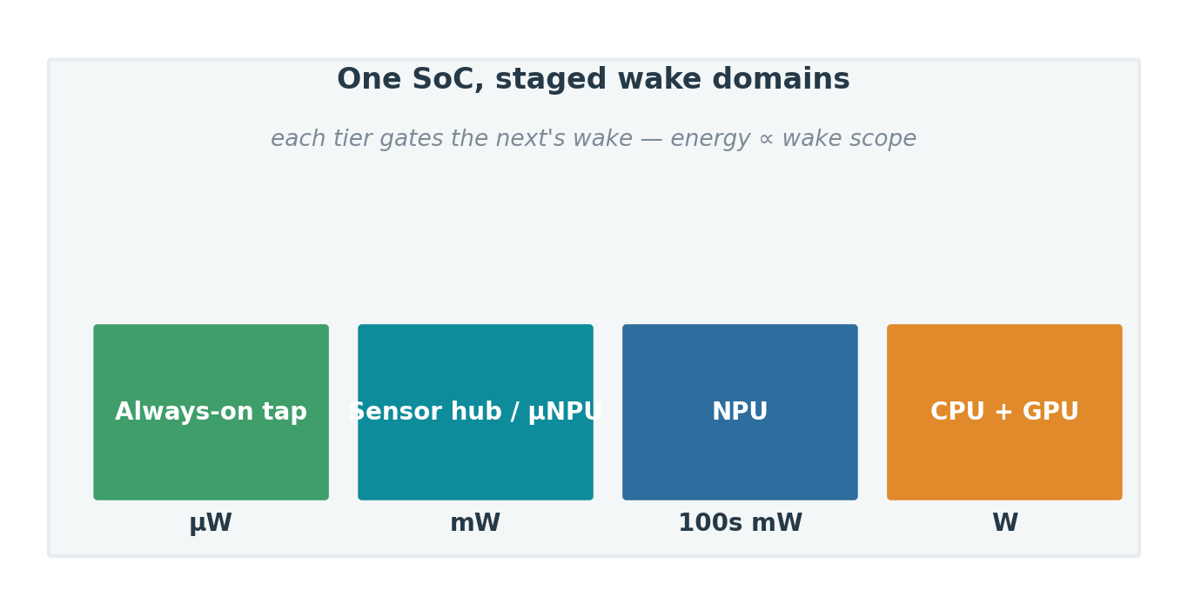
FAMILY
NPUs are the client's standard low-power AI block
Universal in client SoCs (≥40 TOPS floor).
Power-domain-first; sustained/ambient work.
Heavy generative inference still runs on the GPU.
Coverage, not TOPS, decides value.
⇒ Structural claim: wake-scope energy + cost floors sit outside the GPU contract, so the edge is where specialization is safest — not that NPUs win the client outright.
Beyond the GPU — 2-hour lecture
29
Notes:
OBSERVATION, not a claim of compute dominance. Hard facts (class A): every mainstream client SoC ships an NPU; Copilot+ mandates ≥40 TOPS (Intel ~48, AMD ~50, Qualcomm 45-85, Apple Neural Engine since 2017); positioned for sustained/ambient low-power work. COUNTER-FACT: heavy local generative inference still runs mostly on the client GPU (CUDA/DirectML) — "the great NPU failure" — because NPU software/operator coverage lags; utilization is low. TOPS ≠ usage. Defensible claim = the takeaway (structural bounds outside the GPU contract). If asked observation vs prediction: mostly observation + a conditional forward claim; softened from "own."

Slide 30
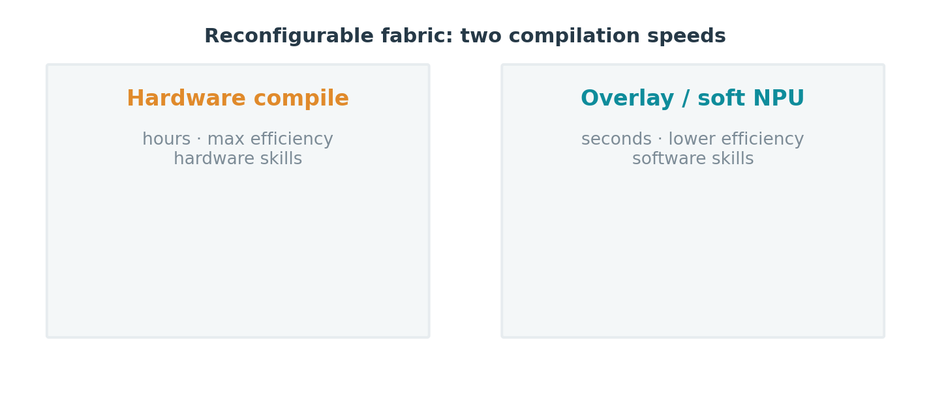
FAMILY
FPGAs: flexibility after manufacturing
⇒ Two compilation speeds. Wins where post-manufacture structure is the requirement; elsewhere a staging tier to ASIC.
Beyond the GPU — 2-hour lecture
30
Notes:
FPGA changes the software contract: structure is configured after manufacturing. Two speeds — full hardware compile (hours, max efficiency, hardware skills) vs overlay/soft-NPU (seconds, software skills). Wins where post-manufacture flexibility IS the requirement (interfaces, long-lifecycle, format experimentation — Microsoft Catapult/Brainwave). Elsewhere it's the industry's staging tier: prove condition 1-3 on FPGA before committing to an ASIC.

Slide 31
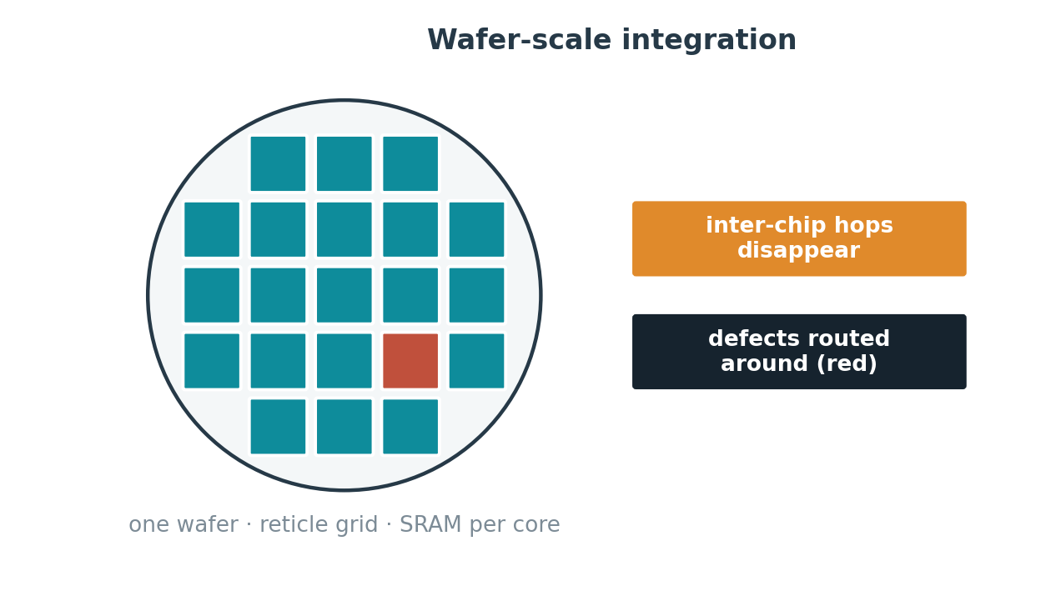
FAMILY
Wafer-scale: state at SRAM distance
⇒ Inter-chip communication becomes on-wafer routing; model-scale state stays close. Survives on anchor tenants.
Beyond the GPU — 2-hour lecture
31
Notes:
Refuse the reticle limit: build one logical accelerator across a whole wafer, so inter-chip comms become on-wafer routing and model-scale state sits in distributed SRAM (Cerebras WSE: ~44 GB on-wafer SRAM, ~21 PB/s). Defects routed around. Contract changes: communication + data placement. Condition 4 met not by broad adoption but by a few enormous anchor tenants.

Slide 32
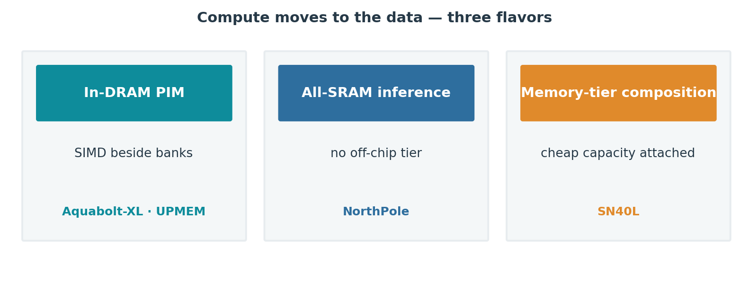
FAMILY
Memory-centric / processing-in-memory
⇒ Strongest condition-3 case in the survey — gated only by the lack of a portable programming model.
Beyond the GPU — 2-hour lecture
32
Notes:
Move compute to the data. Three flavors: in-DRAM SIMD beside banks (Aquabolt-XL, UPMEM), all-SRAM inference with no off-chip tier (NorthPole), tiered capacity attached to the accelerator (SN40L). Attacks the most-measured bounds (decode streaming, embedding gather, mobile wake). Strongest condition-3 case in the whole survey. Gated by ONE thing: no portable programming model.

Slide 33
FAMILY · FORWARD-LOOKING
Neuromorphic: energy proportional to activity
Mechanism
Evidence
Beachhead
Event-driven spikes; synaptic state beside the neurons; nothing switches when nothing changes.
Research-class (TrueNorth, Loihi). Validates the energy model, not yet a mainstream workload.
Extreme edge: always-on sensory, reflex loops, event cameras — sparse-in-time signals.
⇒ The theoretical endpoint of wake-scope logic — a direction of development, not yet a destination.
Beyond the GPU — 2-hour lecture
33
Notes:
Forward-looking, evidence class C/E — be explicit it's not shipping at scale. Input schedules the machine: energy ∝ activity. Validates the energy model (TrueNorth, Loihi) but the dense-tensor/backprop stack maps poorly onto spikes. Plausible beachhead: extreme-edge sparse-in-time sensing. Frame as the theoretical endpoint of the wake-scope logic, not a near-term product.

Slide 34
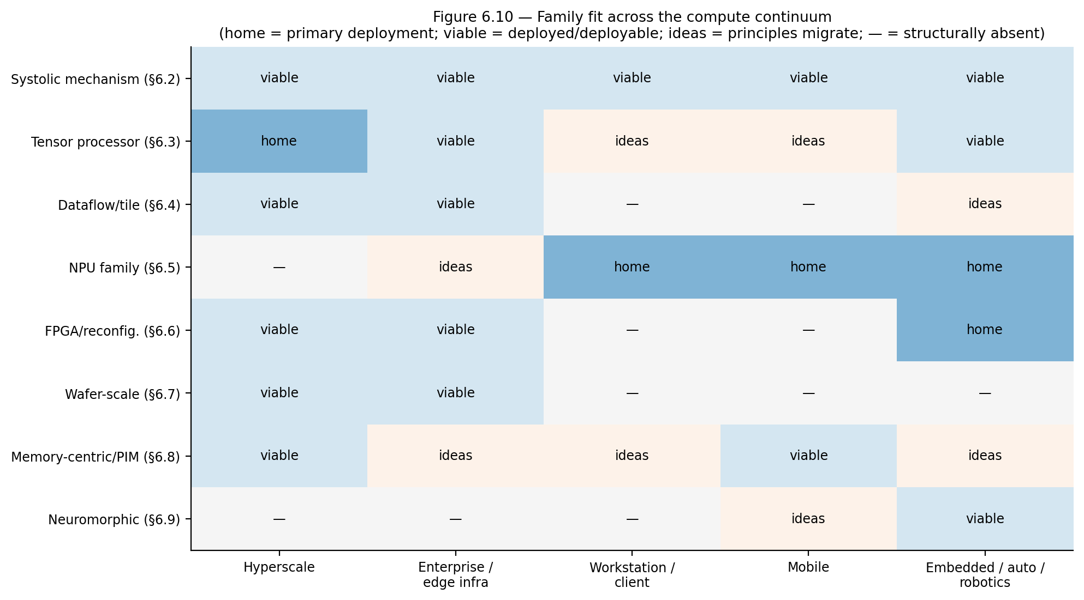
SYNTHESIS
Same families, different binding constraints
⇒ Ideas migrate both ways; implementations diverge because each deployment prices the stressors differently.
Beyond the GPU — 2-hour lecture
34
Notes:
Same families from µW silicon to MW pods, resized against different binding constraints. Ideas migrate both ways (unified memory up, quantization down); implementations diverge because each deployment prices stressors differently. One shared taxonomy, not two industries — this is the payoff of the whole method.

Slide 35
05
The landscape, grouped
Read through the framework — not a product catalog
Beyond the GPU — 2-hour lecture
35
Notes:
Section 5: apply the framework to the real market. Keep it GROUPED — resist the urge to spec-dump. The point is HOW each group resolves condition 4, not part numbers.

Slide 36
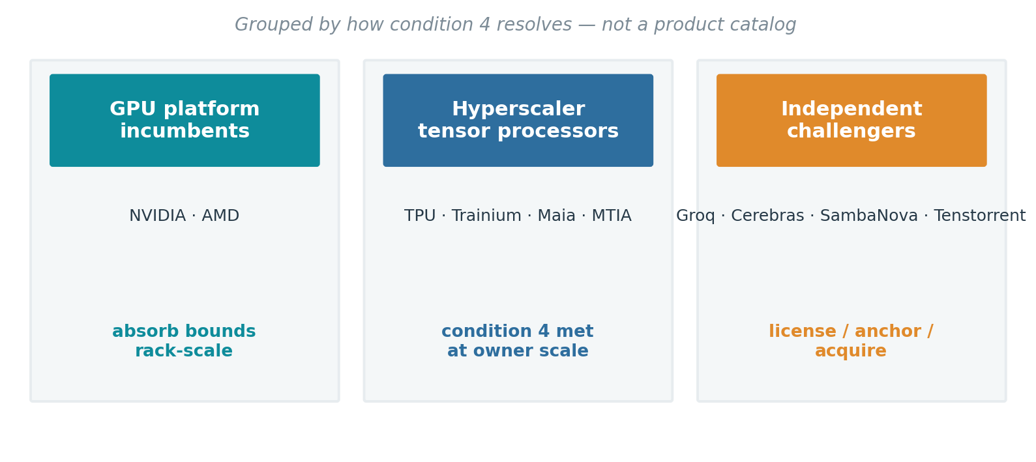
GROUPED LANDSCAPE
Three groups, one deciding variable
⇒ None of the challengers failed on architecture — every trajectory was decided by condition 4.
Beyond the GPU — 2-hour lecture
36
Notes:
Three buckets read through condition 4: incumbents (absorb, sell rack-scale), hyperscaler silicon (condition 4 met at owner scale), challengers (license/anchor/acquire). Headline: none failed on architecture — software capital, volume, and distribution decided every outcome.

Slide 37
GROUP · HYPERSCALER SILICON
The TPU verdict, replicated four times
Google TPU
AWS Trainium
Microsoft Maia
Meta MTIA
Seventh generation; inference-emphasized; pods of thousands.
Generally available; proprietary switch fabric; 'token economics.'
Inference-first; large on-chip SRAM; standard Ethernet.
Recommendation-first; peer-reviewed first generation.
⇒ Every major cloud fields internal tensor processors at generation depth — the second transition as industrial fact.
Beyond the GPU — 2-hour lecture
37
Notes:
The §2.14 TPU verdict replicated at every major cloud — because each has the owner-scale volume + internal model portfolio that satisfies condition 4. Note the two live experiments: inference-first is the new default (serving economics dominate fleet cost), and fabric philosophy has forked (proprietary scale-up vs commodity Ethernet). Snapshot facts — will age; the structural reading won't.

Slide 38
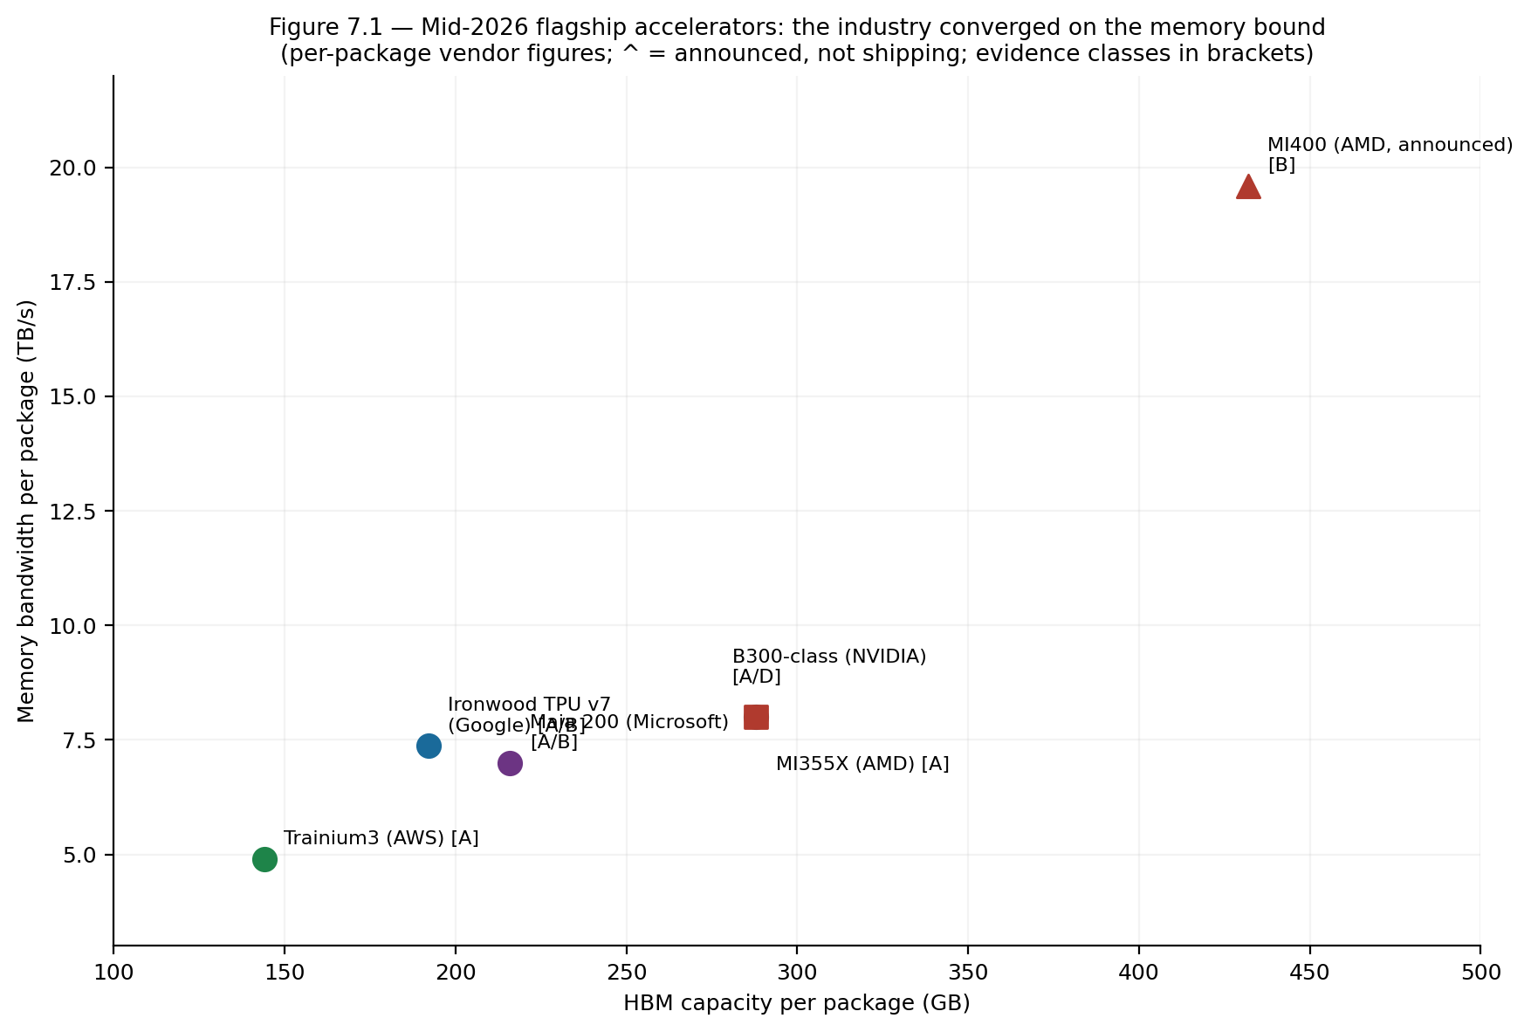
GROUP · GPU INCUMBENTS
The competition is a memory race
⇒ Flagships cluster on capacity and bandwidth, not FLOPS — the absorption thesis operating in public.
Beyond the GPU — 2-hour lecture
38
Notes:
Incumbents (NVIDIA, AMD) now sell rack-scale coherent domains, not cards. Every headline number is a MEMORY or scale-up number — capacity, bandwidth, NVLink-domain size — clustering tightly. That's the absorption thesis in public: they spend transistor/packaging budget on exactly the bounds Chapter 2 measured. The binding purchase constraint is increasingly power, not silicon.

Slide 39
GROUP · CHALLENGERS
The contested middle consolidates
License in
Anchor tenancy
Acquisition
A deterministic-dataflow architecture licensed into the incumbent platform.
Wafer-scale survives on a few enormous compute agreements, then IPO.
Programmable tile processors absorbed by a larger incumbent.
⇒ Condition 4 — software capital, volume, distribution — decided each, not architectural merit.
Beyond the GPU — 2-hour lecture
39
Notes:
How the contested middle resolved in 2025-26: Groq licensed its LPU into NVIDIA (condition 3 vindicated — incumbent paid billions — AND condition 4 enforced); Cerebras survived on anchor tenancy + IPO; Tenstorrent in acquisition talks; SambaNova a niche appliance. The absorption partition predicted GPU-platform absorption; the surprise was the MECHANISM (licensing-in a whole contract). All class-D reporting — flag as such.

Slide 40
GROUP · CLIENT & EDGE
The continuum's other half
AI PC
Mobile SoC
Embedded / µNPU
NPU + GPU under shared memory; bandwidth and coverage, not TOPS, decide.
Three wake tiers; on-device foundation models; thermal equilibrium separates the field.
IP-licensed; cost floor and decade lifecycle dominate.
Robotics
Automotive
Shared taxonomy
GPU-class perception above a deterministic control floor — flexibility wins when algorithms churn.
Determinism and lifecycle become certification objects; supply sovereignty joins economics.
Same families as the datacenter — different binding constraints.
Beyond the GPU — 2-hour lecture
40
Notes:
Client/edge grouped. Recurring theme: memory and coverage, not TOPS, decide. Robotics is the instructive case — it deliberately pays the GPU's generality tax because algorithms churn fastest (flexibility wins). Automotive turns determinism/lifecycle into certification objects. Same families as the datacenter, different binding constraints.

Slide 41
06
Substrate & economics
Software capital, packaging, and cost
Beyond the GPU — 2-hour lecture
41
Notes:
Section 6: the substrate that actually decides winners — software capital, packaging/memory, and the cost stack. This is where condition 4 lives.

Slide 42
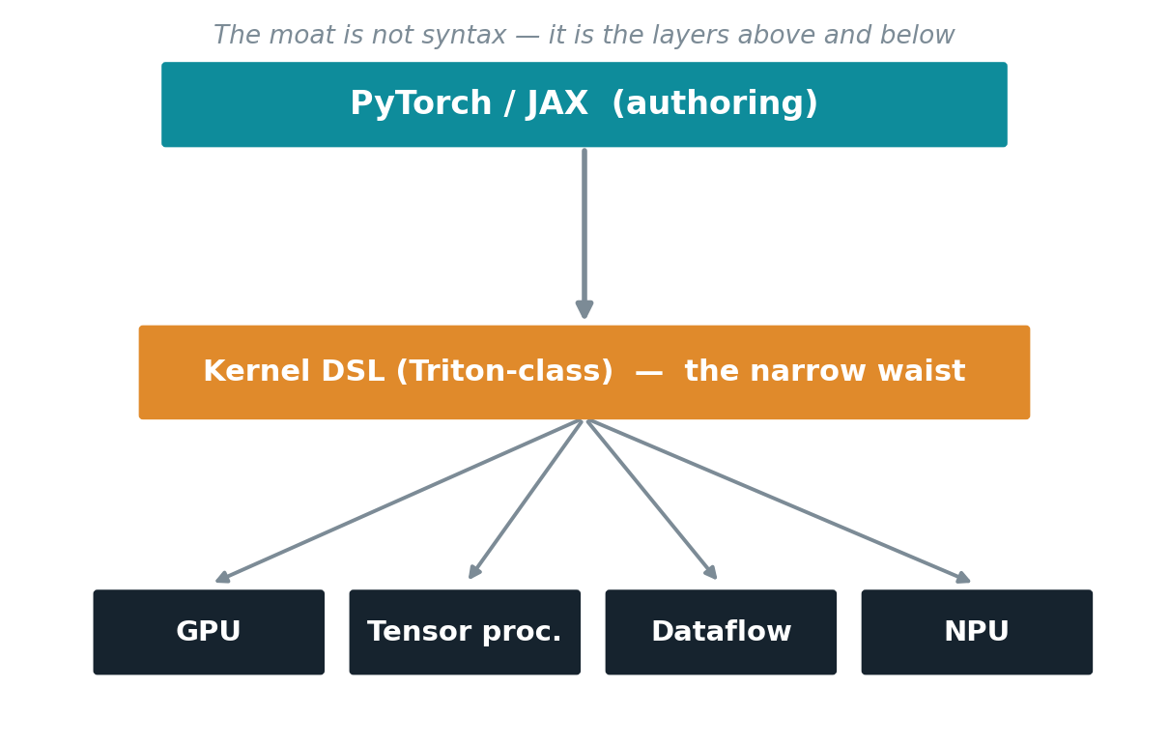
SOFTWARE ECOSYSTEM
The moat is not the kernel language
⇒ Portability efforts aimed at the kernel layer solve the cheapest part; the moat sits above and below the waist.
Beyond the GPU — 2-hour lecture
42
Notes:
CUDA's moat has moved UP the stack: kernel syntax is now mirrored (ROCm/HIP) or abstracted (Triton), so the defensible layers are distributed libraries, serving policy, numerical recipes, operational tooling. The "narrow waist" question: PyTorch as authoring waist, Triton-class DSL as operator waist, proprietary residue in collectives/serving. For a challenger: name which waist you enter and what you do about the residue. "Build our own waist" fails at merchant scale.

Slide 43
THE PACKAGE IS THE NEW NODE
Integration is the frontier
HBM
Packaging
Fabric & optics
Sets every bandwidth bound; three-vendor supply; rivals the logic die in cost share.
Reticle limit drives 2.5D, chiplets, hybrid bonding; capacity itself gates supply.
Scale-up vs Ethernet; co-packaged optics attacks network power, not latency.
⇒ The competitive frontier moved from logic to integration — the package, the rack, the facility.
Beyond the GPU — 2-hour lecture
43
Notes:
The frontier moved from logic to integration. HBM sets every bandwidth bound and its supply/cost is a condition-4 term (three vendors; can rival the logic die in BOM). Packaging: the ~800mm² reticle limit drives 2.5D/chiplets/hybrid bonding; advanced-packaging capacity gates supply. Fabric: scale-up vs Ethernet; co-packaged optics attacks network POWER. Most of Chapter 11's futures are packaging stories.

Slide 44
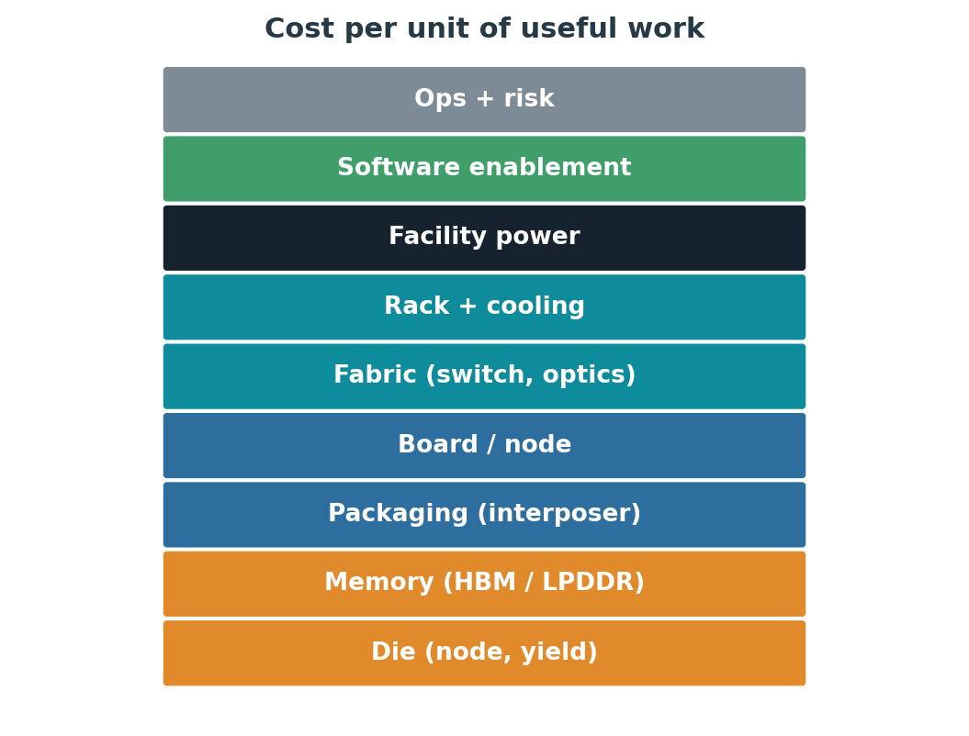
ECONOMICS
The full cost stack of useful work
Every family redistributes weight.
None shrinks the stack uniformly.
Power now gates deployments.
⇒ The necessity test, in cost terms: does a redistribution lower the total for this workload at this volume?
Beyond the GPU — 2-hour lecture
44
Notes:
The full stack from die to service: memory, packaging, board, fabric, rack+cooling, facility power, software enablement, ops, risk. Every family REDISTRIBUTES weight (wafer-scale moves fabric cost into yield; PIM moves logic into memory; NPU into per-unit area) — none shrinks it uniformly. Condition 4 in cost terms: does the redistribution lower the TOTAL for this workload at this volume? Power increasingly gates deployment ahead of capital.

Slide 45
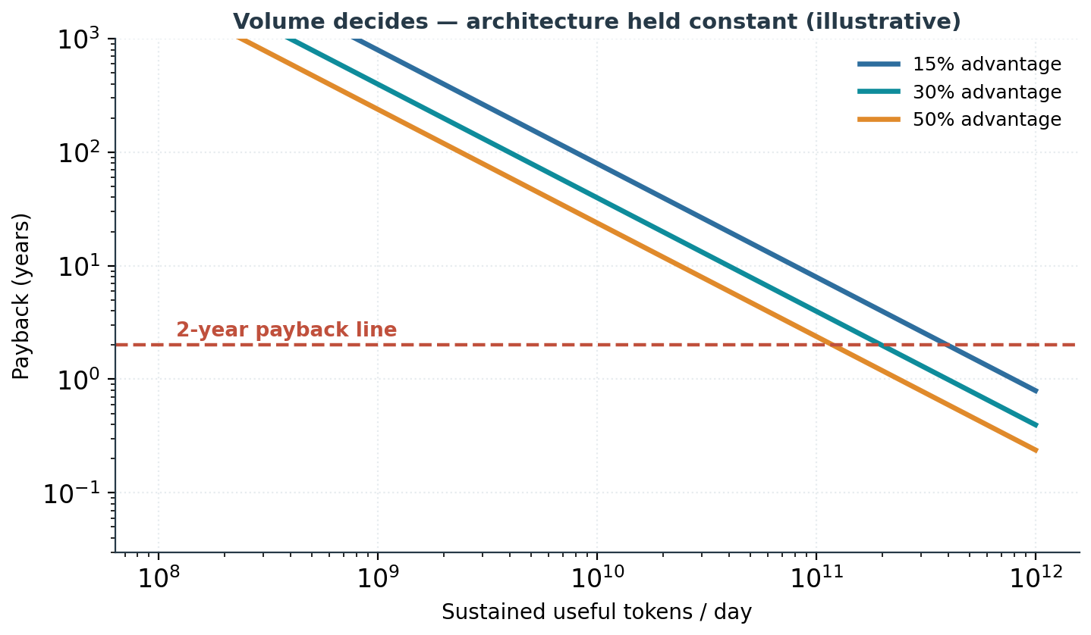
ECONOMICS
Volume decides — architecture held constant
Fixed cost ≈ software enablement.
Savings scale with volume.
Flexibility has option value.
⇒ Below the volume threshold no efficiency percentage rescues the case; above it, small percentages justify large programs.
Beyond the GPU — 2-hour lecture
45
Notes:
Worked break-even (illustrative). Fixed cost dominated by software enablement; recurring savings scale with volume, fixed cost doesn't → a volume threshold. Below it, no efficiency % rescues the case; above it, small % justify huge programs. Explains hyperscale-yes vs enterprise-no on identical architecture (different denominator). Price flexibility as option value: a 20% win today bets the workload holds still.

Slide 46
07
Futures & conclusions
Graded by evidence; what holds everywhere
Beyond the GPU — 2-hour lecture
46
Notes:
Section 7: futures with evidence discipline, then the durable conclusions. Keep futures humble — grade every claim.

Slide 47
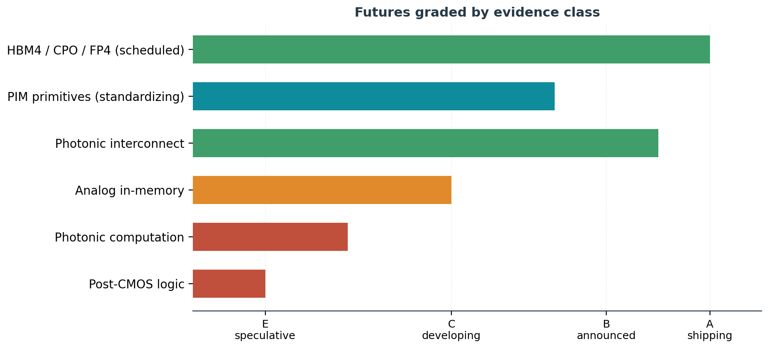
FUTURES
Graded by evidence class
⇒ New memories arrive before new logic; the nearest contract changes enter inside incumbent platforms, via packaging.
Beyond the GPU — 2-hour lecture
47
Notes:
Grade every future. Scheduled (A/B): HBM4, CPO, FP4, chiplets — intensify the present. PIM (B/C) standardizing. Photonic interconnect (A/B) yes, photonic COMPUTATION (C/E) defeated at the conversion boundary today. Analog in-memory (C). Two rules: new memories arrive before new logic; the nearest contract changes enter INSIDE incumbent platforms via packaging, not as standalone families.

Slide 48
DEMAND-SIDE WILDCARDS
What could move the bounds first
Test-time compute
Persistent-state agents
Default sparsity
Reasoning longer, not larger — deepens the decode bound, strengthens inference silicon.
Promote state residency and freshness to first-class bounds — a possible new family.
MoE and retrieval push routing and gather up the priority list.
⇒ If the signatures move, the family taxonomy should be re-derived — the method predicts its own revision.
Beyond the GPU — 2-hour lecture
48
Notes:
The demand side may move before the supply side. Test-time compute (reason longer) deepens the decode bound → strengthens every inference-first thesis. Persistent-state agents promote state residency/freshness — territory no family owns cleanly, the likeliest source of a genuinely new family. Default sparsity pushes routing/gather up. The method predicts its own revision: re-derive the taxonomy from measured signatures each edition.

Slide 49
CONCLUSIONS
What holds across the whole picture
A
Software converges on physics
B
Necessity is decidable
Both transitions are software succeeding until it exposes a hard, measurable bound.
A four-condition test returns specialize / market-no / stay-on-GPU from measurable inputs.
C
Condition 4 dominates
D
Families, not a successor
Software capital, volume, and distribution decide outcomes more than silicon merit.
Each changes a contract the GPU cannot adopt without ceasing to be a GPU.
E
Bounds moved to memory & power
F
One continuum
Capacity, bandwidth, fabric, and facility power separate contenders — not FLOPS.
The same taxonomy reads microwatt silicon and megawatt pods.
Beyond the GPU — 2-hour lecture
49
Notes:
Six findings, each traceable to evidence shown. Leave two ringing: (C) condition 4 / software capital decides most outcomes — audit the stack before the silicon; (E) bounds moved to memory, fabric, facility power — arithmetic peak no longer separates contenders. The one durable tool: the four-condition test.

Slide 50
GUIDANCE
How to use the framework
Software architects
Platform architects
Hardware selection
Design against signatures; respect batch-one; measure at the useful-result boundary; the test, not the catalog.
Evaluate at pod and facility; prefer consumption to ownership until volume proves otherwise; protect software seams.
Signatures → software ceiling → locate the bound in the partition → weight the stack → run the test.
Beyond the GPU — 2-hour lecture
50
Notes:
Role-specific takeaways. Software architects: design against signatures, respect the batch-one ceiling, measure at the useful-result boundary. Platform architects: evaluate at pod/facility, prefer rented specialization to ownership below hyperscale volume, protect the software seams that preserve exit options. Selection: a sequence — signatures → honest software ceiling → locate the bound in the absorption partition → weight the software stack → run the test.

Slide 51
THE ARGUMENT IN ONE SENTENCE
Software optimization succeeds until it exposes a bound; the bound is absorbed by the GPU platform, escaped by changing a contract, or lived with — and the deployment class decides which.
Everything else — signatures, contracts, families, economics — is the machinery that makes that choice decidable.
Beyond the GPU — 2-hour lecture
51
Notes:
Close on the one sentence and stop. The machinery (signatures, contracts, families, economics) exists to make that choice decidable rather than rhetorical. Hand them the four-condition test as the portable takeaway.

