Slide 1


Airport event scheduling application
Students:
Slavu Vlad Constantin
Petruta George-Calin

Slide 2
Contents (first half):
1. General Presentation
2. Theoretical Fundamentals
3. IT Technology
4. Functionalities
5. Actors and related access rights
6. Use case diagrams

Slide 3
Contents (second half):
7. System Architecture
8. Design
9. Operation Mode and UI
10. Portability
11. Competing Software

Slide 4
Chapter 1:
General Presentation

Slide 5
General presentation
Application for scheduling events for an airport
The application allows some operations:
Adding new events
Deleting existing events
Updating existing events
Listing events
Filtering events

Slide 6
General presentation
Another operations
Adding staff members
Adding staff event assignation
Book flights
See booked flights

Slide 7
General presentation
It allows five actors:
Admin
Customer
Guest
Staff manager
Event manager

Slide 8
General presentation
The actors can only access the features allowed to them
The users can sign in, log in and log out to access the application’s features

Slide 9
Chapter 2:
Theoretical Fundamentals

Slide 10
Theoretical fundamentals
Connecting to a database using Spring Framework
Setting up a configuration to a database
Basic operations on a database using JPA Repository

Slide 11
Theoretical fundamentals
Create models for the data
Hashing added passwords
Creating tokens with roles for accessing features

Slide 12
Chapter 3:
IT
Technology

Slide 13
IT technologies
The main used technologies in our application:
Java (Java11)
Spring
Intellij IDEA

Slide 14

IT technologies
Java
Version used: 11
Powerful and versatile
Popular
Long time support available

Slide 15

IT technologies
Spring
Version used: 2.6.0
Helpful in creating high performing applications
Provides infrastructure support
A lot of useful annotations and features
Powerful framework

Slide 16

IT technologies
IntelliJ Idea
Multiple plugins for easier developing
Popular IDE for Java applications
Friendly interface

Slide 17
Chapter 4:
Functionalities

Slide 18
Functionalities
The main functionalities are:
Adding new airport events
Delete airport events
Update airport events
Listing airport events
Filter airport events
Sign up
Log in

Slide 19
Functionalities
Another main functionalities
Adding staff members
Adding staff event assignations
Book flights
List booked flights

Slide 20
Functionalities
Add a new airport event
Feature accessible only to the ADMIN and Event manager actor
Creates a new entry in the database containing information about an airport event

Slide 21
Functionalities
Delete airport event
Feature accessible only to the ADMIN actor
Selects an already existing airport event from the database and delete it

Slide 22
Functionalities
Update airport event
Feature accessible only to the ADMIN actor
Selects an already existing airport event from the database and updates it with new data

Slide 23
Functionalities
Add staff member
Feature accessible only to the ADMIN and Staff manager actor
Creates a new entry in the database containing information about a staff member

Slide 24
Functionalities
Add staff event assignation
Feature accessible only to the ADMIN, Staff manager and Event manager actor
Creates a new entry in the database containing information about a staff event assignation

Slide 25
Functionalities
Book flight
Feature accessible only to the Customer actor
Creates a new entry in the database containing information about a ticket (a booked flight)

Slide 26
Functionalities
List booked flights
Feature accessible only to the Customer actor
Display the list of booked flights for an actor

Slide 27
Functionalities
List airport events
Feature accessible to every actor
Display all the data about the airport events that is requested from the database

Slide 28
Functionalities
Filter airport events
Feature accessible to every actor
Filter the data using filters such as:
Start date
End date
Start location
End location
And then displays it

Slide 29
Functionalities
Sign up
Feature accessible to every actor beside Guest
Creates a new account with a username and a password

Slide 30
Functionalities
Log in
Feature accessible to every actor beside Guest
Enters the application using credentials
Depending on the credentials and the user type, the user receives access to different features

Slide 31
Chapter 5:
Actors &
related access rights

Slide 32
Actors & related access rights
Five actors:
Admin
Customer
Guest
Staff manager
Event manager

Slide 33
Actors & related access rights
Application developed using role-based implementation
When the user logs in, a new token is created
The token keeps information about the user such as:
Username
Role (admin or customer)

Slide 34
Actors & related access rights
Admin
The most important actor of the application
Has access to every feature of the application:
Data modification
Data display
Account operations

Slide 35
Actors & related access rights
Customer
Has restricted access to features
Can NOT access data modification features
The customer can:
Display data
Operate accounts (create, log in, log out)
Book flight
List booked flights

Slide 36
Actors & related access rights
Guest
An actor with only “read” permissions
Has restricted access to features
Can NOT access data modification features
The guest can:
Display data

Slide 37
Actors & related access rights
Staff manager
Has restricted access to features
Manages the staff part of the application
The customer can:
Display data
Operate accounts (create, log in, log out)
Add new staff members
Add new staff event assignation

Slide 38
Actors & related access rights
Event manager
Has restricted access to features
Manages the events part of the application
The customer can:
Display data
Operate accounts (create, log in, log out)
Add new events
Add new staff event assignation

Slide 39
Chapter 6:
Use Case
Diagrams

Slide 40
Use Case Diagrams
for admin

Slide 41
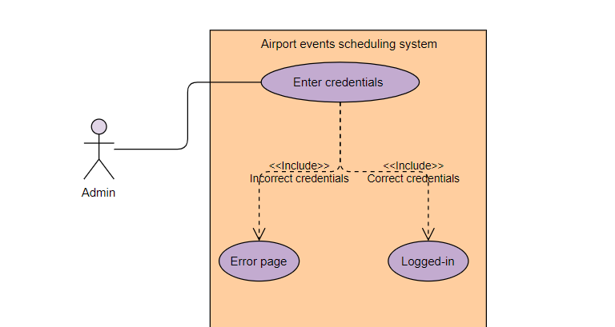
Use case: admin logs in

Slide 42
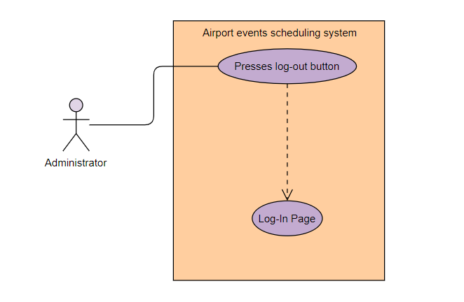
Use case: admin logs out

Slide 43
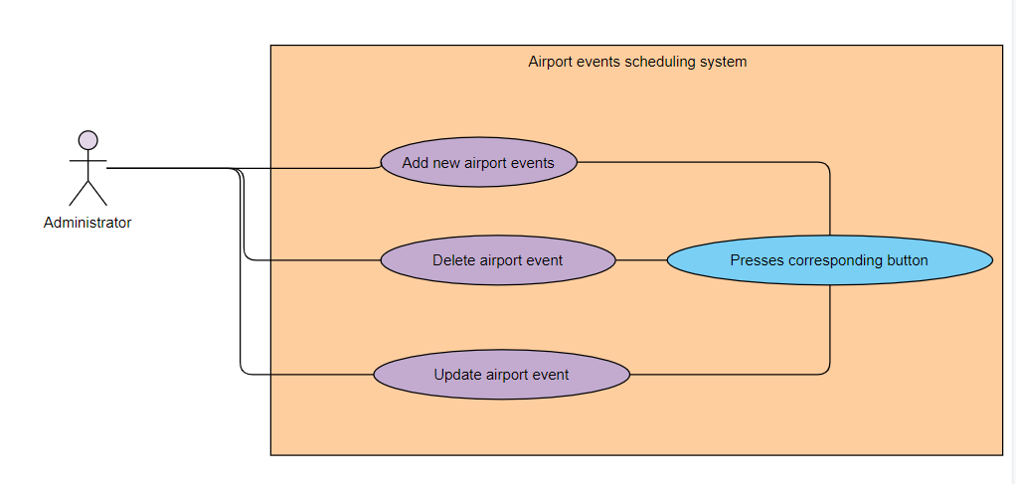
Use case: admin modify events

Slide 44
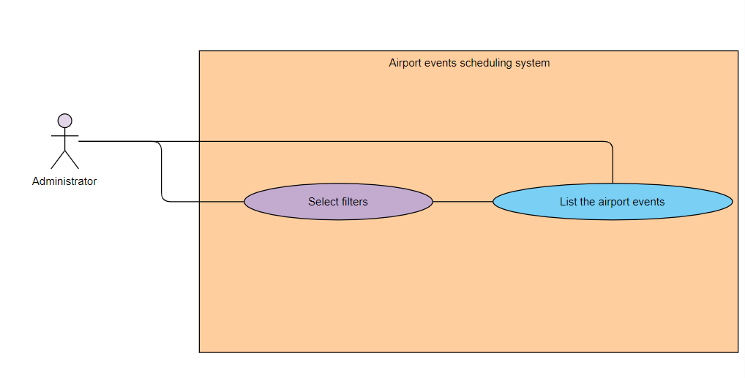
Use case: admin lists and filters events

Slide 45
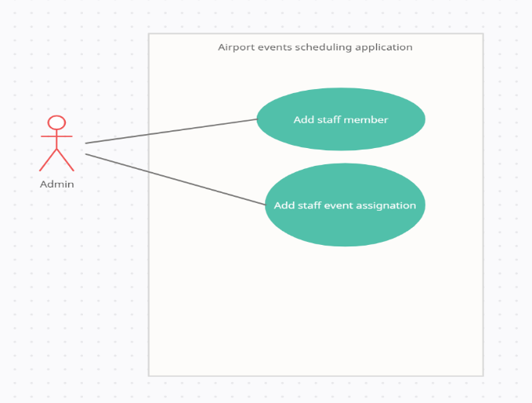
Use case: Create staff members and event assignation

Slide 46
Use Case Diagrams
for customer

Slide 47
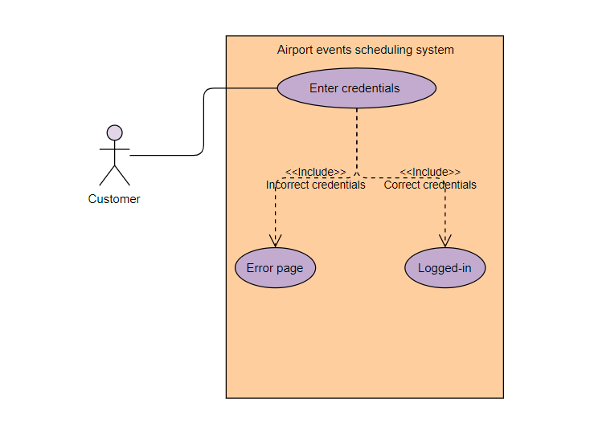
Use case: customer logs in

Slide 48
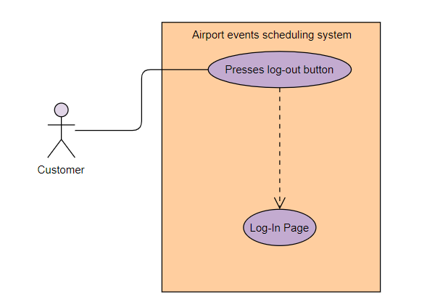
Use case: customer logs out

Slide 49
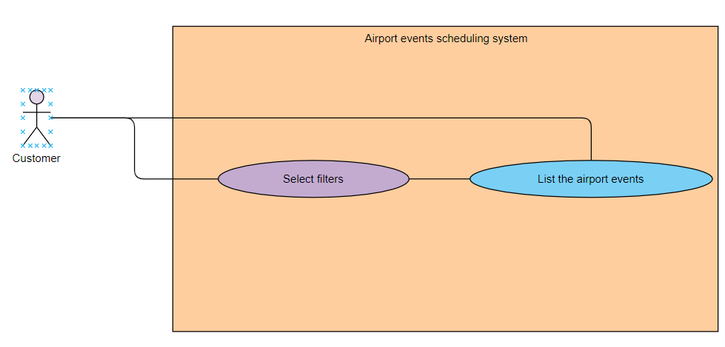
Use case: customer lists and filters events

Slide 50
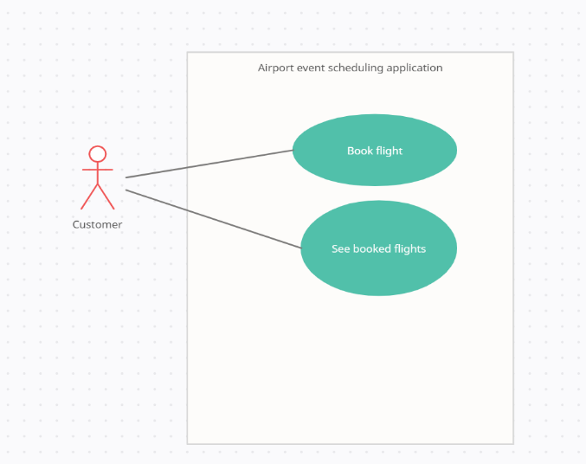
Use case: Book flight and see booked flights

Slide 51
Use Case Diagrams
for Guest

Slide 52
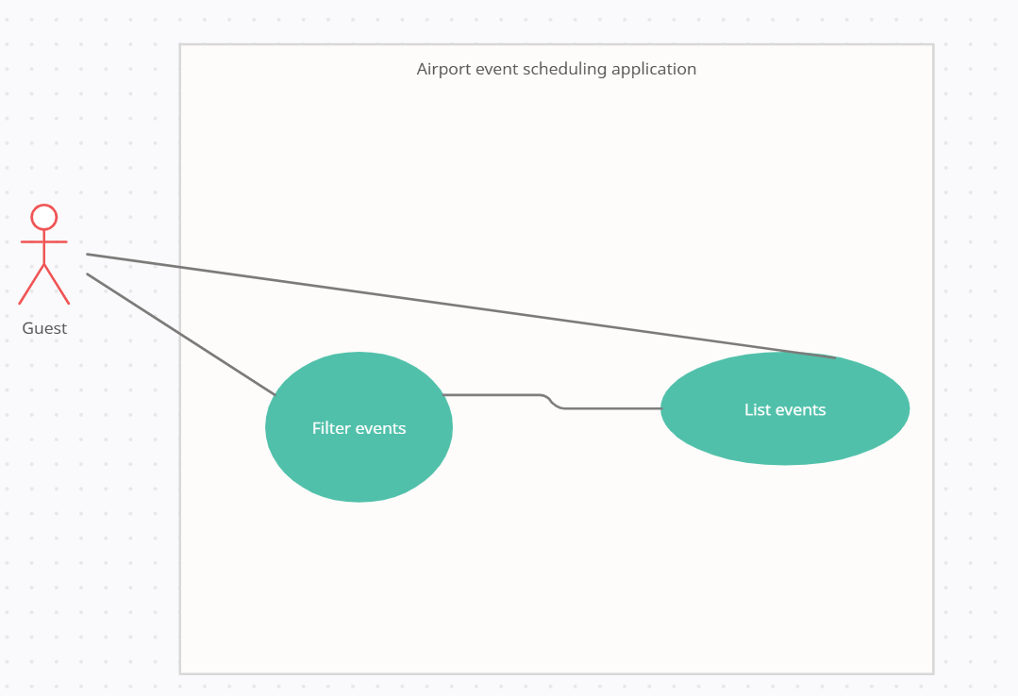
Use case: List and filter events

Slide 53
Use Case Diagrams
for Staff manager

Slide 54
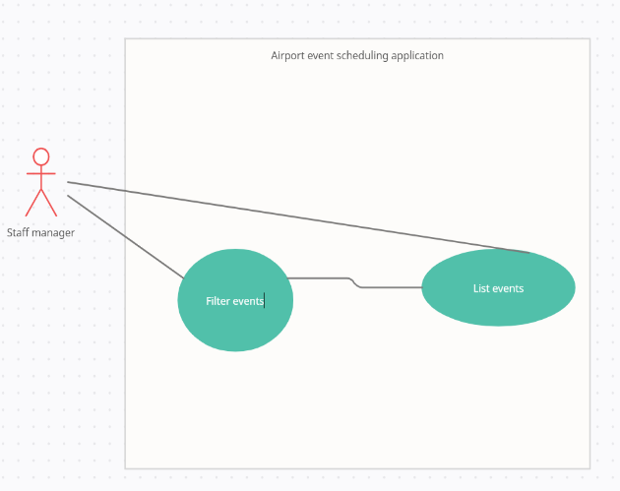
Use case: List and filter events

Slide 55
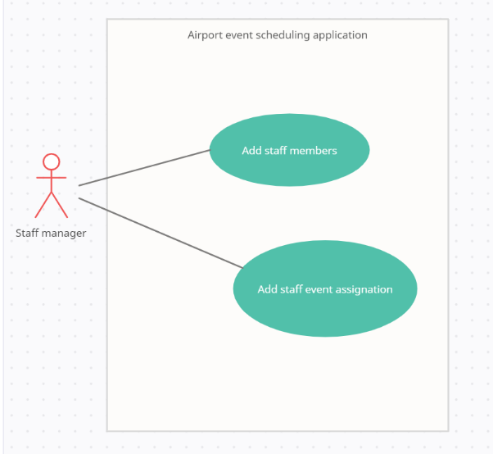
Use case: Create staff member and staff event assignation

Slide 56
Use Case Diagrams
for Event manager

Slide 57
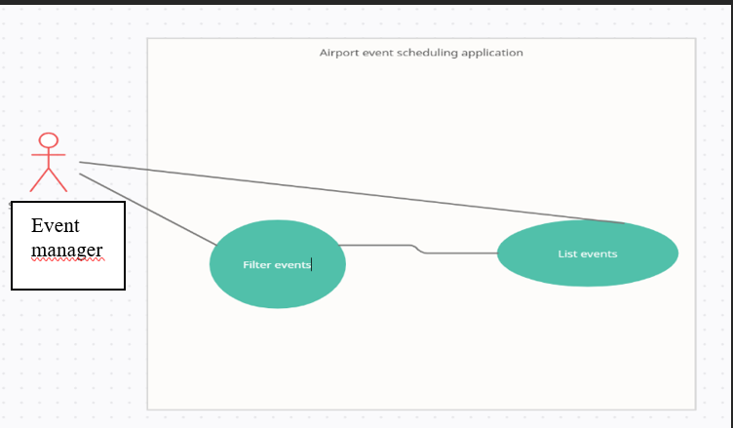
Use case: List and filter events

Slide 58
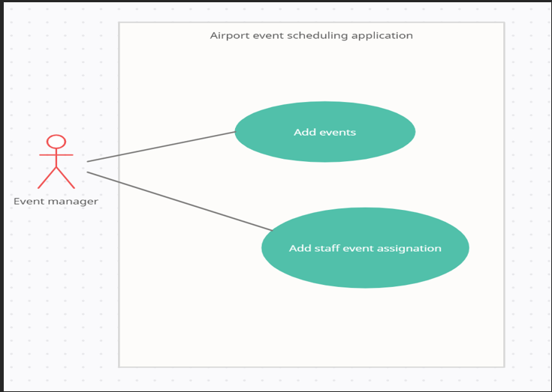
Use case: Create staff member and staff event assignation

Slide 59
Chapter 7:
System
Architecture

Slide 60
System architecture
Purpose of system architecture:
Define:
a comprehensive solution based on:
Principles
Concepts
Properties

Slide 61
Chapter 8:
Design

Slide 62
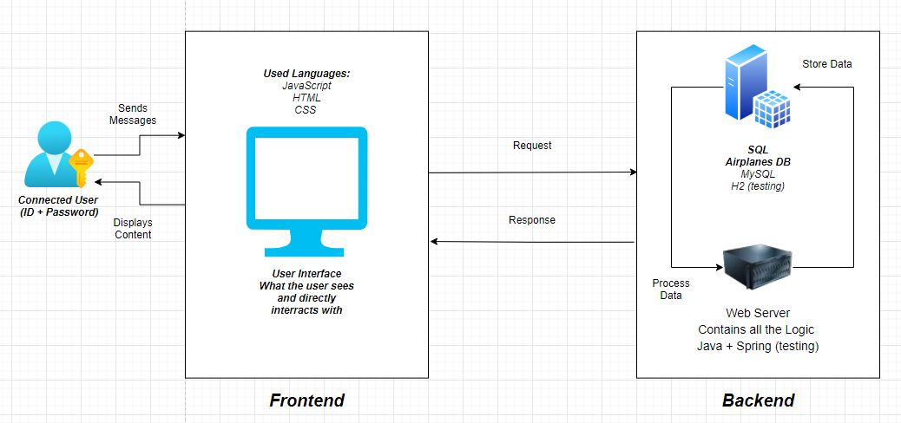
System Architecture Diagram

Slide 63
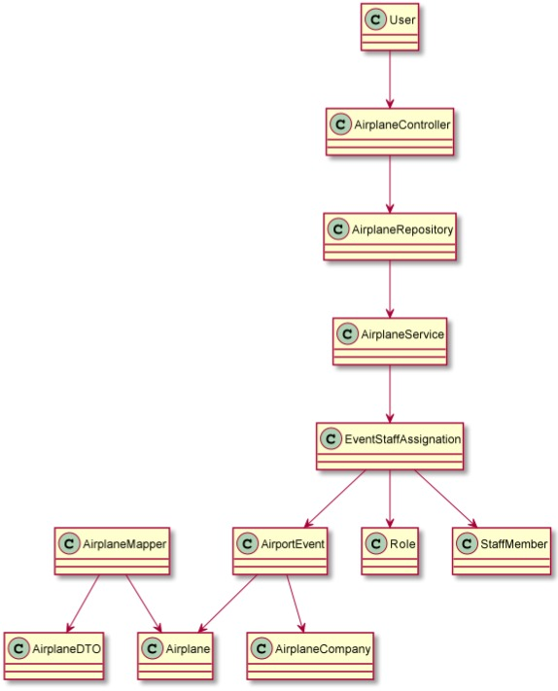
Class Diagram

Slide 64
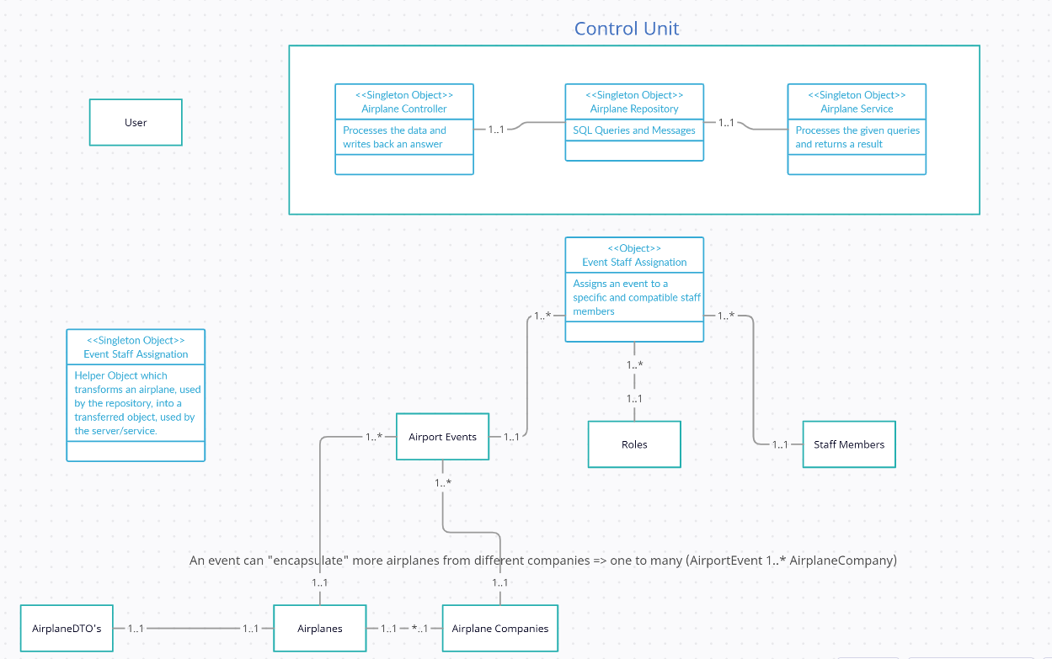
Object Diagram

Slide 65
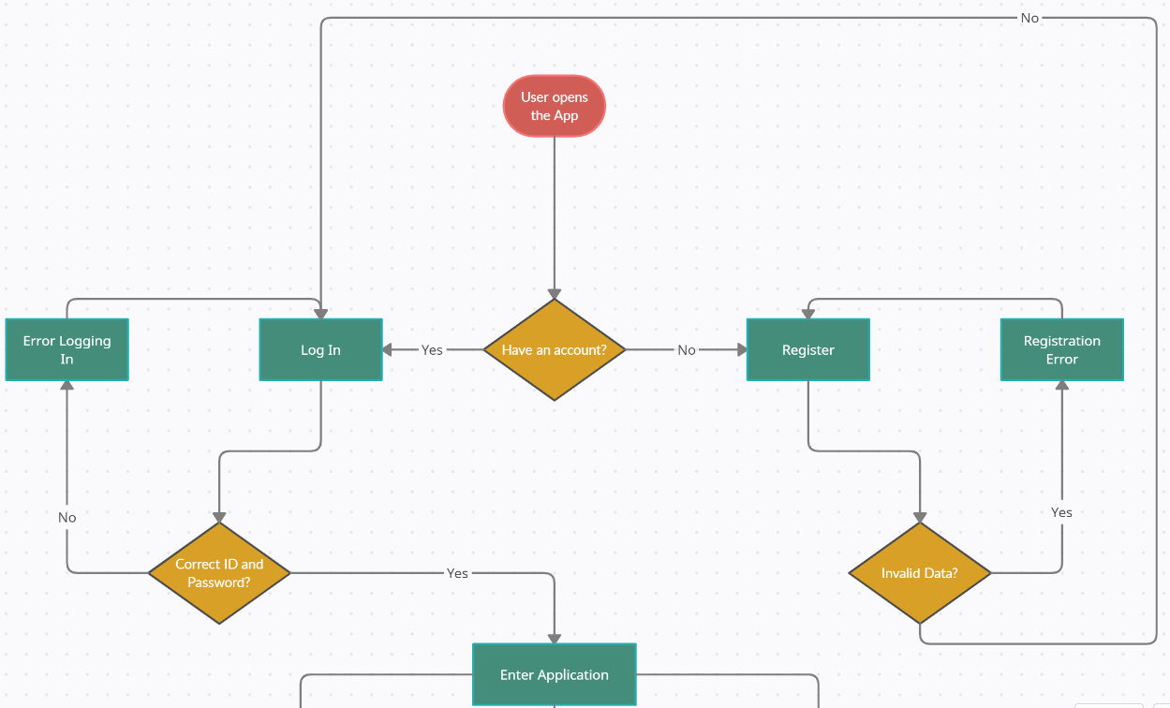
Flow-chart Diagrams

Slide 66
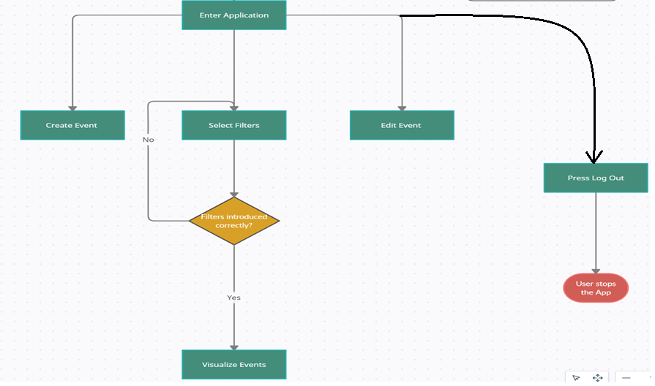
Flow-chart Diagrams (cont’d)

Slide 67
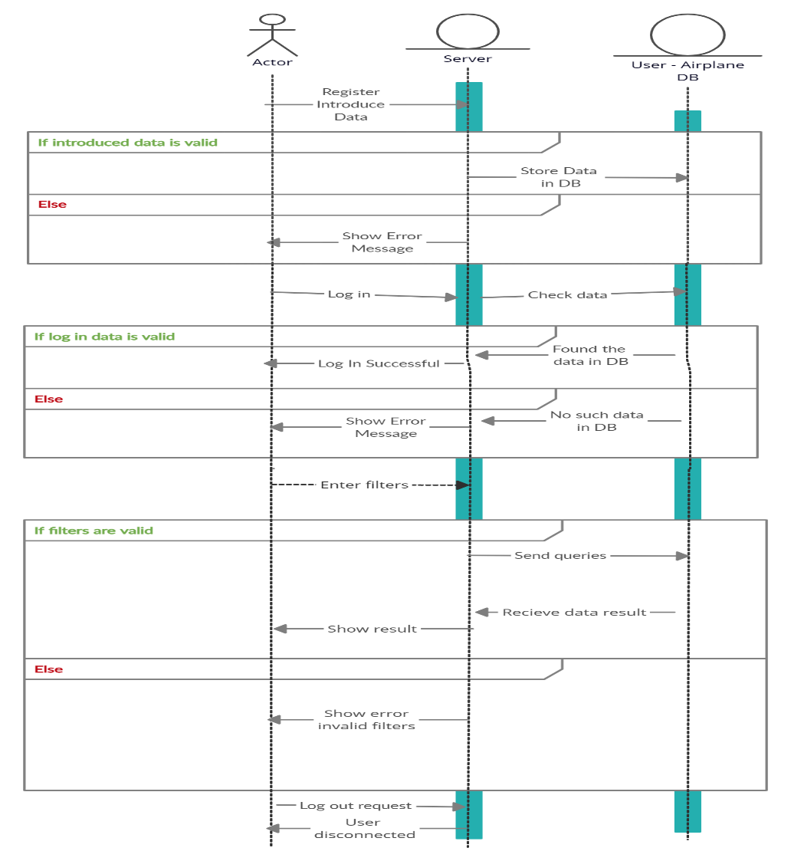
Sequence
Diagrams

Slide 68
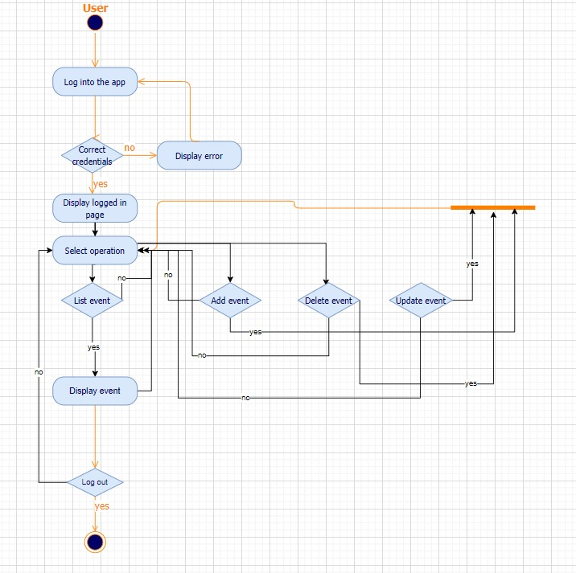
Activity Diagrams

Slide 69
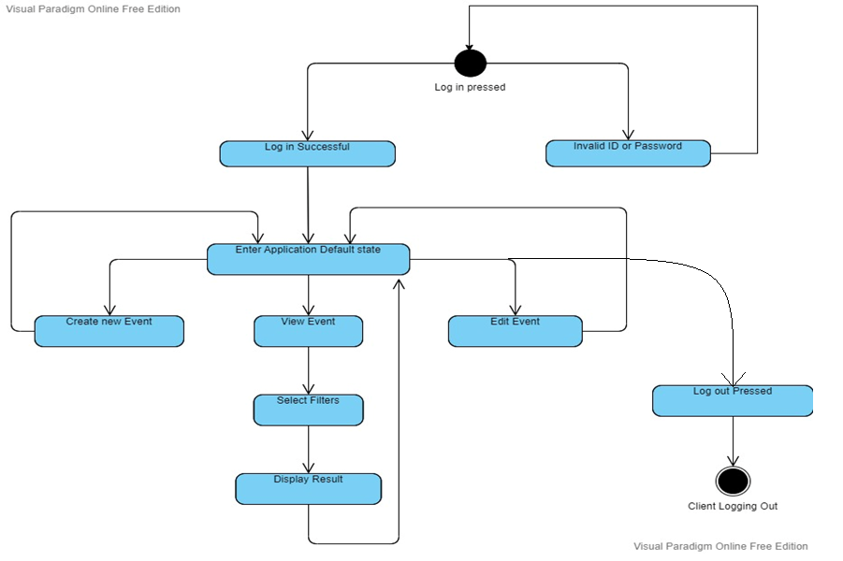
State Transition Diagrams

Slide 70
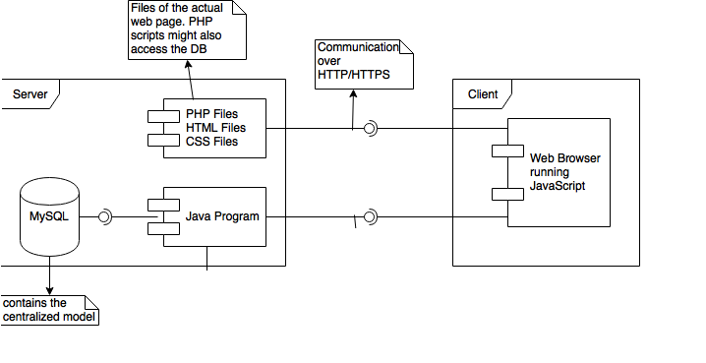
Communication Diagram

Slide 71
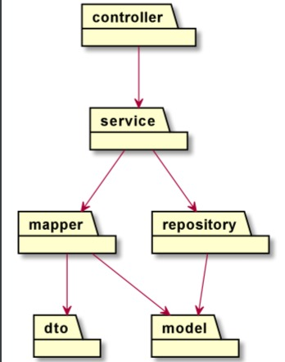
Package Diagram

Slide 72
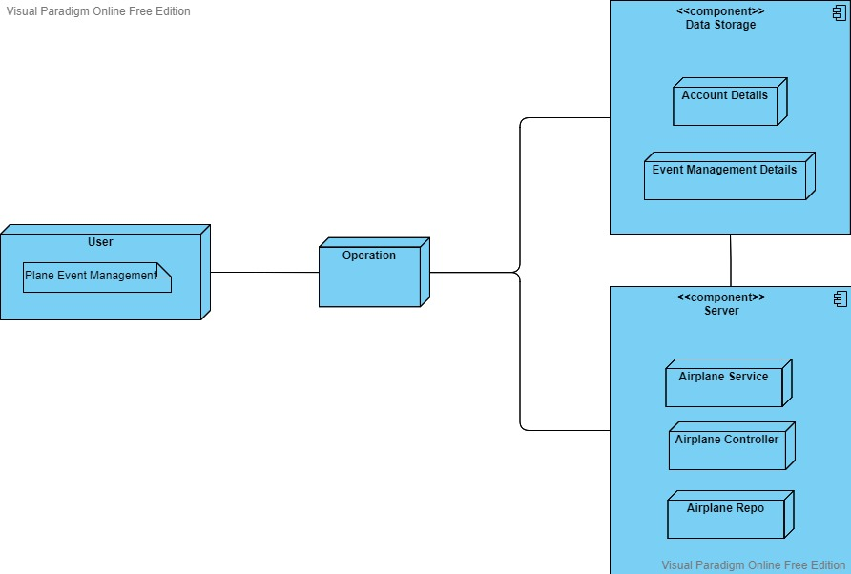
Deployment Diagram

Slide 73
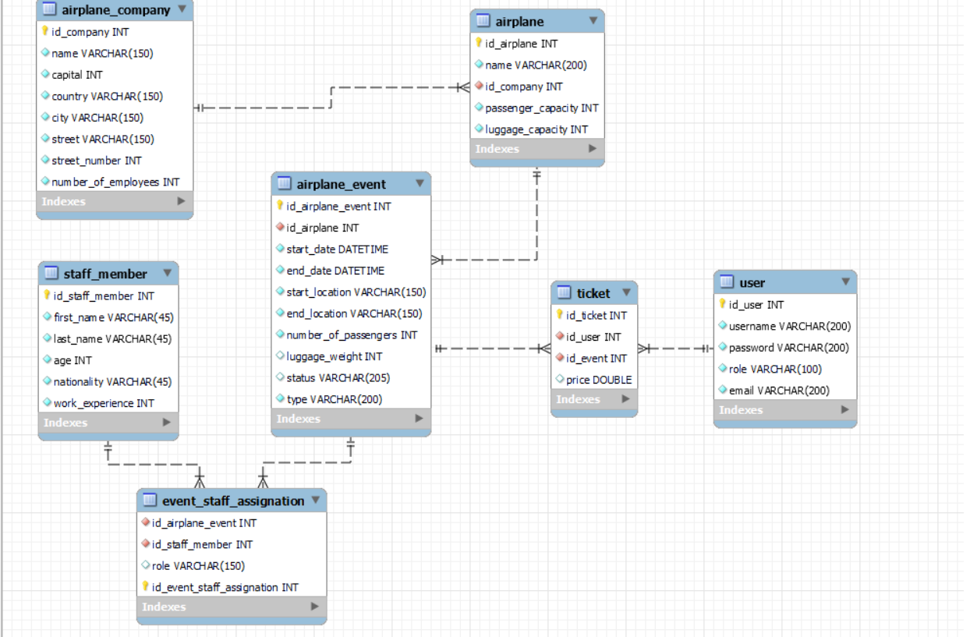
Data-base Diagram

Slide 74
Chapter 9:
Operation mode

Slide 75
Operation mode
Interactive application
Allows the user to access data from a database
Allows the user to connect to an account
Allows the user to access different features using buttons available

Slide 76
Chapter 10:
Portability

Slide 77
Portability
As a web application, it can be used from every device that allows it
It can be used on:
Mobile-based systems
Android
IoS
Computer-based systems
Linux
Windows
MacOS

Slide 78
Chapter 11:
Competing Software

Slide 79
Competing software
Our application is the solution for any airport facing the following problems:
Time related problems
Not having a clear overview of the status of the airport
Impossibility of planning events in a safe and fast way

Slide 80
Competing software
Need for fast and reliable software applications
Dedicated to the internal service of an airport
Easy to use, easy to understand
Friendly interface
Error-handling using validators for entered data

Slide 81


Competing software

