Slide 1
An Introduction To the Spring M.V.C. Framework
Reference From Website By
Tom Kochanowicz

Slide 2
Outline
Where we’ve been
M.V.C. Frameworks
Why Use Spring Framework
IoC (Inversion of Control)
Examples

Slide 3
Where we’ve been
Web based programming “The Servlet Way”
JSP or HTML Form → Submit to servlet → Servlet Processes data & Outputs information
Works well for small applications but can quickly grow out of control because HTML, scrip-lets, java script, tag-libraries, database access, and business logic makes it difficult to organize.
Put simply, lack of structure can cause a “soup” of different technologies.
JSP’s compile to Servlet

Slide 4
“A Better Way?”
Separate the Data Access, Business Logic and Presentation using a M.V.C. Framework.
Choose a M.V.C. framework:
WebWork, Spring, Struts, Java-Server-Faces, Tapestry plus “many more”

Slide 5
Things change:
Struts, by far is the most popular; same creator of Struts (Craig McClanahan) is the co-spec leader of Java Server Faces.
Webwork evolved to Webwork2
Tapestry - has been around for awhile.
Spring – “newer” of the frameworks. Integrates well with any other framework or by itself.

Slide 6
Why Spring Framework?
All frameworks integrate well with Spring.
Spring offers an open yet structured framework, using dependency-injection, a type of inversion-of-control to integrate different technologies together.
Consistent Configuration, open plug-in architecture
Integrates well with different O/R Mapping frameworks like Hibernate
Easier to test applications with.
Less complicated then other frameworks.
Active user community.

Slide 7
Want to integrate your existing web-app with a
Spring middle tier?
  Struts
    http://struts.sourceforge.net/struts-spring/
  Web Work
    http://wiki.opensymphony.com/space/Spring+Framework+Integration
  Tapestry
    http://www.springframework.org/docs/integration/tapestry.html

Slide 8
What if I like Microsoft .NET?
Then try Spring Framework .NET
http://sourceforge.net/projects/springnet/

Slide 9
Why I chose to learn the Spring framework
Because of IoC/Dependency Injection you can easily change configurations.
Addresses end-to-end requirements, not just one part.
Spring is well organized and seems easier to learn then struts.
Portable across deployment environments.
Integrates well with Hibernate
Meant to wet your appetite and note be compressive.

Slide 10
Downsides:
Not as mature as other frameworks (but very stable).
Market share is small at this time, but rapidly growing.
dependency-injection (Inversion-of-control) is a different way of thinking (This is actually a plus).
Not a-lot of tool support for Spring yet. A plug-in for Eclipse is available.
Depends on who you ask.

Slide 11
Spring is not just a Presentation M.V.C. Framework:
Persistence support:
Spring also supports A JDBC Framework that makes it easier to create JDBC Apps.
Supports O/R mapping Frameworks making it easier to use O/R tools like Hibernate & JDO
Spring offers Connection Pooling for any POJO.
Supports transaction framework
Has good support for aspect-oriented-programming
Plus much more.

Slide 12
What is dependency-injection & why use it?
Dependency-injection (a type of IoC) is when you let your framework control your application.
Spring links objects together instead of the objects linking themselves together.
Spring object linking is defined in XML files, allowing easy changes for different application configurations thus working as a plug in architecture.
Dependency injection is where the control of the application is inverted to the framework. This control is configured in the framework with an XML file.

Slide 13
Without Dependency-Injection/IoC
Object B
creates
Object A
Object C
creates
An object creating its dependencies without IoC leads to tight object coupling.

Slide 14
With Dependency-Injection/IoC
Allows objects to be created at higher levels and passed into object so they can use the implementation directly
Object B
setB(IB)
Object A
Object C
setC(IC)
Object A contains setter methods that accept interfaces to objects B and C. This could have also been achieved with constructors in object A that accepts objects B and C.

Slide 15
Spring supports two types of dependency injection
“setter-based” and “constructor based” injection
Code Example of setter based injection:
<beans>
<bean name="person" class="examples.spring.Person">
<property name="email">
<value>my@email.address</value>
</property>
</bean>
</beans>
*** beans are accessed by there “bean name”
Interpretation of the above code:
Person person = new Person();
person.setEmail(“my@email.address”);
This code creates a Person object and calls the setEmail() method,
passing in the string defined as a value.

Slide 16
Constructor based injection
<beans>
<bean name="fileDataProcessor“ class="examples.spring.DataProcessor"
singleton="true">
<constructor-arg>
<ref bean="fileDataReader"/>
</constructor-arg>
</bean>
<bean name="fileDataReader" class="examples.spring.FileDataReader" singleton="true">
<constructor-arg>
<value>/data/file1.data</value>
</constructor-arg>
</bean>
</beans>
Interpretation of the above code:
FileDataReader fileDataReader = new FileDataReader(“/data/file1.data”);
DataProcessor fileDataProcessor = new DataProcessor(fileDataReader);

Slide 17
Spring provides a JDBC Template that manages your connections for you.
*** Simple example of connecting to a datasource. ***
ProductManagerDaoJdbc implements ProductManagerDao {
public void setDataSource(DataSource ds) {
this.ds = ds;
}
}
*** No need to change java code when changing datasource; change in ‘Spring bean’ XML file below.
<beans>
<bean name="dataSource" class="com.mysql.jdbc.jdbc2.optional.MysqlDataSource" destroy-method="close">
<property name="url">
<value>jdbc:mysql://localhost/test</value>
</property>
<beans>
<bean id="prodManDao" class="db.ProductManagerDaoJdbc">
<property name="dataSource">
<ref bean="dataSource"/>
</property>
</bean>

Slide 18
Spring Web
Key Concepts

Slide 19
Spring Web Controllers
In an MVC architecture your controllers handle all requests.
Spring uses a ‘DispatcherServlet” defined in the web.xml file to analyze a request URL pattern and then pass control to the correct Controller by using a URL mapping defined in a “ Spring bean” XML file.

Slide 20
Spring Web Container Setup
In your Web Container, the Spring “bean” XML file exists in the same directory as your web.xml file with a “-servlet.xml” appended to it.
webapps
/tradingapp
/WEB-INF/tradingapp-servlet.xml, web.xml)
/classes
/lib (all jar files)
The dispatcher servlet is mapped to the name “tradingapp” so it knows to look in the “tradingapp-servlet.xml” file to look-up a URL-to- Controller match.

Slide 21
Example of web.xml file
<web-app>
<servlet>
<servlet-name>tradingapp</servlet-name>
<servlet-class>DispatcherServlet</servlet-class>
</servlet>
<servlet-mapping>
<servlet-name>tradingapp</servlet-name>
<url-pattern>*.htm</url-pattern>
</servlet-mapping>
</web-app>
*** Any URL ending with an “.htm” pattern is routed to the DispatcherServlet, the DispatcherServlet loads the tradingapp-servlet.xml file and routes the user to the correct controller.

Slide 22
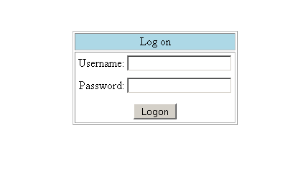
Our Demo Logon Form at URL http://localhost/tradingapp/logon.htm

Slide 23
The tradingapp-servlet.xml file a.k.a. Spring beans XML file is where the majority of your configuration is done.
For example: If working with the URL: /logon.htm
Because the URL ends with .htm the DispatcherServlet loads the tradingapp-servlet.xml file to determine which controller to use.
The tradingapp-servlet.xml file uses Springs SimpleUrlHandlerMapping class to map the URL to a controller, in this case the LogonFormController
Next…what the tradingapp-servlet.xml looks like.

Slide 24
tradingapp-servlet.xml
<bean id="urlMapping" class="org.springframework.SimpleUrlHandlerMapping">
<property name="urlMap">
<map>
<entry key="/logon.htm">
<ref bean="logonForm"/>
</entry>
</map>
</property>
</bean>
<bean id="logonForm" class="com.tradingapp.LogonFormController">
<property name="sessionForm"><value>true</value></property>
<property name="commandName"><value>credentials</value></property
<property name="commandClass">
<value>com.tradingapp.Credentials</value>
</property>
<property name="validator"><ref bean="logonValidator"/></property>
<property name="formView"><value>logon</value></property>
<property name="successView"><value>portfolio.htm</value></property>
</bean>
This class extends Springs SimpleFormController
Which defines a setSuccessView() method
If it passes “validator” then successView, passes to portfolio.htm page

Slide 25
Review of the process so far
User goes to this URL: http://tradingapp/logon.htm
Since the URL ends with “.htm”, the tradingapp-servlet.xml file is loaded to determine what controller to use.
The <bean name urlMapping …/> says to refer to the <bean id="logonForm" class="com.tradingapp.LogonFormController">
Since the LogonFormController extends SimpleFormController we can use the methods defined in the SimpleFormController class to do all kinds of form checking, e.g. validation.

Slide 26
What our LogonFormController Looks Like.
public class LogonFormController extends SimpleFormController {
public ModelAndView onSubmit(Object command) throws ServletException {
return new ModelAndView(new RedirectView(getSuccessView()));
}
}
Remember our tradingapp-servler.xml file?
<bean id="logonForm" class="com.tradingapp.LogonFormController">
<property name="sessionForm"><value>true</value></property>
<property name="commandName"><value>credentials</value></property
<property name="commandClass">
<value>com.tradingapp.Credentials</value>
</property>
<property name="validator"><ref bean="logonValidator"/></property>
<property name="formView"><value>logon</value></property>
<property name="successView"><value>portfolio.htm</value></property>
</bean>
If no validation errors, go here

Slide 27
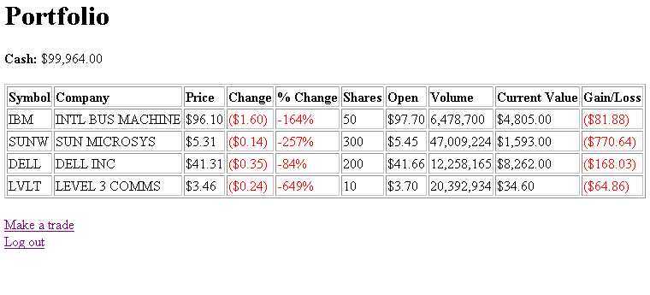
successView /portfolio.htm

Slide 28
Where do I go if there is a validation error in my logon page?
tradingapp-servler.xml
<bean id="logonForm" class="com.tradingapp.LogonFormController">
<property name="sessionForm"><value>true</value></property>
<property name="commandName"><value>credentials</value></property
<property name="commandClass">
<value>com.tradingapp.Credentials</value>
</property>
<property name="validator"><ref bean="logonValidator"/></property>
<property name="formView"><value>logon</value></property>
<property name="successView"><value>portfolio.htm</value></property>
</bean>
<bean id="logonValidator" class="com.devx.tradingapp.web.LogonValidator"/>
*** Your LogonFormController will check the validation “first” without writing
any additional code because your LogonFormController extends Springs SimpleFormController.
Next: The LogonValidator implements Springs Validator interface.
On error go back to formView, that is where you started.

Slide 29
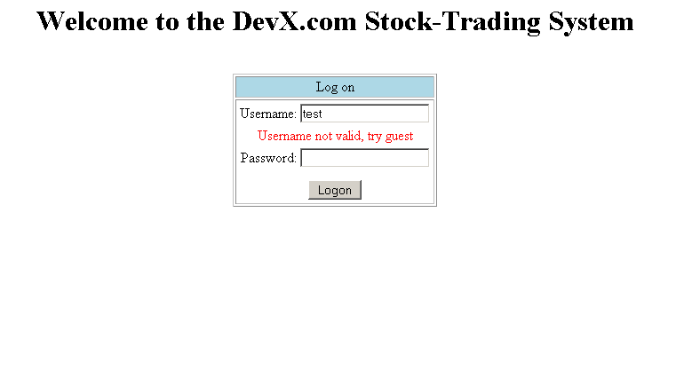
Logon page with error message
Next: code for LogonValidator implements Springs Validator

Slide 30
Example code of validator
tradingapp-servler.xml
<bean id="logonForm" class="com.tradingapp.LogonFormController">
<property name="commandName"><value>credentials</value></property
<property name="commandClass">
<value>com.tradingapp.Credentials</value>
</property>
<property name="validator"><ref bean="logonValidator"/></property>
<property name="formView"><value>logon</value></property>
<property name="successView"><value>portfolio.htm</value></property>
</bean>
<bean id="logonValidator" class="com.devx.tradingapp.web.LogonValidator"/>
public class LogonValidator implements Validator {
public void validate(Object obj, Errors errors) {
Credentials credentials = (Credentials) obj;
if (credentials.getPassword().equals("guest") == false) {
errors.rejectValue("password", "error.login.invalid-pass",
null, "Incorrect Password.");
}
} Next: Command/Form Backing Bean
Command / form backing bean

Slide 31
Command/Form Backing Bean is a POJO
public class Credentials {
private String username;
private String password;
public String getPassword() {
return password;
}
public void setPassword(String password) {
this.password = password;
}
public String getUsername() {
return username;
}
public void setUsername(String username) {
this.username = username;
}
}
Next: Why its called a “command” or “form backing bean”

Slide 32
Command/Form Backing Bean is a POJO
logon.htm form
public class Credentials {
private String username;
private String password;
public String getPassword() {
return password;
}
public void setPassword(String password) {
this.password = password;
}
public String getUsername() {
return username;
}
public void setUsername(String username) {
this.username = username;
}
}
Username:
Password:
The logon form is “backed” by the Credentials bean and given a commandName of “credentials” defined in out springapp-servlet.xml file. “credentials” will be our “command object” we will use to bind the form to the bean.
Next: another look at springapp-servlet.xml file

Slide 33
springapp-servlet.xml file
<bean id="logonForm" class="com.tradingapp.LogonFormController">
<property name="commandName"><value>credentials</value></property
<property name="commandClass">
<value>com.tradingapp.Credentials</value>
</property>
<property name="validator"><ref bean="logonValidator"/></property>
<property name="formView"><value>logon</value></property>
<property name="successView"><value>portfolio.htm</value></property>
</bean>
We use the commandName “credentials” with Spring’s tag library, to bind the Credentials bean to the logon form.
Next: Code that shows logon form binding to commandName

Slide 34
logon form binding to commandName using Springs Tag Library
<%@ taglib prefix="spring" uri="/spring" %>
<html>
<head><title>DevX.com Stock-Trading System Logon</title></head>
<body>
<spring:bind path="credentials.username">
<input type="text" name="username"
<spring:bind path="credentials.password">
<input type="password" name="password" />
</body>
</html>
Spring’s taglib has bound the bean to the form

