Slide 1
Parametric Terrain Generation
Vlad Vengrenyuk

Slide 2
Intro
Generation of 3d terrain
Only input is parameters to the algorithms, no height map used

Slide 3
How is this useful?
Video games
Movies
3D Art
Simulations

Slide 4
Algorithms
Terrain Generation:
  Fault Algorithm
  Circle Algorithm
Smoothing:
  Band Smoothing Filter

Slide 5
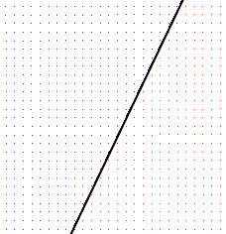
Fault Algorithm
http://www.lighthouse3d.com/opengl/terrain/index.php3?fault

Slide 6
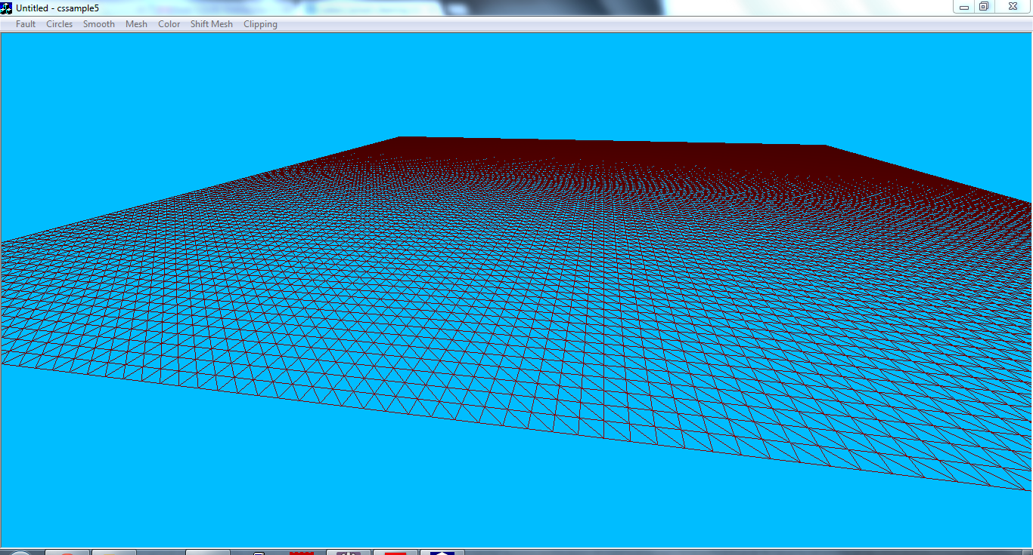
Fault Algorithm

Slide 7
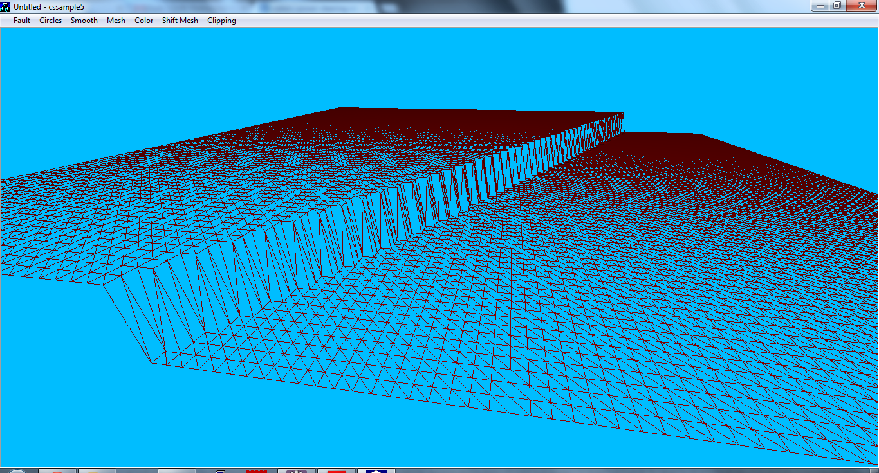
Fault Algorithm

Slide 8
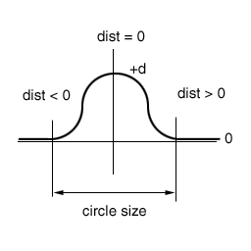
Circles Algorithm
http://www.lighthouse3d.com/opengl/terrain/index.php3?circles

Slide 9
Circles Algorithm

Slide 10
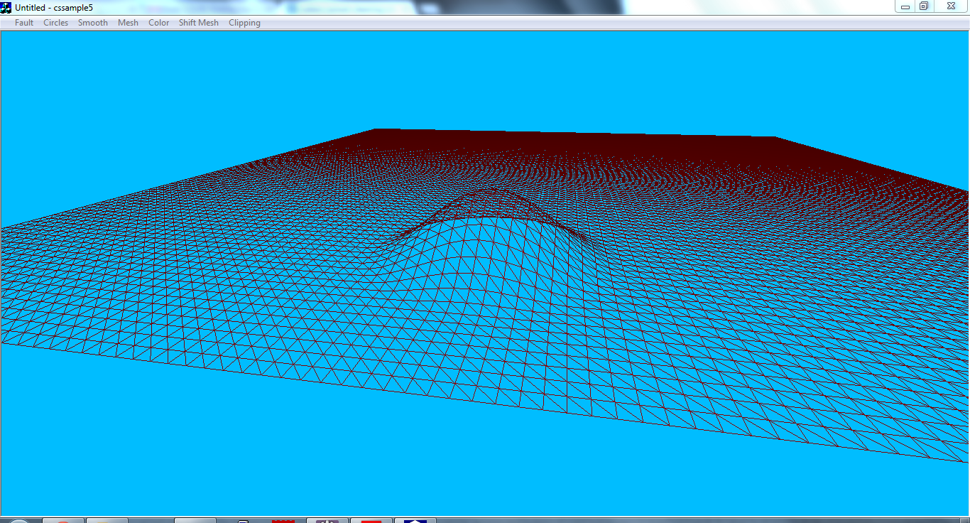
Circles Algorithm

Slide 11
Band Smoothing Filter
for(x=1; x<maxWidth; x++)
height[x,z] = height[x-1,z] * (1-k) +
height[x,z] * k;

Slide 12
Band Smoothing Filter

Slide 13
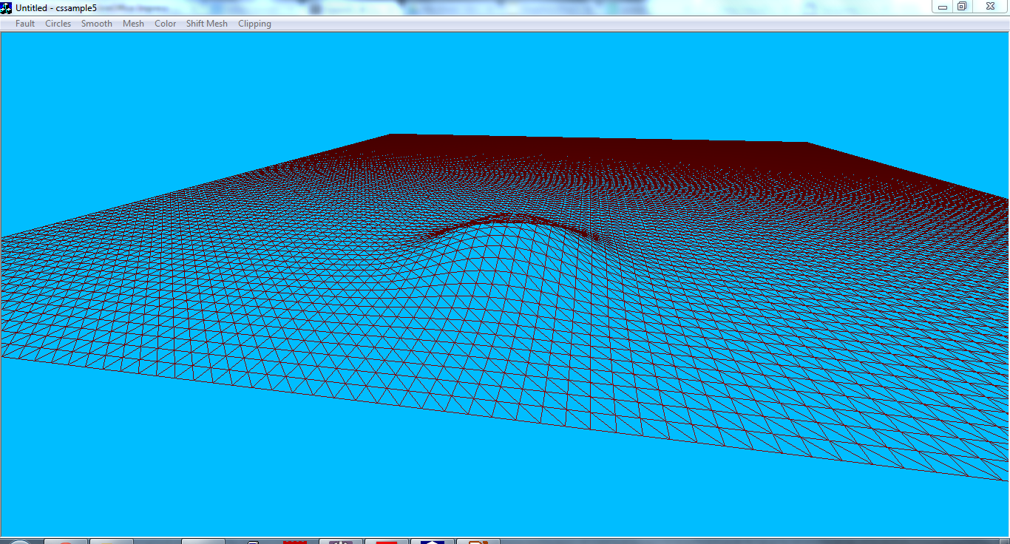
Band Smoothing Filter

Slide 14
Combination
All of these algorithms act on the same mesh, so they can be chained together

Slide 15
Additional Tools
View Flat/Shaded/Wireframe
Shift mesh up/down
Shift mesh so average height is 0
Reset mesh
Clip heights below 0
Height Based Color (Work In Progress)

Slide 16
To do...
Color
Additional algorithms

