Slide 1
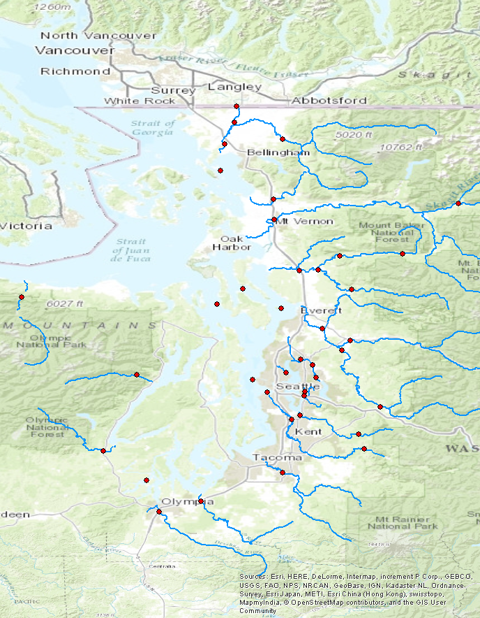
Bertrand Cr.
Maps for
later reference
Nooksack
Samish
Skagit
Stillaguamish (NF, SF)
Elwha
Snohomish
Sammamish
Skykomish
Duckabush
Thornton Cr.
Mercer Sl.
Snoqualmie
Skokomish
Cedar
Puyallup
Green
Deschutes
Nisqually

Slide 2
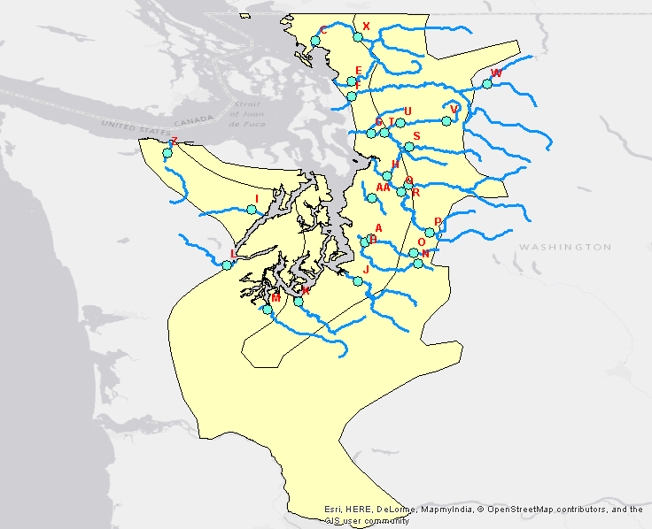

Slide 3
trends: 1
covariates: air temp, precip, snowmelt
unknown seasonal variation: removed

Slide 4
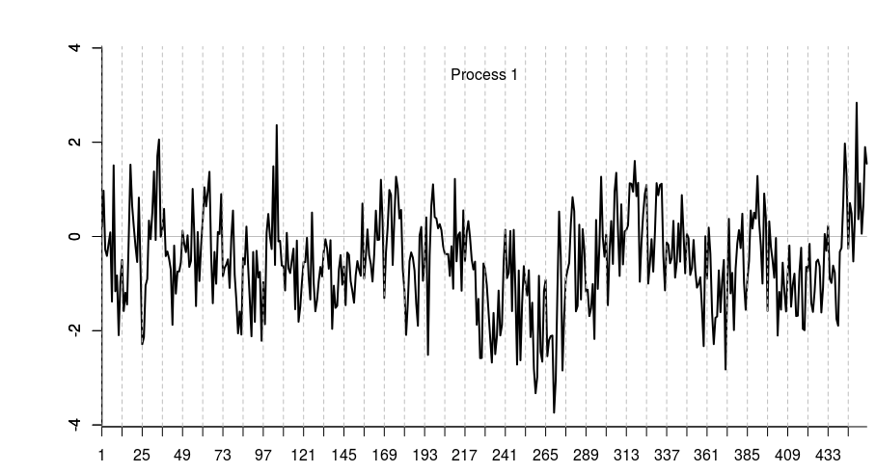

Slide 5
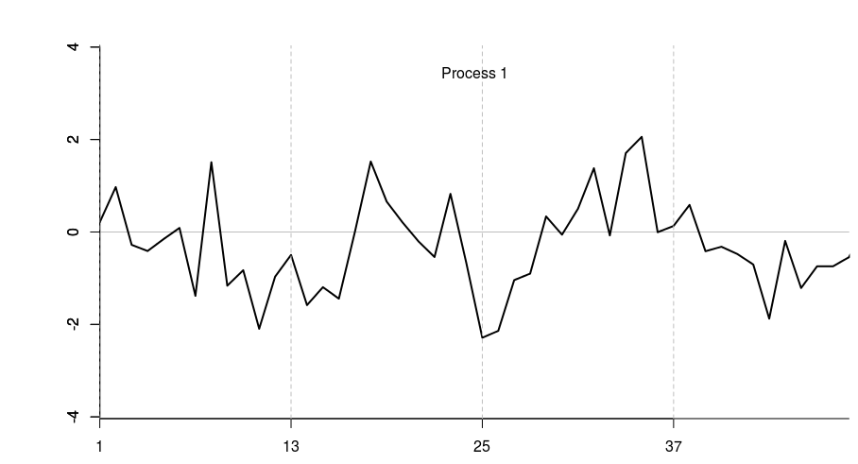
Close-up of first four years

Slide 6
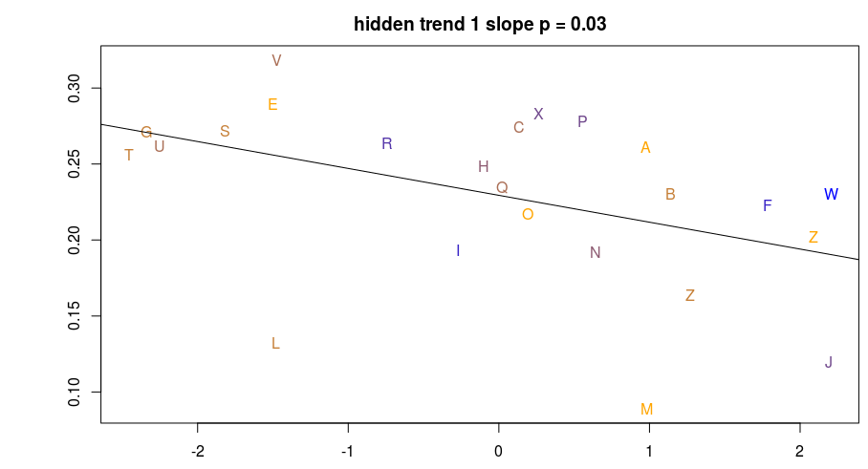
X is PC2, Y is factor loadings on the shared trend.
The loadings correlate with PC2, which is driven by runoff and Base Flow Index.
They do not correlate with PC1, which includes slope, elevation, ice, etc.
Points are colored by % watershed area > 1000m (blue=high, orange=low)

Slide 7
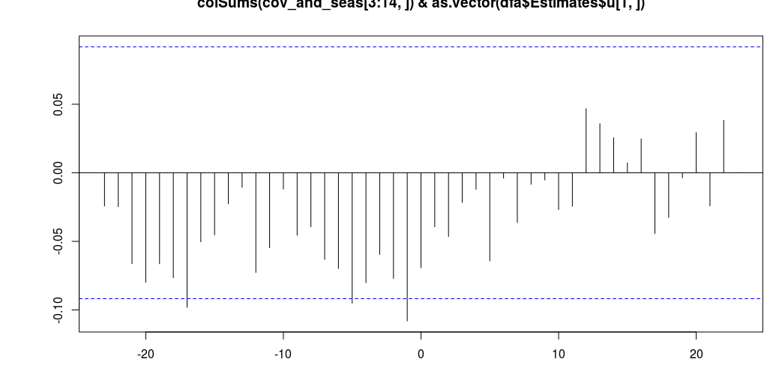
Cross-correlation between the trend and air temperature.
The significant CCF values at negative lags can be interpreted as,
“air temperature is inversely correlated with whatever the trend is tracking,
1, 5, and 17 months later.”
We'd expect some significant lags by chance, so I won't read much into this, but
compare with the next CCF below.

Slide 8
trends: 1
covariates: air temp, precip, snowmelt
unknown seasonal variation: included
(i.e. fair game for the trend to track)

Slide 9
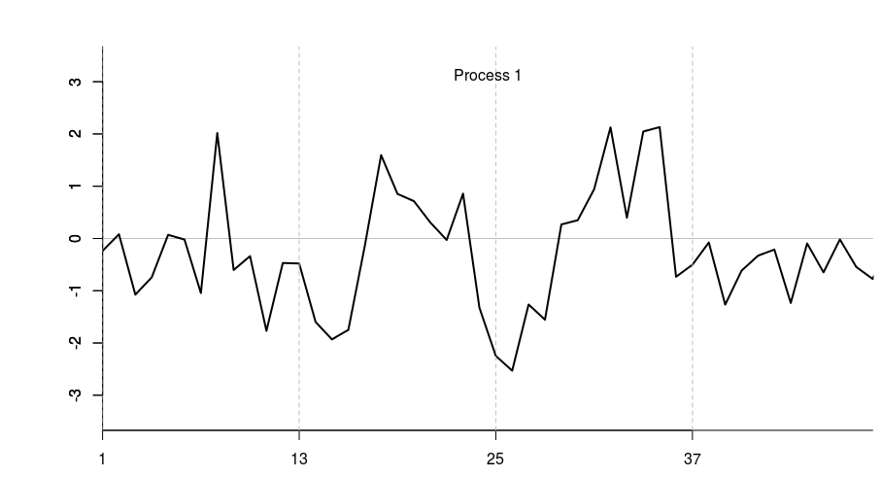
The overall shape of the trend hasn't changed, but a close-up
reveals possible 4-point seasonal structure emerging.

Slide 10
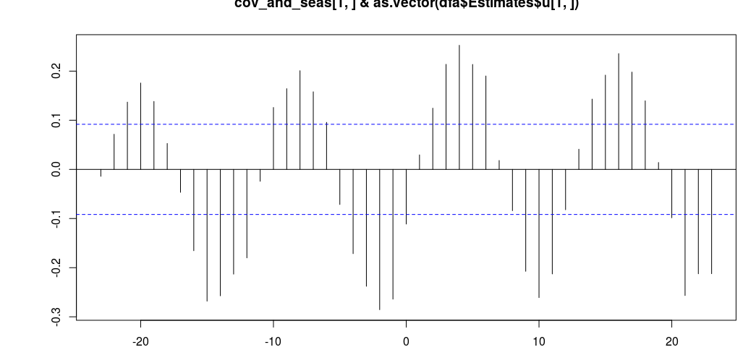
The PC regressions are very similar, but now cross-correlation reveals that the
trend follows air temperature at a lag of 2-6 and 9-11 (I'm looking at the two
“peaks” in the upper right).

Slide 11
trends: 2
covariates: air temp, precip, snowmelt
unknown seasonal variation: included

Slide 12
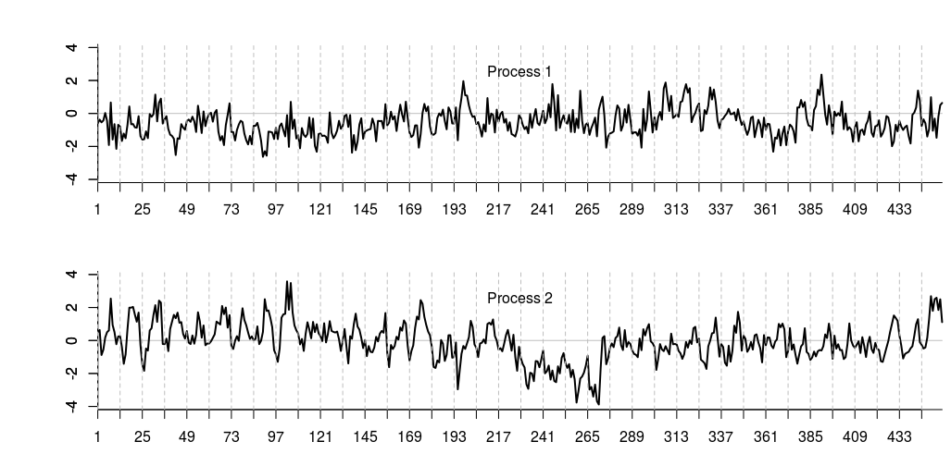

Slide 13
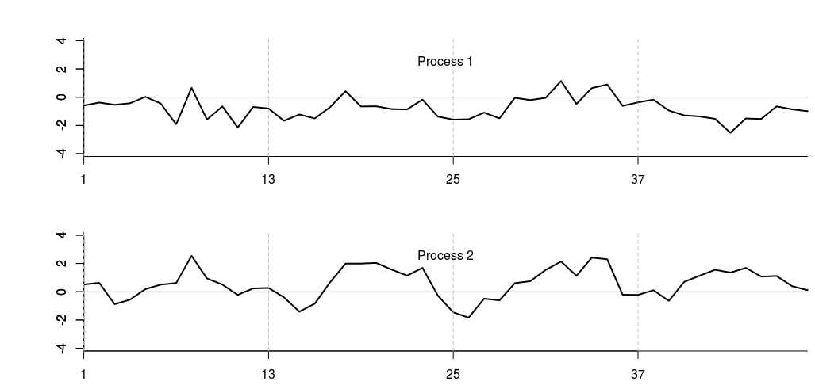

Slide 14
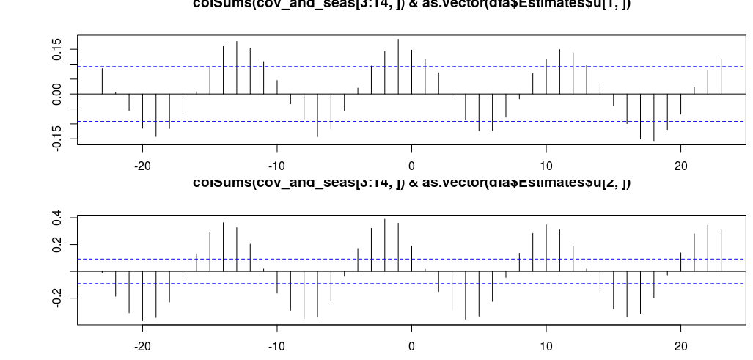
Shared trend 1 correlates with PC2.
Shared trend 2 correlates weakly with elevation, but not with PC1.
Here's cross-correlation between air temp and trend 1 (top), and trend 2 (bottom):
Now, the trends respond after 3-6 months with an inverse relationship to air temp.

Slide 15
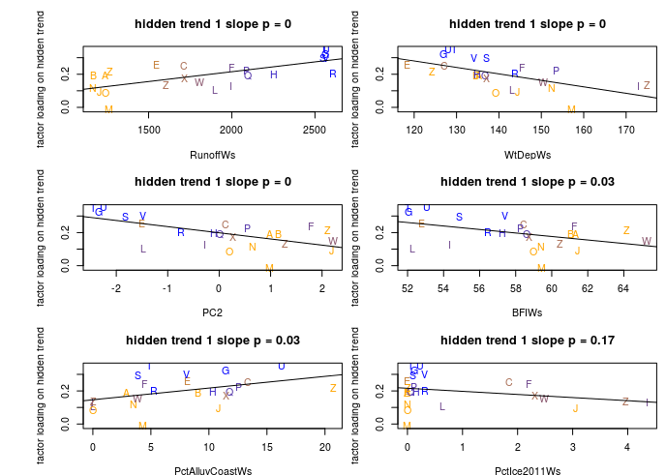
The reason nothing correlates with PC1 is that the snowmelt covariate
accounts for elevational variation. If I leave snowmelt out of the model,
trend 2 correlates with PC1.
Here are the strongest relationships with trend 1 loadings, colored by
runoff:

Slide 16
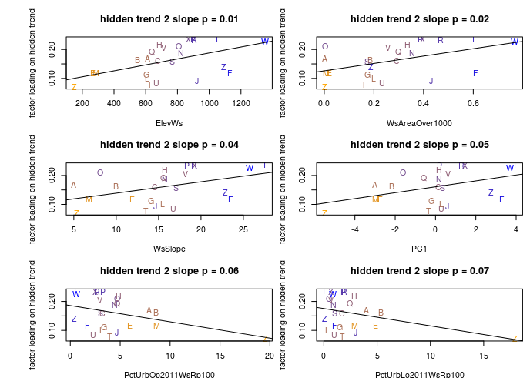
Here are the strongest relationships with trend 2 loadings,
colored by elevation:

Slide 17
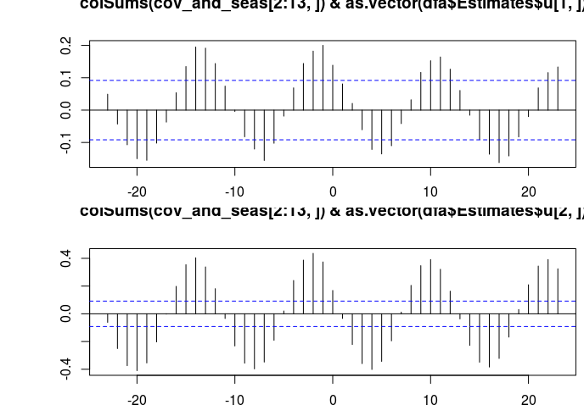
And the final cross-correlation (air-trend_1 on top; air-trend_2 on bottom)

