Slide 1
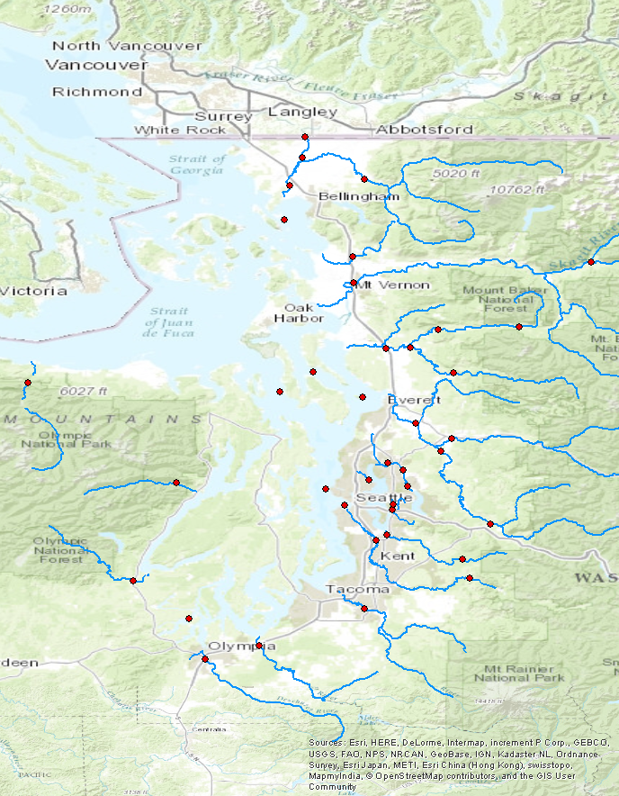
Bertrand Cr.
Nooksack
Samish
Skagit
to make this line up with labels, zoom to sites layer on arcmap and use default export size
Stillaguamish (NF, SF)
Elwha
Snohomish
Sammamish
Skykomish
Duckabush
Thornton Cr.
Mercer Sl.
Snoqualmie
Skokomish
Cedar
Puyallup
Green
Deschutes
Nisqually

Slide 2
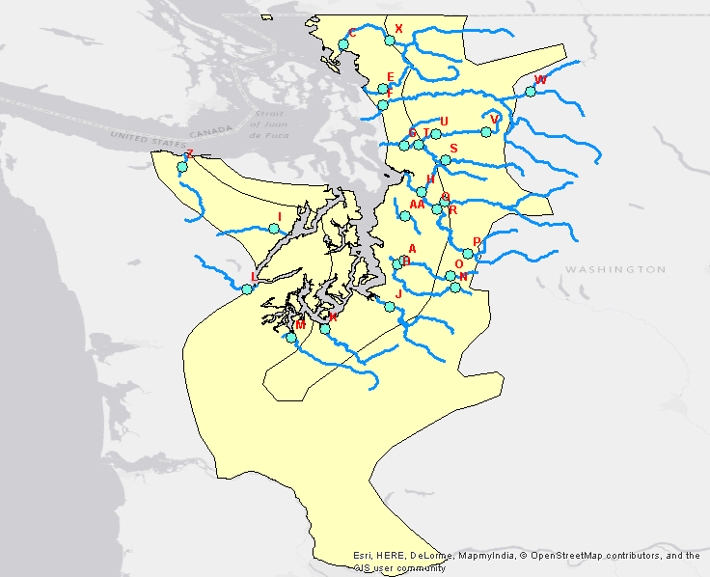

Slide 3
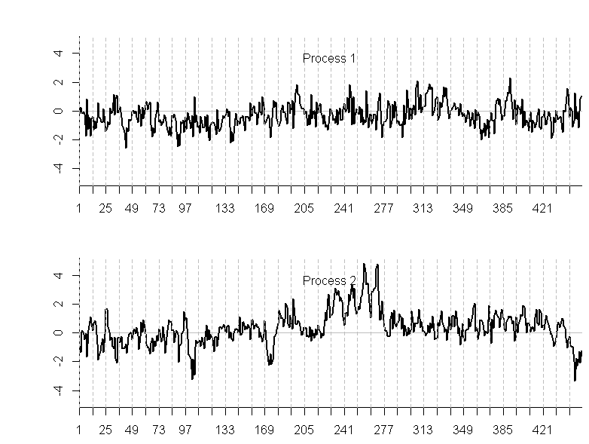

Slide 4
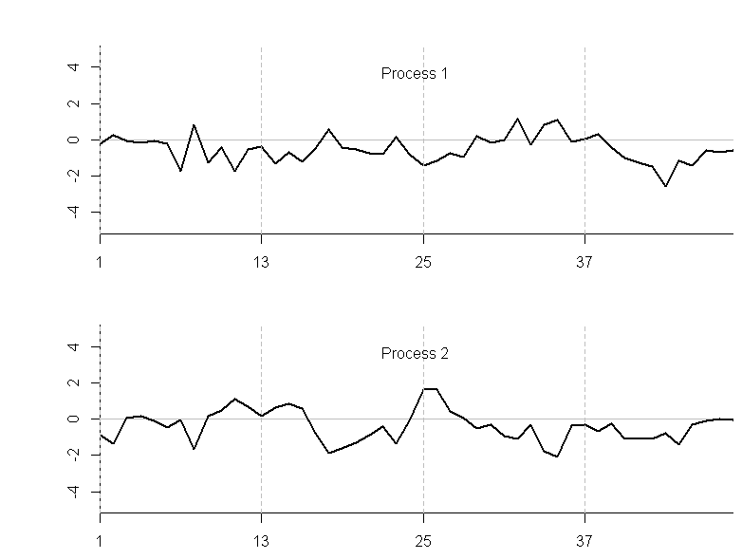

Slide 5
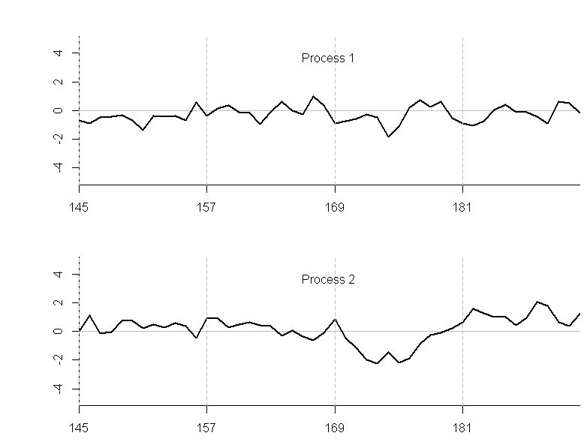

Slide 6
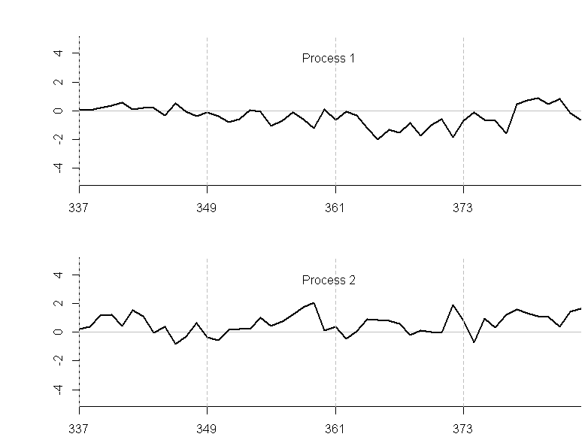

Slide 7
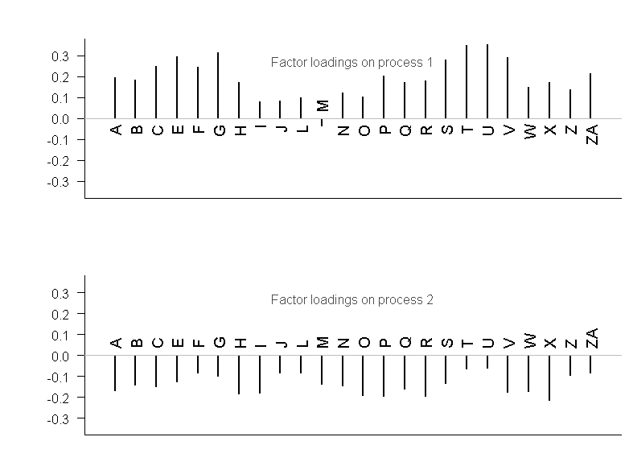

Slide 8
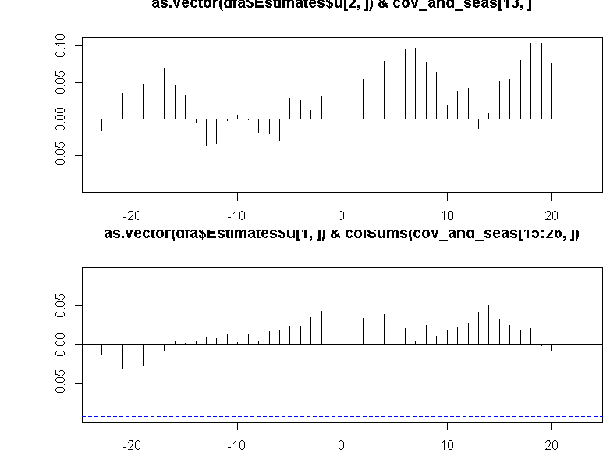

Slide 9
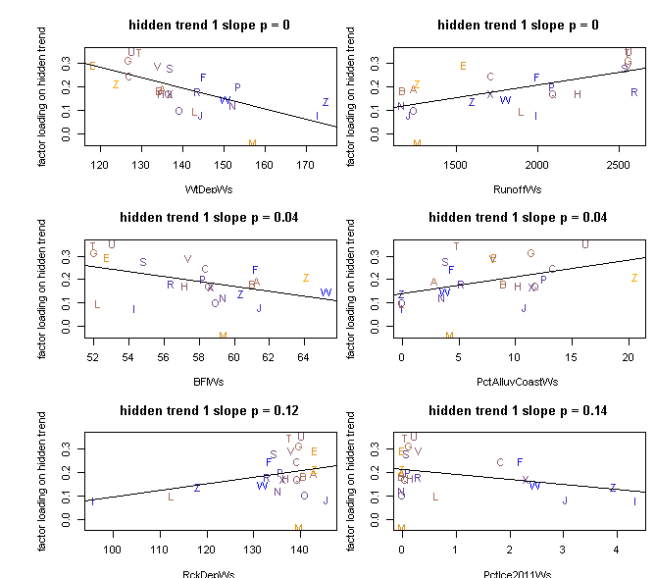

Slide 10
