Slide 1
all figures

Slide 2
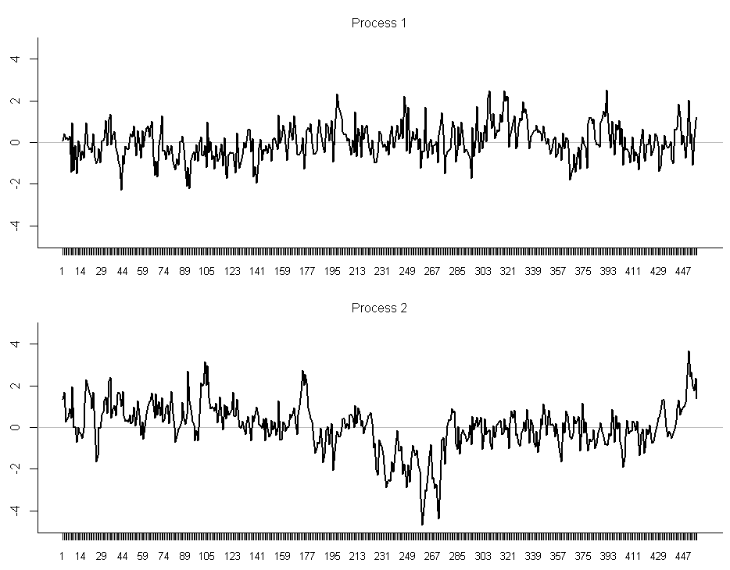

Slide 3
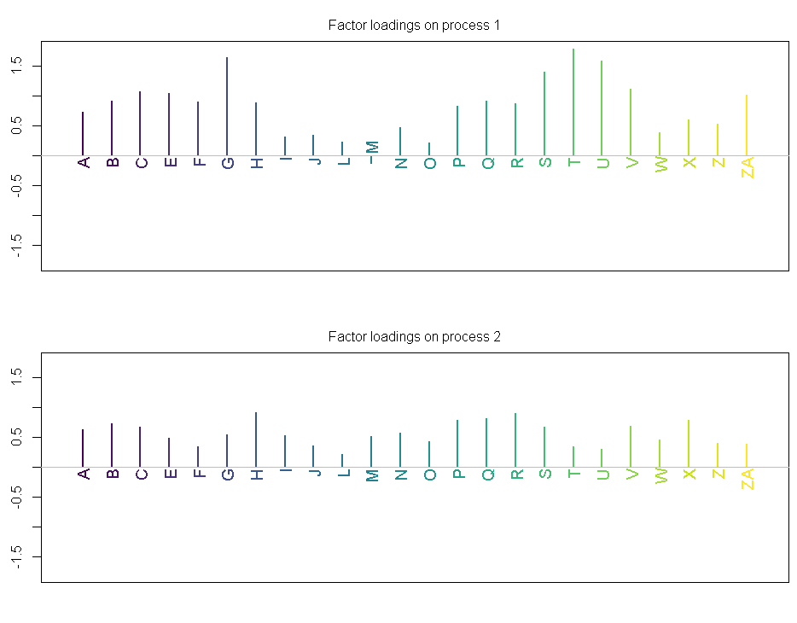

Slide 4
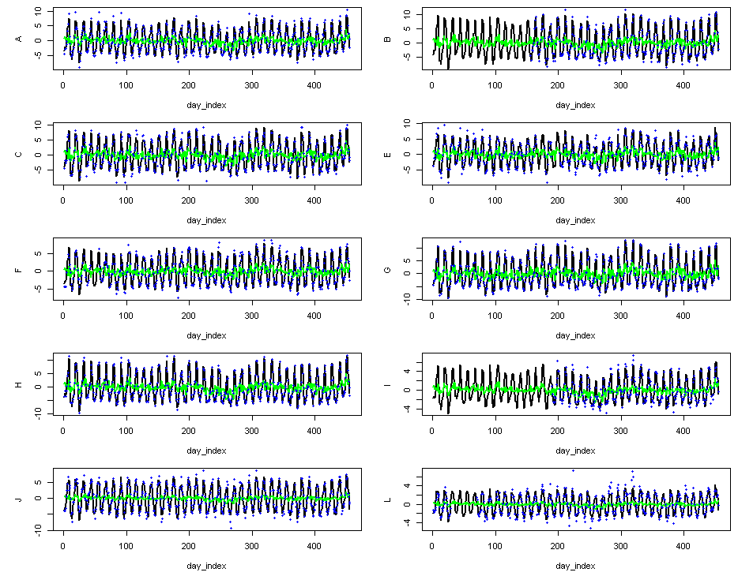

Slide 5
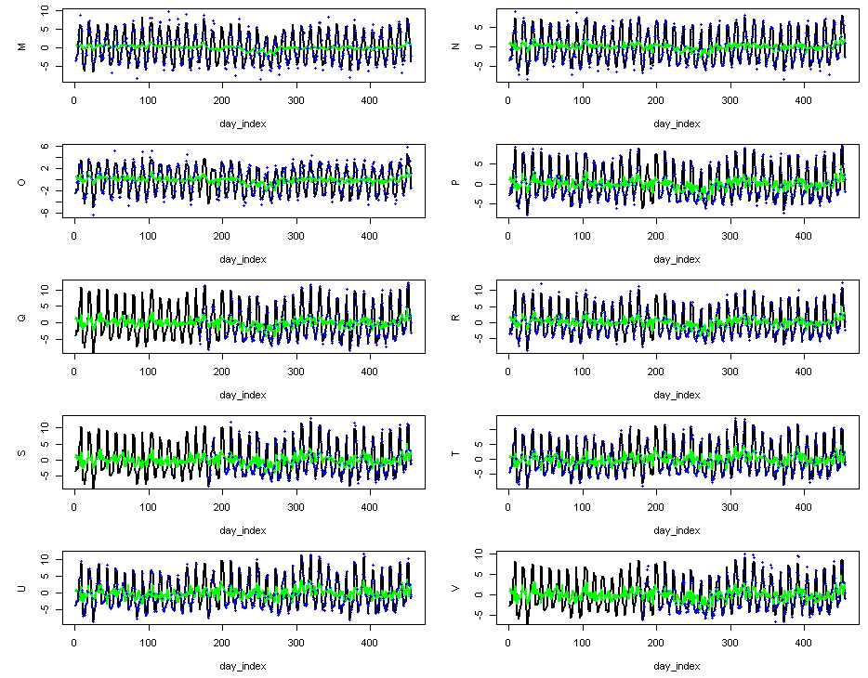

Slide 6
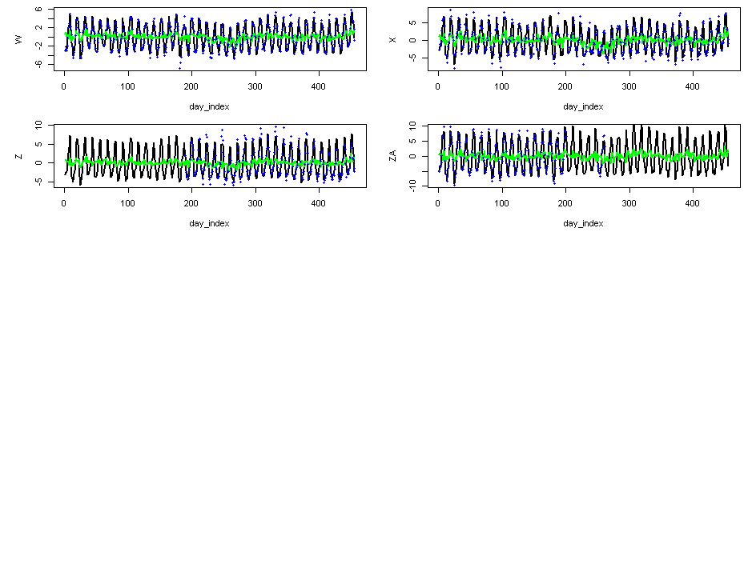

Slide 7
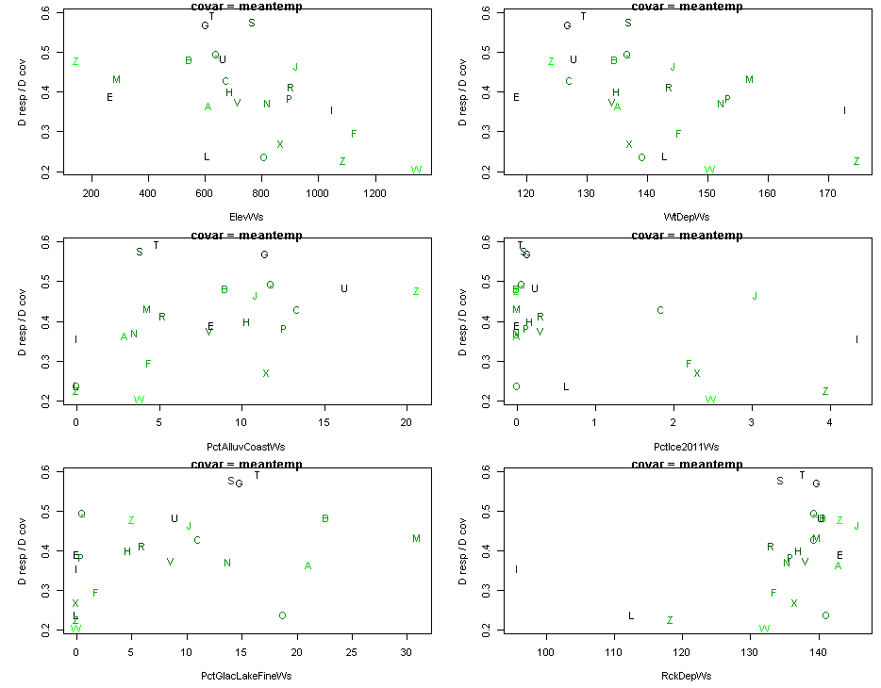

Slide 8
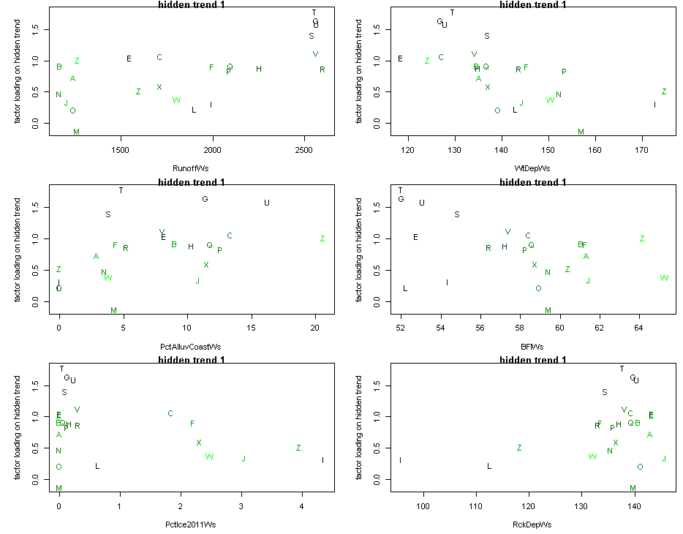

Slide 9
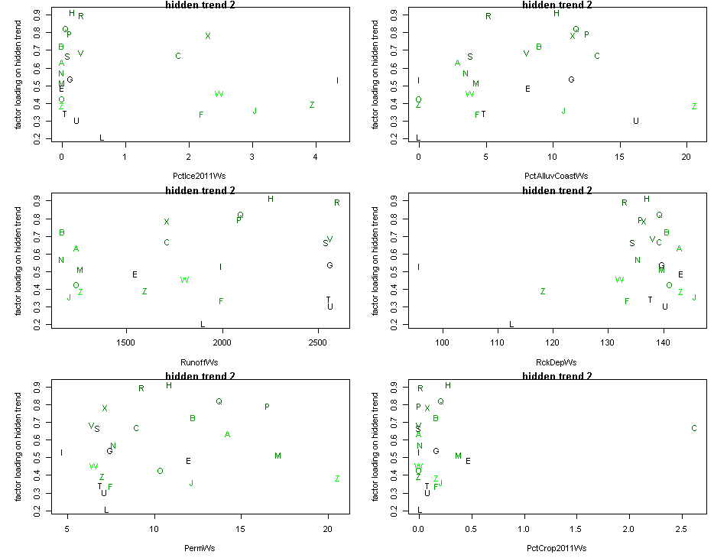

Slide 10
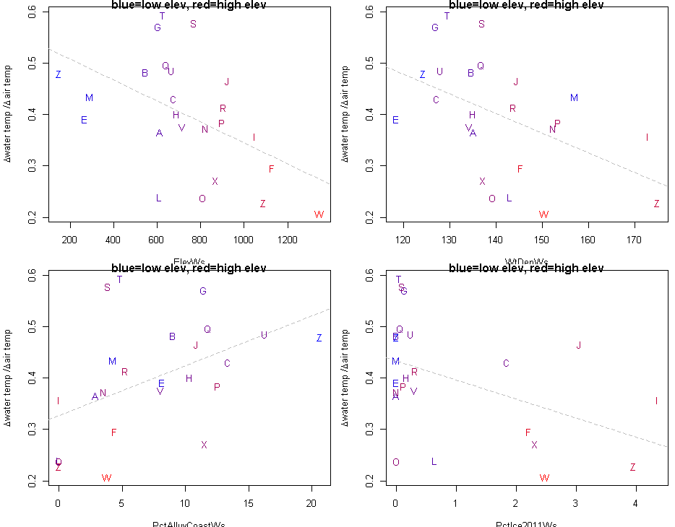

Slide 11
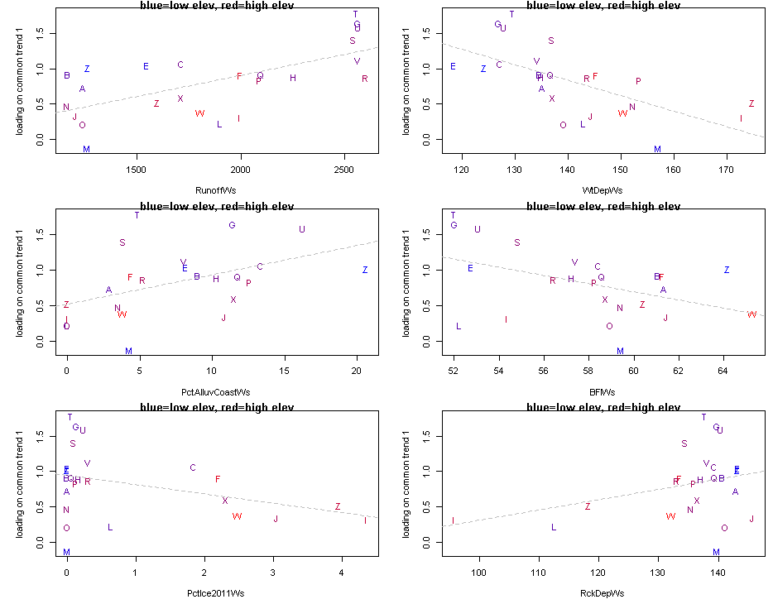

Slide 12
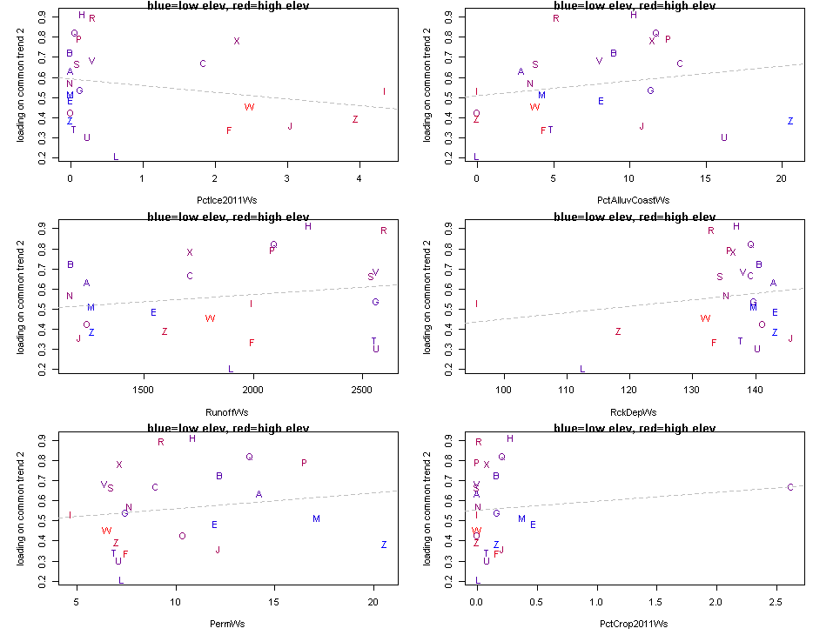

Slide 13
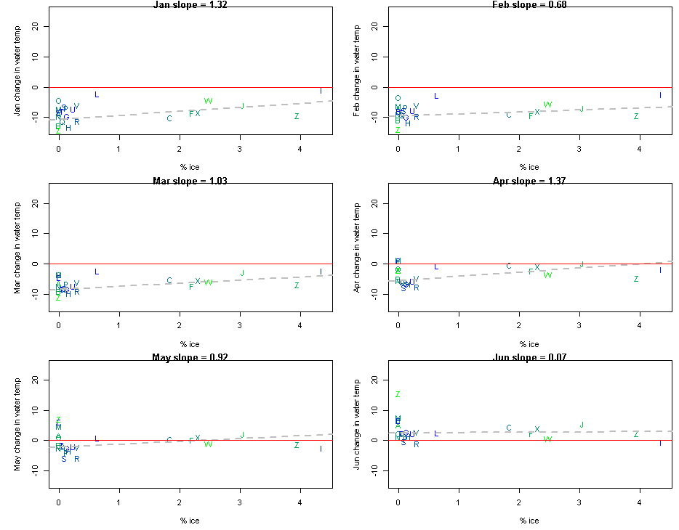

Slide 14
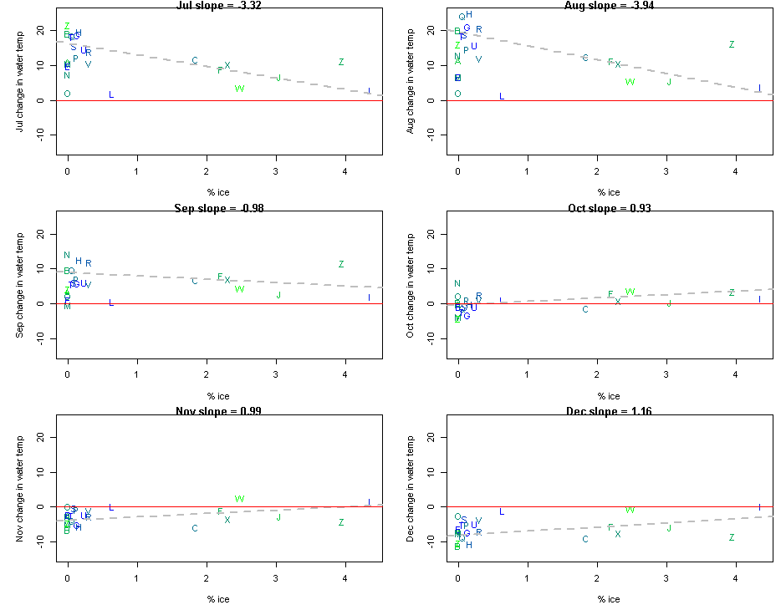

Slide 15
storyline

Slide 16
Map will go here

Slide 17
can show some example time series,
or extract trends and plot them all, colored by
latitude

Slide 18
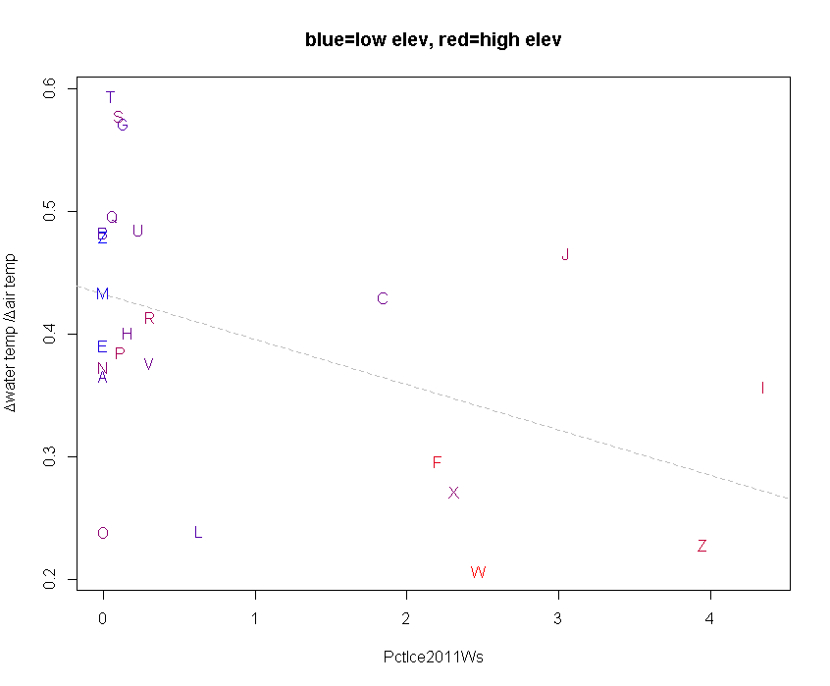

Slide 19
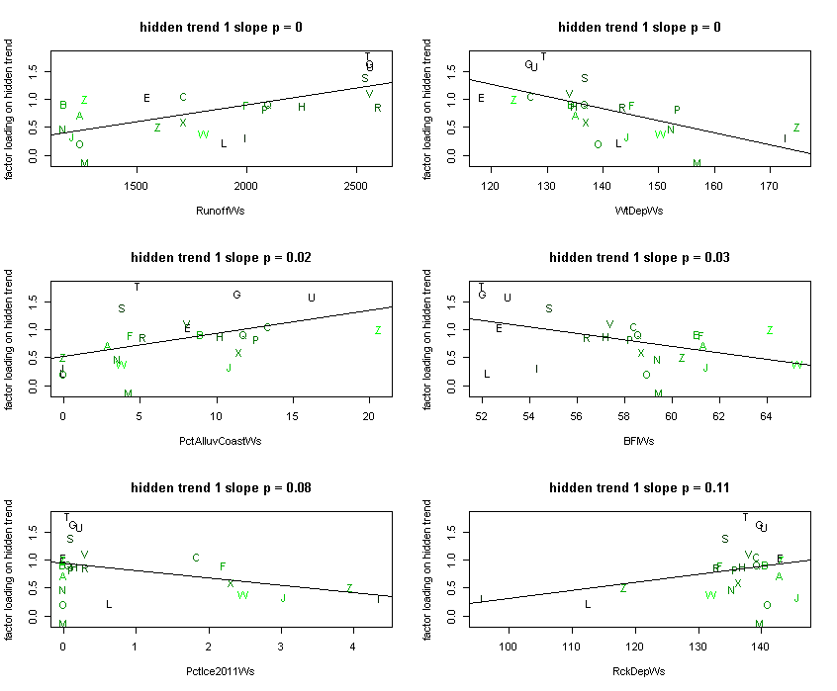
percent
ice
and
other
elevation
covars
explained by
hidden trend
1.
ht 2 is worth
very little in
this regard.
i can show 4
of these (or just 1)
to illustrate
that they have
picked up the
elev/ice cover
phenomenon

