Slide 1
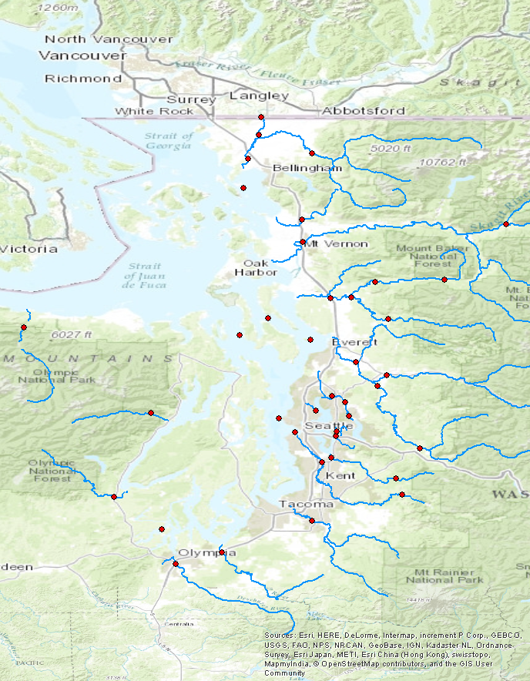
Bertrand Cr.
Nooksack
sites
Samish
Skagit
Stillaguamish (NF, SF)
Elwha
Snohomish
Sammamish
Skykomish
Duckabush
Thornton Cr.
Mercer Sl.
Snoqualmie
Skokomish
Cedar
Puyallup
Green
Deschutes
Nisqually

Slide 2
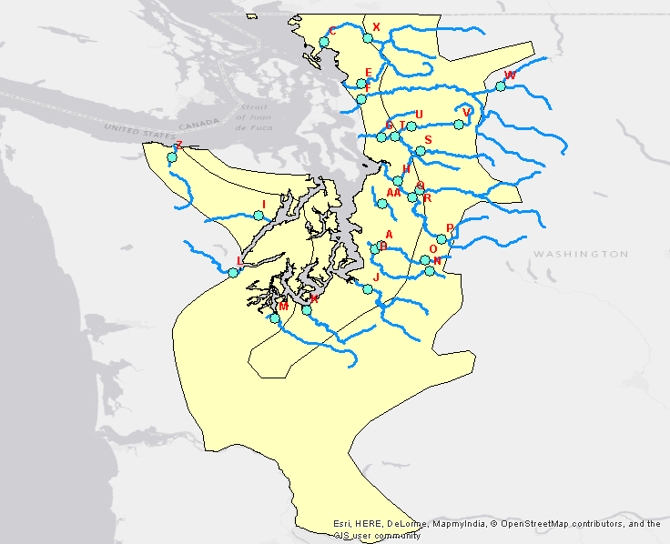
site IDs

Slide 3
I ran a full suite of DFA models to see which best fit the data (evaluated based on AIC, likelihood, and R²). By full suite I mean:
1-3 hidden trends
fixed/fourier/no seasonality
diagonal + equal, diagonal + unequal, unconstrained error structures
covariates: mean temp, max temp, precip, drought, heating degree days, mean temp + precip, none
best model: 2 trends, fixed season, diag and unequal, precip
Then I regressed effect sizes (Δsussol/ Δ precip) and factor loadings against landscape variables.
See landscape_variable_guide.xlsx (attached to email) for a full list of variables tested.

Slide 4
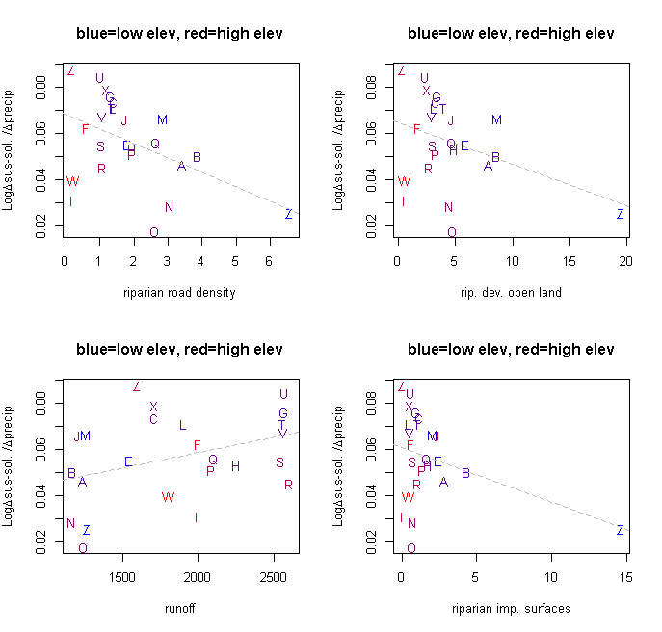
Effect sizes against best correlated landscape variables

Slide 5
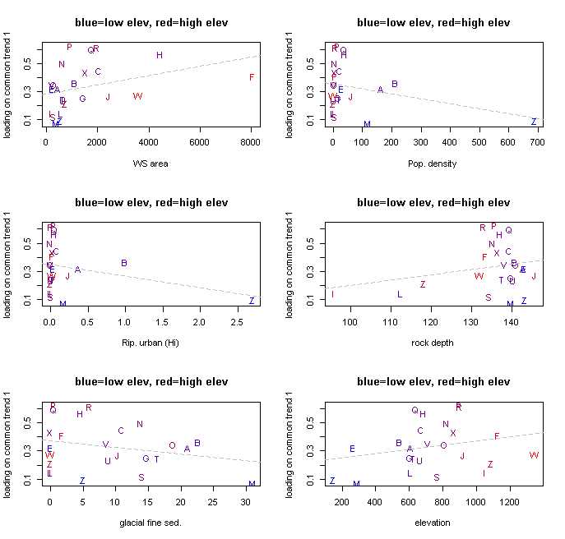
process loading (1) against best correlated landscape variables

Slide 6
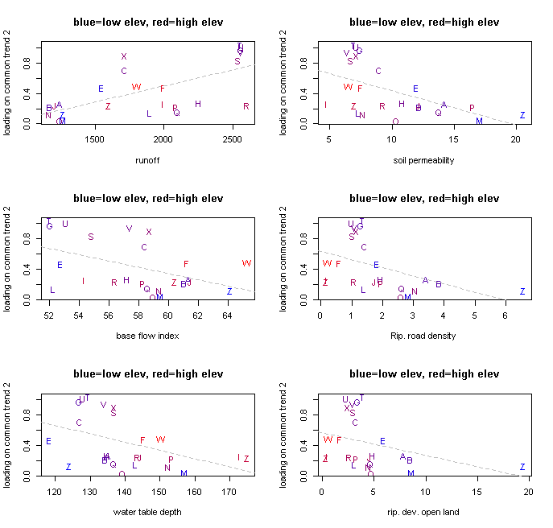
process loading (2) against best correlated landscape variables

Slide 7
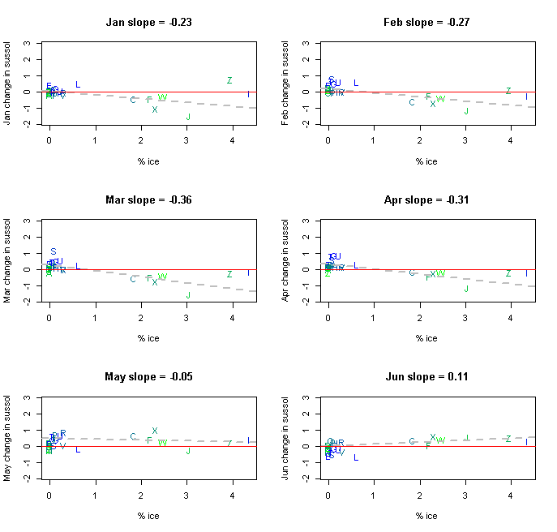

Slide 8
