Slide 1
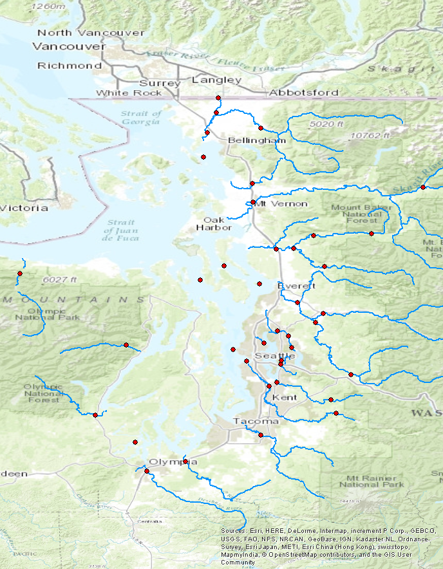
Bertrand Cr.
Nooksack
Samish
Skagit
to make this line up with labels, zoom to sites layer on arcmap and use default export size
Stillaguamish (NF, SF)
Elwha
Snohomish
Sammamish
Skykomish
Duckabush
Thornton Cr.
Mercer Sl.
Snoqualmie
Skokomish
Cedar
Puyallup
Green
Deschutes
Nisqually

Slide 2
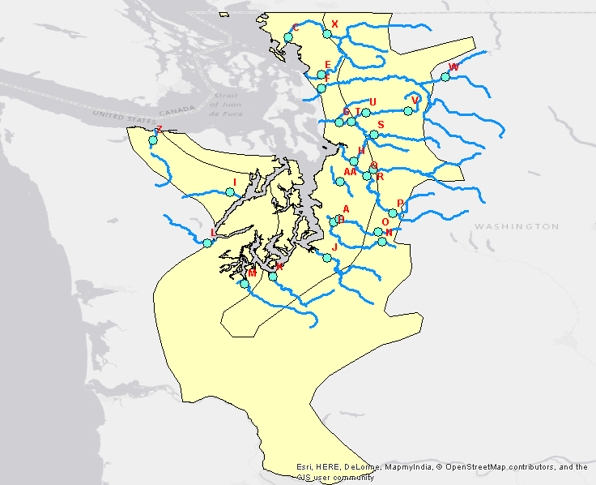

Slide 3
trends: 1
covariates: air temp, precip, snowmelt
unknown seasonal variation: removed

Slide 4
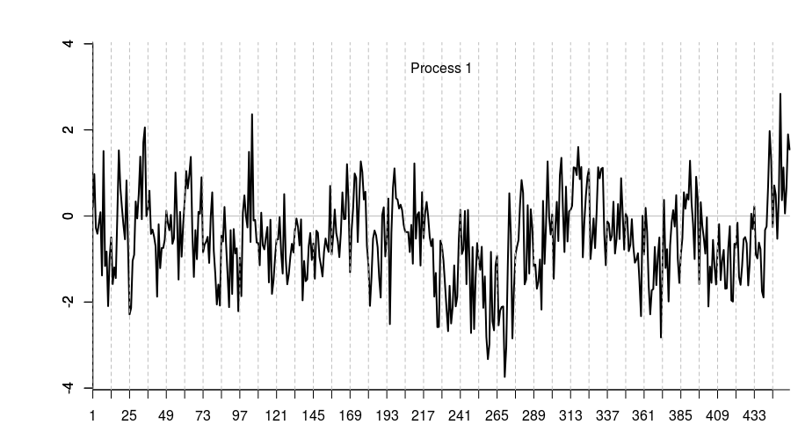

Slide 5
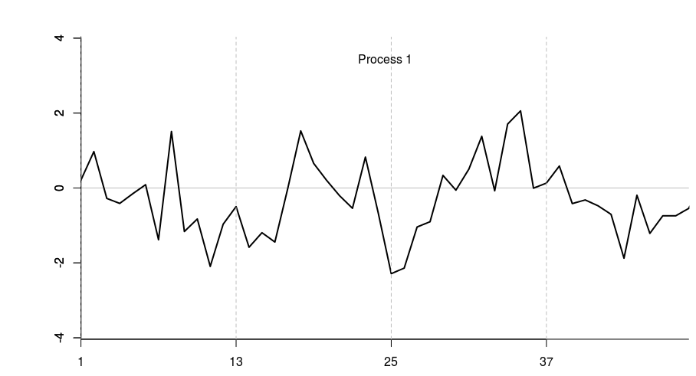
Close-up of first four years

Slide 6
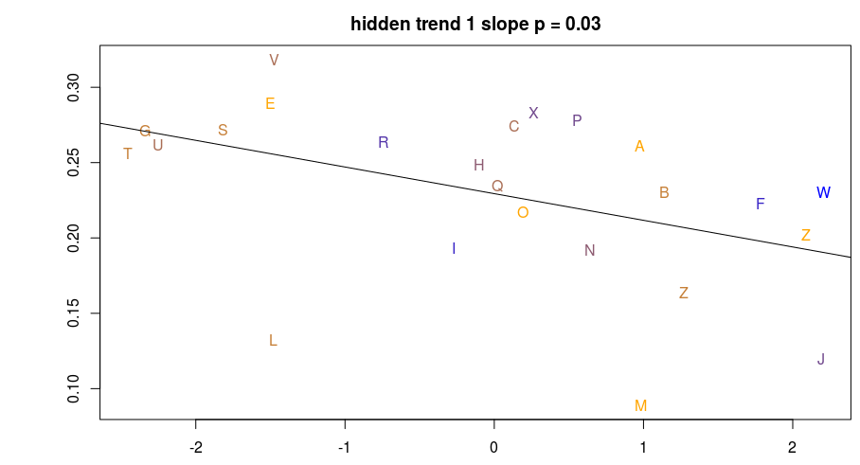
X is PC2, Y is factor loadings on the shared trend.
The trend correlates with PC2, which is driven by runoff and Base Flow Index.
It does not correlate with PC1, which contains slope, elevation, ice, etc.
Points are colored by % watershed area over 1000m (blue=high, orange=low)

Slide 7
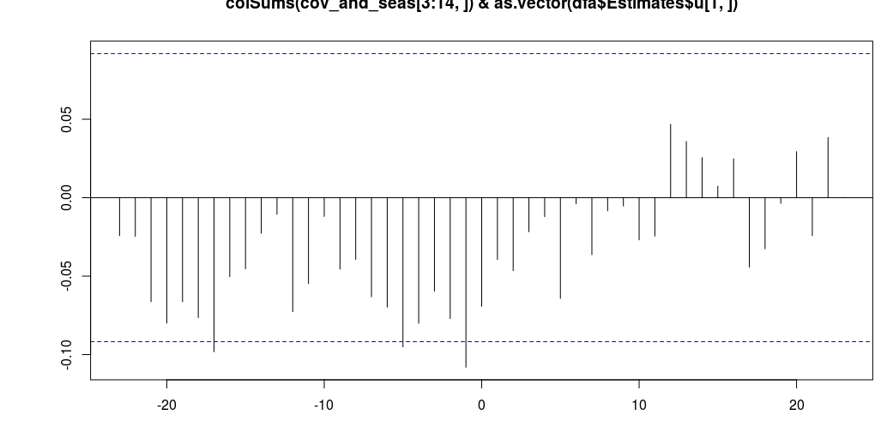
Cross-correlation between the trend and air temperature.
The significant CCF values at negative lags imply that air temperature responds to
whatever the trend is tracking, 1, 5, and 17 months later. this must be noise.
However, compare with the next CCF below.

Slide 8
trends: 1
covariates: air temp, precip, snowmelt
unknown seasonal variation: included
(i.e. fair game for the trend to track)

Slide 9
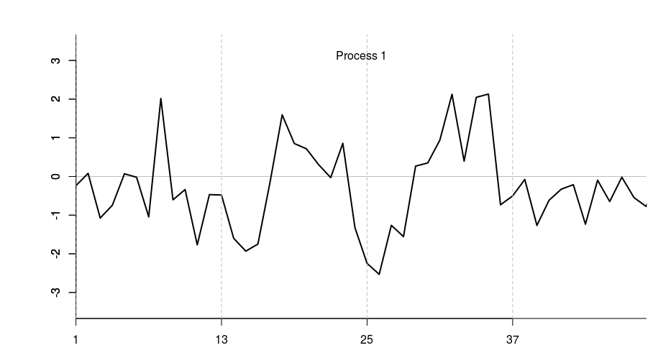
The overall shape of the trend hasn't changed, but a close-up
reveals possible 4-point seasonal structure emerging.

Slide 10
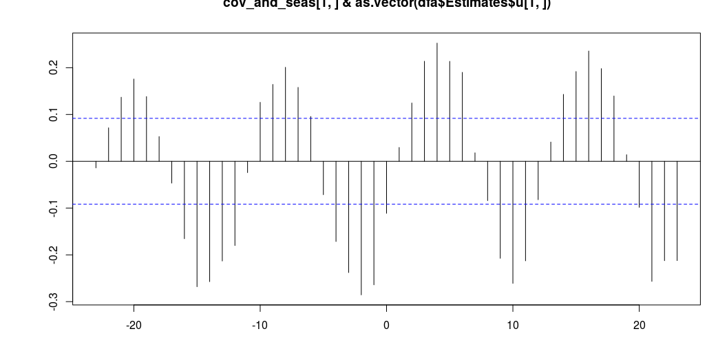
The PC regressions are very similar, but now cross-correlation reveals that the
trend follows air temperature at a lag of 4.

Slide 11
trends: 2
covariates: air temp, precip, snowmelt
unknown seasonal variation: included

Slide 12
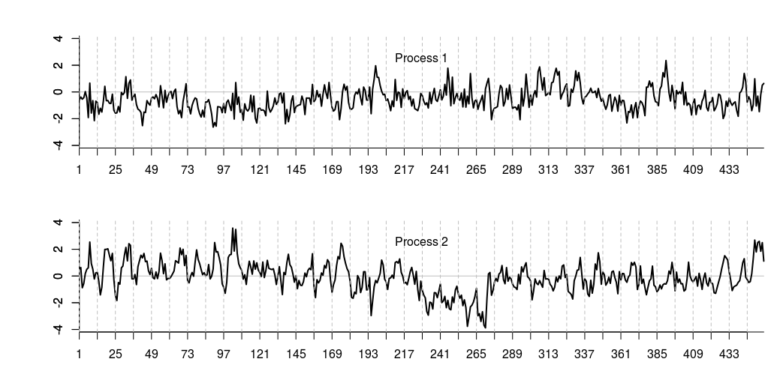

Slide 13
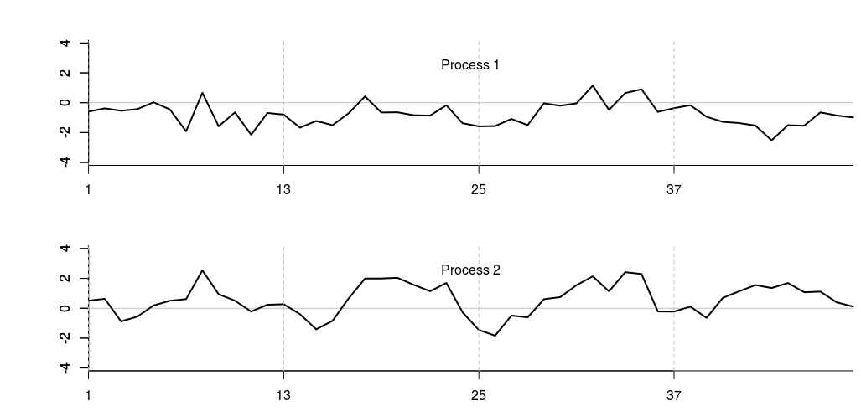

Slide 14
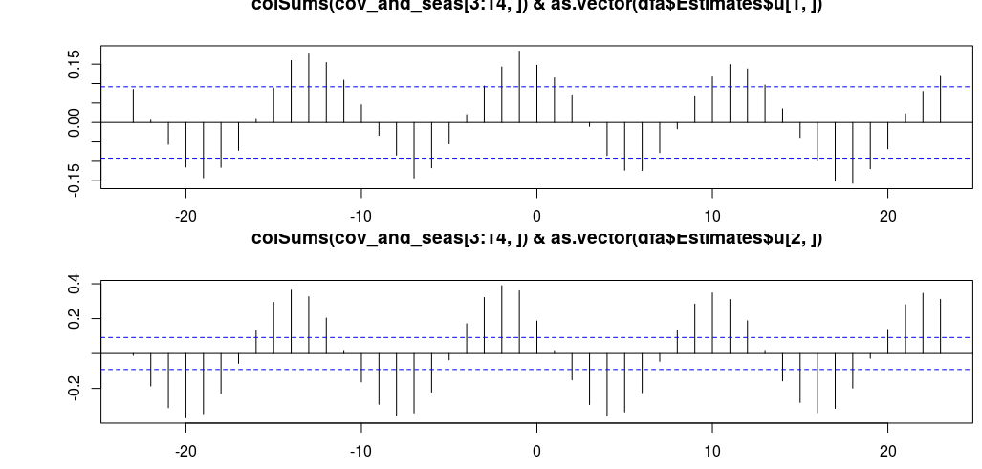
Shared trend 1 correlates with PC2. Still no correlation with PC1.
Here's cross-correlation:

