Slide 1
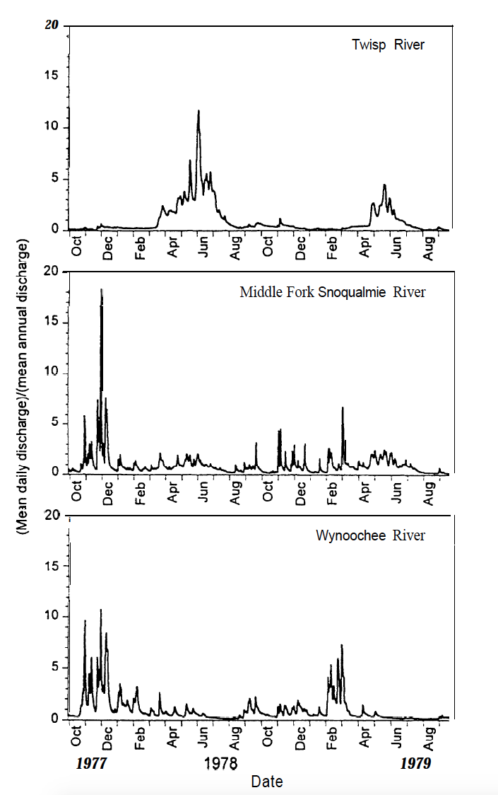
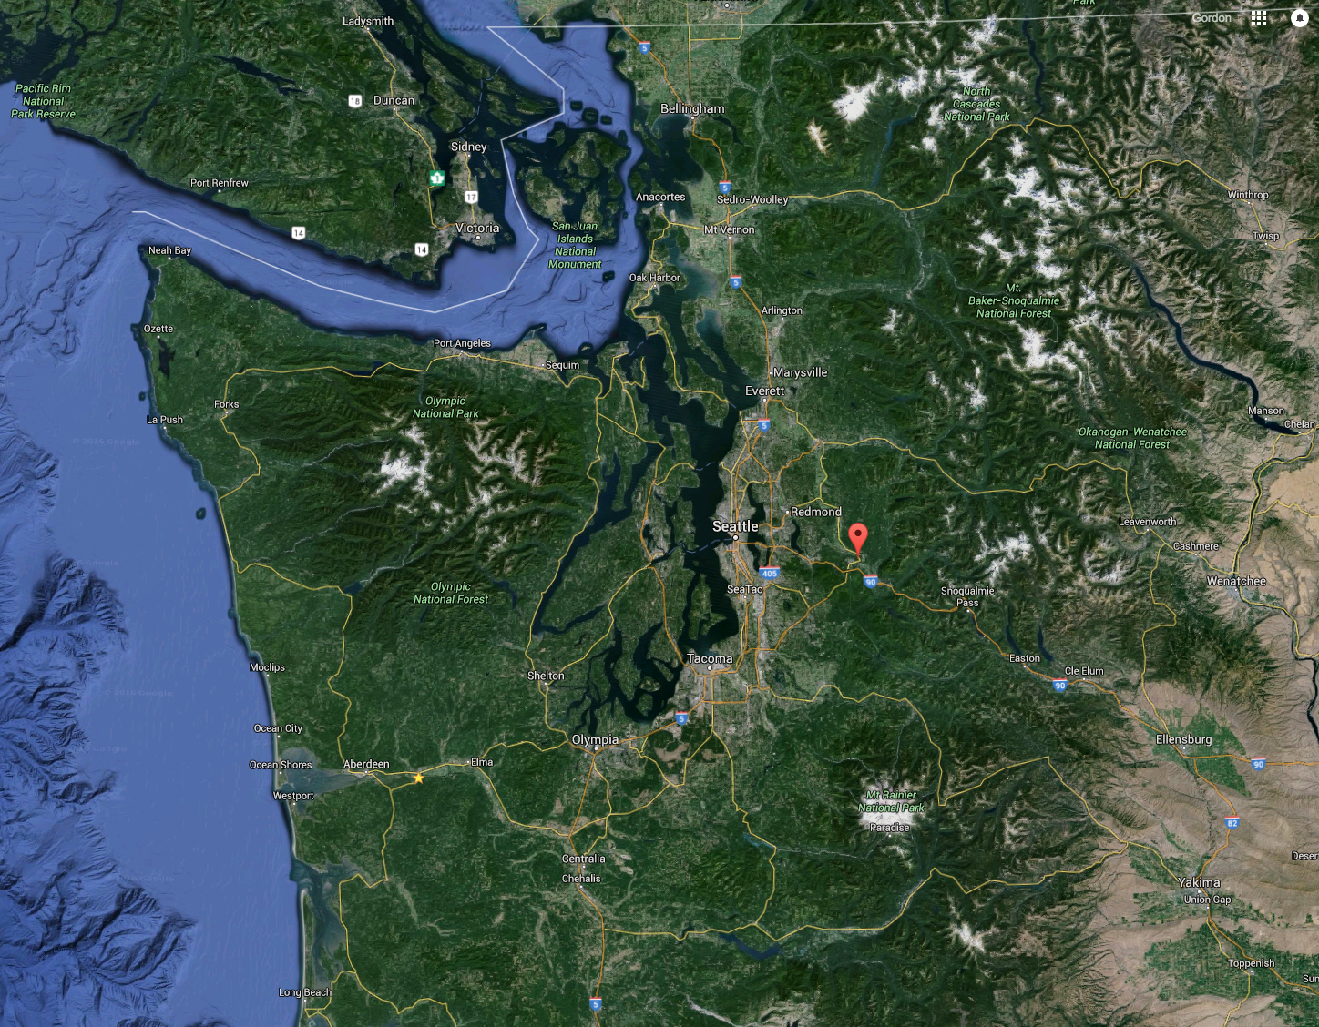
Seasonality of River Discharge
Snow dominated
The amount of water in a river at any given time is a function of both the amount of precipitation and the form of precipitation.
Rain on snow
Rain dominated

Slide 2
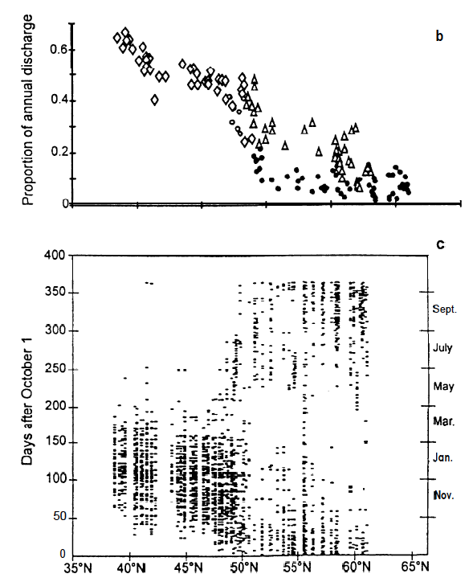
Strong latitudinal effect on timing of annual peak discharge
Proportion of annual discharge carried during Dec-Feb
Anderson & Naiman 1997

