Slide 1

Contact management system
JAVAC

Slide 2

Member roles
Project Manager – Htet Oo Thu
Software Programmers – Wai Yan Moe Lwin
Phone Myat Ko Ko
Software Testers – Wai Yan Moe Lwin
Phone Myat Ko Ko

Slide 3
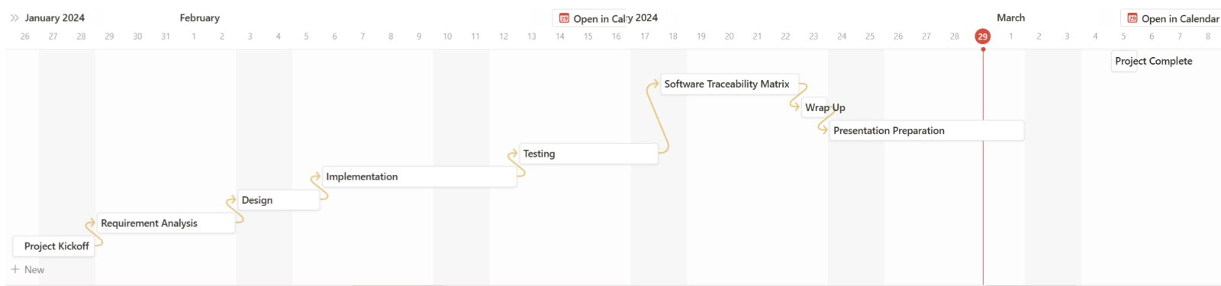
Project timeline
Project Kickoff – Jan 26
Project Complete – Mar 5

Slide 4
Technologies and Tools
Technologies used to develop the program – JDK, VS Code
Project Management Tools – Notion
Diagram Tools – draw.io
Document and Version Control Tools – MS 365 Word, GitHub.
Collaboration and Communication Tools – MS team

Slide 5
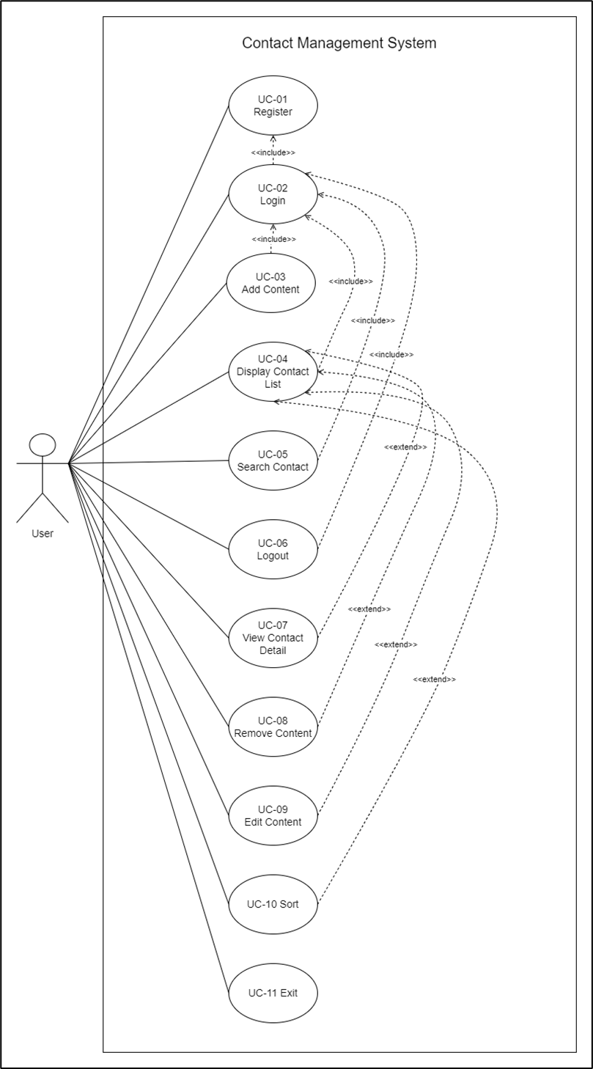
Use cases
Main features
UC – 03 Add Contact
UC – 07 View Contact Detail
UC – 08 Remove Contact
UC – 09 Edit Contact

Slide 6
Use cases
Additional Features
UC – 01 Register
UC – 02 Login
UC – 04 Display Contact-List
UC – 05 Search Contact
UC – 06 Logout
UC – 10 Sort
UC – 11 Exit

Slide 7
URS & SRS for uc-03
[URS-03]: User can create a new contact with name, phone number, email (optional), and
address (optional).
[SRS-08] The system shall display prompts to choose 1(Add Contact), 2(Display Contact-List), 3(Search Contact), 0(logout).
[SRS-09] The system shall display prompts to enter name, phone number, email (optional), and address (optional).
[SRS-10] The System shall create a new contact and add it to the user contact list.
[SRS-11] The system shall redirect to the “Home Menu” prompts.

Slide 8
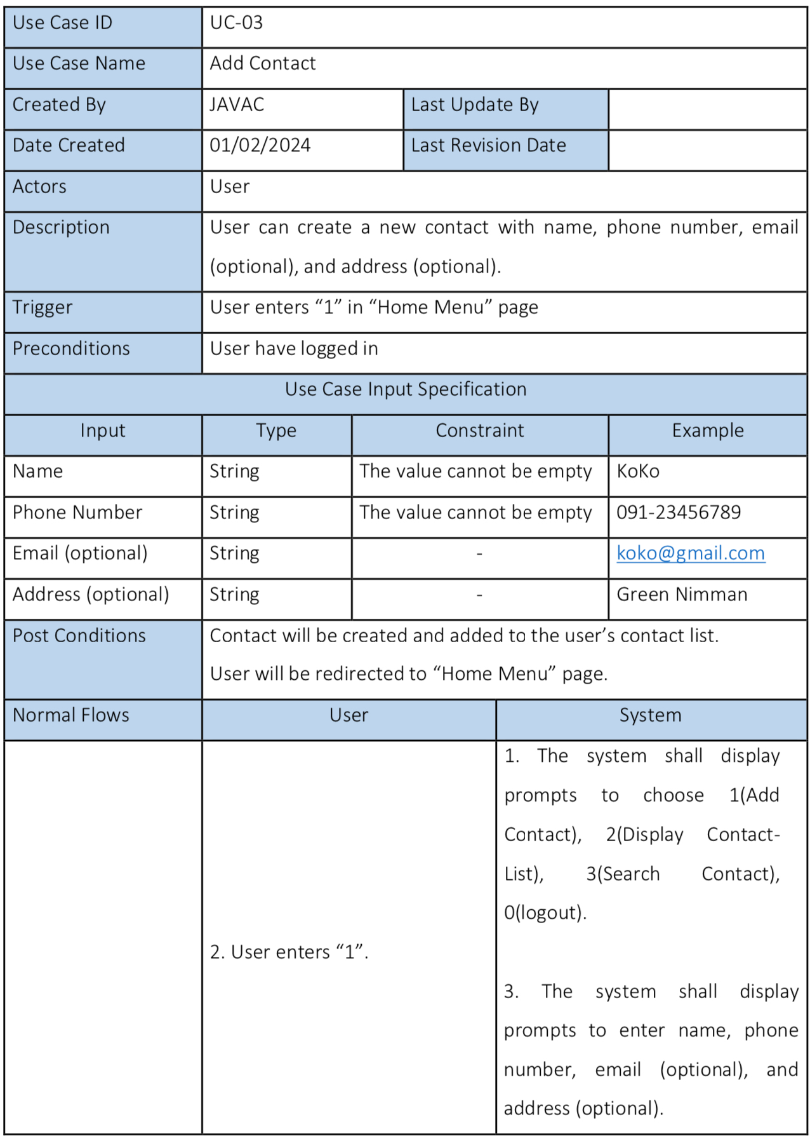
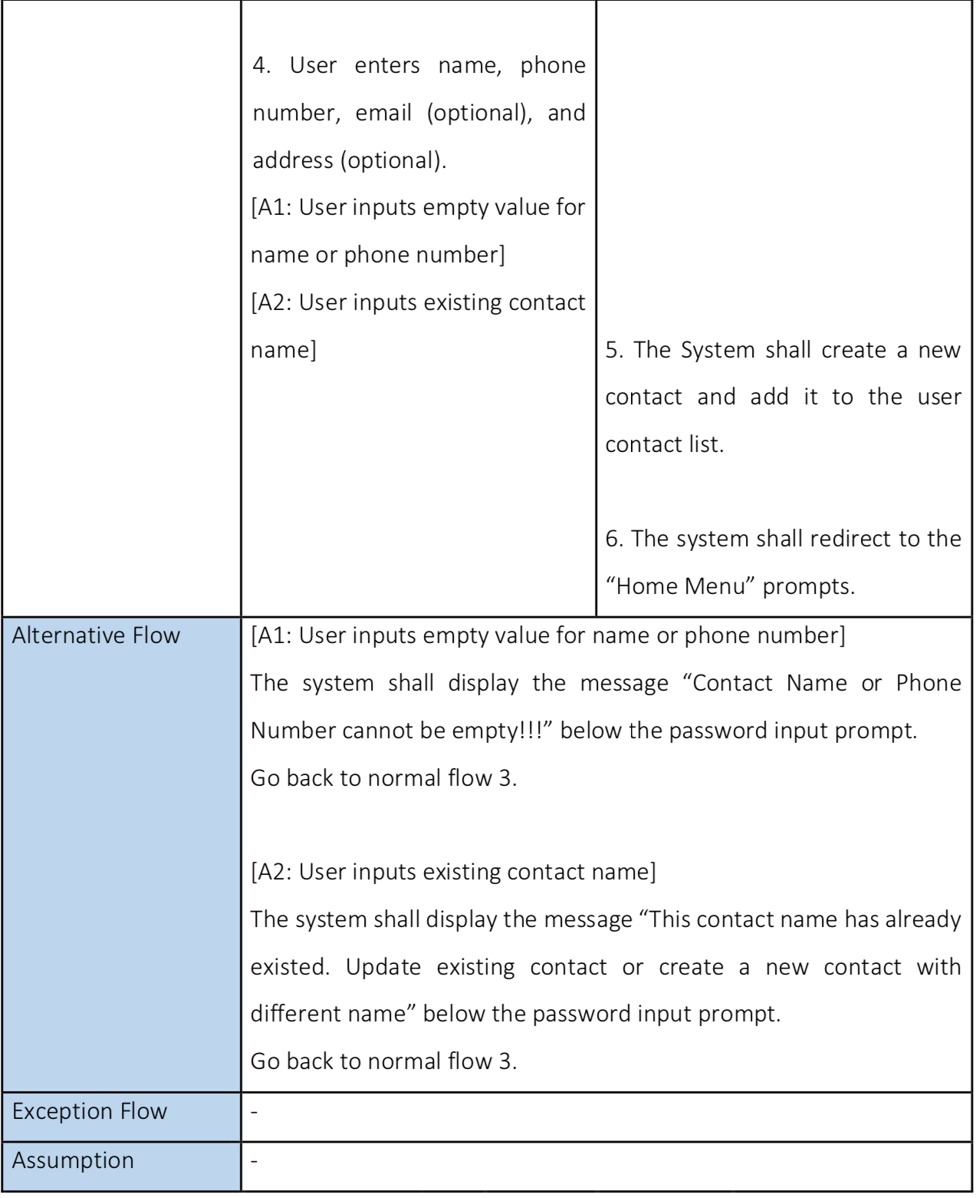
Use cases

Slide 9
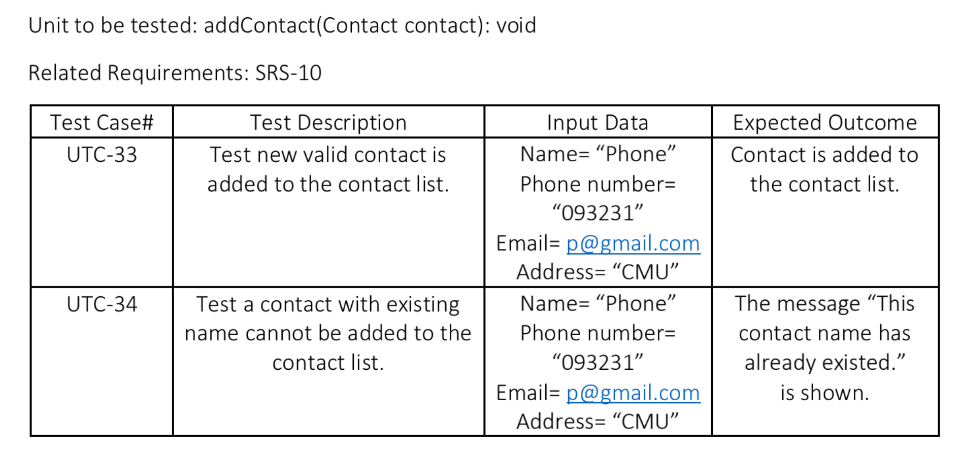
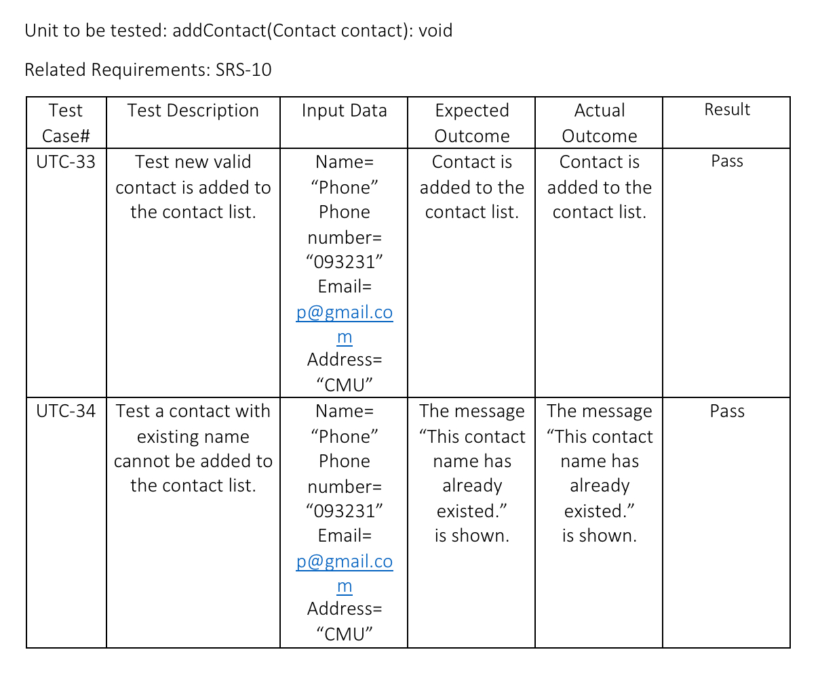
testing plan & record

Slide 10
reflection
We learned about the importance of documentation in software engineering. It is also important to understand the requirements and clearly specify them.
As we have to code as a team, we need to write code that is readable and understandable. We need to design the program to lower level so that both of us know what we need to write.
Successes:
We implemented the required features with relatively low bugs that we passed most of the test cases in the first time.
We have completed the project in time.
Areas for improvement:
We could have improved our source code to be cleaner and more consistent, so it is easier to read and maintain.

Slide 11

Thank You

