Slide 1
LENDING CLUB CASE STUDY
Case Study Performed by
Vijay Mahesh Lakhe
Mahalingam Palavesam

Slide 2
Business Objectives
This company is the largest online loan marketplace, facilitating personal loans, business loans, and financing of medical procedures. Borrowers can easily access lower interest rate loans through a fast online interface.
Like most other lending companies, lending loans to ‘risky’ applicants is the largest source of financial loss (called credit loss). The credit loss is the amount of money lost by the lender when the borrower refuses to pay or runs away with the money owed. In other words, borrowers who default cause the largest amount of loss to the lenders. In this case, the customers labelled as 'charged-off' are the 'defaulters'.
If one is able to identify these risky loan applicants, then such loans can be reduced thereby cutting down the amount of credit loss. Identification of such applicants using EDA is the aim of this case study.
In other words, the company wants to understand the driving factors (or driver variables) behind loan default, i.e. the variables which are strong indicators of default. The company can utilise this knowledge for its portfolio and risk assessment.
To develop your understanding of the domain, you are advised to independently research a little about risk analytics (understanding the types of variables and their significance should be enough).

Slide 3
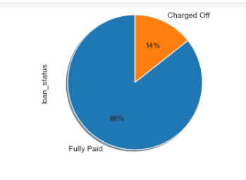
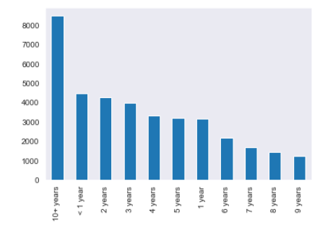
Key Observation
Majority of customers have paid off which is a good sign and 14% are defaulters .
Fully Paid – 86 %
Charged Off(Defaulters) – 14%
Customers having 10+ years Employee length , loan has been distributed the most .

Slide 4
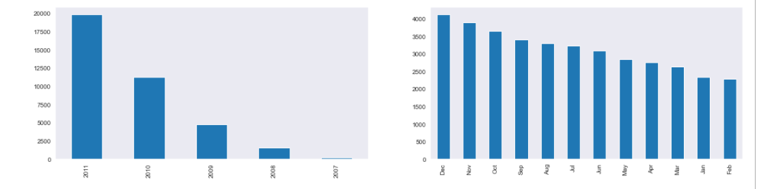
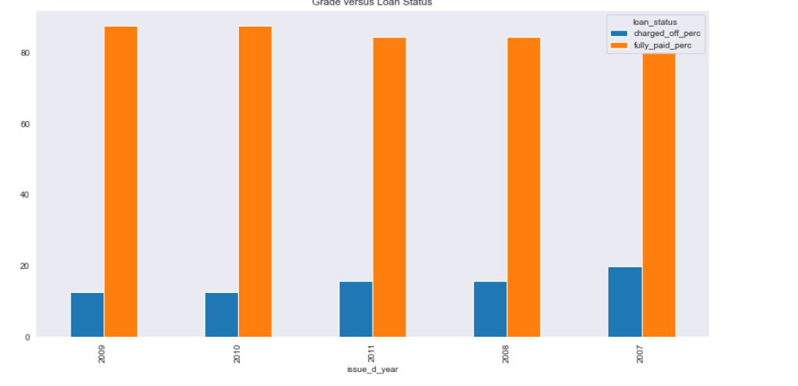
Key Observation
2011 most of the loans were being distributed as the Global and US economy was blooming.
Dec , Nov Most of the loans have been distributed as its holiday season , and most of the customers generally tend to spend more money during these months .
Most percentage of defaulters are from the year 2007 since there was recession.

Slide 5
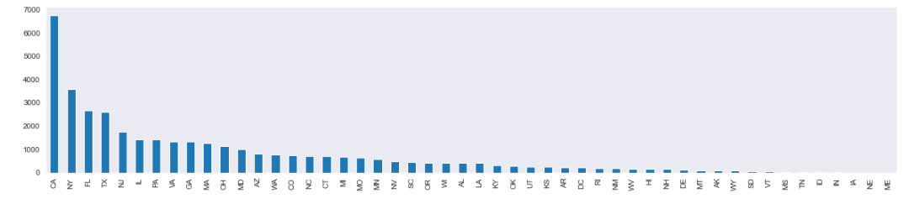
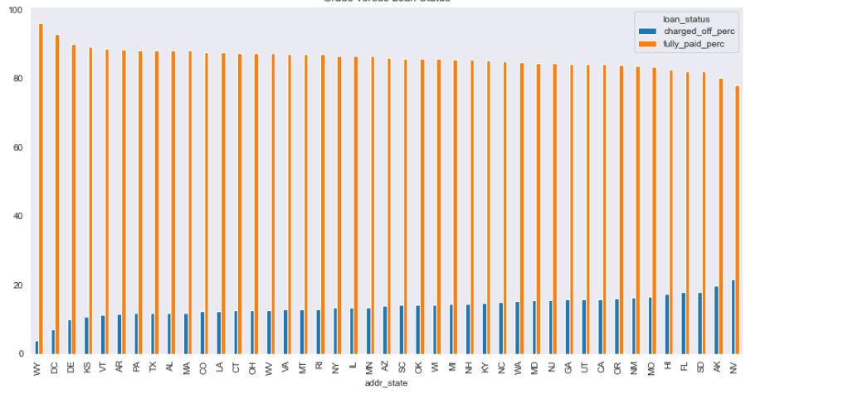
Key Observation
CA , NY , FL and TX being the highest customer count which is true since these are the top 4 states in US having high population .
By not considering the lowest loan distributed state , we can see that NV and AK are having more Defaulter percentage.

Slide 6
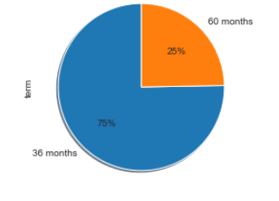
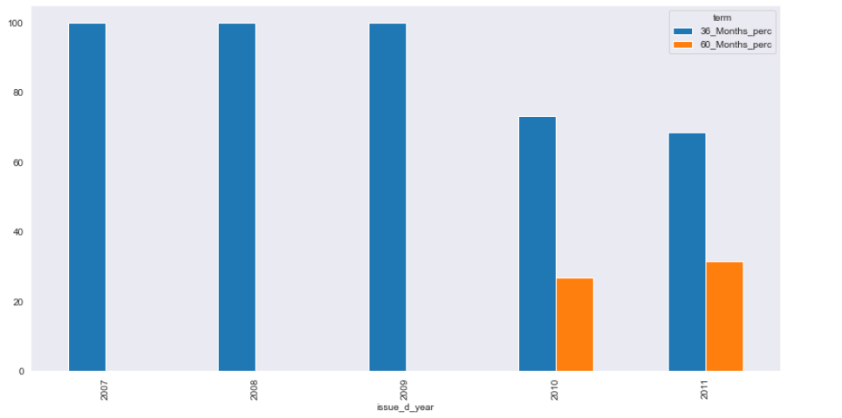
Key Observation
Only 25% of customers are having 60 Months Loan Period
60 Month Term Loan Period was introduced in the year 2010 onwards.

Slide 7
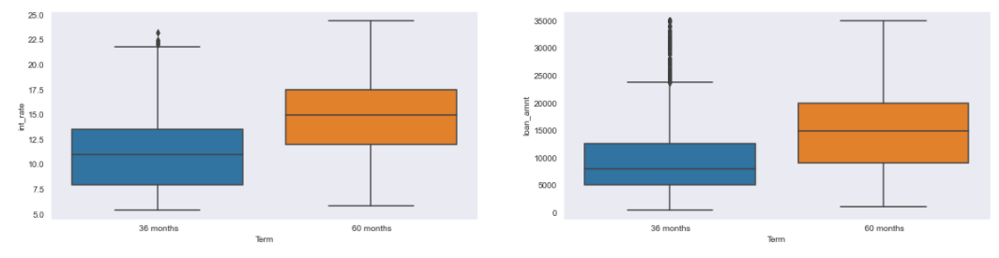
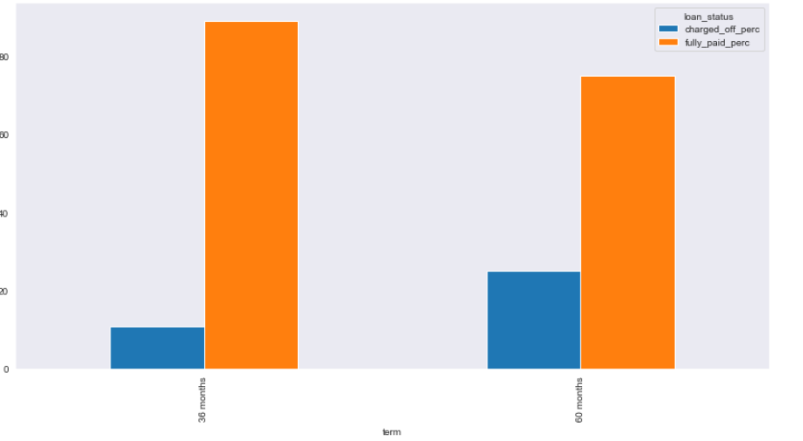
Key Observation
As expected, 60 Months term are for mostly for High Loan Amount which in turn will have High Interest Rate
Even though Majority of Loan Term is 36 months , but the Charged off customers are mainly from 60 months Loan Term . Which can be a driving factor as the Loan amount is huge which leads to High Interest Rate

Slide 8
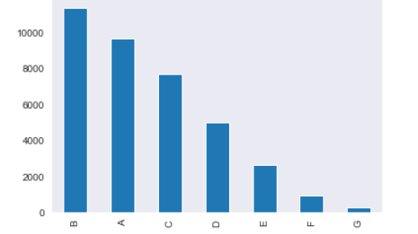
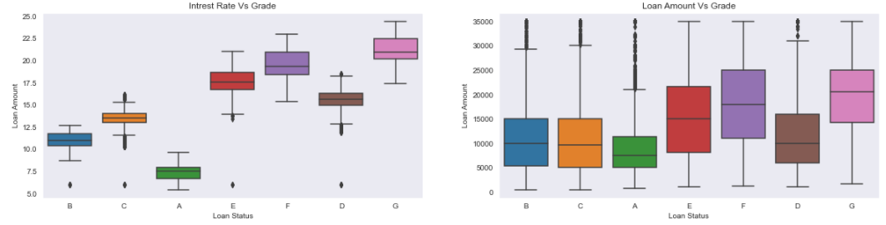
Key Observation
Most of the loan has been distributed to Grade A and B
Grade D - G have High Interest Rate and there is huge variation in loan amount for Grade D - G

Slide 9
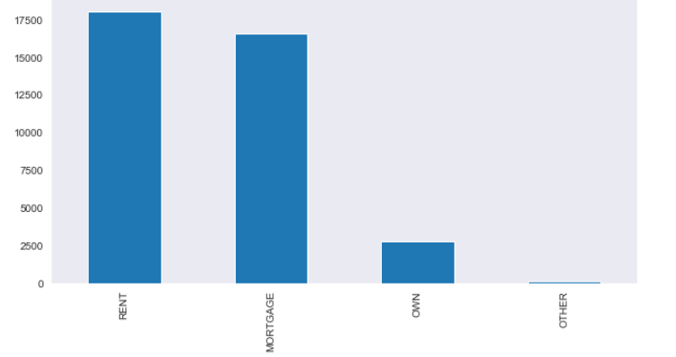
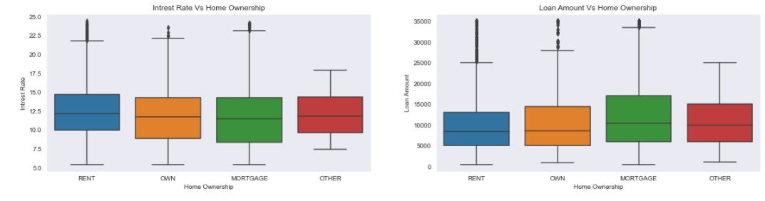
Key Observation
Majority of customers are either Staying in Rented property or Mortgage
Generally, we see higher loan amount – high interest rate , but regarding Mortgage Owners the Interest rate drops.
Also 75th percentile of Mortgage loan amount is high.

Slide 10
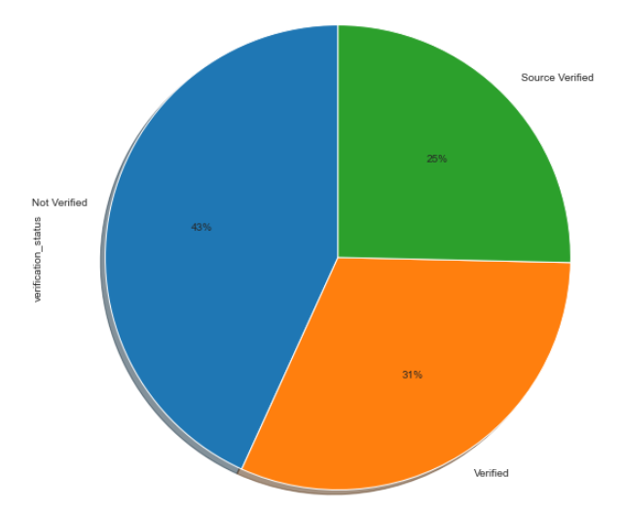
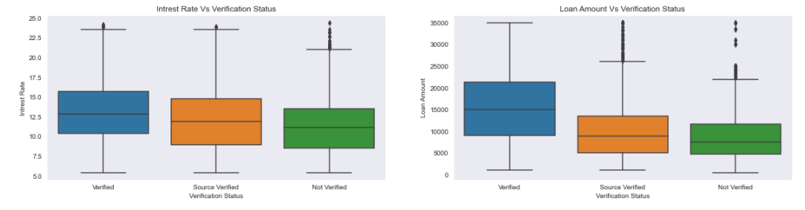
Key Observation
43 % customers are Not Verified.
31% customers are Verified.
26% customers have Source Verified .
Company should make sure higher amount of loans are not provisioned to customers who are not verified , also company is taking risk of providing more number loan to Not Verified customers.

Slide 11
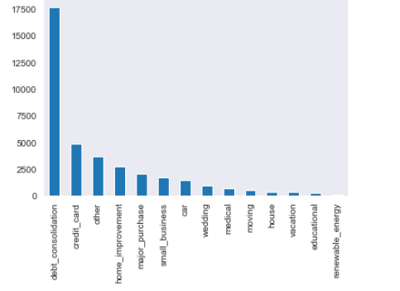
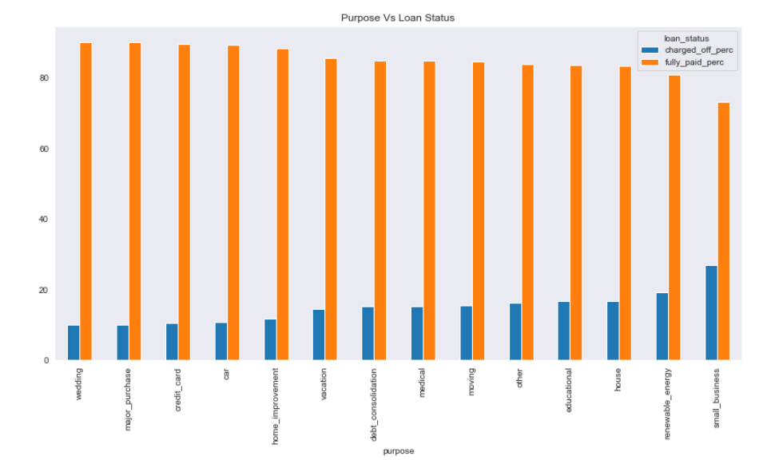
Key Observation
Majority of Loan distributed to customers request for purpose of Debt Consolidation
We see customers requested loan for Small Business are having huge default percentage .

Slide 12
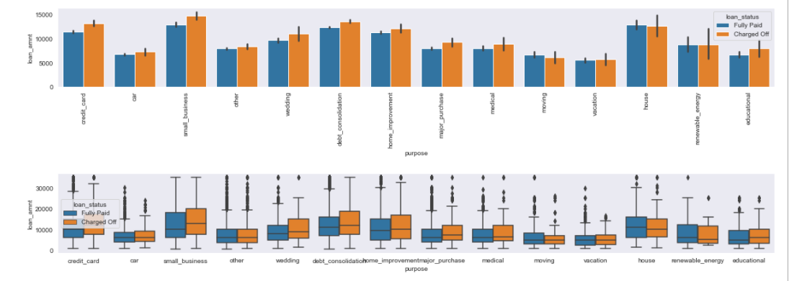
Key Observation
We see higher loan amount provided to customers requested loan for Small Business and House .

Slide 13
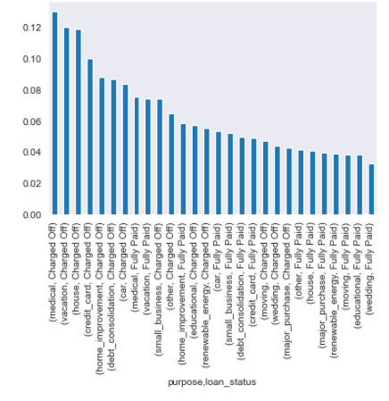
Key Observation
Company has provided loans to Vacation and House purpose for customers having high average for Public Record .
As Medical Loans are urgent and required for emergency purpose , company should try to provide low loan rates so customers can return it .

Slide 14
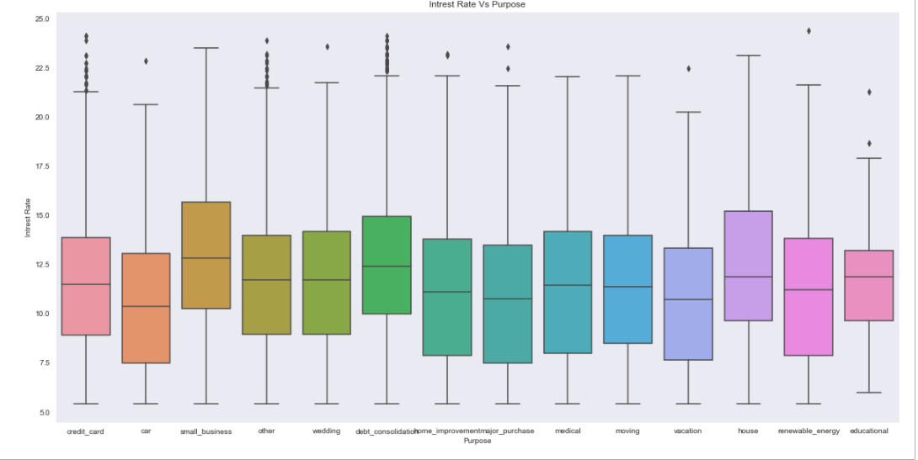
Key Observation

Slide 15
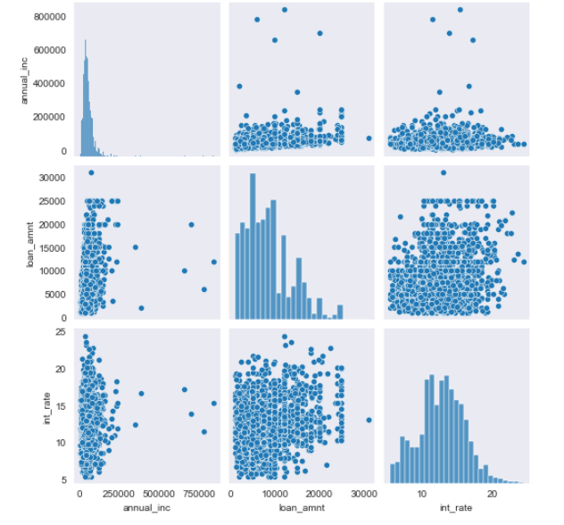
Key Observation
When a customer is Not Verified and with no Bankruptcy record , company should try to not provide higher loans when reported Annual Income is high as below data shows for Defaulters having No Verification and no bankruptcy . It will save company from loss

Slide 16
Recommendations
NV and AK states have high percentage of defaulters . Company needs to take extra caution while providing loan.
Most percentage of defaulters are from the year 2007 since there was recession . When there are sign of recession or during recession banks should provide loans for purpose of Medical and in case for other purpose should consider lowering the interest Rate and set a limit on the Loan amount .
Regarding Mortgage user’s company is loaning higher amount for purpose not associated to House , company needs to take extra caution as they do already need to pay Mortgage amount along with other credit accounts
As the loan amount is high for Small Business and Housing , lot of defaulters are under it hence company need to produce new strategy to tackle these users by taking more stake regarding their business or house.
We see a greater number of Not Verified defaulters requested loan for Medical purpose as it can’t be denied , company should think to lower the interest rate for these loans so small instalments can easily be paid .
When a user is Not Verified and with no Bankruptcy record , company should try to not provide higher loans when reported Annual Income is high.
Company should not be providing Higher Loan amount for Not Verified Users except for Medical purpose.
Company needs to ramp up Verification status as 43% of users are not verified and it’s a risk in lending loans without performing proper background verifications

