Slide 1
Improved Image Quality Metrics
By Varun Lalwani and Zhiwei Tang

Slide 2
Outline
Improved Image Quality metrics
Problem Statement
Assumptions
Preprocessing
Images
Producing Dataset
Implementation
Result
Summary
Conclusion

Slide 3
Assumptions
Improved Image Quality metrics
Outdoor Images
Image Size: (100 x 100 x 3): RGB
Reference Based Model
Classification

Slide 4
Classes
Improved Image Quality metrics
3: Really Bad image
2: Medium Bad image
1: A little Bad compared to reference
0: Similar Quality to reference
-1: A little better compared to reference
-2: A better image
-3: A really good quality image

Slide 5
Preprocessing
Improved Image Quality metrics
Why Preprocessing? Lack of large datasets online.
20 Outdoor Images
Resized them to (100 x 100 x 3)
Smoothened them with 3 different level of intensity
Added Gaussian Noise with 3 different level of intensity
Added Salt & Pepper Noise with 3 different level of intensity

Slide 6


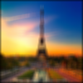




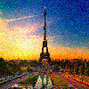
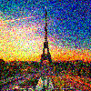
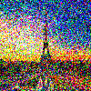
Images
Improved Image Quality metrics
Original
Intensity: 1
Intensity: 2
Intensity: 3
Blur
S & P
Noise
Gaussian
Noise

Slide 7
Producing Dataset
Improved Image Quality metrics
10 Sub images for 1 Image
We take all pairs of 2 images, with Repetition allowed, and horizontally concatenate them
Left Image is reference Image
Right Image is Image to be classified
Each Pair belongs to a class out of 7 classes mentioned
So there are 100 pairs for 1 Image
There are 20 Images, so in total 2000 pairs.

Slide 8


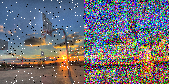
Example
Improved Image Quality metrics
3
-3
2

Slide 9
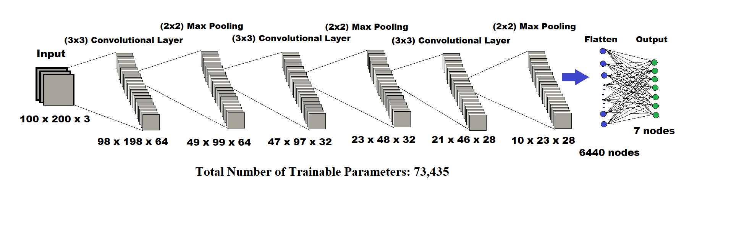
The Data Driven Model
Improved Image Quality metrics
Data Distribution = 85:10:5

Slide 10
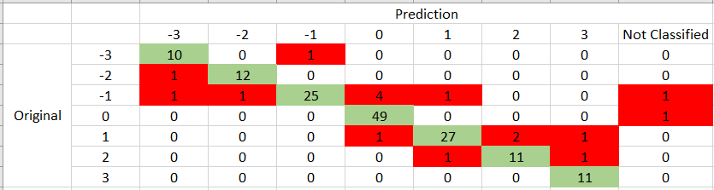
Result
Improved Image Quality metrics
Training Accuracy = 91.3%
Validation Accuracy = 89%
Testing Accuracy = 89.5%

Slide 11


Result
Improved Image Quality metrics
Observed that the type of images, which the model mostly failed to classify accurately, involved comparing a blurred image to a noisy image
Should have been:
Prediction:
-1
-3
0
-1

Slide 12

Experiment 2
Improved Image Quality metrics
Now we try to run our classifier on a Portrait Image of Shinchan

Slide 13
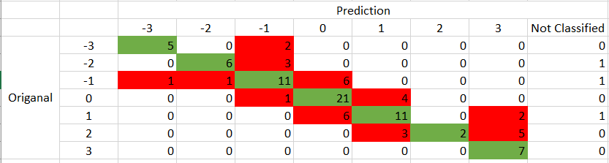
Results
Improved Image Quality metrics
Testing Accuracy = 63%

Slide 14
Future Plans
Improved Image Quality metrics
Try a deeper neural network
Extend our training dataset from outdoor images
Try more types of errors in it like luminance, JPEG compression
Try non- reference based image quality estimation
Try gathering more people for classifying images

