Slide 1
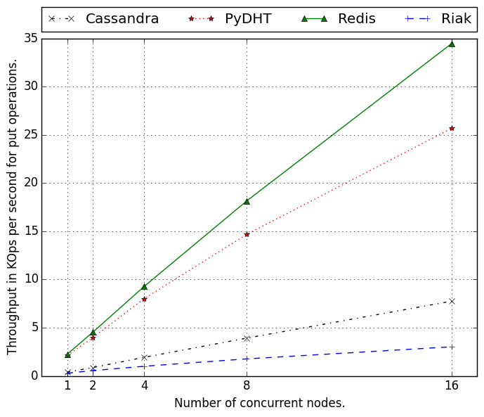
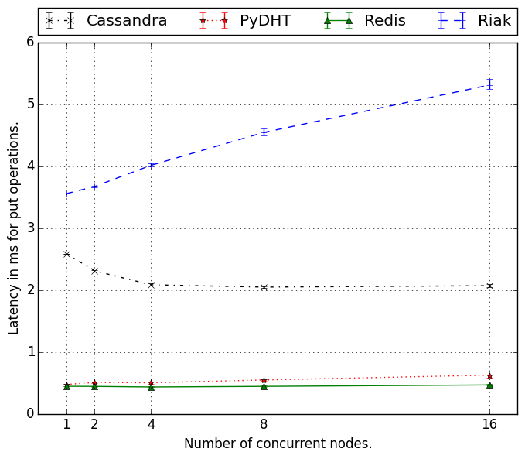
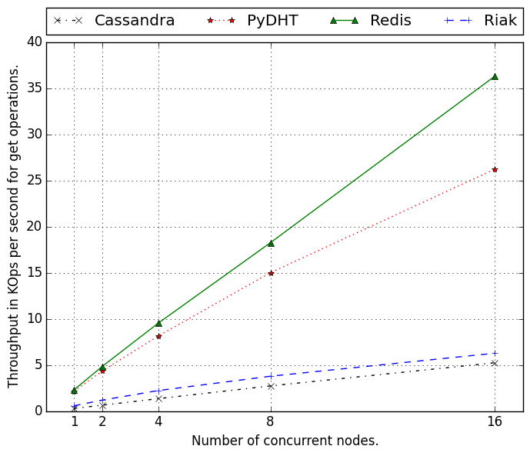
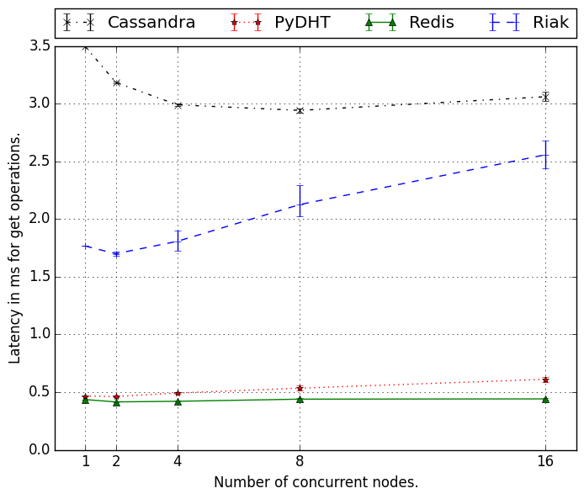
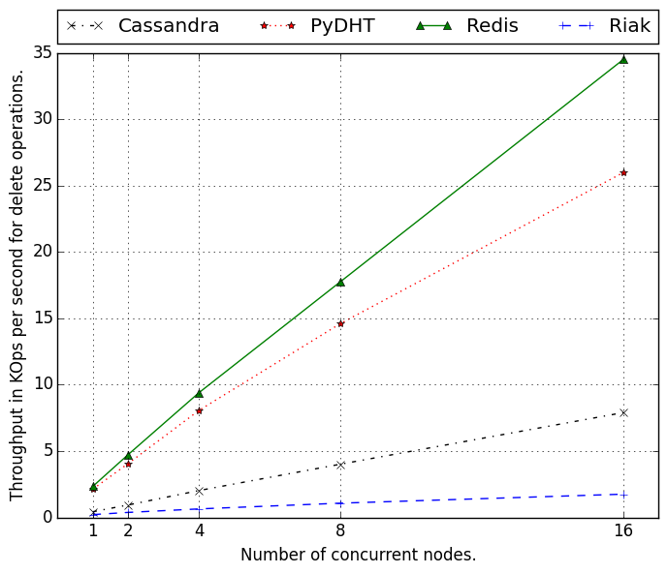
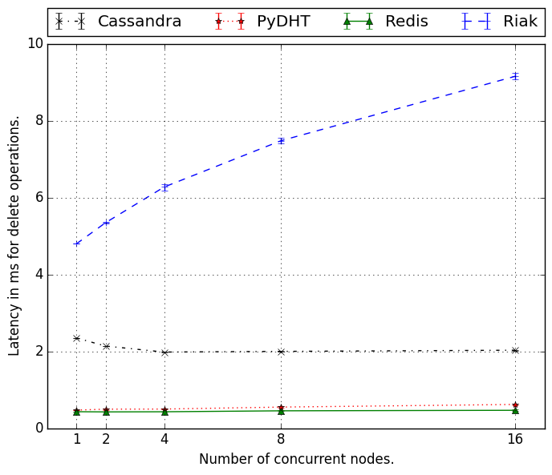
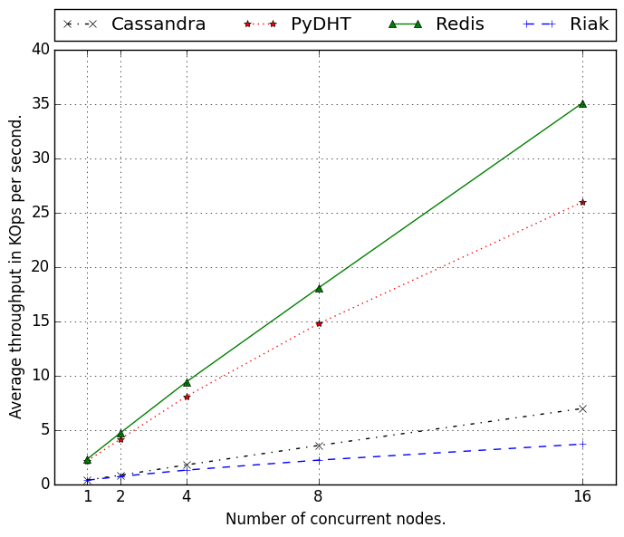
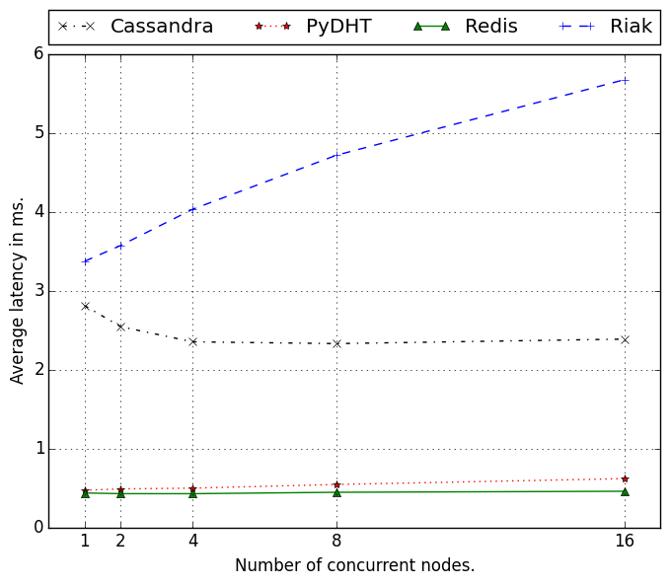
52
Benchmarking of Commercial NoSQL Databases and of a Python Implementation of a Distributed Key-Value Store.
Virgile LANDEIRO DOS REIS – A20316060 – vlandeir@hawk.iit.edu
Abstract
Evaluation
In this poster, we compare the performance (via throughput and latency) of four NoSQL database systems over three operations: put, get, and delete. Three of these systems (Cassandra, Riak, and Redis) are developed and supported by teams of developers and implement advanced operations such as replication, sharding, or node failure management. The last system has been implemented in Python during a one-semester class. We find that Redis outperforms all the other systems for these operations. Cassandra seems to be the less scalable system whereas PyDHT is close to Redis in throughput and latency.
Motivation
Centralized databases disadvantages:
Single point of failure.
Bottleneck on IO or CPU.
Not flexible enough for high scale computing.
Relational database?
Relational model is not flexible.
Languages similar to SQL can be implemented (e.g. CQL in Cassandra).
Key-value stores can easily be used by other applications (e.g. ZHT).
Proposed Work
Compare throughput and latency performance of four NoSQL systems on put, get, and delete operations:
Cassandra
Riak
Redis
PyDHT
Deploy each system over 16 m3.large EC2 instances.
Scale the nodes executing concurrent requests from 1 to 16.
Each concurrent node runs 30K operations of each type: put, get, delete (10B keys and 90B values).
Compute throughput in KOps/sec and latency in ms.
Visualize the results to know which system provides the best throughput, the lowest latency.
Which system is the most scalable overall?
Conclusion
After evaluating the four systems on EC2, we notice that Redis is the most scalable system overall. This system is an in-memory database that does not implement consistent caching. Therefore, on small key-value pairs, it seems coherent that this system performs the best. Similarly, PyDHT is in-memory and does not implement replication, making it lighter and more appropriate for this use case. On the other hand, Cassandra and Riak are NoSQL databases that are more robust to failures as well as best fitted for handling large amount of data.

