Slide 1
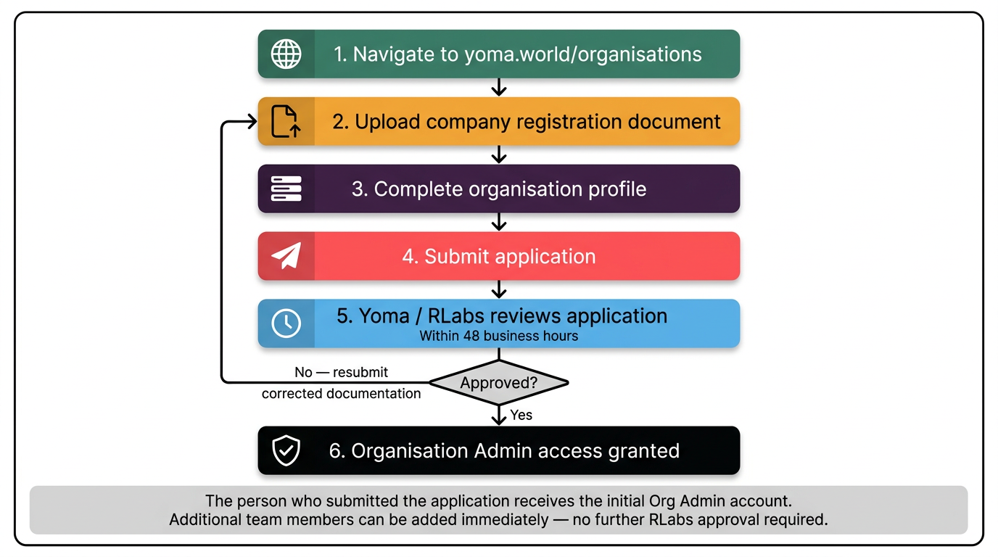
Organisation Registration Flow
02-getting-started › 02-02 Setting Up Your Organisation

Slide 2
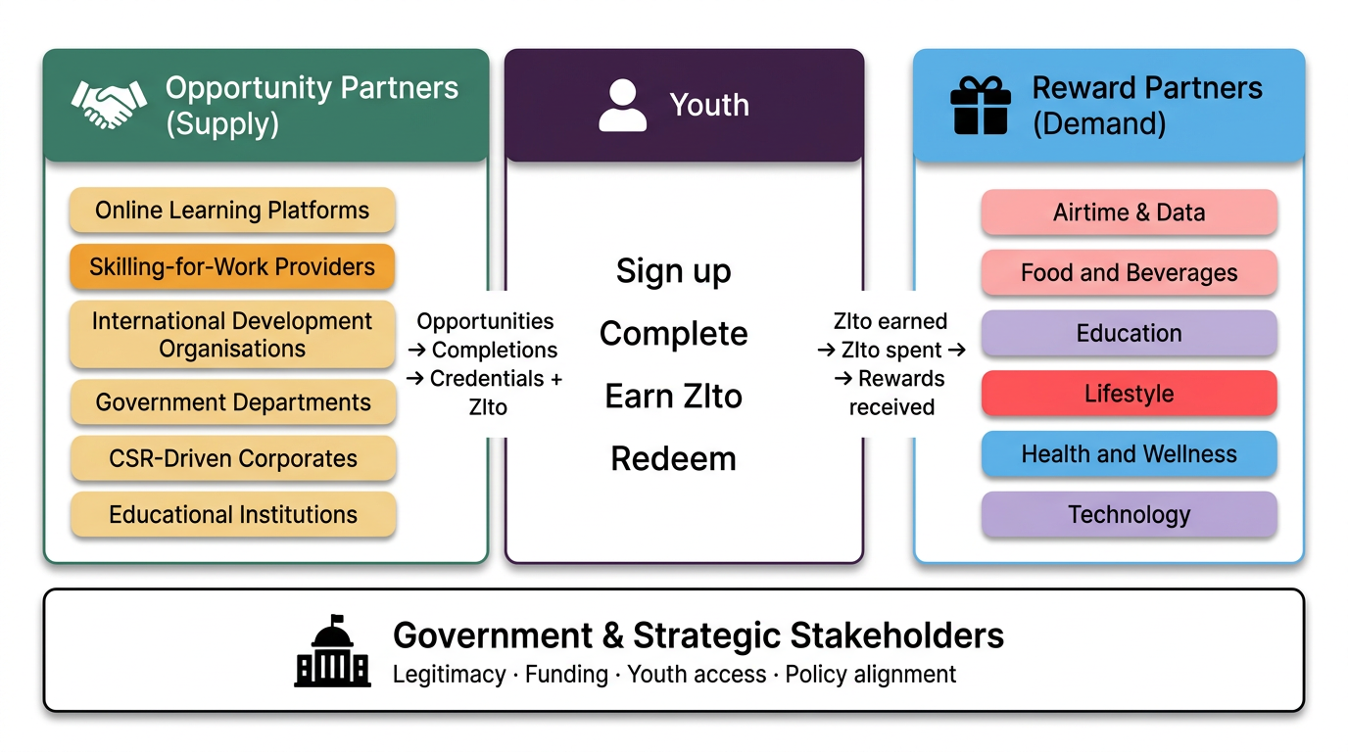
Stakeholder Map
02-getting-started › 02-03 Stakeholder Mapping

Slide 3
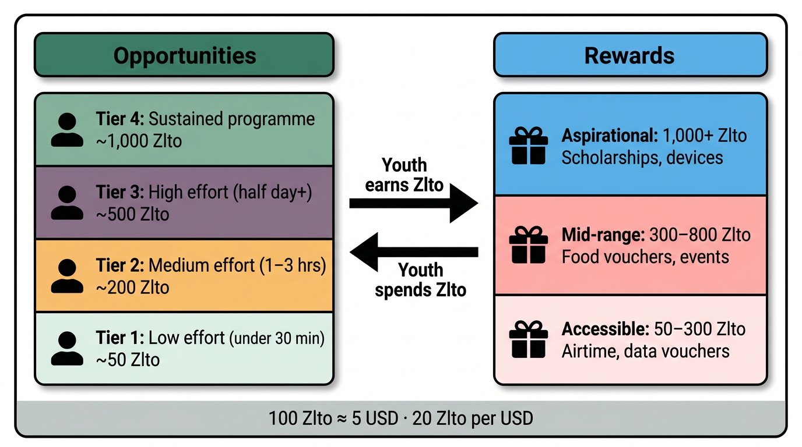
The Zlto Economy System
02-getting-started › 02-04 Planning Your Points Economy

