Slide 1
Whisper Fine-Tuning

Slide 2
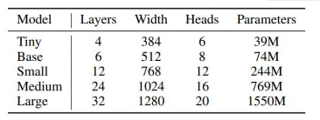
Whisper model
Multilingual ASR model
Transformer based
Variants
Tiny
Base
Small
Medium
Large

Slide 3
Dataset
Czech Parliament Plenary Hearings - 444 hours
Common Voice - 256 hours of crowdsourced Czech
Preprocessing
Hugging Face datasets loading script
NeMo Punctuation and Capitalization model
Finetuned using UD_Czech-CAC and UD_Czech-PDT treebanks
Merging datasets

Slide 4
Training
classical fine-tuning
base and small variant of the model
batch size = 64
learning rate = 1e-5, 10000 steps
PEFT + LORA + INT8
large v2 variant of the model
rank=16, scale=16
learning rate = 1e-4, 5000 steps
batch size=64 vs. 4 without any on A40 48GB
trained on Galdor cluster at MetaCentrum
NVIDIA A40 48GB

Slide 5
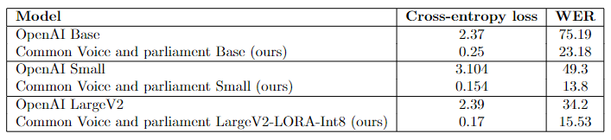
Results - Common Voice and Parliament

Slide 6
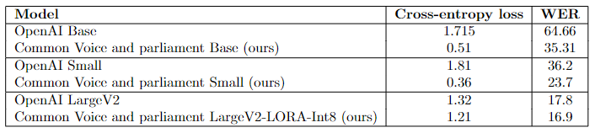
Results - VoxPopuli

