Slide 1
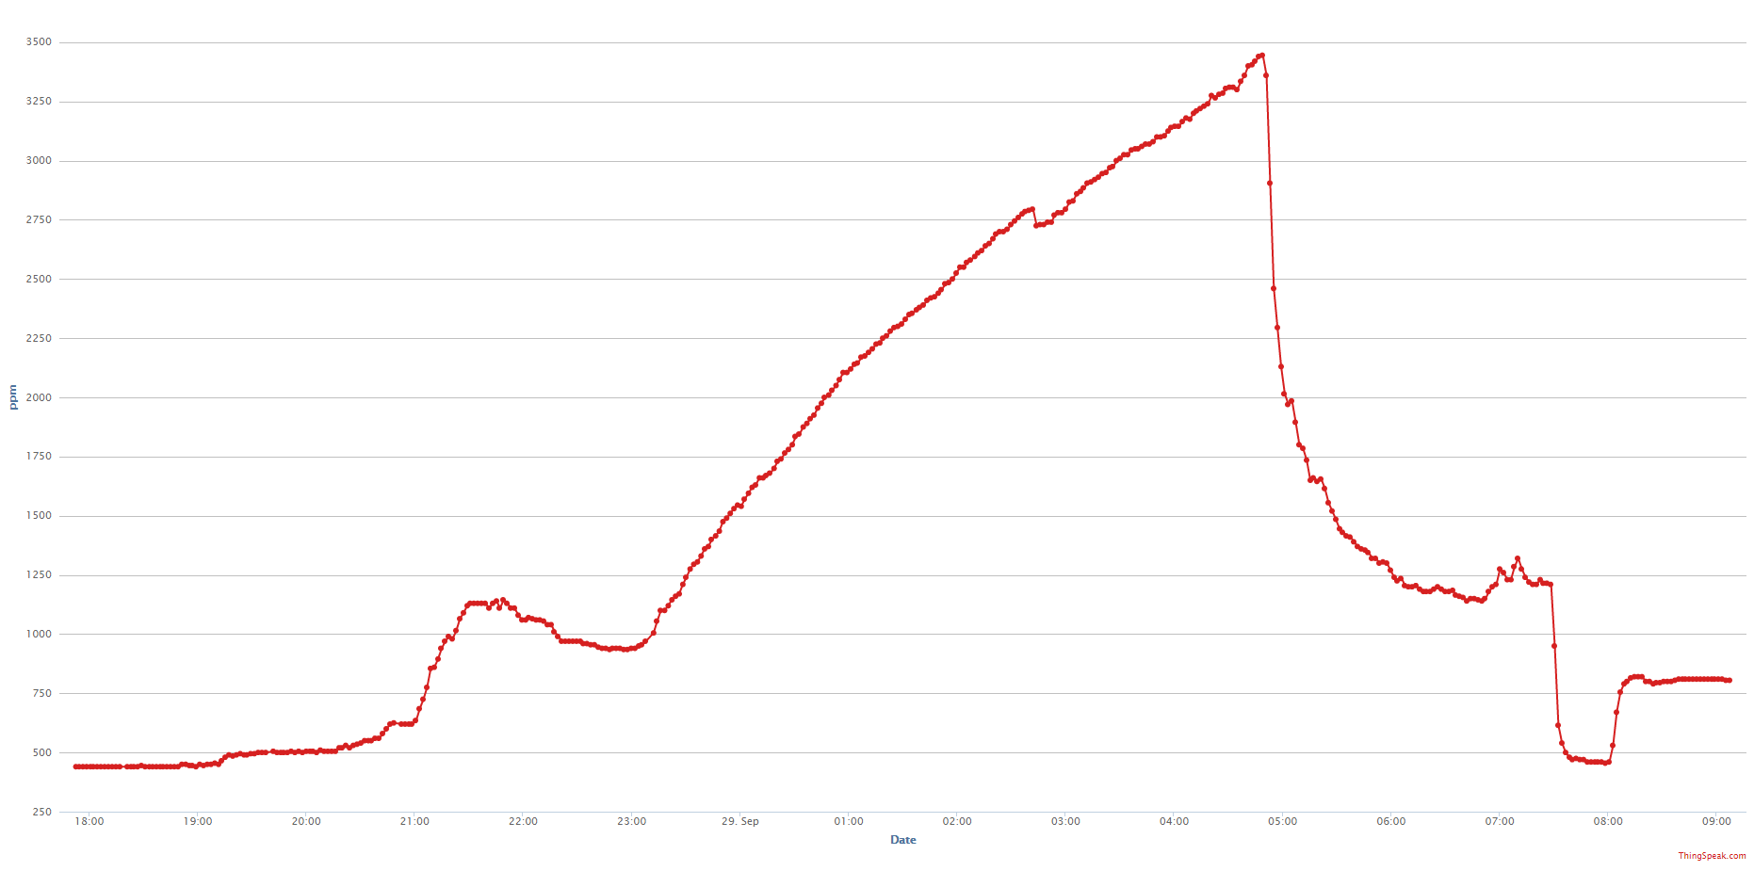
3500
Door Wide open.
1 Parent sleeping
3000
Rate:
~430 ppm/H
2500
Window Closed. Door Opened
Parents Going to Sleep.
Door Closed
2000
2 Parents waking Baby
Open Door briefly to drink water
1500
Putting Baby to sleep
1000
Door Closed. Otside Window Open
Baby is alone, door partly open
500
20:00
22:00
00:00
02:00
04:00
06:00
08:00

