Slide 1
movieID | movieTitle | rated | actors | plot
movie1 | Beaches | PG-13 | Bette Midler, Barbara Hershey, John Heard, Spalding Gray | A privileged rich debutante and a cynical struggling entertainer share a turbulent, but strong childhood friendship over the years.
movie2 | Taken | PG-13 | Liam Neeson, Maggie Grace, Leland Orser, Jon Gries | A retired CIA agent travels across Europe and relies on his old skills to save his estranged daughter, who has been kidnapped while on a trip to Paris.
movie3 | Gone Girl | R | Ben Affleck, Rosamund Pike, Neil Patrick Harris, Tyler Perry | With his wife's disappearance having become the focus of an intense media circus, a man sees the spotlight turned on him when it's suspected that he may not be innocent.
movie4 | War of the Worlds | PG-13 | Tom Cruise, Dakota Fanning, Miranda Otto, Justin Chatwin | As Earth is invaded by alien tripod fighting machines, one family fights for survival.

Slide 2
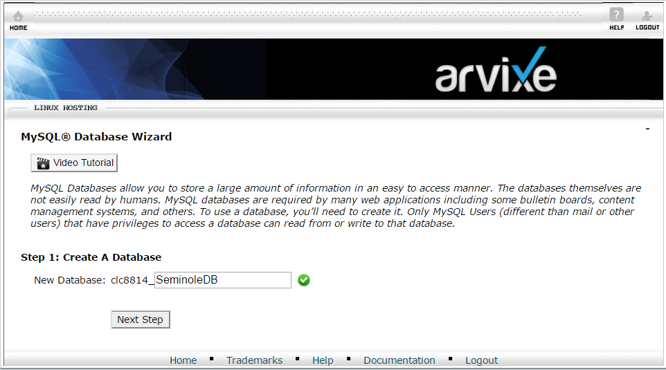
movieDatabase

Slide 3
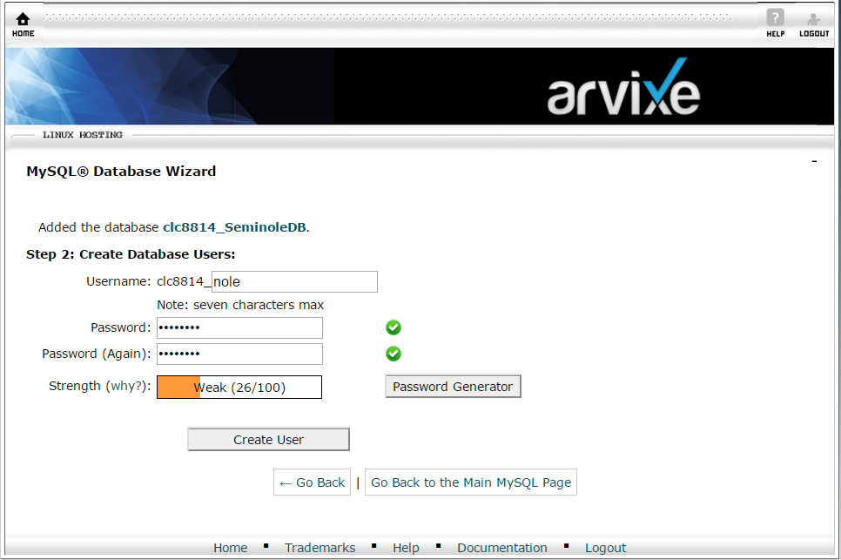
movieDBUser

Slide 4
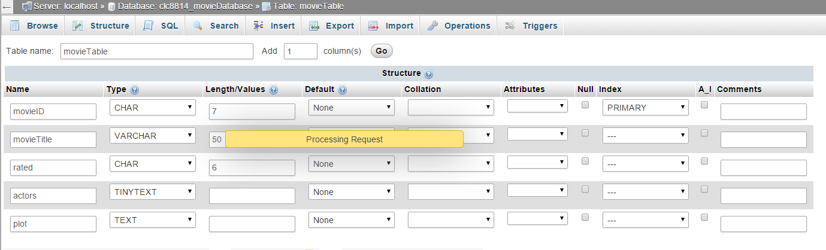

Slide 5
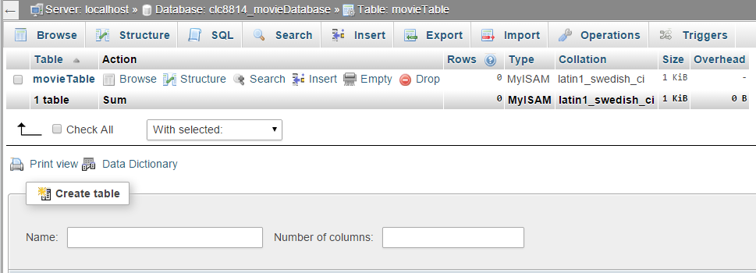

Slide 6
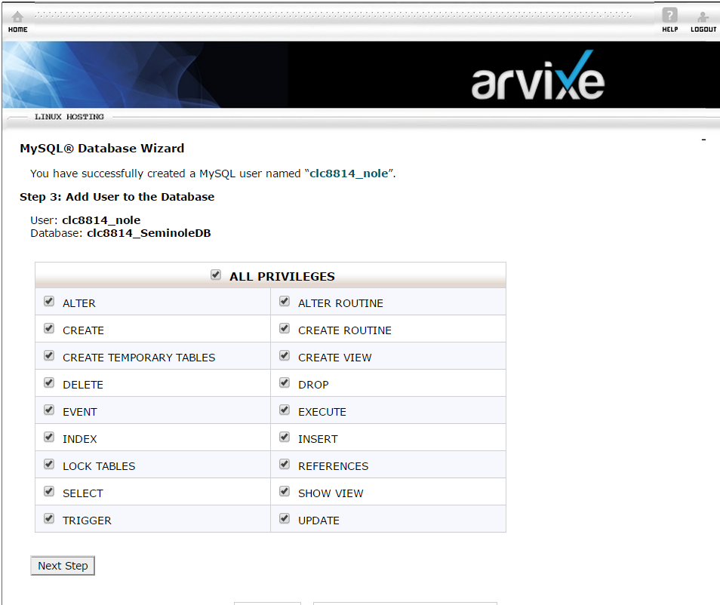
“clc8814_movUser”
User: clc8814_movUser
Database: clc8814_movieDatabase

Slide 7

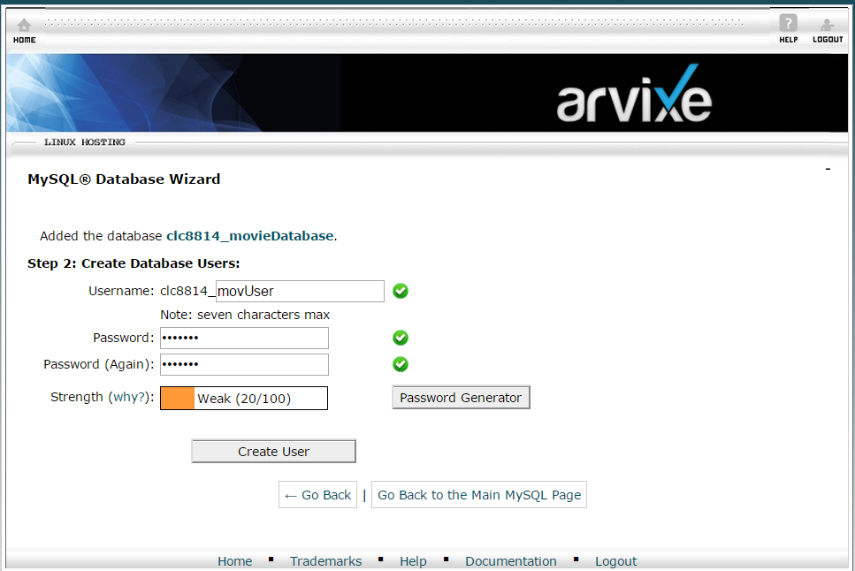

Slide 8
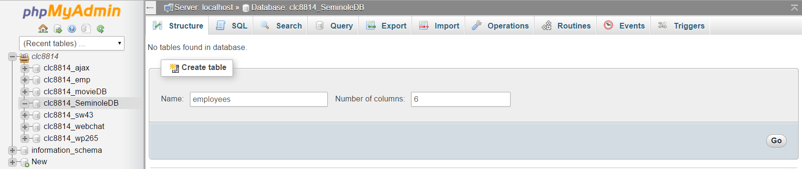
Clc8814_movieDatabase

Slide 9
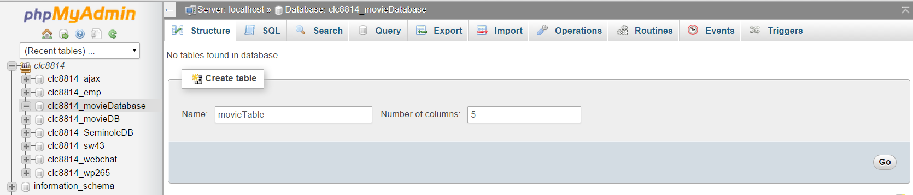

Slide 10
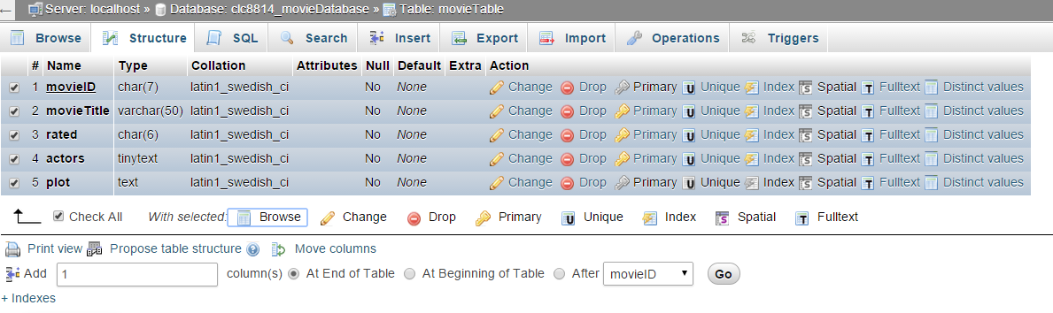
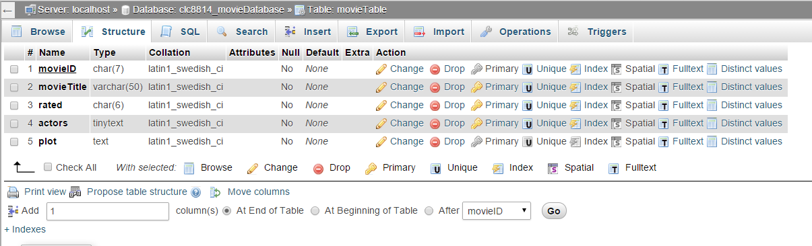

Slide 11
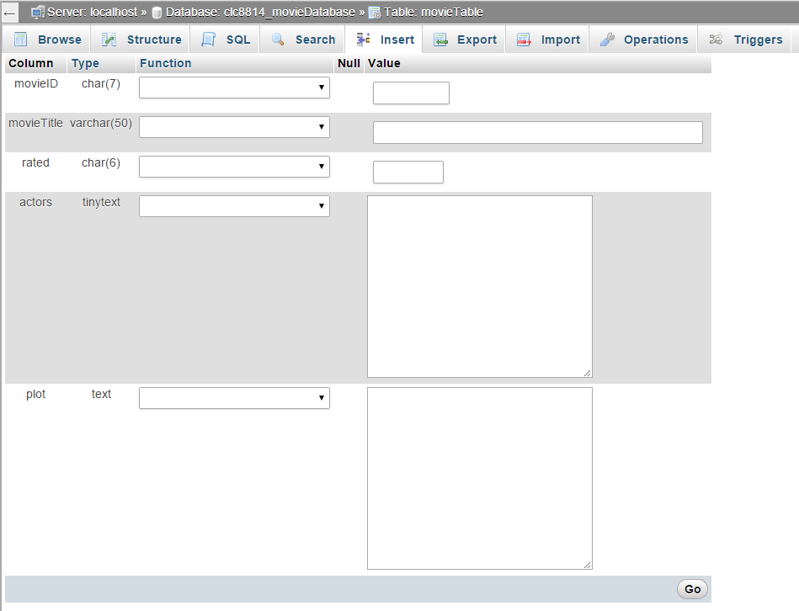

Slide 12
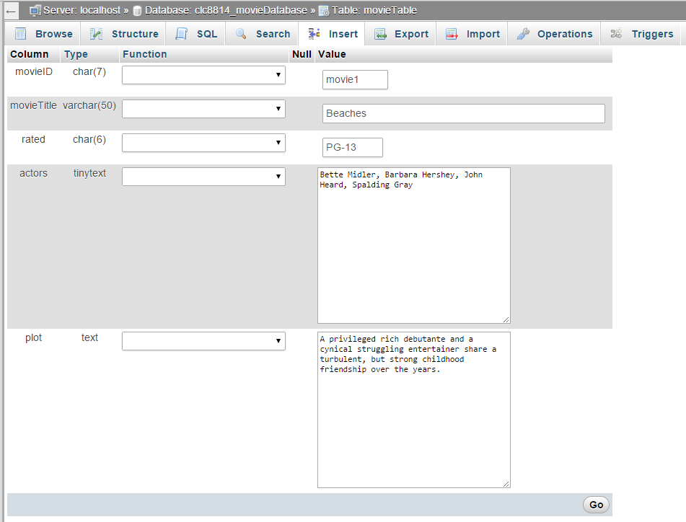
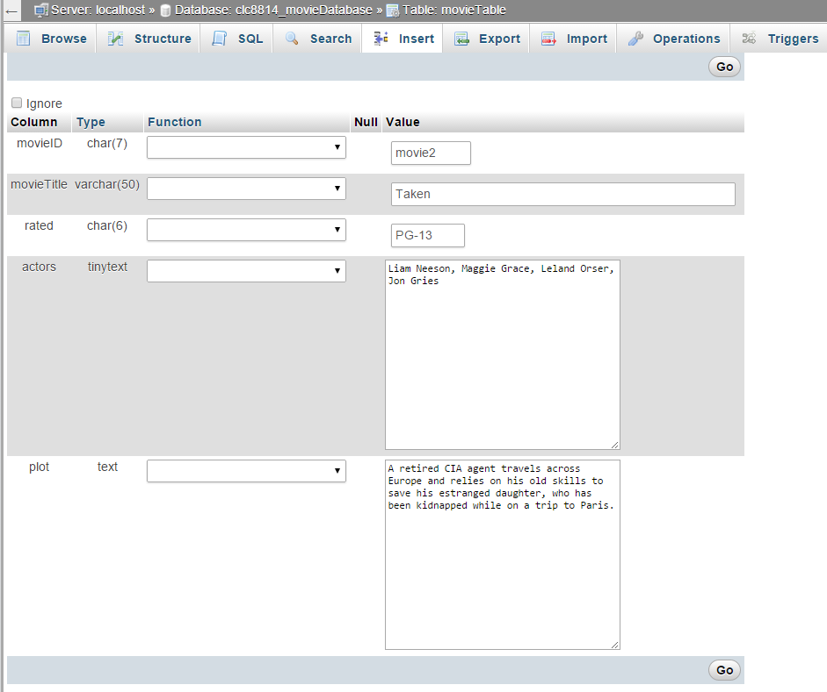

Slide 13
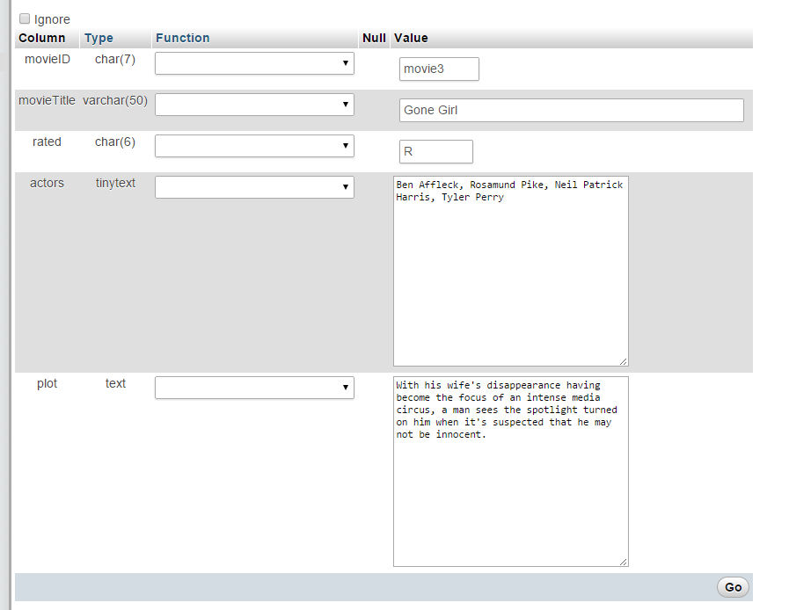

Slide 14
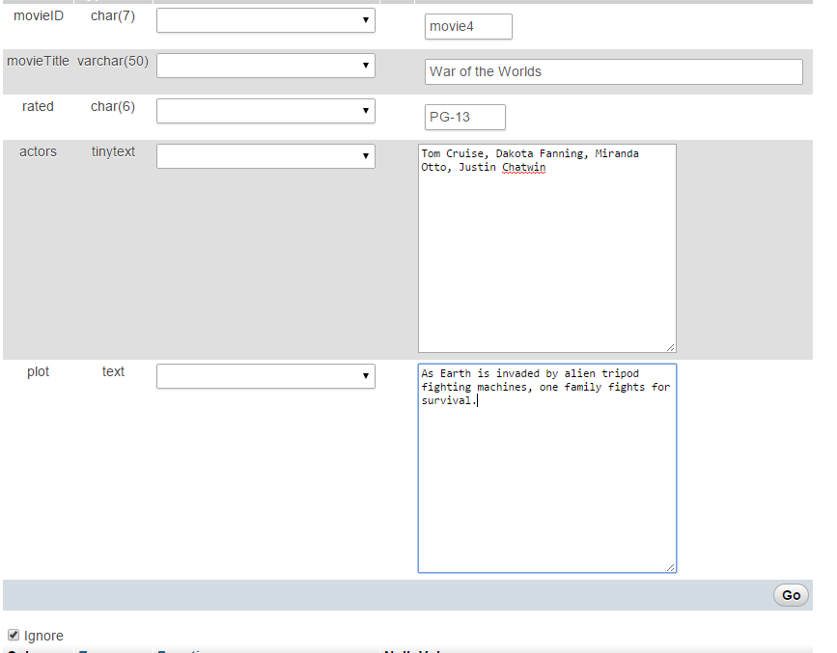

Slide 15
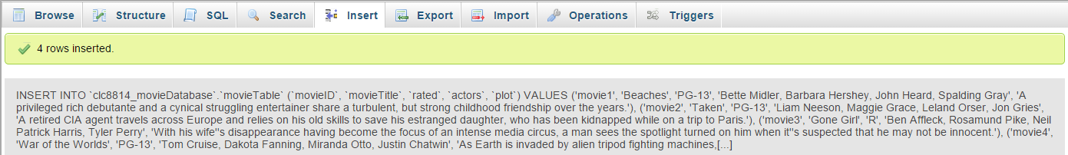

Slide 16
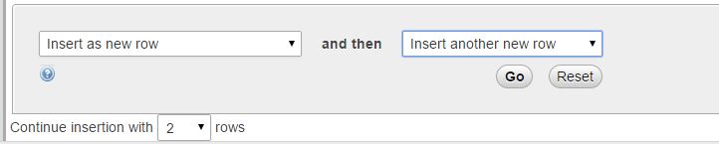
5

