Slide 1
Success indicators of crowdfunding projects
Lukas Vlcek

Slide 2

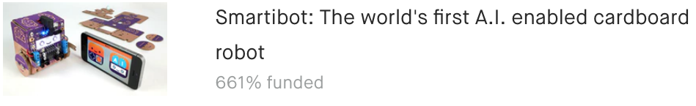


Crowdfunding
Crowdfunding platforms
Aggregate funds from small investors
New technology, art, journalism, games, personal projects, charity
Kickstarter
Biggest, oldest
250,000 creative projects
15 categories
International

Slide 3

Competition for FUNDING
Projects only funded if goal is reached
Goals from $1 to $100,000,000
150,000 funded
36% overall success rates
How to increase the chances of success?

Slide 4
Indicators of funding success and who cares?
Clients
Project proposers: individuals, startups, small companies
Their goal
Maximize the chances of successful funding
Service
Provide guidance in tailoring proposals
Payment: fixed amount or percentage of funds if proposal is successful
How?
Modeling based on historical data

Slide 5
Datasets: sources and aggregation
Online source:
Monthly updated repositories collected by Web Robots web scraping company
Available in CSV formats (30 files each month)
Combined into a single data frame
Removed duplicates
250, 000 records, 32 features, several in JSON strings
43 GB to 90 MB of CSV data

Slide 6
Data wrangling
Extracted information from JSON strings
Formed a new feature of category type by aggregating subcategories
Time strings converted to datetime format
Selected 18 features for further processing

Slide 7
Exploratory Analysis

Slide 8
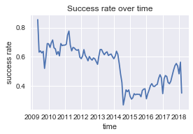
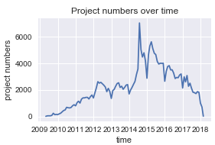
Changes in TIME
Project numbers spiked in mid 2014 due to expansion to new countries
Corresponding decrease in success rates
Analysis limited to data after mid 2014

Slide 9
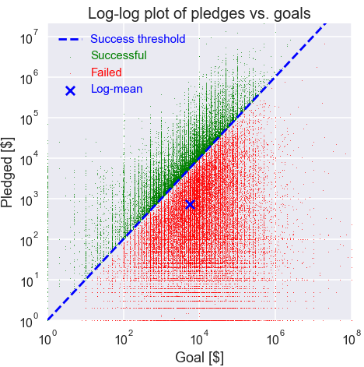
Goals vs. Pledged amounts
Goal and pledged amount follow approximately log-normal distribution
Smaller goals correlated with lower pledged amounts but higher success rates

Slide 10
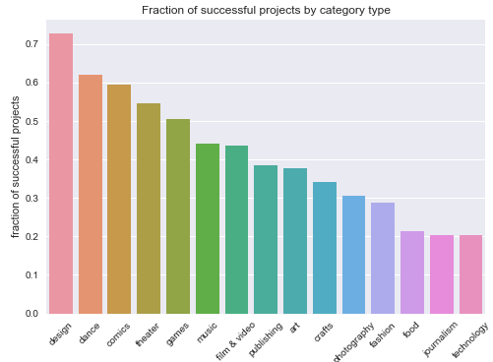
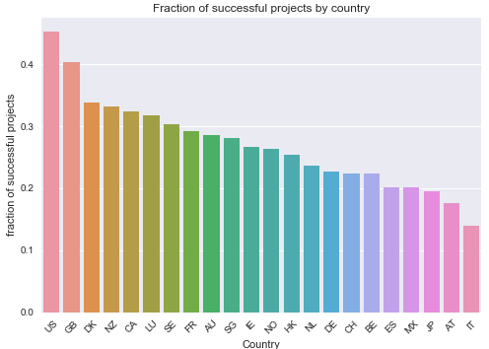
Success based on category and country of origin
Creating new features: category type
Eliminating uninformative features

Slide 11
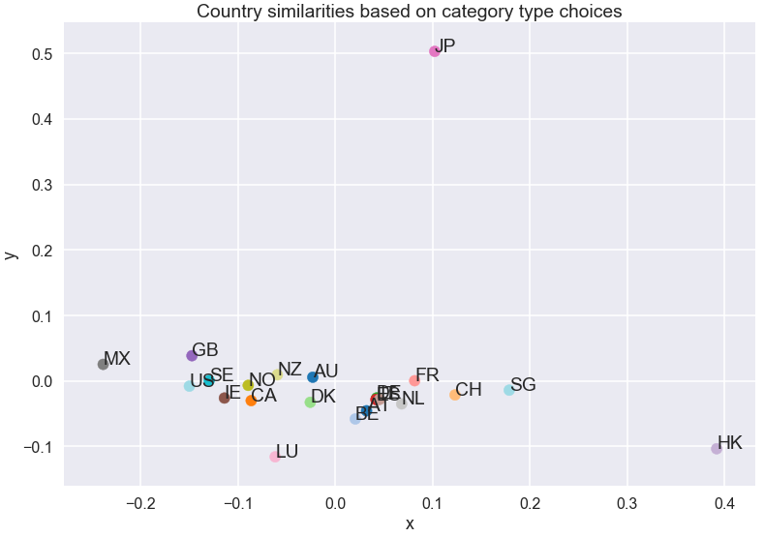
Category preferences based on country of origin
Creating new features: category type
Eliminating uninformative features

Slide 12
Predictive modeling
Supervise learning
Binary classification: Success (1) or Failure (0)
Tools
Pandas + Scikit-learn libraries

Slide 13
Data preparation
One-hot encoding of categorical variables

Slide 14
Handling Textual data
Creating new features: category type
Eliminating uninformative features

Slide 15
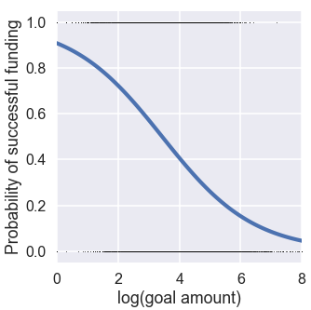
Logistic Regression
Creating new features: category type
Eliminating uninformative features

Slide 16
Modeling Pipeline
Creating new features: category type
Eliminating uninformative features

Slide 17
Hyperparameter optimization
3-fold cross-validation
Eliminating uninformative features

Slide 18
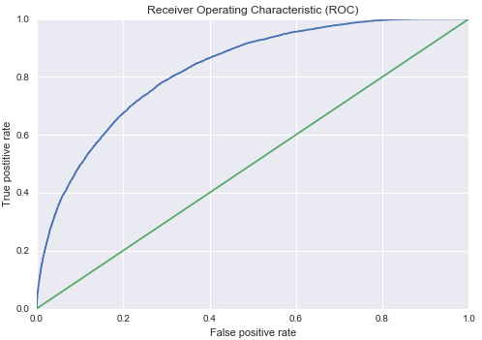
Model evaluation
3-fold cross-validation
Eliminating uninformative features

Slide 19
Conclusions
3-fold cross-validation
Eliminating uninformative features

