Slide 1
Success indicators of crowdfunding projects
Lukas Vlcek

Slide 2

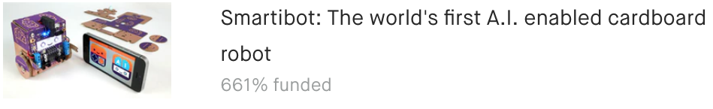


Crowdfunding
Crowdfunding platforms
Aggregate funds from small investors
New technology, art, journalism, games, personal projects, charity
Kickstarter
Biggest, oldest
250,000 creative projects
15 categories
International

Slide 3

Competition for FUNDING
Projects only funded if goal is reached
Goals from $1 to $100,000,000
150,000 funded
36% overall success rates
How to increase the chances of success?

Slide 4
Indicators of funding success and who cares?
Clients
Project proposers: individuals, startups, small companies
Their goal
Maximize the chances of successful funding
Service
Provide guidance in tailoring proposals
Payment: fixed amount or percentage of funds if proposal is successful
How?
Predictive modeling based on historical data

Slide 5
Datasets: sources and aggregation
Online source:
Monthly updated repositories collected by Web Robots web scraping company
Available in CSV formats (30 files each month)
Combined into a single data frame
Removed duplicates
250, 000 records, 32 features, several in JSON strings
43 GB to 90 MB of CSV data

Slide 6
Data wrangling
Extracted information from JSON strings
Formed a new feature of category type by aggregating subcategories
Datastamp strings converted to datetime format
Selected 18 features for further processing

Slide 7
Exploratory Analysis

Slide 8
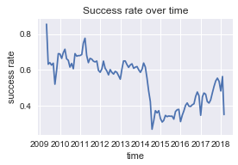
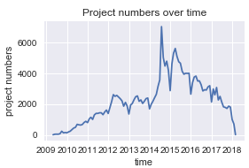
Changes in TIME
Project numbers spiked in mid 2014 due to expansion to new countries
Corresponding decrease in success rates
Analysis limited to data after mid 2014

Slide 9
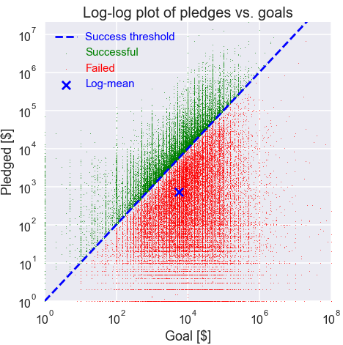
Goals vs. Pledged amounts
Goal and pledged amount follow approximately log-normal distribution
Smaller goals correlated with lower pledged amounts but higher success rates

Slide 10
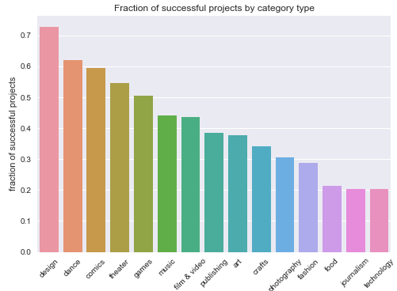
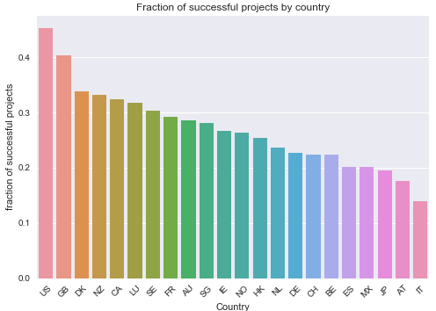
Success based on category and country of origin
Statistically significant differences between proposal success in different categories and for different countries of origin
Are these differences correlated?

Slide 11
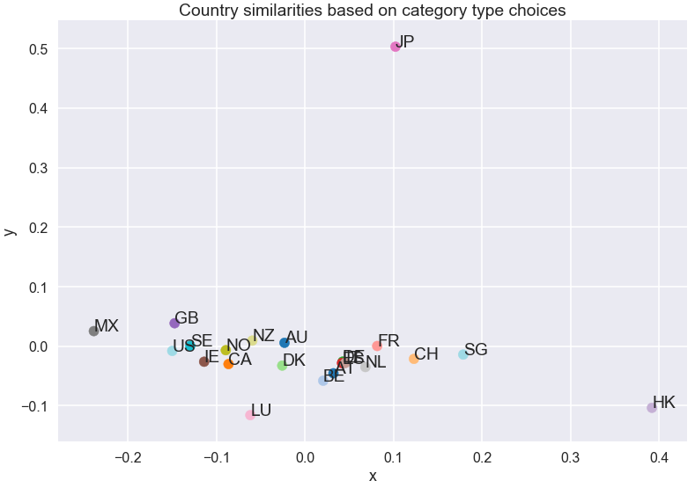
Category preferences based on country of origin
Compare country-of-origin similarity based on category preferences
Clear grouping of countries with similar geographic and cultural similarities:
Europe vs. Asia vs. America
Technologically advanced vs. developing
Similarity based on distances in the space of conditional probabilities of category choice, given a country of origin
Reduced to 2 dimensions using the principal component analysis (PCA)

Slide 12
Predictive modeling

Slide 13
Approach
Supervised learning
Binary classification:
Success (1) or Failure (0)
Logistic regression
Feature selection
Tools
Pandas + Scikit-learn libraries
Informative features
Feature | Type
Goal amount | Numerical
Category type | Categorical
Country of origin | Categorical
Project name | Text
Project description | Text
Project name length | Numerical

Slide 14
Data preparation
One-hot encoding of categorical variables
Category type, country of origin
Conversion of text to count vectors
Logarithm of goal amounts
Separate goal amounts features for each category type
Input to ML pipeline in the form of pandas dataframe

Slide 15

Handling Textual data
Features: project name, project description
Simple ‘Bag of words’ approach
Conversion to count statistics: CountVectoriser()
Selection of most informative words
Chi-squared statistics, KBest selection
Counts for selected words used in logistic regression

Slide 16
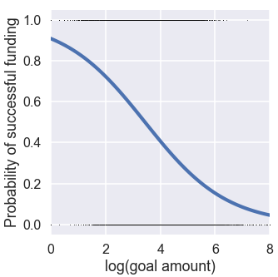
Logistic Regression classification
Simple, fast, easy interpretation
Hyperparameters
Metric: L1, L2
Regularization coefficient C
For textual data: direct mapping from Naïve Bayes classifier

Slide 17
Modeling Pipeline
Train-test split (0.2)
Feature separation
Project name
Project description
Remaining features
CountVectorizer
CountVectorizer
-
Kbest selector
Kbest selector
-
Feature union
Logistic regression

Slide 18
Hyperparameter optimization
3-fold cross-validation
Grid search
Hyperparameters
L1, L2 - Logistic regression loss functions
C – Logistic regression regularization coefficient
K – number of most informative words used for regression
Chi2, mutual information – metrics for KBest selection
Chosen
L2, C=0.2, K = 2000, Chi2

Slide 19
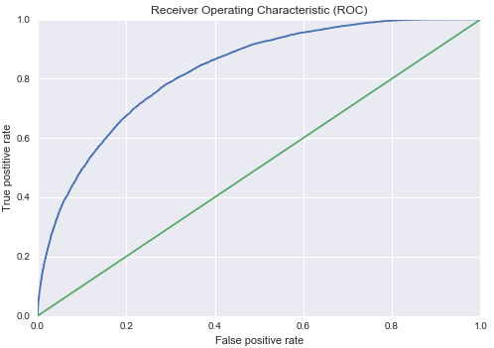
Model evaluation
Area under Receiver operating characteristic (ROC) curve: 0.83 (‘good’ predictor)
Accuracy: 0.75
Precision: 0.70
Recall: 0.60
Comparison with staff picks:
(10% acceptance threshold):
Matches or exceeds human
 | Precision | Recall | F1 score
Model | 0.86 | 0.23 | 0.36
Staff pick | 0.86 | 0.21 | 0.34

Slide 20
Conclusions
Predictive model of project success
Allows tuning crowdfunding proposal parameters, such as goal amount, project description, and refine category choice
Prediction metrics based on historical data can match or exceed human assessment (staff picks)
Speed and accuracy of the model can be used for filtering out ‘bad’ ideas and increasing the chance of good ones
Model can be further improved by more sophisticated natural language processing methods and including interactions between features (beyond linear model)

