Slide 1
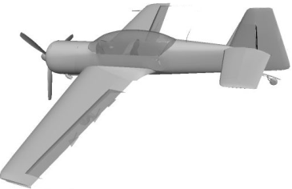
CG
North
East
NED
Down, towards the Earth center

