Slide 1
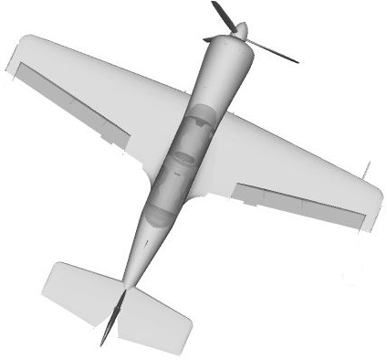
North
CG
Ground track

