Slide 1
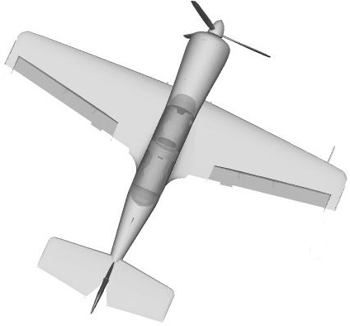
North
CG
Ground track

Slide 2
North
CG
Ground track

