Slide 1
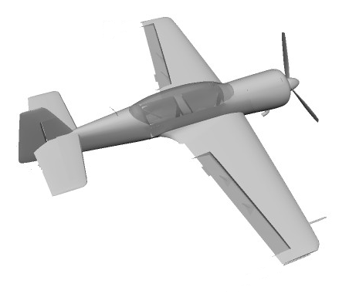
Left aileron
Rudder
Elevator
Right aileron

Slide 2
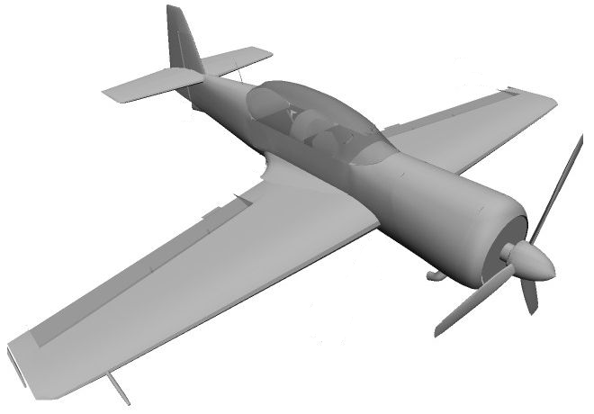
Rudder
Elevator
Left aileron
Right aileron

