Slide 1
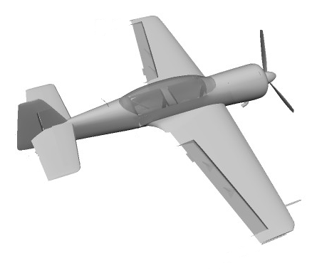
Left aileron -
Rudder -
Elevator -
Right aileron -

Slide 2
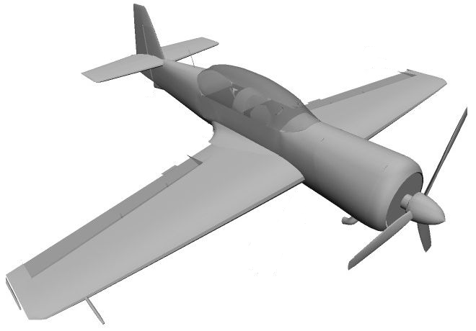
Rudder
Elevator
Left aileron
Right aileron

