Slide 1
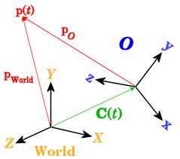
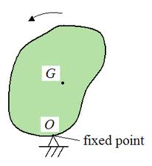
Topic # 3 Rigid Body Dynamics

Slide 2
Outline of the Chapter
Linear momentum in a moving frame
Example
Angular momentum in a moving frame
Example
Full set of 6DoF EOM of a rigid body.

Slide 3
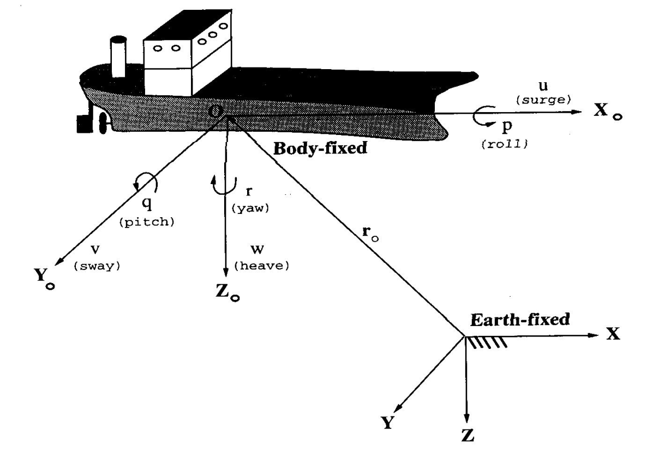
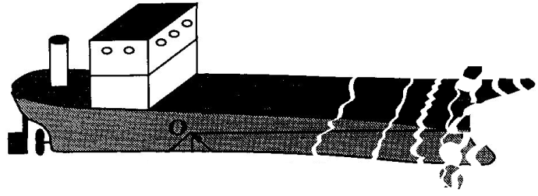

Momentum of a Particle
Consider an “isolated” particle of a rigid body
P
Q
R _{i}=P+Q
Interaction of a body with surrounding non-homogeneous environment (air-fluid-gas) dictates that linear and angular momentum should be considered in Body Reference frame
F _{i}
Internal force
Eternal force

Slide 4
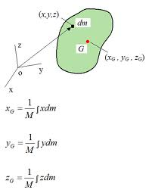
Linear Momentum in a Moving Frame
Use Coriolis theorem for an absolute derivative of a velocity vector:
- Center of gravity
- Complete force in body coordinates

Slide 5
Linear Momentum in a Moving Frame
Expanding the last triple vector product (ABC=BAC-CAB) results in the following scalar form:

Slide 6
Linear Momentum in a Moving Frame
If r_{g}=0, i.e. the location of a body frame coincides with the CG, then:

Slide 7

Example: Rotating Mass on a String
Calculate the force acting on the body that is rotated along a circle with constant speed U.
x
1. Connect a ref.frame to the mass with local x oriented forward and y inward towards the center:
Pivot point
y

Slide 8
Angular Momentum in a Moving Frame
Similar to the case of linear momentum of rigid body consisted of “isolated particles”:
Using definition of r_{g} simplifies first term

Slide 9
Angular Momentum in a Moving Frame
Second term expands using the same triple vector product rule (ABC=BAC-CAB)* as:
Where the moments of inertia are defined as:
* See calc.m script on the shared drive

Slide 10
Angular Momentum in a Moving Frame
Third term expands using the same triple vector product* rule and the definition of inertia as:
* See calc.m script on the shared drive

Slide 11
Angular Momentum in a Moving Frame
Finally, using SNAME notation M={K,M,N}:

Slide 12
Angular Momentum in a Moving Frame
This equation can be significantly simplified if the body coordinate frame is placed at the CG and the coordinate axis coincide with the principal inertia axis of the body.

Slide 13
Complete System on 6DOF EOM of a Rigid Body
Except for the external forces F and M the complete system of 6DOF EOM in body coordinates can be represented as:
In addition there are two kinematic equations:

Slide 14
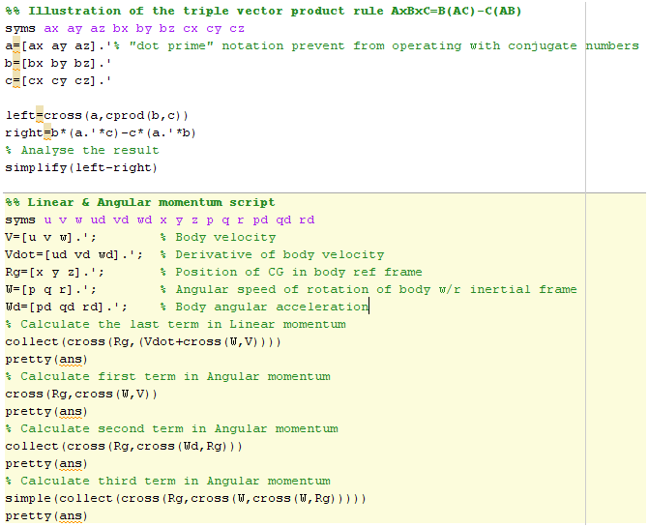
Symbolic Manipulations in Support of Lin/Ang Momentum
See calc.m script on the shared drive

Slide 15
Example of Static Stability
Consider stability of rotations of a homogeneous body about each of the main axes with constant angular rate Ω. Assume no external forces or moments acting on the body.
z
x
Approach (x-axis):
y
1.
2.
3.
, α – defines stability
Coupling
Oscillates but does not grow

Slide 16
Example of Static Stability
z
x
Approach (y-axis):
y
1.
2. As before, differentiate first eq. and substitute into eq.3
3.
, α – defines stability
Coupling
Practice the case of z-axis
unstable

Slide 17
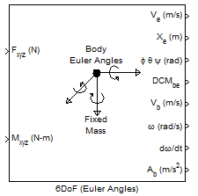
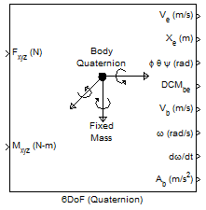
Introduction to 6DOF Modeling of EOM of a Rigid Body
Aerospace Blockset/Equations of Motion/6DoF/6DoF (Euler Angles)=> Integrates the six-degrees-of-freedom equations of motion in body axis.
The 6DoF (Euler Angles) block considers the rotation of a body-fixed coordinate frame (X_{b} , Y_{b} , Z_{b} ) about a flat Earth reference frame (X_{e} , Y_{e} , Z_{e} ). The origin of the body-fixed coordinate frame is the center of gravity of the body, and the body is assumed to be rigid, an assumption that eliminates the need to consider the forces acting between individual elements of mass. The flat Earth reference frame is considered inertial, an excellent approximation that allows the forces due to the Earth's motion relative to the "fixed stars" to be neglected.

Slide 18
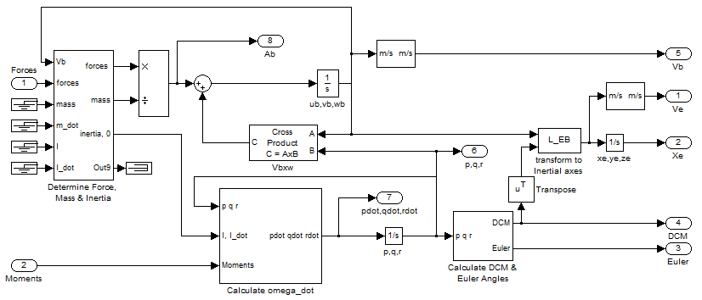
6DOF Model of EOM of a Rigid Body
States of the model

Slide 19
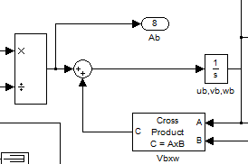
Linear Momentum
F
m
Origin of {B} is at the CG
0
0

Slide 20
6DOF Model of EOM of a Rigid Body

Slide 21
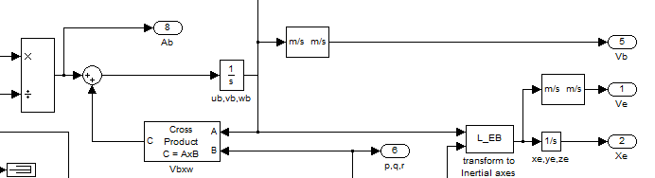
Dead Reckoning
F
m
p,q,r
DCM

Slide 22
6DOF Model of EOM of a Rigid Body

Slide 23
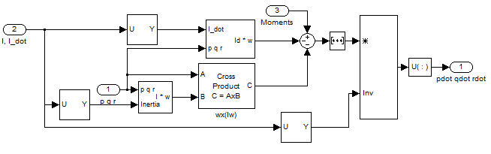
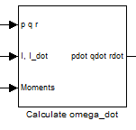
Angular Momentum of a Rigid Body

Slide 24
6DOF Model of EOM of a Rigid Body

Slide 25
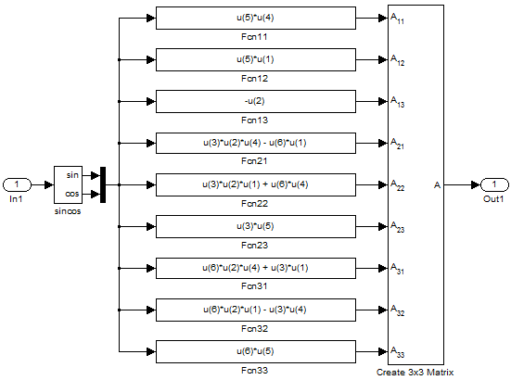
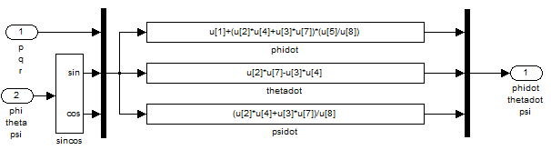
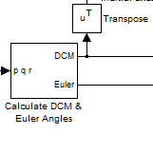
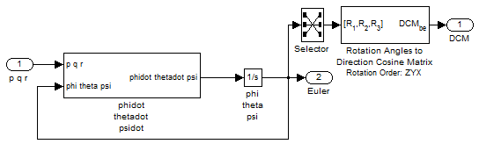
Kinematics of a Rigid Body (Euler Angles)

Slide 26
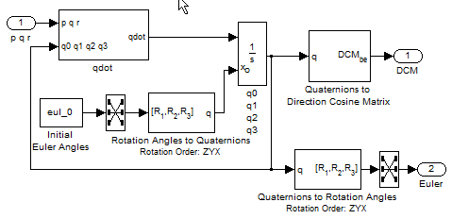
Kinematics of a Rigid Body (Quaternions)
If interested – watch a short movie (Gimbal_Lock_Explained.flv) explaining the phenomenon of gimbal lock and the need for quaternion.

Slide 27
Closing Notes
Linear momentum in a moving frame
Example
Angular momentum in a moving frame
Example
Full set of 6DoF EOM of a rigid body.
Example of static stability.
Simulink Implementation of the 6DoF EOM.
What is next? =>
Forces and Moments

