Slide 1
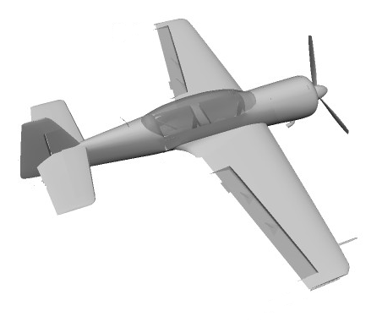
Left aileron
Rudder
Elevator
Right aileron

