Slide 1
Illustrations presented in the order of appearance

Slide 2
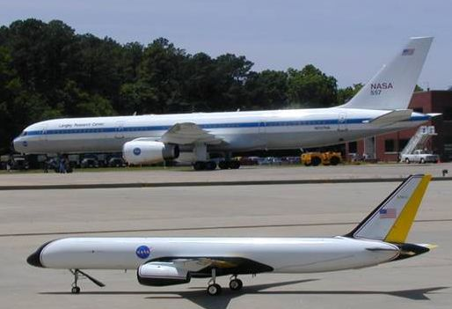

Slide 4
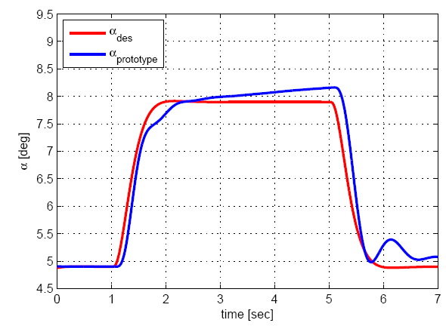
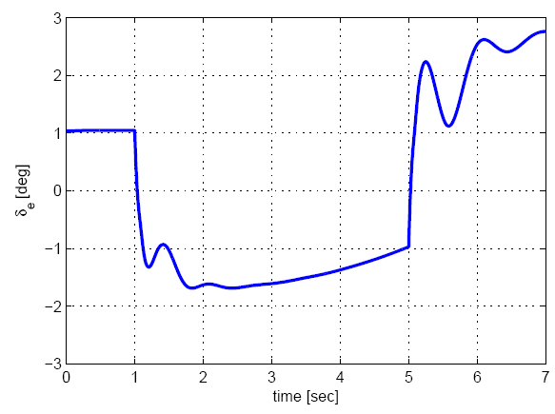

Slide 6
5
Direction of improvement
4
4
0%
4
3
3
0%
5%
3
Nominal design
2
2
10%
Number of Vectors
10%
2
1
1
15%
5%
1
0
0
20%
20%
0
15%
12
16
20
24
28
32
36
40
44
48
DV4 (Pcmshp)

Slide 7
40
34
35
0%
35
0%
30
22
3.23%
25
12.9%
20
16
27.42%
15
28.23%
Number of Vectors
9
17.74%
10
0
0
4
4
0
7.26%
5
3.23%
0
0%
5.55
5.7
5.85
6
6.15
6.3
6.45
6.6
6.75
6.9
DV1 (PwnAm)

Slide 8
5
4
0%
0%
4
0%
33.33%
3
2
66.67%
Number of Vectors
0%
2
0%
0%
1
0
0
0
0
0
0
0
0
0%
0%
0
5.55
5.7
5.85
6
6.15
6.3
6.45
6.6
6.75
6.9
DV1 (PwnAm)

Slide 9
0.22
0.2
Pareto optimal solutions
0.18
Prototype
0.16
Feasible solutions
0.14
Criterion 2 (errnorm_Linf) -> MIN
0.12
0.1
0.08
0.06
12
15
18
21
24
27
30
33
36
39
DV3 (PCsbw)

Slide 10
220
200
Pareto optimal solutions
180
Prototype
160
Feasible solutions
140
Criterion 18 (TDM) -> MAX
120
100
80
60
40
12
15
18
21
24
27
30
33
36
39
DV3 (PCsbw)

Slide 11
0.16
Pareto optimal solutions
Prototype
0.14
Feasible solutions
0.12
Criterion 14 (FQrms) -> MIN
0.1
0.08
0.06
0.65
0.675
0.7
0.725
0.75
0.775
0.8
0.825
0.85
0.875
0.9
DV2 (PztAm)

Slide 12
220
200
Pareto optimal solutions
180
Prototype
Feasible solutions
160
140
Criterion 18 (TDM) -> MAX
120
462
202
Improvement of Prototype
100
106
80
318
254
358
60
40
0.08
0.085
0.09
0.095
0.1
0.105
0.11
0.115
0.12
0.125
0.13
0.135
0.14
0.145
0.15
0.155
0.16
0.165
0.17
0.175
0.18
Criterion 3 (errnorm_L2) -> MIN

