Slide 1
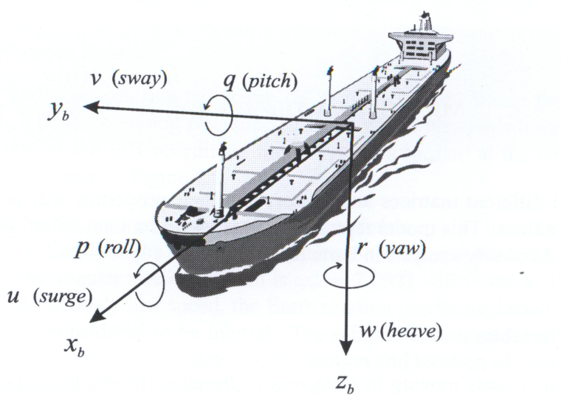
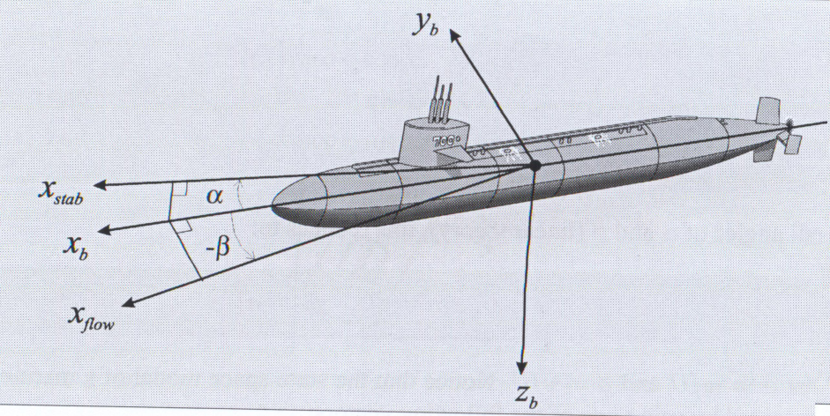
Chapter# 1 6DoF Modeling of Marine Vehicles Topic #1 Introduction

Slide 2
Outline of the Chapter
Introduction
Kinematics
Mechanics
Rigid body dynamics
6DoF equations of motion
Hydrodynamic forces and moments
Introduction to environmental disturbances
Objective of the chapter is to develop generalized 6DoF equations of motion of a marine vehicle.

Slide 3
Topic#1: Introduction
Subject of the course is Control of a marine vehicle.
Guidance is the action of determining the course, attitude and speed of the vehicle relative to some reference frame to be followed by the vehicle. In simple terms, guidance defines trajectory (Path + Velocity profile) to be followed by the vehicle.
Navigation is the action of determining the vehicle states with respect to either reference frame of the reference trajectory. In simple terms, navigation defines errors to be “eliminated” at the control stage.
Control is the development and application to a vehicle of appropriate forces and moments for operating point, tracking and stabilization. This usually involves designing the appropriate control laws.

Slide 4
GNC Example: Weather Routing CLS
Winds, waves and currents
FForward ctrl
Actuators
Dynamics
Kinematics
Feedback ctrl
Motion Sensors
Reference
Guidance
Coord. Transform.
Weather data
Automatic Weather Routing control system solves two principal tasks: (i) based on the weather prediction data it provides an optimal (for example min fuel) path and (ii)performs path tracking to ensure that the optimal route is followed by the vehicle.
“Guidance and Control of Ocean Vehicles,” by Thor I. Fossen, 1994.

Slide 5
GNC Example: Weather Routing CLS
Winds, waves and currents
u
ν
FForward ctrl
Actuators
τ
Dynamics
Kinematics
η
Feedback ctrl
Motion Sensors
η_{d}
Reference
ξ
Guidance
Coord. Transform.
Weather data
DOF |  | Forces & Moments | Linear and angular velocities | Position and Euler angles
1 | Surge | X | u | x
2 | Sway | Y | v | y
3 | Heave | Z | w | z
4 | Roll | K | p | φ
5 | Pitch | M | q | θ
6 | Yaw | N | r | ψ
SNAME notations [1950]
η ,ν , τ – Fossen notations
=τ
=ν
=η

Slide 6
Scope of Disciplines
Control
Winds, waves and currents
Navigation
u
ν
FForward ctrl
Actuators
τ
Dynamics
Kinematics
η
Feedback ctrl
Motion Sensors
η_{d}
Reference
ξ
Guidance
Coord. Transform.
Weather data

Slide 7
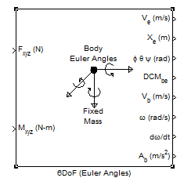
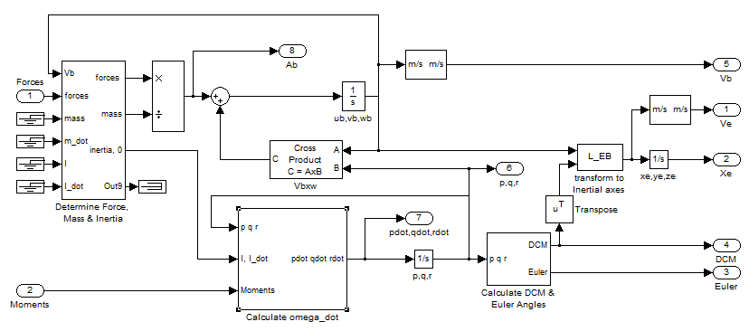
Overall Practical Objective of Ch.I
Ultimate goal - Develop good understanding of 6DoF modeling of rigid bodies motion

Slide 8
Closing Notes
Contributing disciplines:
Calculus & Linear algebra
Hydrodynamics
Navigation
Control theory

Slide 9
Introducing Simulink
The best way to know Simulink is to use Mathworks Documentation and Getting Started manuals along with the WebMinars (states for Web Based Seminar) provided for free for all registered users of the Mathworks Software; registering at www.mathworks.com is also free and does not require having a license.
Therefore, it is advisable to go the above URL and create an account. Then go to the Support page ( http://www.mathworks.com/company/events/webinars/index.html ) and find (1) the Recorded WebMinars section where choose (2) Simulink as a product of interest. Finally, You should have the screen looking similar to this (3):
1
2
3

Slide 10
Getting Familiar with Simulink
As a good starting point one can choose the following seminars (presented in the order of progressive learning ):
Introduction to Simulink (Optional if already familiar with Simulink)
This webinar is an introduction to Simulink®, a platform for multidomain simulation and Model-Based Design for dynamic and embedded systems. Through product demonstrations, attendees will see a high-level overview of the major capabilities and how Simulink can be used to design, simulate, implement, test, control, signal processing, communications, and other time-varying systems. Highlights include major new features in Simulink for component–based modeling for large systems, Simulink and Stateflow user interface and integration, data management and visualization, and MATLAB language support. This webinar is for people unfamiliar with Simulink.
Introduction to Simulink for Control Design
This webinar is an introduction to Simulink® for control design. It will introduce key features in Simulink and the Simulink product family that let you build sophisticated controllers in an integrated workflow. Through consumer electronics and automotive product demonstrations, attendees will see a high-level overview of the major capabilities and how to design, simulate, implement, and test control systems within the Simulink environment. This webinar will highlight how to easily design single and multiloop control systems including supervisory logic in Simulink. We will also demonstrate how to optimize control system performance to meet time and frequency-based requirements. This webinar is for people unfamiliar with using Simulink for control design and is the second in a series of Introduction to Simulink webinars.
Linear System Analysis in Simulink
This webinar features techniques for performing trim (equilibrium point) analysis on models built in Simulink®. Viewers will see how to use these equilibrium points to linearize aircraft models and to analyze the results for control design. Highlights include analysis on aircraft flying in various flight conditions, using general techniques that can be applied to many nonlinear systems. This webinar will showcase the Simulink® Control Design GUI as well as automation using a command line interface. The third in a series, this webinar is intended for viewers who have used MATLAB or Simulink for control design or for linear analysis. Simulink users interested in the high-level capabilities available for control design in Simulink should view the recorded webinar “Introduction to Simulink for Control Design.”

Slide 11
Getting Familiar with Simulink
4. Interactive Control Systems Tutorial ( http://www.mathworks.com/academia/student_center/tutorials/controls-tutorial-launchpad.html# .
This more practical tutorial introduces you to the use of MathWorks tools for modeling dynamic systems. It includes a section on using Simulink Control Design™ for designing and analyzing control systems modeled in Simulink. Select sections based on your experience with control design. You can download files of the examples featured in this tutorial ( you can find them in a share drive).
System Representation (25 minutes) - Learn the basics of representing dynamical systems in MATLAB and Simulink.
Introduction to System Representation 3:05 -Review how to model differential equations in Simulink.
Linear Time-Invariant Systems 12:15 - Learn the basics of representing LTI systems in MATLAB.
Simulink Block Diagrams 10:34 - Learn the basics of modeling and simulating LTI systems in Simulink.
System Analysis (35 minutes) - Learn to analyze LTI systems using Control System Toolbox.
Introduction to System Analysis 2:19 - Review example systems and where to find help for Control System Toolbox.
Time Domain Analysis 19:15 - Obtain transient response characteristics of first-order and second-order systems and relate them to system parameters.
Frequency Domain Analysis 14:16 - Compute system responses to sinusoidal inputs and obtain Bode diagrams.
Control Design (65 minutes) - Design and implement common compensator structures in MATLAB and Simulink.
Introduction to Control Design 3:01 - Explore why feedback controllers are used in real-world applications.
Analyzing Closed-Loop Systems 23:45 - Apply open-loop techniques such as root locus and understand how closed-loop systems respond to external disturbances.
Implementing Common Compensator Structures 20:03 - Model and tune common compensators to meet design requirements.
Designing Compensators in Simulink 21:10 - Apply a control design workflow to model, tune, and verify controllers in Simulink.

Slide 12
Getting Familiar with Simulink
Multi-Loop Control Design in Simulink® - Made Easy
This webinar is a hands-on case study of new tools for Simulink® that facilitate a simplified workflow for designing multi-loop control systems. The case study looks at an aircraft landing system that will follow a predefined trajectory, subject to turbulent and gust-type wind disturbances. This is a true multi-loop design that would typically require many iterations. We will demonstrate how you can analyze and design all loops simultaneously. Attendees will get a detailed demonstration of the tools available to simplify the design of control systems with loop interactions. The webinar will use an integrated user environment that incorporates classical design techniques such as root-locus, bode-design, and Nichols-based design, combined with optimization to achieve time- and frequency-based performance requirements.
Advanced Aerospace Analysis with Aerospace Toolbox and Aerospace Blockset
This webinar provides an overview of Aerospace Toolbox. The webinar explains what Aerospace Toolbox is, why MathWorks developed this product, who can use this product, and how they can use it. By using product demos this webinar shows the key capabilities of Aerospace Toolbox and explains how you can use these capabilities for advances aerospace data analysis. The webinar shows how Aerospace Toolbox can be used for:
Working with aerospace reference standards, such as International Standard Atmosphere model, MIL-HDBK-310 Atmosphere model, WGS84 gravity model. Importing aerodynamic coefficient from Digital Datcom.
Visualizing flight data through an interface to FlightGear flight simulator

