Slide 1
North
X
Z down
X
Camera
UAV
LOS
Target

Slide 2
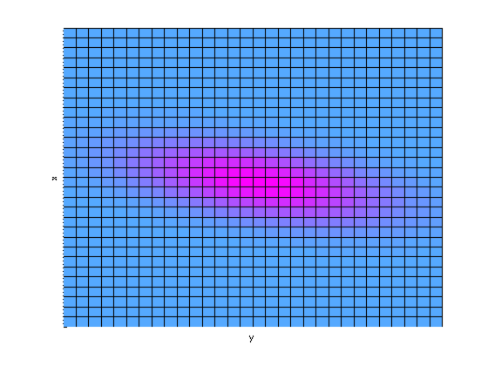
North
X
Z down
X
glider
thermal
y

Slide 3
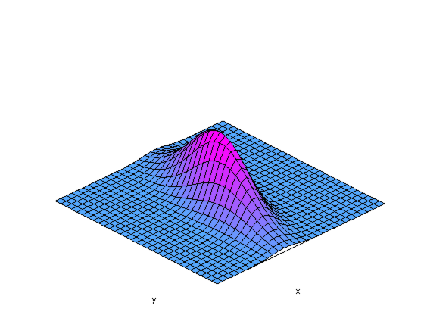
North
X
Z down
X
glider
thermal
y

