Slide 1
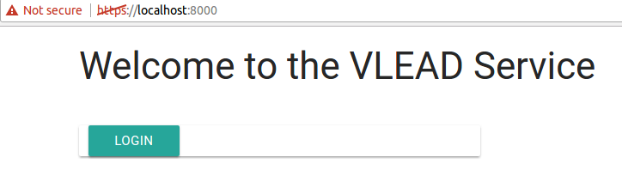
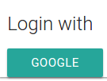
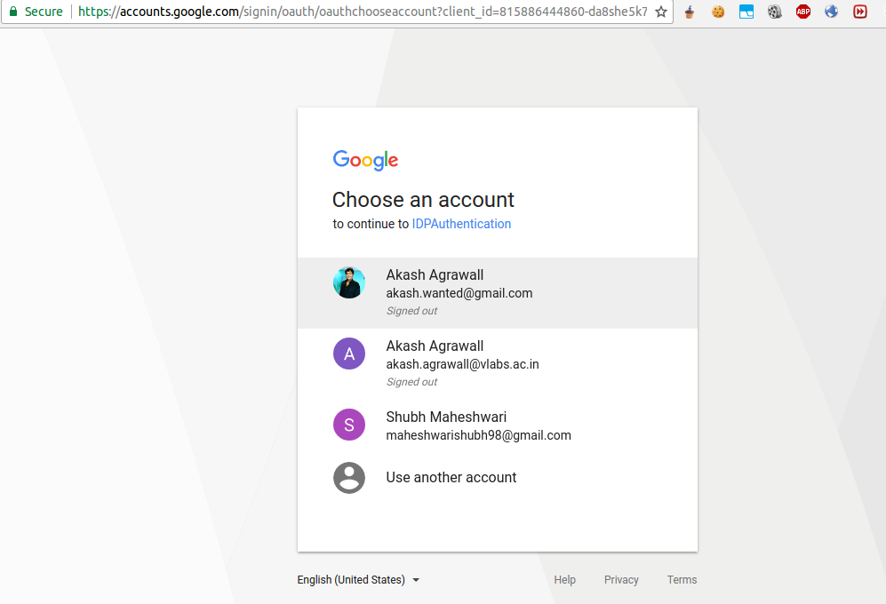
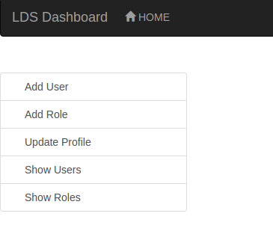

Authentication and Authorization Between Services
INTRODUCTION
We are trying to make an oauth service using google as a single sign-on followed by common authorizarion for all the microservices
The Project could be split up into two phases:
1. Surveying and Research
2. Implemenntation of the model
Phase 1
We needed to survey current industrial standards according to our requirements and look for for possible solutions.
Phase 2
We have done an impelentation of the oauth service model using an Oauth Server,a client Server and LDS dashboard, an existing VLEAD microservice.
METHODS
1.In our OAuth Model the user opens one of the microservices and tries to login into VLEAD
Authentication with
Google:
The user is redirected to
Our microservice and using
Google-Sign-on the user is
Authenticated by google
After authentication:
As now the users
credentials are available
At the check_login() endpoint
of the oauth service.
Logout:
User is logged out of all the
microservices
AIM
VLabs follows a microservice acrchitectural style to increase modularity and allow for scaling. With different services sitting on different servers authorization in between is required. Also from the user perspective, an authentication system allowing for Single-Sign On was also needed.
RESULTS
Phase 1
After analysis of various standards, we decided to use an approach encorporating the Oauth protocol.
CONCLUSIONS ~Have none other than maybe put what i put for results here instead.
Phase 1
Use an Oauth protocol based system to provide both authentication(via user flow) and authorization between services(server flow).
Projit Bandyopadhyay,
Shubh Maheshwari

