Slide 1
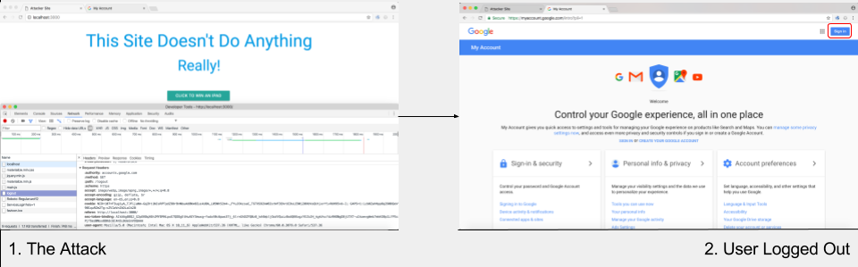
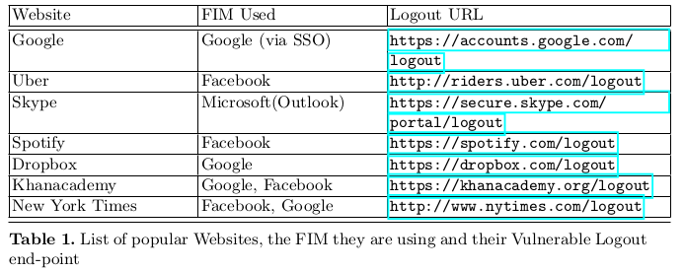

Modeling and Mitigating Cross Origin Attacks on FIM Based Services Using CORP
Aim
- To see if FIM is vulnerable to cross origin attacks through both modelling and experimentation.
- To understand and use CORP(a browser security policy) to mitigate these attacks through the browser.
What We Did
- Created two models: Pre-CORP and
Post-CORP, which were specifically defined on systems
which use FIM and are affected by cross origin attacks.
- Mitigated the CORA in the Post-CORP model using
CORP policy, in Alloy.
- Experimented with two main types of attacks: login
detection and autologout.
- Succcesfully mitigated the CORA using CORP in the
Chromium browser.
Conclusion
- FIM is not an all-encompassing security solution as it is vulnerable to CORA.
- CORP as a browser security policy would increase safety for users.
Akash Agrawall
Shubh Maheshwari
Projit Bandyopadhyay
Venkatesh Choppella

