Slide 1
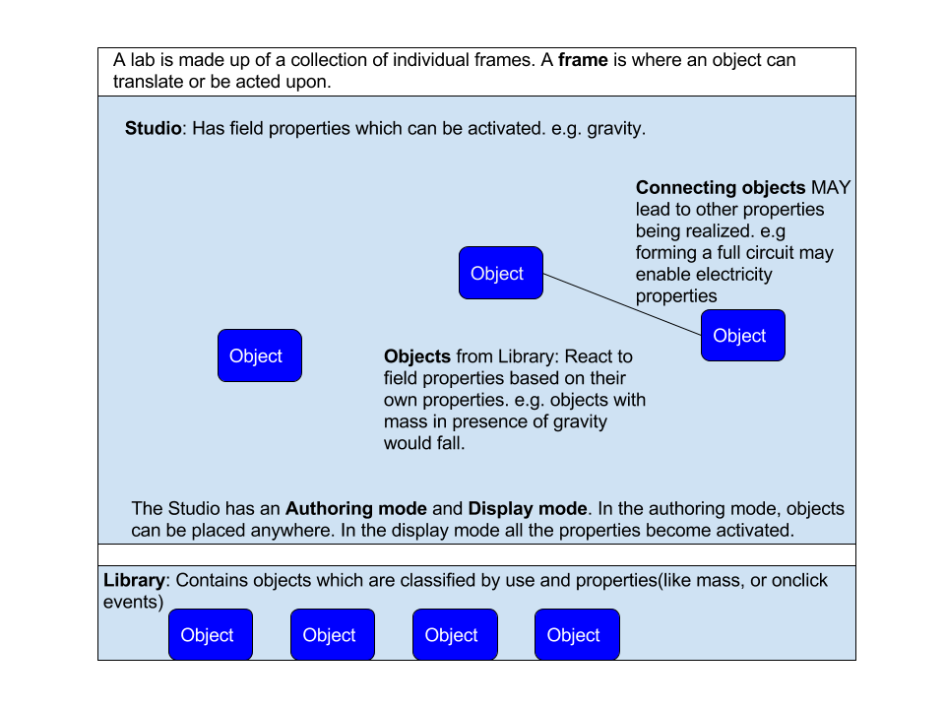

Lab Authoring Tools for Vlabs
Aim
- To create a set of tools which can be used make online labs for Vlabs, thus allowing labs to be mass-produced and customized to individual needs.
- Create a scalable programming model by which reusable objects and methods can be stored in a library.
What We Did
- Comparative study on various modeling software and game engines / software.
- Created a programming model to develop lab authoring tools.
- Created a simple studio where objects can be uploaded, placed, and moved around.
Conclusions
- Building a Vlabs Authoring Station is viable.
- Most modeling software is too complex(high learning curve and has precision that we don’t require) to be used to develop simple experiments.
- The studio developed can be used to speed up other virtual labs work, like conversion of labs.
Venkatesh Choppella
Projit Bandyopadhyay

